Slide 1

New Generation in WSCC
Presentation
September 5, 2001
Proprietary and Confidential 9/5

Slide 2
Updates
Regional News
Western U.S. electricity generation averaged 67,500 aMW during July, 5.0% below July 2000, but up 1,300 aMW from June (PIRA Western Grid Market Forecast). The decline in generation primarily reflects poor hydro conditions throughout the West. The decline in hydro production has been partially offset by the start-up of several gas-fired power plants, especially in California. In the Northwest, the hydroelectric outlook received a boost with January-July runoff coming in at 58.2 MAF, 3.5 MAF above the Northwest River Forecast Center’s 54.7 MAF final projection last month. Budgeting for the additional runoff has permitted the resumption of limited spill in the Lower Columbia and increased monthly generation.
PIRA estimates July hydro generation averaged 8000 aMW, 500 aMW higher than initial expectations, but still 2,500 aMW below June’s peak. August generation has also been revised upward and, taking account of the near normal temperatures, is estimated at 8,750 aMW. Hydroelectric generation in July is believed to have increased only slightly to 4,550 aMW, just above June’s 4,500 aMW, as temperatures in California were close to normal, and new gas generation kicks in. Similarly in August, higher gas fired generation (up another 1,000 aMW) and the absence of abnormally hot temperatures should cause hydroelectric generation to cut back to around 4,000 aMW as more water is conserved.
British Columbia continues to import off-peak electricity, roughly 340 aMW in July, allowing additional water storage for on-peak generation and improving the outlook for winter supply. Meanwhile, in the desert Southwest, after exporting close to 3,000 aMW of power to California during July, exports are estimated to have fallen back to around 1,900 aMW as higher cooling demand in Arizona and New Mexico absorbed excess generation. With generation and interchange activity relatively unchanged from July, August WSCC generation is expected to average just over 68,300 aMW, 6.5% below August 2000. This decline is primarily attributed to the relatively cooler conditions experienced this year. Next month, WSCC generation is expected to decline to about 62,400 aMW, as cooling demand gradually dissipates, on its way to a seasonal low in October at just over 60,100 aMW before winter heating demand becomes a factor in November.
Major Changes Since Last Report
Under Construction:
On 8/29/01 Edison International began construction on the 500 MW Midway Sunset combined cycle natural gas power plant that is expected to have a heat rate of 7160 Btu. The plant is located in Kern County, California and will add power to the ZP-26 region when it comes on-line around October, 2002.
Also in California, Calpine Corp. announced that construction has started on the 510 MW Otay Mesa power plant in San Diego County. The project is expected to be completed in the summer of 2003 and will add power to the ZP-26 region.
Completed Projects :
On 8/29/01 the LADWP announced that construction has been completed on the LADWP Harbor V Expansion project, which will add 237 MW to the SP-15 region.
Puget Sound Energy announced on 8/30/2001 that construction is complete on the 110 MW natural gas fired Fredonia Expansion project located in Skagit County, WA.
PacifiCorp’s Klamath Falls Cogen plant came online on 8/30/01. The plant will add up to 484 MW to the Western Power Grid and is located just 30 miles from the Oregon – California border. The heat rate on the new plant is 7160 Btu.
Black Hills Corp’s Fountain Valley Power Plant in Fountain, Colorado has been completed. The 240 MW facility has a heat rate of 9,800 Btu and was completed on 8/13/01.
California

Slide 3
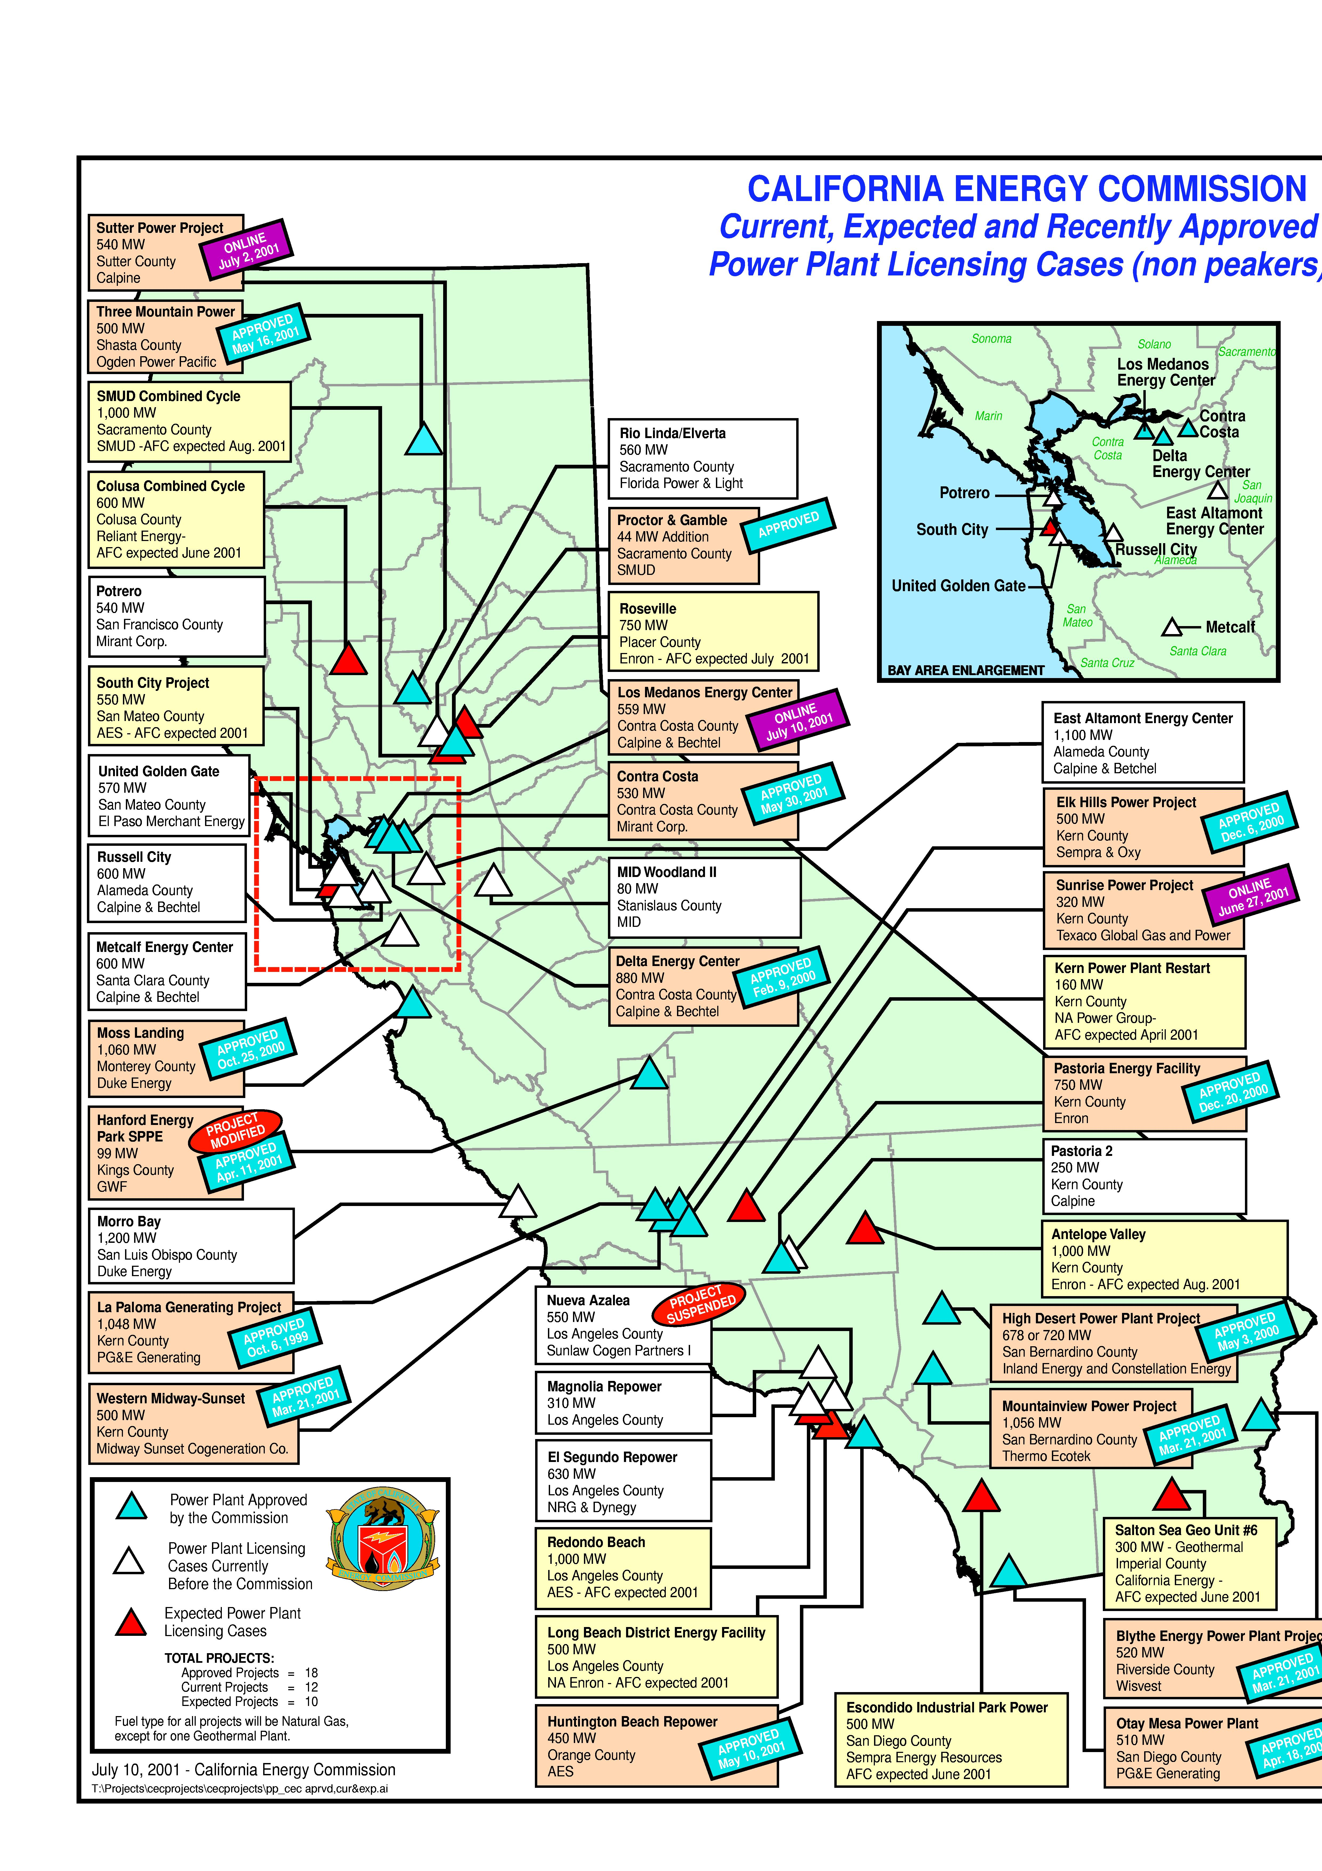
CALIFORNIA
High Probability Plants (UC) Under Construction (AP) Approved by CEC
San Onofre / 20 MW / Sep-01 (UC)
San Gorgonio / 20 MW / Sep-01 (UC)
Chino Correctional Facility / 176 MW / Oct-01 (UC) / 9664 HR
Elk Hills (Phase 1) / 350 MW / Mar-02 (UC) / 7,067 HR
La Paloma (Phase 1) / 521 MW / Mar-02 (UC) / 6,870 HR
Delta Energy / 880 MW / Jun-02 (UC) / 7,178 HR
La Paloma (Phase 2) / 522 MW / Jun-02 (UC) / 6,870 HR
Moss Landing / 1,060 MW / Jun-02 (UC) / 7,067 HR
Midway-Sunset / 500 MW / Oct-02 (UC) / 6,793 HR
Pastoria (Phase 1) / 755 MW / Jul-03 (UC) / 6,760 HR
Otay Mesa / 510 MW / Jun-03 (UC) / 7,100 HR
Blythe (Phase 1) / 520 MW / Mar-03 (UC) / 7,100 HR
Elk Hills (Phase 2) / 220 MW / Mar-02 (UC) / 7,067 HR
High Desert / 720 MW / Jun-03 (UC) / 7,178 HR
Sunrise Power (Phase 2) / 320 MW / Aug-03 (UC) / 11,021 HR
Medium-High Probability Plants
(UC) Under Construction (AP) Approved by CEC
Mountainview / 1,056 MW / Jul-03 (AP) / 6,704 HR
Pastoria (Phase 1) / 755 MW / Jul-03 (AP) / 6,760 HR
Four Mile Hill Project / 50 MW / Dec-03 (AP)
Three Mountain Power / 500 MW / Mar-04 (AP)
Rio Linda / 560 MW / May-04 (AP)
California

Slide 4
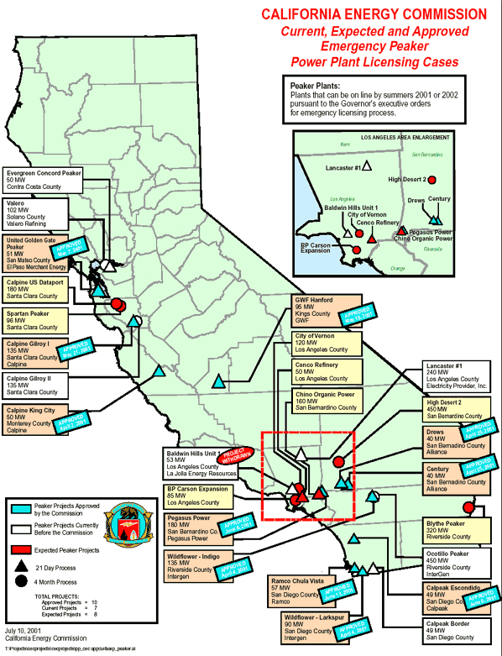
CALIFORNIA
Emergency Peaker Plants
NP15
Red Bluff / 49 MW / Aug-01
Gilroy (Phase 1) / 135 MW / Sep-01
King City / 50 MW / Sep-01
Panoche Peaker / 49 MW / Sep-01
SP15
Century Project / 40 MW / Sep-01
Drews Project / 40 MW / Sep-01
CalPeak Border / 49 MW / Sep-01
Escondido (CalPeak) / 49 MW / Sep-01
Pegasus Power Project / 180 MW / Nov-01
Recently Withdrawn Peaker Plants
CENCO Electric Company/ 50 MW / WD on 7/27/01
Evergreen Concord / 50 MW / WD on 8/1/01
Lancaster #1 / 240 MW / WD on 7/24/01
Chula Vista (RAMCO) / 62 MW / WD on 7/11/01
Baldwin / 53 MW / WD on 6/21/01
California

Slide 5
CALIFORNIA UPDATES
(08/02/01 DJI) The South Coast Air Quality Management District postponed a public hearing Wednesday on whether to allow AES Corp. to fire up two retooled generators at its Huntington Beach Power Plant. The district issued a permit in May for the project, but the city of Huntington Beach and AES have appealed. At issue is a condition requiring the firm to enter a long-term contract with the state promising to sell at least half of the energy produced in California. If the company failed to meet this condition, it would not be eligible for pollution "credits" required to restart the generators. The plant needs the credits because it will emit more pollution than allowed by law. AES says that setting up such a contract is impossible and that if the condition is not removed, it will not be able to start the generators. The first had been scheduled to begin operation Tuesday. The city is appealing the permit because it says it was improperly issued, is not consistent with the state Energy Commission's permit and lacks adequate air-quality monitoring requirements.
(08/04/01 PowerMarketers.com) Nearly insolvent utility Southern California Edison said on Friday it has reached agreements to keep at bay most of the power generators that sued it because they weren't getting paid. In a conference call with holders of its defaulted debt, the utility unit of Rosemead, California-based Edison International said it has settlements in place with three big power generators, and was near agreement, perhaps as soon as Friday afternoon, with the fourth. SoCal Edison had earlier agreed with more than 100 other power suppliers, collectively known as "qualifying facilities" or "QFs," to pay a fraction of its unpaid power bills, which soared because California utility deregulation blocked it from passing on all of its rising power costs to consumers. The utility racked up more than $5.4 billion in debt as a result.
(08/05/01 DJI) Geothermal plants in the Geysers area north of the Napa Valley have tapped steam fields to produce electricity since the 1960s. The 350-degree steam rushes more than 1,500 feet up from the earth, spinning turbines that create a constant flow of power. But mismanagement of the steam fields beneath the hilly northwestern California region that straddles the Sonoma and Lake county lines has led to a large decline of pressure, and a drop of more than 50 percent in the amount of power the plants produce. State power grid managers estimate they're losing about 900 megawatts of geothermal electricity because of the gradual depletion of the steam fields. That's enough power for roughly 675,000 homes.
(8/13/01 CEC) On July 6, 2001, Reliant Energy filed an Application for Certification (AFC) with the California Energy Commission for the construction and operation of the Colusa Power Plant, a proposed nominal 500 megawatt (MW) natural gas-fired, combined-cycle electric generating facility. The proposed power plant would consist of two combustion gas turbines that will burn natural gas and a steam turbine driven with steam generated by Heat Recovery Steam Generators. Each combustion gas turbine and the steam turbine will be connected to one of three separate electric generators. Output of the generators will be connected to step-up transformers and then to a new PG&E switchyard. Natural gas will be supplied to the project site via a new 2,500-foot-long pipeline interconnected to the PGT/PG&E gas transmission lines located east of the proposed project site. The pressure reducing/metering station will be located within the facility. The pipeline tap will be located adjacent to the existing PG&E Compressor Station.
California
Notes:
CISO has reset target pricing mechanism for the real time energy imbalance market. The price of the highest decremental bids is greater than the price for the lowest incremental bid. The new price is to be greater of zero or the lowest incremental bid.

Slide 6
CALIFORNIA UPDATES (cont’d)
(8/13/01) CalPeak Power LLP proposed to construct a simple-cycle peaking electric generation facility consisting of one FT8 Pratt & Whitney Twinpac, with two gas turbine engines and one 49.5 megawatt (MW) generator. The Project is called the CalPeak Enterprise #7 Project and will be located in the City of Escondido, San Diego County, California.
(8/13/01) Calpine Corporation today announced that initial construction of 135 megawatts of peaking generation capacity will begin during this week adjacent to its existing Gilroy Power Plant in Gilroy, Calif. Through an Application for Certification (AFC) filed with the California Energy Commission (CEC) on April 25, 2001, Calpine proposed to add three 45-mw simple-cycle gas turbine peaking units in the first of a two-phase process. Upon completion the two-phase build out, the Gilroy Energy Center will be a 270-mw, natural gas-fired, simple-cycle peaking generation facility located on approximately 9.5 acres at 1400 Pacheco Pass Highway in Gilroy. Commercial operation of Phase One is scheduled for September 2001. An additional three 45-mw gas turbine generators will be installed in Phase Two with full build-out estimated for May 2002. Phase Two requires the filing of an additional application with the CEC and is subject to a four-month review process.
(8/13/01) The Indigo Energy Facility is a nominally rated 135 megawatt power plant located at 19th Avenue, east of North Indian Avenue and north of Interstate 10 in the City of Palm Springs, Calif. The proposed plant will utilize three GE LM6000 Enhanced Sprint gas turbine engine-generators equipped with state-of-the-art air pollution control features in a simple-cycle mode.
(8/13/01 CEC) On August 2, 2001 the City of Vernon, California filed an Application for Certification (AFC), for its proposed Malburg Generating Station Project (MGSP), Phase I with the California Energy Commission seeking approval to construct and operate an 80.6 megawatt (MW) natural gas-fired, simple-cycle electric generating facility. The plant will be owned and operated by the City of Vernon. The proposed project would be located on approximately 2.4 acres of the City of Vernon's existing Station A. The existing plant site includes 5.9 acres located at 2715 East 50th Street, in Vernon, California, in Los Angeles County. The site is owned by the City of Vernon. Pursuant to Public Resources Code section 25552(e)(5), within three years, MGSP will be modified for combined cycle operation and is anticipated to ultimately produce approximately 120 MW of electricity. The project's Phase I is proposed to be operational in a simple-cycle mode for the summer of 2002. The Phase II combined cycle operation is planned to begin by the third quarter of 2003. The proposed power plant will consist of two ALSTOM GTX100 frame-type gas turbine-generators with dry low-nitrogen oxides (NOX) combustors for NOX control. The power plant will also be equipped with Selective Catalytic Reduction (SCR) systems for additional NOx control and oxidation catalyst systems for carbon monoxide (CO) and volatile organic compounds (VOCs) control. Each CTG will have a gross capacity of 41.2 MW at 750 F ambient temperature and 50 percent relative humidity
(08/13/01 EIS) Calpine Corporation, the San Jose, Calif.-based independent power company, announced plans to purchase 27 steam turbine generators from Siemens Westinghouse for its new fleet of North American power generating facilities. Calpine expects turbine deliveries to begin in September 2002, with full inventory in place by February 2005. Combined, the turbines represent up to 5,400 megawatts of generating capacity.
California
Notes:
CISO has reset target pricing mechanism for the real time energy imbalance market. The price of the highest decremental bids is greater than the price for the lowest incremental bid. The new price is to be greater of zero or the lowest incremental bid.

Slide 7
CALIFORNIA UPDATES (cont’d)
(8/16/01 Powermarketers.com) California has quietly started buying natural gas in response to the energy crisis, forming a gas supply operation that could become one of the largest in the state. But in a repeat of the state's tactics when it lined up $43 billion in electricity contracts, officials won't say how much they have spent so far -- or how much they plan to buy in the future. The state is already supplying gas for one power plant this month in an attempt to keep generating costs in check, and it has signed a small contract for gas storage space, state officials said. But they refused to provide the public with records of any of the purchases. Releasing additional details -- such as the price officials paid - - would jeopardize the state's goal of keeping electricity costs down by delivering cheaper fuel to natural gas-fueled power plants that serve California, said Ray Hart, deputy director of the state Department of Water resources. If private energy traders knew what the state planned to buy, Hart said, they could rush in, scoop up the supplies and demand substantially higher prices to resell them to the state, he said. Details of the state's gas deals will be made public as much as six months after they're signed, when they no longer give traders any advantage, he said. That stance has raised an outcry among Republicans and consumer advocates, who criticized the Davis administration earlier this year for delaying disclosure of state power contracts that locked in a huge percentage of California's power needs for more than a decade. "If there were a competitive bidding process, then, yes, the price should be secret while it's pending," said Marcel Hawiger, a natural gas analyst for the consumer group The Utility Reform Network. "But in a situation like it is now where they're just negotiating backroom deals, we think they should be disclosing everything right away." Critics of the Davis administration who think the state already got rooked on the power contracts are equally leery about the state's foray into the natural gas market.
(8/22/01 Powermarketers.com) The roller-coaster of peaks and dips in power prices that have characterized the U.S. energy industry recently will translate into a boom-or-bust cycle for the construction of new power plants and volatile prices for consumers, energy experts say. The erratic nature of U.S. power supplies is exemplified by the low prices and warnings of surplus electricity in parts of the country this summer -- just months after the Bush administration warned of drastic shortages. "Power is cyclical now, like oil and gas," said Raymond C. Niles, an analyst at Salomon Smith Barney. "It's going to be moving like a pendulum now between tight supplies and abundant supplies, high prices and low prices." The inconsistency of the market creates a problem, some experts say, because many generation companies, operating in newly deregulated markets, are watching the price of power and little else to decide when to build new plants. When power prices fall, companies with plans for new generating plants are quick to drop them, according to Jone-Lin Wang of Cambridge Energy Research Associates, a consulting firm. "We would like to see more educated developers who don't just look at price, that they have a better understanding of the demand growth pattern in a region and who else is building what," Wang said. A senior official in the Bush administration acknowledged that new capacity was coming online without government action, but he said policy initiatives are needed to improve the electric grid and pipeline network. And some analysts said the falling prices will give regulators a chance to figure out how to smooth the market. "Lower prices for now will give us the breathing room to deal with the issue of how to handle price spikes on the policy level," said Christopher Seiple of RDI Consulting. "The danger is that people will forget that price spikes ever occurred -- until they occur again"
California
Notes:
CISO has reset target pricing mechanism for the real time energy imbalance market. The price of the highest decremental bids is greater than the price for the lowest incremental bid. The new price is to be greater of zero or the lowest incremental bid.

Slide 8
CALIFORNIA UPDATES (cont’d)
(8/23/01 DJI) Calpine Corporation, the San Jose, Calif.-based independent power company, today announced construction is under way for the 750-megawatt Pastoria Energy Center. Thirty miles south of Bakersfield, Calif., the project is located on property leased from the Tejon Ranch Corporation. Projected to be on line in the summer of 2003, the Pastoria Energy Center will be generating electricity to meet high summer demand. "Pastoria is the latest in a series of Calpine projects intended to provide near- and long-term solutions to the power crunch in the West," said Calpine Senior Vice President, Jake Rudisill. "We've achieved several milestones this summer and we are extremely pleased to be able to point to yet another." Last month, Calpine's Sutter Energy Center became the first major power project to begin commercial operations in California in more than a decade. A week later, Calpine's Los Medanos Energy Center, the largest power project to begin commercial operations in the San Francisco Bay Area in more than 30 years, entered operations. The California Energy Commission licensed the Pastoria project in December 2000, and construction activities may require as many as 800 workers. The facility will feature three General Electric Frame 7FA gas combustion turbines in combined-cycle with two steam turbines. Fueled by natural gas and operated with an advanced emissions control system, Pastoria will be among the cleanest and most efficient conventional power resources in California. Once the facility is in operations, Calpine will employ 30-35 full-time professionals with an annual payroll in excess of $1.7 million. Calpine will manage all aspects of the energy center, including engineering and design, construction, fuel supply, operations, and power marketing.
(8/23/2001 LA Times) In the category of man bites dog, mouse hunts cat, and fish rides bicycle, consider the following: What if a government bureaucracy was so responsive, so lightning quick, that private businesses couldn't keep up with it? In a sense, that is what has happened in California this summer. State officials, long accused of holding back development, have used everything short of WD-40 to make it easier to build power plants--so much so that some developers have found themselves struggling to match the bureaucrats' pace. The state Energy Commission faced the latest case Wednesday when the Calpine Corp. sought--and received--more time to build a plant in King City, an agricultural town between San Luis Obispo and San Jose. The state had licensed the plant in May, 19 business days after Calpine applied. Calpine eventually had to admit that it was not going to be able to live up to its part of the bargain under the state's emergency, 21-day licensing procedure, which called for it to supply power by Sept. 30. "These are unusual circumstances, this 21-day process," Calpine attorney Jeffery Harris told the Energy Commission, which is the umbrella agency handling power plant licensing in California. They are, and it is.
(8/27/01 Power Daily) Corona, Calif., a city about 50 miles east of Los Angeles, has begun developing a 65-MW combined-cycle cogeneration facility to add capacity and improve power dependability for its residents and local businesses. Corona has selected Colorado-based CH2M HILL to provide project management, permitting, engineering and design, procurement support and construction management services for the development.
California
Notes:
CISO has reset target pricing mechanism for the real time energy imbalance market. The price of the highest decremental bids is greater than the price for the lowest incremental bid. The new price is to be greater of zero or the lowest incremental bid.

Slide 9
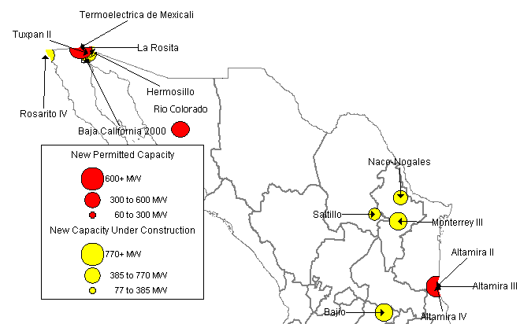
MEXICO NEW GENERATION MAP
High Probability Plants
Rosarito III / 541 MW / Aug-01 / 6,870 HR
Baja California 2000 / 61 MW / Sep-01
Tuxpan II / 495 MW / Dec-01 / 7,160 HR
Altamira II / 495 MW / May-02
Naco-Nogales / 339 MW / Jun-02
Energia Industrial Rio Colorado / 470 MW / Sep-02
Hermosillo / 250 MW / Sep-02
La Rosita / 765 MW / Apr-03
Monterrey III / 490 MW / May-03
Bajio / 495 MW / Jun-03
Saltillo / 248 MW / Jun-03
Medium-High Probability Plants
Altamira III / 518 MW / May-03
Altamira IV / 518 MW / May-03
Termoelectrica de Mexicali / 600 MW / Aug-03
Mexico

Slide 10
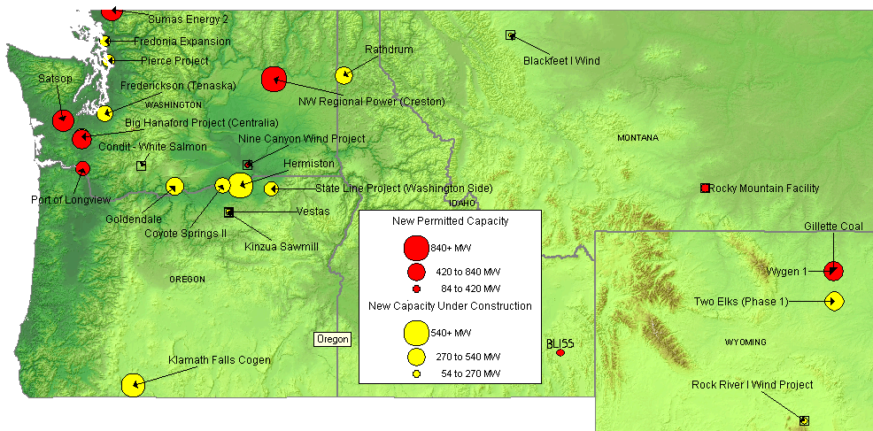
NORTHWEST NEW GENERATION MAP
High Probability Plants
Kinzua Sawmill / 10 MW / Sep-01
Pierce Project / 154 MW / Sep-01
Rathdrum / 270 MW / Oct-01 / 6,760 HR
Bliss / 90 MW / Sep-01
Blackfeet I Wind / 22 MW / Oct-01
Rock River I Wind Project / 50 MW / Oct-01
State Line Project / 200 MW / Dec-01
Two Elks (Phase 1) / 300 MW / Dec-01
Vestas / 35 MW / Dec-01
Coyote Springs II / 231 MW / Jun-02 / 6,760 HR
Frederickson (Tenaska) / 248 MW / Jun-02
High Probability Plants (cont’d)
Big Hanaford Project (Centralia) / 248 MW / Jul-02 / 7,349 HR
Hermiston / 536 MW / Aug-02 / 6,700 HR
Goldendale / 288 MW / Sep-02 / 7,200 HR
Wygen 1/ 80 MW / Jul-03
Chehalis Power / 520 MW / Nov-03 / 6,704 HR
Medium-High Probability Plants
Rocky Mountain Facility / 110 MW / Jul-02
Sumas Energy 2 / 660 MW / Sep-02 / 6,793 HR
NW Regional Power (Creston) / 838 MW / Jun-03
Port of Longview / 290 MW / Jul-03 / 7,800 HR
Satsop / 600 MW / Oct-03 / 6,765 HR
Gillette Coal / 500 MW / Jun-05
Nine Canyon Wind Project / 11 MW / Sep-02
PNW

Slide 11
NORTHWEST UPDATES
Washington
(08/06/01 DJI) The Yakima Nation and PacifiCorp have announced a preliminary agreement to submit a competing license application for the Priest Rapids hydroelectric project on the Columbia River. The license for the Priest Rapids and Wanapum dams, currently held by Grant Public Utility District, expires in 2005. The dams, whose output is 825 average megawatts (enough to power 600,000 homes), are located on the ceded lands of the Yakima Nation above Hanford Reach in central Washington. In a joint statement, the partners said that virtually all of the project's low-cost electricity output will stay in the region for Washington and Oregon consumers served by both public and investor-owned utilities. Under an 1855 treaty, the Yakima Nation has a 1.2 million-acre reservation surrounded by the 10 million acres it ceded to the United States. The treaty guarantees the Nation's historic role to manage fish and wildlife, and other cultural resources in its ceded territory. PacifiCorp, an electric utility based in Portland with 1.5 million customers in six states, has extensive hydroelectric experience, operating more than 50 facilities primarily in the Pacific Northwest.
(8/06/01 DJI) About four dozen workers will be recalled to Kaiser Aluminum Corp.'s idled smelter, but no date has been set to restart the plant . The Mead plant was idled in December, when Kaiser decided it was more profitable to resell the electricity the plant consumed than continue to smelt aluminum. About 400 workers were laid off at the time. Almost 1,000 people work at the Mead smelter when it is in full production. Kaiser began recalling workers last week and will evaluate its options over the next couple of weeks, Ashe said. The BPA wants the region's power-hungry aluminum industry to remain idled for up to two years while more power plants are added in the Northwest. Currently, the BPA is responsible for providing more power than it can produce. To make up for the remainder, it must go on the open market to purchase power. The BPA asked operators of the region's 10 aluminum smelters to shut down and remain closed when their five-year contracts are renewed in October. All but Kaiser agreed. In June, the BPA announced rate increases would be held to 46 percent for six months beginning Oct. 1. The agency allotted about 250 megawatts to Kaiser while continuing to negotiate the terms of an extended shutdown. "BPA wants that power," Powers said. Since the BPA announced its rate hike, wholesale power prices have plunged, putting Kaiser in a much better position to buy at a relatively low cost the electricity needed for a smelter restart.
PNW
Notes:
Formerly (stalled) NWPE 220 MW project. FPL bought rights in 1/99. Construction to began 9/1/99 As of 4/25/00 Unit 1 not complete and gas line construction has been stalled.

Slide 12
NORTHWEST UPDATES (cont’d)
Washington (cont’d)
(08/08/01 DJI) Energy Northwest said on Wednesday that six Northwestern public utilities had committed to the Nine Canyon wind project and four more may also subscribe. The six utilities, Grays Harbor, Grant, Benton, Okanogan, Chelan and Douglas Public Utility Districts (PUDs) have agreed to receive a total of 32 megawatts (MW) of power. If four more PUDs also join the project the capacity will be 36 MW. Energy Northwest said the project, to be located near Kennewick, Washington, is expected to cost $44 million for 36 megawatts produced by 28 turbines.
(8/13/01 Powermarketers.com) Hoping to repair a cash crunch, Spokane's Avista Corp. has sold its interest in a proposed Longview power plant to an Atlanta company. Mirant Corp. announced Tuesday that it is taking over development of a 286-megawatt power plant project planned at Longview's Mint Farm Industrial Park. Neither company would disclose the financial terms of the deal. The Avista project is one of two power plants proposed in Longview. Enron Corp. of Houston is hoping to begin construction of a 290-megawatt plant on Port of Longview property in August.
(8/23/01 EIS) Tractebel Project Development, Inc., announced that construction had commenced on the $360 Chehalis Power Project, which will be built on a 31-acre site in Lewis County, Washington, near the City of Chehalis. Fueled by clean natural gas and operated in conjunction with an advanced emissions control system, the Chehalis Power Station will add up to 505 MW of much needed power to the region's energy supply beginning in late 2003. The project will utilize a multiple cell air condenser to minimize water usage and will be among the cleanest and most efficient electric power resources in the state. Energy generated from the facility will be sold directly into the Northwest Power Pool.
(8/16/01 MWD) Two Pacific Northwest municipal utilities Wednesday proposed at least 16% rate increases to cover part of the 46% boost in wholesale power prices they expect to see from the Bonneville Power Administration Oct. 1. The Snohomish County Public Utility District, Everett, Wash., said its staff is proposing a 16-18% rate increase in October. It must be approved by its Board of Commissioners and will bring the PUD’s total rate hike this year to 53%. On Jan. 1, 2001, the utility increased rates 35%, citing high wholesale power costs and the region’s long-running drought that has reduced the amount of power it can generate. The utility is BPA’s largest municipal utility customer and will buy 80% of its 823 MW load from the federal power-marketing agency in October. The Emerald People’s Utility District, Eugene, Ore., also said it will increase rates by 16% because of higher charges from BPA. Emerald Board President Katherine Schacht described BPA’s hike as “a very tough pill to swallow. We need to regain rate control in the Northwest and not be influenced by California, aluminum companies and an erratic market,” she said. Emerald expects its power purchase costs to increase by $4.7-million to $14.9-million annually, depending on market prices.
Idaho
(8/2/01 Powermarketers.com) The city of Rathdrum has postponed its legal challenge of a state tax law until representatives of Cogentrix Energy Inc., can meet with the state. In July, the city announced its plan to file a brief in 1st District Court challenging a 1995 law that prevents the city from using property taxes from a power plant to increase its budget. Cogentrix plans to open its 270-megawatt Rathdrum Power Plant later this summer.
PNW
Notes:
Formerly (stalled) NWPE 220 MW project. FPL bought rights in 1/99. Construction to began 9/1/99 As of 4/25/00 Unit 1 not complete and gas line construction has been stalled.

Slide 13
NORTHWEST UPDATES (cont’d)
Oregon
(08/06/01 DJI) Pollution from 44 proposed power plants within the Bonneville Power Administration's service area would perceptibly worsen some of the Northwest's most famous mountain views, a federal analysis shows. Views of Mount Hood in Oregon and Mount Rainier and the Olympic Mountains would be affected by tiny particles of soot that mix with airborne water droplets to scatter and absorb light. Emissions from 44 mostly gas-fired power plants also would cause more visibility problems in the Columbia River Gorge and other protected wilderness areas in the Northwest, officials familiar with the report told The Oregonian newspaper. Acid rain levels would increase slightly in national parks. Bonneville power officials said the study considered the highly unlikely scenario that all 44 power plants would be built and generate 23,000 megawatts of power at once. The Northwest's projected need during the next decade is 6,000 to 8,000 megawatts, officials said. The analysis found that even if 11,000 megawatts of electricity came online, the visible effects still would be detectable around most of the wilderness areas in the Northwest. In some cases, those effects are considered unacceptable to the National Park Service. The superintendents from Olympic, Mount Rainier and North Cascades national parks have written to the power authority asking it to require that power plant applicants offset their expected pollution by reducing emissions from other sources.
(08/07/01 EIS) The first new power plant built in the Northwest in several years officially entered into commercial operation July 29, initiating deliveries of much-needed power to the Pacific Northwest and California. The City of Klamath Falls and PacifiCorp Power Marketing, Inc., the non-regulated affiliate of Portland-based PacifiCorp, developed the Klamath Cogeneration Facility, a 484-megawatt natural gas-fired, advanced combined-cycle cogeneration facility, as a merchant plant to serve the energy-starved Western U.S. power grid. The plant sits less than 30 miles from one of the most actively traded electricity markets at the California-Oregon border. Construction of the plant began in June 1999, with start up this May and significant test power flowing into the grid the last two months. The City of Klamath Falls is the owner of the plant and previously sponsored the issuance of $309 million in project revenue bonds that made the plant possible.
(8/17/01 Oregonian) As Portland General Electric officially began generating electricity at its Beaver Peaker power plant Thursday, Chief Executive Peggy Fowler heralded the event as a determined step toward easing the Northwest's energy crunch. "Our region needs energy," said Fowler, at the on-site dedication ceremony near Clatskanie. "We have to do more on the supply side -- and that's what this is all about." The 24.5-megawatt plant also is about the risks and money propelling the West into a higher-priced energy future. The single-cycle, gas-fired generator is known in the industry as a "peaker plant.
PNW
Notes:
Formerly (stalled) NWPE 220 MW project. FPL bought rights in 1/99. Construction to began 9/1/99 As of 4/25/00 Unit 1 not complete and gas line construction has been stalled.

Slide 14
NORTHWEST UPDATES (cont’d)
Montana
(08/22/2001Dow Jones Energy Service) NorthWestern Corp's (NOR) plans to have 80 megawatts of the proposed 240-megawatt Montana First Power Plant on line by October were foiled Tuesday by petitions that challenge the company's state environmental permit, a company spokesman confirmed Wednesday. NorthWestern now projects that the earliest those 80 MW will come on line will be in early 2002, said spokesman Roger Schrum. The original timetable of the combined cycle, natural gas-fired plant near Great Falls placed it at full output by fall 2002. "We're hopeful that an expedited appeals process will be put in place, but we don't know yet if that will happen so we don't know when" the plant will come online fully, Schrum said. The Montana Environmental Information Center and two other groups have filed petitions with the state Board of Environmental Review asking that it reconsider its decision granting an air-quality permit to the plant. A spokesperson for Montana's division of the Department of Quality has estimated that the appeals will postpone the start date of construction for NorthWestern's plant by at least four months, Schrum said. "We're disappointed that there is a challenge to the permit we've already received approval for," Schrum said. "We worked hard to meet with various groups and neighbors and to participate in public hearings. Our filing was made in compliance with all applicable laws." NorthWestern has offered to make a portion of the power from the plant available to a state power pool, which would sell the power to industrial customers at-cost.
PNW
Notes:
Formerly (stalled) NWPE 220 MW project. FPL bought rights in 1/99. Construction to began 9/1/99 As of 4/25/00 Unit 1 not complete and gas line construction has been stalled.

Slide 15
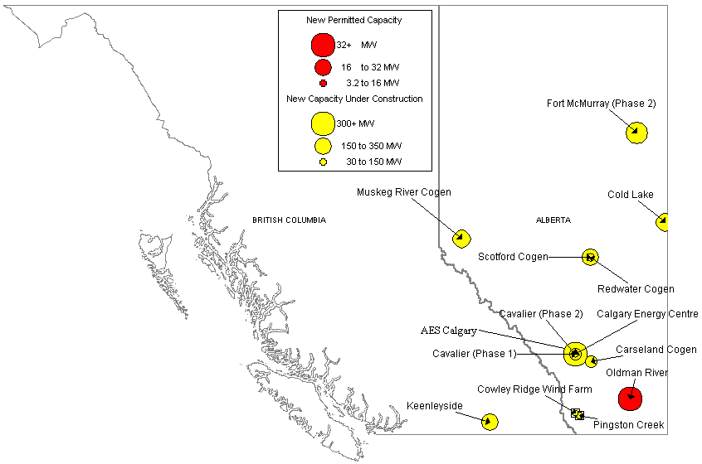
CANADA NEW GENERATION MAP
High Probability Plants
Cowley Ridge Wind Farm / 6 MW / Oct-01
Balzac Cogen / 106 MW / Nov-01
Carseland Cogen / 80 MW / Nov-01
Redwater Cogen / 40 MW / Nov-01
Cavalier (Phase 2) / 26 MW / Dec-01
Valleyview / 46 MW / Dec-01
Pingston Creek / 30 MW / Jun-02
Cold Lake / 170 MW / Oct-02
Muskeg River Cogen / 170 MW / Nov-02
Scotford Cogen / 150 MW / Dec-02
Keenleyside / 150 MW / Jan-03
Calgary Energy Centre / 300 MW / May-03
AES Calgary (Phase 2) / 175 MW / Dec-03
Fort McMurray (Phase 2) / 238 MW / Aug-04
Medium-High Probability Plants
Rainbow Lake / 46 MW / Feb-02
Oldman River / 32 MW / May-02
Canada

Slide 16
CANADA UPDATES
(08/13/01 PMA) Vancouver, BC, -- Donald Sharpe, President of Gemini Energy Corp. announced that a fourth Warbonnet natural gas well has been brought on production. The WB 2-26d, in which Gemini has a 42.5% working interest, was flow tested at a rate of 6.1 million cu. ft. of gas over 24 hours and is currently producing at a rate of 4.5 million cu. ft. of per day against a line pressure of 980 psi.
(8/15/01 ATCO Power) In March, ATCO Power announced that it would install two General Electric, LM 6000 gas turbine generators with a capacity of 92 MW at its existing site near Grande Prairie at Valleyview Alberta. One of these units will now be redirected to the Rainbow Lake site consistent with the transmission system needs. Construction on the Valleyview project is progressing as per schedule for an in-service date of November 2001.
(8/20/01 EIS) Phase I of the SunBridge Wind Power Project is now generating renewable energy to the SaskPower grid from three test wind turbines in Gull Lake, Saskatchewan. SunBridge is a $20 million partnership (50:50) between Suncor Energy Inc. and Enbridge Inc. to develop this wind power project. Enbridge Pipelines will be the operator of the facility, and SaskPower will purchase the electricity produced at the facility to provide power for federal government buildings in Saskatchewan and other customers. The initiative was stimulated by a 10-year $12.4 million federal government commitment last fall to support green power development in Saskatchewan.
(8/23/01EIS) PanCanadian Petroleum Limited announced today that the first of its Alberta power plants - the Cavalier Power Station - has received its commissioning certificate and is now selling electricity to the Alberta Power Pool, supplying the expanding power demand of Calgary and southern Alberta. PanCanadian Energy Services, the Company's gas and power marketing division, will manage the operations of the Cavalier plant. ``This is a very exciting day for PanCanadian because it marks the first time we have produced and sold electricity commercially in Alberta,'' said Nancy Laird, Senior Vice President Marketing & Midstream. Construction of the Cavalier Power Station started in the fall of 2000. The plant, 100 per cent owned and operated by PanCanadian, is located 55 kilometres east of Calgary and is currently producing up to 85 megawatts of power in its first phase of operations. Eighty-five megawatts of power can supply the electricity requirements for approximately 85,000 homes.
Canada
Notes:
Formerly (stalled) NWPE 220 MW project. FPL bought rights in 1/99. Construction to began 9/1/99 As of 4/25/00 Unit 1 not complete and gas line construction has been stalled.

Slide 17
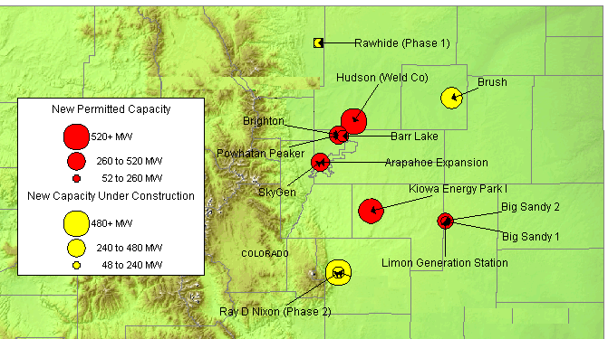
ROCKIES NEW GENERATION MAP
High Probability Plants
Rawhide (Phase 1) / 80 MW / Sep-01 / 11,400 HR
Limon Generating Station / 140 MW / Jun-02 / 11,873 HR
Brighton / 140 MW / Apr-02
Brush / 328 MW / May-02 / 7,500 HR
Arapahoe Expansion / 45 MW / Jun-02 / 9,500 HR
Ray D Nixon (Phase 2) / 480 MW / Dec-02 / 7,067 HR
Medium-High Probability Plants
Big Sandy 1 / 75 MW / Nov-01
Peetz Wind / 9 MW / Dec-01
Powhatan Peaker / 280 MW / May-02
Barr Lake / 128 MW / Jun-02
Gobbler’s Knob Wind / 54 MW / Jun-02
Big Sandy 2 / 225 MW / Nov-02 / 10,500 HR
SkyGen / 270 MW / Jun-03
Hudson (Weld Co) / 516 MW / Jun-04 / 7,100 HR
Kiowa Energy Park I / 475 MW / Jul-04 / 7,160 HR
Rockies

Slide 18
ROCKIES UPDATE
(8/13/01 HESI) More than 220 construction workers are now on site at the Limon Generating Station project, which is rapidly taking shape about five miles south of the eastern Colorado town of the same name. According to Martin Schwemmer, project manager for both the Limon and Brighton units presently under construction, workers had the Limon project about 45 percent complete as of early July. Limon Generating Station will ultimately produce power for both Xcel energy and Tri-State. There are two generators — with 70 megawatts of capacity each — currently being installed at this location. When the contract with Xcel takes effect early in 2002, one of the units will produce power for Xcel Energy and the other will be dispatched by Tri-State for use by its membership. However, since the units are both scheduled to go on line in November 2001, Tri-State will have both units available for its system for several months before the contract term with Xcel begins.
(8/20/01 Yahoo) Black Hills Energy Ventures, a unit of Black Hills Corp. said on Friday its 240-megawatt Fountain Valley Power Project, a natural gas-fired power plant near Colorado Springs, Colo. has started service. The plant's output, generally enough to light around 240,000 homes, is under a 10-year contract with Public Service of Colorado, a unit of Xcel Energy, Rapid City-based Black Hills said in a statement. The Fountain Valley power plant, Black Hill's largest completed generation project to date, is part of the company's strategy of putting a substantial part of its generation under long-term contracts. In 2001, Black Hills has raised its independent power generation capacity by 140 percent to around 600 megawatts and expects to exceed 1,000 MW in 2003.
Rockies

Slide 19
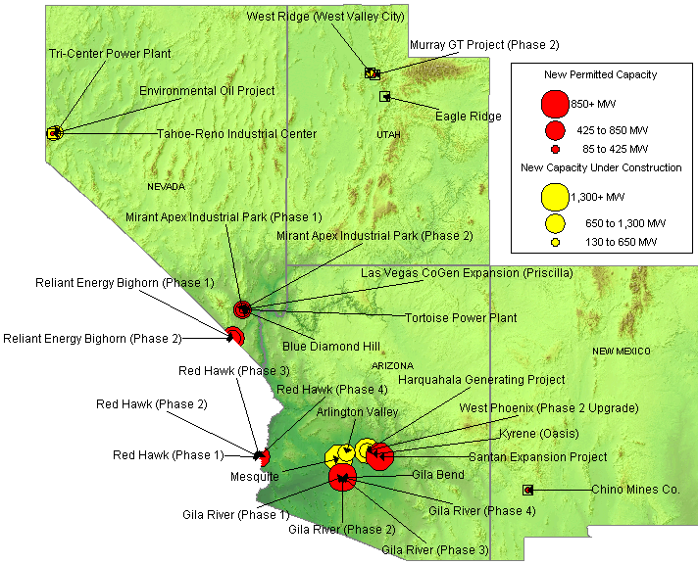
SOUTHWEST NEW GENERATION MAP
High Probability Plants
Environmental Oil Project / 30 MW / Sep-01
West Ridge / 160 MW / Sep-01 / 9,518 HR
Murray GT Project (Phase 2) / 15 MW / Oct-01
Kyrene (Oasis) / 265 MW / Feb-02 / 7,125 HR
Red Hawk (Phase 1) / 580 MW / Jun-02 / 7,067 HR
Red Hawk (Phase 2) / 580 MW / Jun-02 / 7,067 HR
Arlington Valley / 570 MW / Aug-02 / 7,067 HR
Gila River (Phase 1) / 575 MW / Aug-02 / 7,067 HR
LV CoGen Expansion / 225 MW / Sep-02
Gila River (Phase 2) / 575 MW / Dec-02 / 7,067 HR
Mesquite / 1,250 MW / Jan-03 / 7,067 HR
Gila River (Phase 3) / 575 MW / Mar-03 / 7,067 HR
Mirant Apex Industrial Park (Phase 1) / 550 MW / Mar-03 / 7,067 HR
Gila River (Phase 4) / 575 MW / May-03 / 7,067 HR
West Phoenix (Phase 2 Upgrade) / 440 MW / Jun-03 / 7,196 HR
Harquahala Generating Project / 1,083 MW / Sep-03 / 6,880 HR
Mirant Apex Industrial Park (Phase 2) / 550 MW / Mar-04 / 7,067 HR
Medium-High Probability Plants
Chino Mines Co. / 50 MW / Sep-01
Tortoise Power Plant / 60 MW / Mar-02
Steamboat Springs Geothermal / 30 MW / Jun-02
Reliant Energy Bighorn (Phase 2) / 575 MW / Jun-03
Blue Diamond Hill / 400 MW / Jun-04
Gila Bend / 845 MW / Jun-04
Santan Expansion Project / 825 MW / Dec-05
Red Hawk (Phase 3-4) / 680 MW / Jun-06
DSW

Slide 20
SOUTHWEST UPDATES
Arizona
(08/03/01 DJI) Construction of a new 600-megawatt natural gas-fired combined cycle power plant in Arizona is almost complete and it should go into commercial operation by the end of August, a spokeswoman for one of the project's partners said on Friday. Griffith Energy Project, LLC, a joint venture of PPL Global and Duke Energy, is building the plant, which will have around 420 MW of baseload capacity with the balance available during periods of peak demand. A PPL spokeswoman said construction is done. The project has secured long-term transmission service to allow direct sales at the Mead substation, a major trading hub for sales to California, Nevada and other western markets.
(08/13/01 Powermarketers.com) Griffith Energy, LLC a 50/50 joint venture between PPL Global (Fairfax, Va.) and Duke Energy North America (Charlotte, N.C.) has completed construction of the $300 million Griffith Energy Project in Mojave County near Golden Valley, Ariz. Commercial operation of the plant is expected to commence by late August 2001. Generating Equipment includes two GE Power Systems model MS7001FA combustion turbines, two Vogt-NEM heat recovery steam generators and a Toshiba steam turbine generator capable of producing 600 megawatts (MW) of baseload capacity. BVZ Power Partners (Black & Veatch/Zachry) constructed the plant. The project will supply wholesale energy to the Western Systems Coordinating Council (WSCC) via transmission connection to the Mead, Nev., 500/345/230kV substation.
(8/17/01 PD) In a move that could help merchant generators in Arizona move power to areas of growing demand, the Salt River Project proposed Wednesday to build a 500-kV transmission line to connect the Palo Verde nuclear station to southeast Phoenix. Although the exact siting for the project has yet to be determined, the proposed line would run from the Palo Verde nuclear generating station, about 50 miles west of Phoenix, to a site near Mesa, southeast of Phoenix. A 230- kV double circuit line would then connect the new receiving station to SRP’s Browning receiving station located in east Mesa. The project would cost around $160-million. SRP hopes to have the necessary permits in place by 2004 and the project built by 2006.
DSW

Slide 21
SOUTHWEST UPDATES (cont’d)
Nevada
(8/15/01 Las Vegas Journal) A North Carolina energy company is proposing to build a 1,100 megawatt, gas-fired power plant in Lincoln County 13 miles northwest of Mesquite. Toquop Energy, a subsidiary of Charlotte, N.C.-based Cogentrix Energy, wants to build the plant on land owned by the Bureau of Land Management. The proposed site is near the Toquop Wash, the Kern River Gas Pipeline and a major electric transmission line. The project would cost an estimated $550 million. Because it is distant from other air pollution sources, Cogentrix may have less difficulty in obtaining an air quality permit than the developers of seven plants in the Apex industrial area north of Las Vegas. The Nevada Bureau of Air Quality has yet to receive an air quality application for the project. The proposed Cogentrix plant is so large it will be subjected to a more thorough review than most plants, meaning it could take six months to a year. King said permitting could be completed by the middle of next year and the plant could be operational by fall of 2004.
(8/17/01 EIS) Pinnacle West Energy, the generation subsidiary of Pinnacle West Capital Corporation, plans to develop a natural gas-fired electric generating station 20 miles north of Las Vegas, Nevada. The 570-megawatt Silverhawk Power Station is the first project that the Company will develop in Nevada. ``Southern Nevada, particularly the Las Vegas area, is growing faster than most areas of the country,'' said Bill Stewart, president of Pinnacle West Energy. “Building this power plant in Nevada is a very important step in our overall growth strategy and reinforces our position as one of the top power producers in the West. The site we're developing is ideally situated to meet the energy demands of the people of Nevada while also having transmission access into Arizona.'' Pinnacle West Energy has started the project engineering and permitting and has purchased major equipment. Construction on the combined-cycle Silverhawk plant, located in the APEX industrial park, is scheduled to begin in the Spring of 2002, and the plant is projected to be in service by the Spring of 2004. The Company has signed a memorandum of understanding with Las Vegas-based Southern Nevada Water Authority to be a 25-percent owner of the plant. Total cost of building the plant is expected to be about $400 million.
DSW

Slide 22
SOUTHWEST UPDATES (cont’d)
New Mexico
(08/13/01 MWD) Houston-based Regent Energy, a natural gas exploration and production company, has reached an agreement with Millennium Energy Ventures, a private venture capital and project development company in Texas, to develop a 500- MW, natural gas-fired power plant in San Juan County, N.M., the companies said Friday. Both companies will own the facility, which is estimated to cost roughly $250 million, with Regent retaining ownership of 75% of the project and Millennium holding on to the remainder. Under the agreement, Millennium will manage the permitting, estimated at six to nine months, and the construction process, and will arrange the equity. Also, Millennium will assist Regent in the acquisition of several gas fields in the Four Corners area of San Juan and Rio Ariba counties of New Mexico, totaling an estimated 90 bcf and 20 mmcf/d, the companies said. This natural gas production will be sufficient to power 100 MWof the power plant, with the remaining supplies coming from other San Juan County producers.
Utah
(08/14/01 MWD) Intermountain Power Agency, an alliance of 23 municipalities in Utah, has plans to add a 900-MW, coal-fired unit to its 865-MW power plant in Delta, Utah, IPA General Manager Reed Searle said. The IPA, the Los Angeles Department of Water and Power and the Utah Associated Municipal Power Systems are putting together a power development agreement that will outline terms of the cost, operation and management of the new unit. The LADWP is the operator of the existing facility and the primary purchaser of its output. If the Delta facility is expanded, the three entities working on the development of the project expect to gain roughly five to six California partners and about 40 to 50 Utah partners that would be interested in tapping the capacity, Searle said. Despite the uncertainty, IPA anticipates that the unit will begin commercial operation in June 2007.
DSW

Slide 23
SUMMARY
Summary

Slide 24
Sorted List By Online Date

Slide 25
Sorted List By Online Date

Slide 26
Sorted List By Region

Slide 27
Sorted List By Region

Slide 28
Sorted List By Region

Slide 29
WSCC CAPACITY ADDITIONS
NOTE: 100% of Capacity Under Construction, 50% of Permitted Capacity
Summer Summary

Slide 30
New Gas Generation Summary

