Slide 1
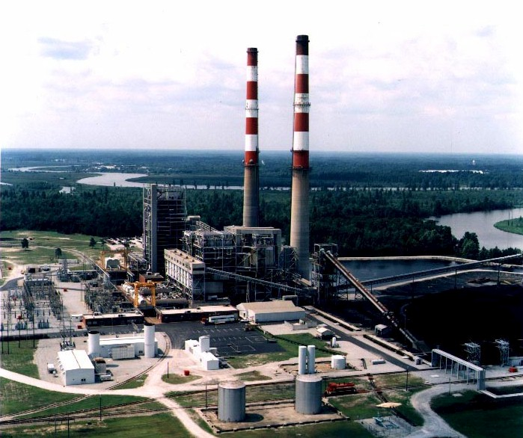
Tracking New Coal-Fired Power Plants
Coal’s Resurgence in Electric Power Generation

Slide 2
Coal’s Resurgence in Electric Power Generation (59 Plants & 36 GW New Capacity Proposed at $39 Billion Investment) (Equivalent Power for more 36 Million Homes)
0.3 GW
$0.3 B
1
1.0 GW
$1.2 B
2
0.2 GW
$0.2 B
1
2.0 GW
$1.5 B
4
0.5 GW
$0.8 B
1
0.5 GW
$0.8 B
1
2.3 GW
$3.0 B
4
0.5 GW
$0.5 B
1
1.8 GW
$2.6 B
5
0.9 GW
$0.9 B
1
2.3 GW
$3.3 B
4
0.7 GW
$0.7 B
3
0.5 GW
$0.6 B
1
1.3 GW
$1.3 B
2
1.2 GW
$1.2 B
2
0.6 GW
$0.9 B
1
3.7 GW
$2.8 B
5
Undecided6.4 GW
$6.8 B
7
1.3 GW
$1.3 B
3
1.6 GW
$1.6 B
2
3.1 GW
$3.5 B
3
0.5 GW
$0.6 B
1
1.5 GW
$1.5 B
1
0.3 GW
$0.3 B
1
0.6 GW
$0.6 B
1
0.4 GW
$0.4 B
1
LEGEND
Capacity (GW)
Investment (B - Billion $)
Proposed Plants
Source: NETL New Coal Capacity Database

Slide 3
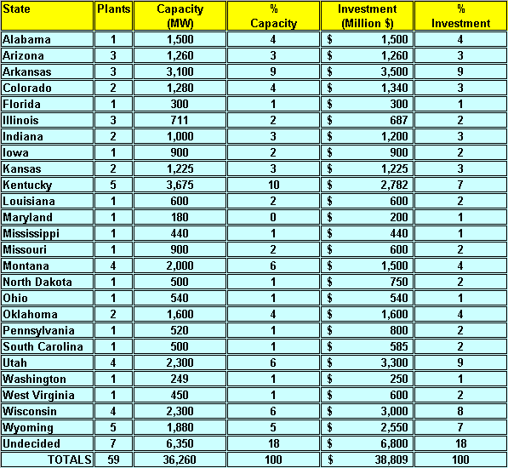
Coal’s Resurgence in Electric Power Generation (59 Plants & 36 GW New Capacity Proposed at $39 Billion Investment) (Equivalent Power for more 36 Million Homes)
Source: NETL New Coal Capacity Database

Slide 4
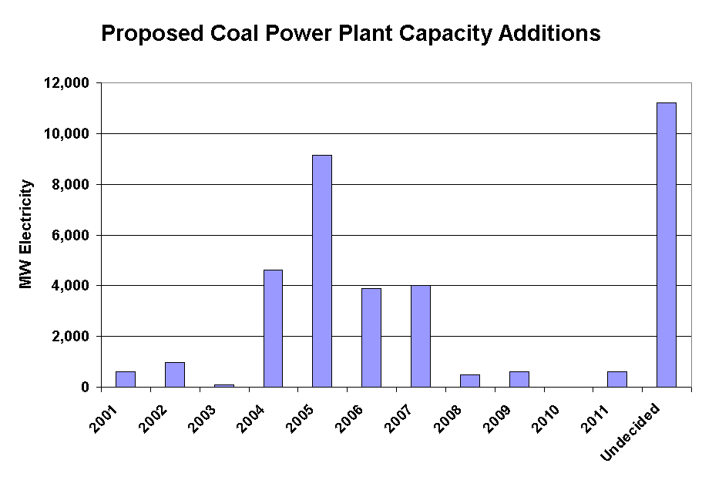
Coal’s Resurgence in Electric Power Generation (59 Plants & 36 GW New Capacity Proposed at $39 Billion Investment) (Equivalent Power for more 36 Million Homes)
Source: NETL New Coal Capacity Database

Slide 5
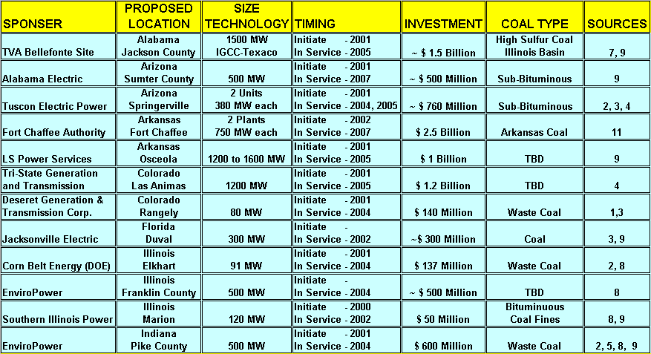
Coal’s Resurgence in Electric Power Generation (59 Plants & 36 GW New Capacity Proposed at $39 Billion Investment) (Equivalent Power for more 36 Million Homes)
Source: NETL New Coal Capacity Database

Slide 6
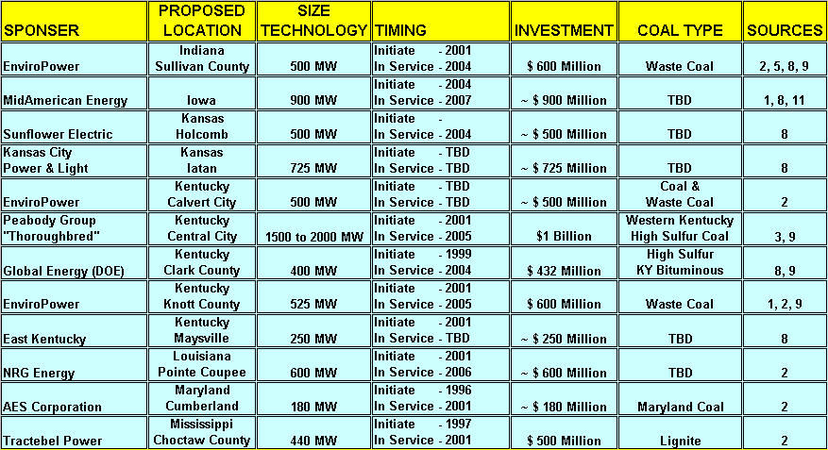
Coal’s Resurgence in Electric Power Generation (59 Plants & 36 GW New Capacity Proposed at $39 Billion Investment) (Equivalent Power for more 36 Million Homes)
Source: NETL New Coal Capacity Database

Slide 7
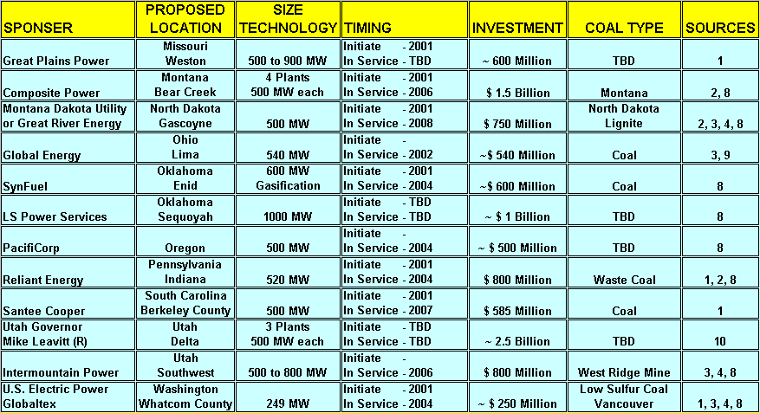
Coal’s Resurgence in Electric Power Generation (59 Plants & 36 GW New Capacity Proposed at $39 Billion Investment) (Equivalent Power for more 36 Million Homes)
Source: NETL New Coal Capacity Database

Slide 8
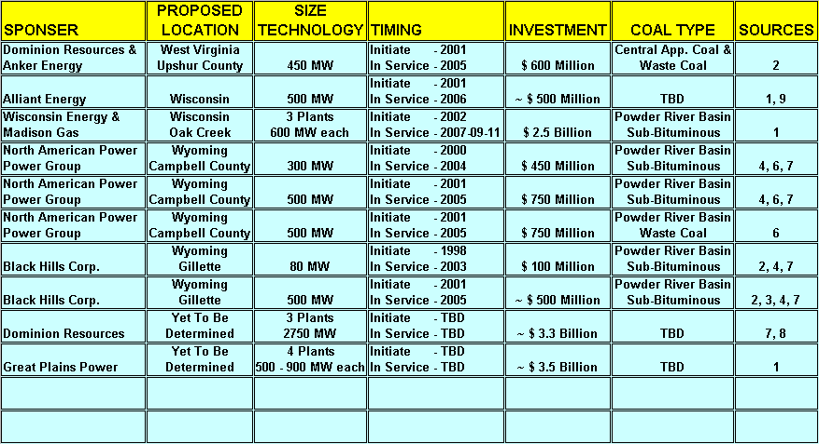
Coal’s Resurgence in Electric Power Generation (59 Plants & 36 GW New Capacity Proposed at $39 Billion Investment) (Equivalent Power for more 36 Million Homes)
Source: NETL New Coal Capacity Database

Slide 9
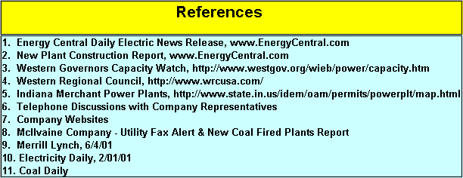
References for NETL New Coal Capacity Database
Source: NETL New Coal Capacity Database

