Slide 1
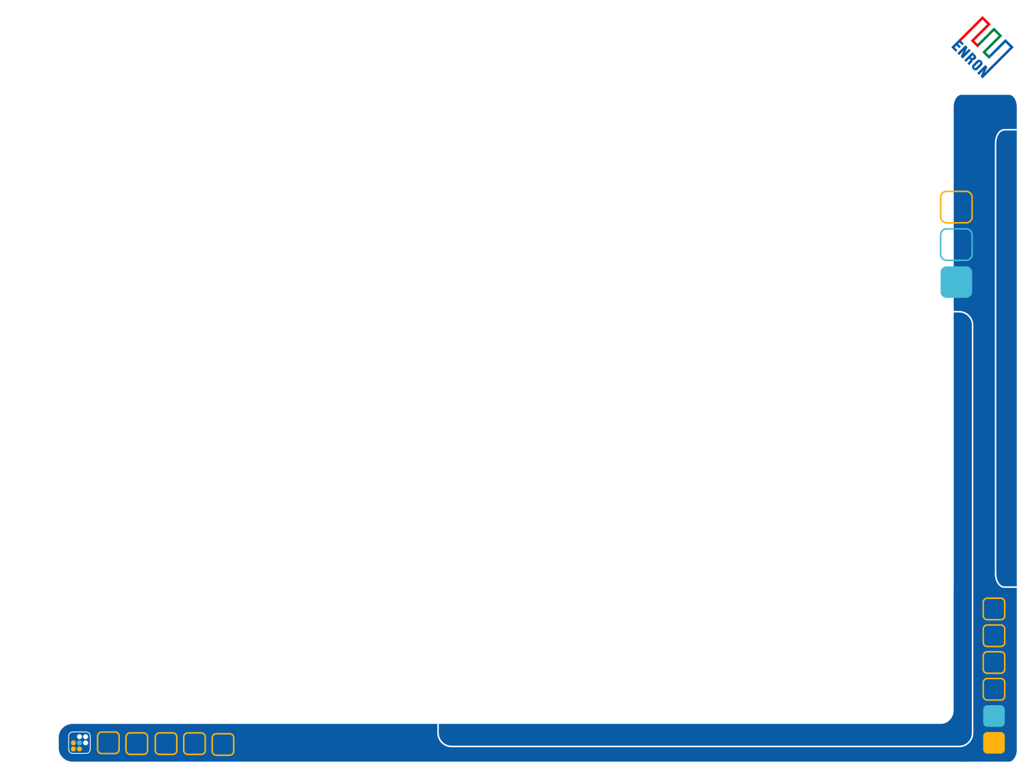
Neural Network
Assisted Trading for the Gas Market
NAT-Gas
October, 2001

Slide 2
Contents
The following items are my thoughts provided in subsequent slides
Some of the issues identified with the existing model (simple3)
Problem definition
Possible factors to use as levers to maximize profit or minimize cost
Data source that would be required to calibrate input for the tool
Suggested relationship that could be modeled and presented in easy to use application
Notes:
Paying for storage when utilized enables better management of costs and revenues.

Slide 3
Simple3 model issues
Select few potential issues/questions identified with current model
The result of the simplified model provided the positive MTM result only at the end of the period. However, during the run up and run down, it produced significant negative MTM values (see graphs in following slides).
RAND() random variable shocks are used to simulate the next time step. Using same shock across all time steps implies that market events arrive at the same source of uncertainty independent of market price level, market makers activities, etc… It may be useful to use historical data to calibrate a stochastic process that determines the run up/down transaction arrival frequency AND another discrete stochastic process to buy or sell volume that is tied to existing inventory, etc. That is, more complicated model with multiple stochastic events would be required.
The money made from the spread should be tracked separately along with MTM value in setting the spread for the next time step to suggest weights for bias towards directional or bid-offer profits.
Action (buy, sell, null) should be adjusted using a stochastic process (based on historical data or trader assumption) and should be path dependent to correctly capture the momentum and adjust spread accordingly.
Volume of the transaction is currently fixed and equally applied to buys and sells. Shouldn’t the volume should be tied to prevailing position or average of prevailing positions?
Notes:
Paying for storage when utilized enables better management of costs and revenues.

Slide 5
Problem Definition
Model scope and problem definition
The model to provide optimal means to adjust bid-offer spreads during transient market events to be developed along side the lead trader and eventually placed in an auto-mode for certain activities to work passively.
Overall goal is to take advantage of such transient by maximizing MTM or minimizing costs.
It should be practical and mechanical to initially capture all relevant parameters and interaction between curves and along the terms of each curves.
The key parameters that lead to selecting a bid-offer spread in a given transient condition should be visible as to be easily adjusted and retrieve updated spread value. Such interactions and overrides should be tracked to help the model learn from the trader to improve the probability of maximizing value in subsequent predictions.
Link certain fundamental information such as key weather or pipeline information pertaining to the underlying market would be a natural extension and the model should be designed to allow such linkage in the future.
The model should be able to dynamically link to existing database of historical prices and other relevant information to accurately take such data into account.
It should be built in phases so that it is put to use in relatively short time frame while enhancements are progressing.
Notes:
Paying for storage when utilized enables better management of costs and revenues.

Slide 6
Current Spread to input relationship
aveSellPrice(t)
aveBuyPrice(t)
Cash(t)
MTM(t)
Mark-to
Market
Value
TotalSells(t)
TotalBuys(t)
NetPos(t)
t
Mid(t)
Action(t)
Buy,sell,
null
Offer(t)
Bid(t)
Offer(t)
t-1
Bid(t-1)
Spread(t-1)
Offset(t-1)
Constants
Intensity factor: trailing # of transaction to use in averaging intensity
Intensity: average delta time between transactions
Dead interval: maximum elapsed time before a transaction or an event is assumed to occur
Offset: % by which spread is adjusted up or down depending on the transaction
Offset reversion ratio: % by offset is reduced if deal interval has elapsed
Spread reversion rate: $ amount by spread is reduced if the dead interval has elapsed
Volume to sell/buy: incremental volume that is sold/bought when a transaction occurs
Momentum: a measure of if the market is selling or buying
Adjusted momentum: momentum number increase to cause larger reaction position
Position sensitivity: long/short threshold position number that used to adjust v-factor adjust
V-factor adjust: amount by which momentum is increased if position sensitivity is increased
Minimums: spread, offset, spread offset, respective minimum limits
Action: Buy, sell, null transaction assumed for the transaction arrival time
Input parameters
Transfer
function

Slide 7
Current Spread to input relationship--detail
aveSellPrice(t)
aveBuyPrice(t)
Cash(t)
MTM(t)
Mark-to
Market
Value
TotalSells(t)
TotalBuys(t)
NetPos(t)
t
Mid(t)
Action(t)
Buy,sell,
null
Offer(t)
Bid(t)
Offer(t)
t-1
Bid(t-1)
Spread(t-1)
Offset(t-1)
MAX:
Momentum
T(t) Transaction
Arrival Time
SpreadMin
Adjusted Momentum
Offset(t-1) +
Spread-offsetMin
Offset Minimum
Offset reversion ratio
Null: Spread(t-1) –
Spread reversion rate
Action(t-1)
Buy,sell,
null
Random Shock
T(t-1)
Input parameters
Action(t)
Buy,sell,
null
Dead interval
Sell or Buy:
Vlookup(Trans based offset) +
Vlookup(Intensity based spread adj) +
Spread(t-2)
Transfer
function

Slide 8
Possible improvements
Objective:
Dynamically Optimize MTM for a give
period by Establishing transfer functions
(boxes) to appropriately setting spread.
The model should learn from history
And/or trader actions so relevant input
Parameters and transfer functions
Should be easily modifiable
aveSellPrice(t)
aveBuyPrice(t)
Cash(t)
MTM(t)
Mark-to
Market
Value
TotalSells(t)
TotalBuys(t)
NetPos(t)
t
Mid(t)
Action(t)
Buy,sell,
null
Trailing MTM rate of change—first and second derivatives should be used to estimate momentum
Offer(t)
Bid(t)
Offer(t)
Optimize MTM along time and select parameters
t-1
Bid(t-1)
Spread(t-1)
Offset(t-1)
MAX:
Momentum
T(t) Transaction
Arrival Time
SpreadMin
Adjusted Momentum
Offset(t-1) +
Spread-offsetMin
Offset Minimum
Offset reversion ratio
Null: Spread(t-1) –
Spread reversion rate
Action(t-1)
Buy,sell,
null
Random Shock
T(t-1)
Input parameters
Action(t)
Buy,sell,
null
Dead interval
Sell or Buy:
Vlookup(Trans based offset) +
Vlookup(Intensity based spread adj) +
Spread(t-2)
Transfer
function
Random Shock

