Slide 1
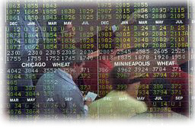


Enron Net Works
®
Jeffrey McMahon
Enron Net Works
Vice Chairman &
Chief Commercial Officer
<number>

Slide 2
Current Market Conditions
Many industries exist that sell commodity - like products through legacy distribution channels comprised of complex sales forces and long term relationships with little price transparency (“Dine ‘Em and Sign ‘Em”).
  Result - Enormous inefficiencies exist in the pricing of commodity products.
The internet provides a unique opportunity to have immediate and inexpensive access to customers through a web-based transaction platform.
  Result - All incumbent companies are vulnerable due to reduced/no barriers to entry.
The equity markets have created an enormous value differential between old economy businesses and new economy businesses.
  Result - Possible rate of return opportunities are multiples of historical rates of return (“Winner Takes All”).

Slide 3
“ In five years time, all companies will be
internet companies, or they won’t be
companies at all.”
Andrew Grove
Chairman
Intel Corp.

Slide 4
Recent Enron eCommerce Experience
EnronOnline
Almost 50% of transactions are executed online
Significant overall volume increase
Material market share increase
Enhanced Profitability
Transaction costs are decreasing
Migrated to “THE” information source of energy prices
Validation of Enron’s eCommerce Business Model

Slide 5
“Enron[Online] was having problems this
morning, so we were flying blind”
Gas Daily April 11, 2000

Slide 6
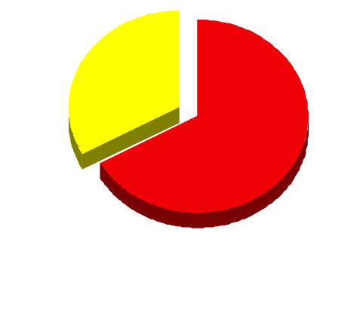
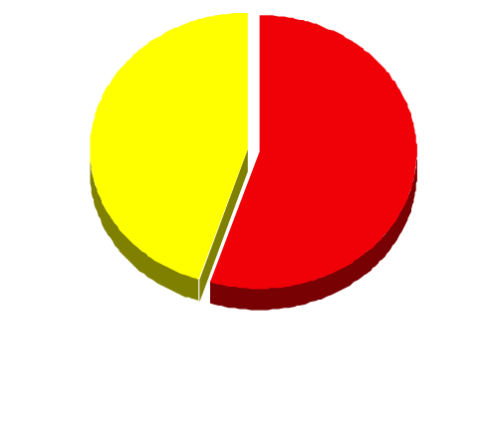
EnronOnline Versus Traditional Channels
(Currently)
Volume
Transactions
33%
45%
67%
55%
EnronOnline
Traditional Channels

Slide 7
Utilization of EnronOnline
(% of Transactions)
Traditional Channels
EnronOnline

Slide 8
Transactions via EnronOnline
(Weekly)

Slide 9
EnronOnline Statistics
Total Life to Date Transactions > 107,000
Currently > 45 % of Enron’s Transactions
Average Daily Transactions > 1,400
Life to Date Notional Value of Transactions > $43 billion
Daily Notional Value Approximately $700 Million
Currently > 33% of Enron’s Notional Volume
Number of Products Offered - Approximately 750
Number of Currencies Traded in = 13
Development Time Approximately 7 Months
Announcement Date October 26, 1999
Launch Date November 29, 1999

Slide 10
Realization
If some other company had launched
EnronOnline 8 months ago, today’s
discussion would be about
HOW ENRON BECAME THE
#2 PLAYER IN THE U.S.
GAS MARKET!!

Slide 11
Lessons Learned
Principal based vs. Exchange based (“Bulletin Board”) is
THE ONLY SUSTAINABLE eCOMMERCE B2B MODEL
Everyone is a potential competitor
Time to market is critical with product roll-out (first mover advantage)
Must continue to innovate to maintain first mover advantage
Business model could have broad applications in other industries

Slide 12
B2B Exchanges
Create new distribution channel
Based on “network effects” principle
Flawed Revenue Model
Suffer from lack of liquidity

Slide 13
Business Strategy
Identify industries that have commodity-like products where the incumbents are predominantly using legacy distribution channels.
Determine entry vehicle into the industry (i.e. partnership, acquisition, contractual rights, etc.).
Deploy eCommerce platforms to capture market share rapidly.
Convert old economy businesses into new economy businesses and capture the value creation.
Combine Enron’s IT Group and eCommerce efforts into one commercial organization for focused execution of the business plan with the objective of increasing Enron’s multiple.

Slide 14
Why Enron?
We have been B2B for years
We have strong skills in risk intermediation and good systems to control risk
We are already positioned as having successfully migrated from the “old economy” to the “new economy” company
We have a proven Business Model and track record of transforming markets
We have successfully sourced capital for all potential investments

Slide 15
Execution Plan
Upgrading
  Streamlining processes to do business the best, most
  efficient way we can
Expanding
  Growing market share in current businesses
Penetrating
  Rapidly establishing significant stakes in new markets

Slide 16
eCommerce Initiatives
Currently Underway
Energy
Pulp & Paper
Metals
Credit
EnronOnline.com
ClickPaper.com
TBD
EnronCredit.com

Slide 17
eCommerce Initiatives
Under Consideration
Petrochemicals
Grains
Straight Through Processing
Transaction Management
Logistics (Shipping, air cargo, etc.)

Slide 18
Enron Net Works Organization
April 13, 2000
Office of the Chairman
Greg Whalley - Chairman and Chief Executive Officer
Mike McConnell - Vice Chairman & Chief Operating Officer
Jeff McMahon - Vice Chairman & Chief Commercial Officer
Technology
Phillipe Bibi
CTO
Human Resources
Robert Jones
Vice President
Investments
Steve Horn
Vice President
New Markets
Identification
Jay Fitzgerald
Managing Director
Finance
Bill Brown
Vice President &
Regional CFO
Technology Origination
Allan Sommer
Vice President
Corporate Development
TBD
Enron Online
Louise Kitchen
Managing Director
Pulp & Paper
Greg Piper
Managing Director
Metals
Bruce Garner
Vice President
Financial Markets
Harry Arora
Vice President
Energy Settlements
Tom Gros
Vice President
Procurement
George Wasaff
Managing Director

Slide 19
®
<number>

