Slide 2
“ It is Not the Strongest of the Species
That Survives, Not the Most Intelligent,
but the Most Responsive to Change.”
Charles Darwin
The Origin of the Species

Slide 3
Current Market Conditions
Many industries exist that sell commodity - like products through legacy distribution channels comprised of complex sales forces and long term relationships with little price transparency (“Dine ‘Em and Sign ‘Em”).
Result - Enormous inefficiencies exist in the pricing of commodity products.
The internet provides a unique opportunity to have immediate and inexpensive access to customers through a web-based transaction platform.
Result - All incumbent companies are vulnerable due to reduced/no barriers to entry.
The equity markets have created an enormous value differential between old economy businesses and new economy businesses.
Result - Possible rate of return opportunities are multiples of historical rates of return (“Winner Takes All”).

Slide 4
“ In five years time, all companies will be
internet companies, or they won’t be
companies at all.”
Andrew Grove
Chairman, Intel Corp.

Slide 5
U.S. eCommerce Growth
B2B
B2C
Source: Forrester Research, Inc.

Slide 6
Worldwide eCommerce Growth
Source: Forrester Research, Inc.

Slide 7
Lessons Learned
Principal based vs. Exchange based (“Bulletin Board”) is THE ONLY SUSTAINABLE eCOMMERCE B2B MODEL.
Everyone is a potential competitor.
Time to market is critical with product roll-out (first mover advantage).
Must continue to innovate to maintain first mover advantage.
Business model could have broad applications in other industries.

Slide 8
Business Strategy
Identify industries that have commodity-like products where the incumbents are predominantly using legacy distribution channels.
Determine entry vehicle into the industry (i.e. partnership, acquisition, contractual rights, etc.).
Deploy eCommerce platforms to capture market share rapidly.
Convert old economy businesses into new economy businesses and capture the value creation.
Combine Enron’s IT Group and eCommerce efforts into one commercial organization for focused execution of the business plan with the objective of increasing Enron’s multiple.

Slide 9
Why Enron?
We have been B2B for years.
We have strong skills in risk intermediation and good systems to control risk.
We are already positioned as having successfully migrated from the “old economy” to the “new economy” company.
We have a proven Business Model and track record of transforming markets.
We have successfully sourced capital for all potential investments.

Slide 10
Execution Plan
Upgrading
Streamlining processes to do business the best, most
efficient way we can.
Expanding
Growing market share in current businesses.
Penetrating
Rapidly establishing significant stakes in new markets.

Slide 11
eCommerce Initiatives
Energy EnronOnline.com
Pulp & Paper ClickPaper.com
Metals MG plc
Credit EnronCredit.com
Financial Products EnronDirectFinance.com

Slide 12
Enron’s Global eCommerce Activities
= EnronOnline Trading Activity
= Other eCommerce Activity
= Planned eCommerce Activity

Slide 13
Funding Decision Tree
EPS Dilution
Issue Common, Convert and/or Debt
Issues
P/E Multiple Reduction
Credit Rating Dilution
Yes
Substantial Upside Sharing
Fund on Balance Sheet?
Enron Support?
Vehicle Governance
Enron Net Works Business Model
No
No
Create Incubator Vehicle
Raise Private Equity
VC Funds
LBO Funds
Pensions
CalPERs
Issues
Costly Capital
Credit Rating Dilution
Exit Strategy
Yes
Structured Transaction
Issues
Use of Capacity
Limited Risk Transfer
JEDI II
Condor
LJM
Other

Slide 14
Financial Sponsor Considerations
Issues
Sharing of Control
Business integration with ENE
business units
Credit Support
Transfer Pricing
Potential Conflict of Interest
Benefits
Additional Deal Flow
Potential upside to ENE stock price (“Sizzle”/Publicity)
New Ideas
Financial Depth

Slide 15
Enron Net Works Organization
Office of the Chairman
Greg Whalley - Chairman and Chief Executive Officer
Mike McConnell - Vice Chairman & Chief Operating Officer
Jeff McMahon - Vice Chairman & Chief Commercial Officer
Technology
Philippe Bibi
CTO
Human Resources
Robert Jones
Vice President
Corporate Development
TBD
Investments & New
Markets Identification
Jay Fitzgerald
Managing Director
Finance
Bill Brown
Vice President &
Regional CFO
Technology Origination
Allan Sommer
Vice President
Enron Online
Louise Kitchen
Managing Director
Pulp & Paper
Greg Piper
Managing Director
Metals
Bruce Garner
Vice President
Financial Markets
Harry Arora
Vice President
Energy Settlements
Tom Gros
Vice President
Procurement
George Wasaff
Managing Director

Slide 16
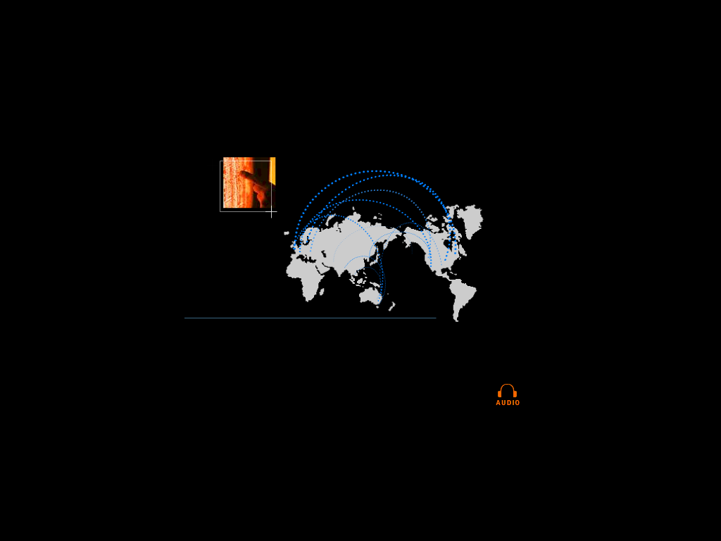

eCommerce is Becoming Core to the Global Energy Business
01010
91919
01382
83710
91817
01010
91919
01382
83710
91817
01010
91919
01382
83710
91817
01010
91919
01382
83710
91817
91919
010102374621985712398571928509129759812659821598601010237462198571239857192850912975981265982159860101023746216
010102374621985712398571928509129759812659821598601010237462198571239857192850912975981265982159860101023746298
global networks

Slide 17
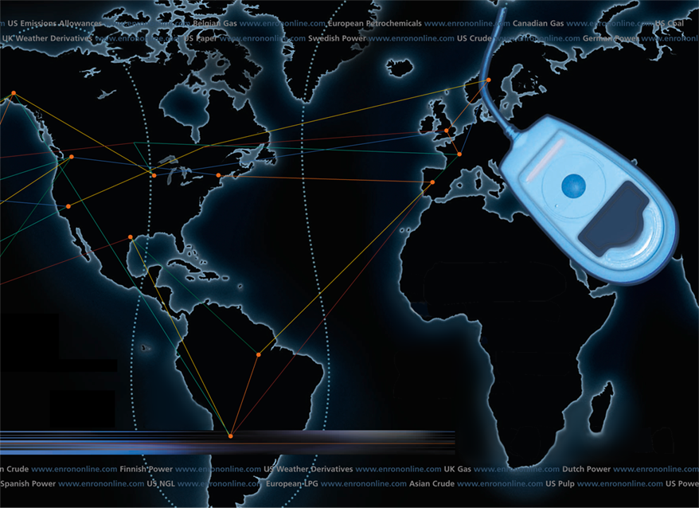
Putting the Energy into e-commerce
EnronOnline
TM
TM

Slide 18
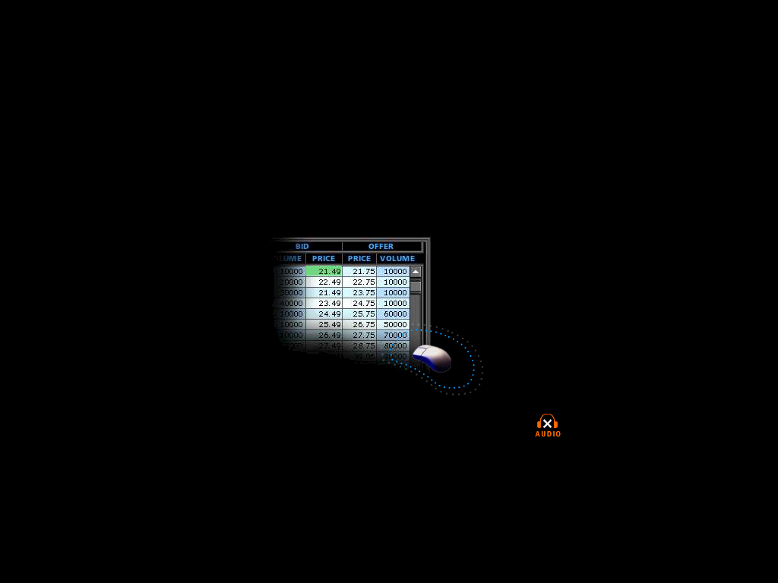

What is EnronOnline?
A Free, Internet-based, Global Transaction System Which Allows Counterparties to View Real Time Prices From Enron’s Traders and Transact Instantly Online
click & transact
Putting the Energy into e-commerceTM

Slide 19
How does EnronOnline differ from current way our customers currently conduct business?
Currently With EnronOnline
Internet
Enron
Enron
Putting the Energy into e-commerceTM

Slide 20
Benefits of EnronOnline
Free of charge
Real-Time Pricing Information
Access to complementary markets and product information
Simple access via the Internet
Easy to use
Fast and Secure Execution
Enron’s Best Prices
Putting the Energy into e-commerceTM

Slide 21
EnronOnline Launch Schedule
November 1999 US & Canadian Natural Gas
December 1999 US Power
Nordic Power
Plastics
Pulp & Paper
Coal
January 2000 Belgian Natural Gas
Emissions
German Power
LPG
Oil & Refined Products
Petrochemicals
Spanish Power
Swiss Power
UK Natural Gas
UK Power
US Weather
Putting the Energy into e-commerceTM

Slide 22
Enron’s global wholesale transaction business …………..moves online
February 2000 EnBank Virtual Storage Auction (UK)
European Weather
March 2000 Australian Power
Credit Derivatives
Dutch Power
Emissions Auctions (US)
April 2000 Austrian Power
May 2000 Bandwidth
European Coal
Asian Crude & Products
June 2000 Pipeline Capacity Auction
Putting the Energy into e-commerceTM

Slide 23
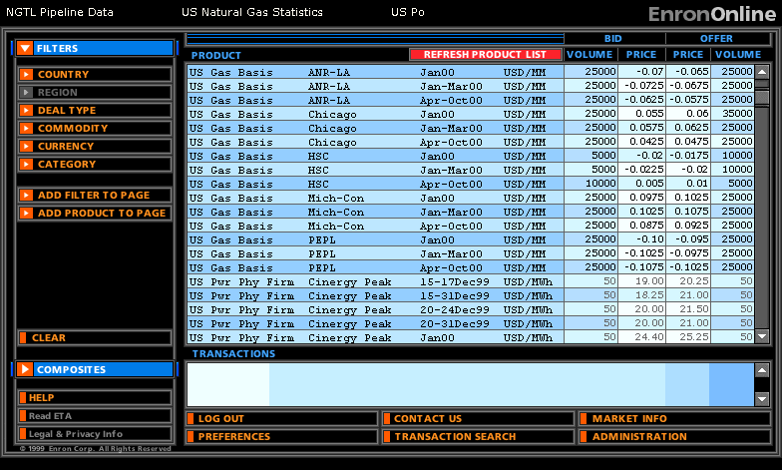
Quotes Page
Putting the Energy into e-commerceTM

Slide 24
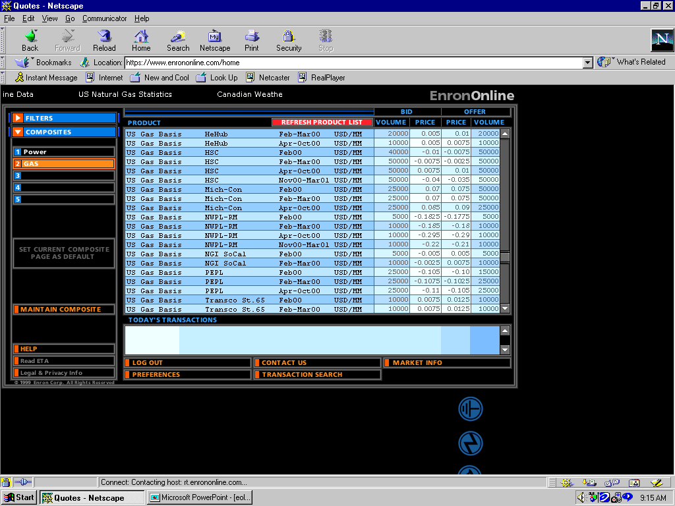
Click on Bid or Offer Price
Putting the Energy into e-commerceTM

Slide 25
Submission Screen
Putting the Energy into e-commerceTM

Slide 26
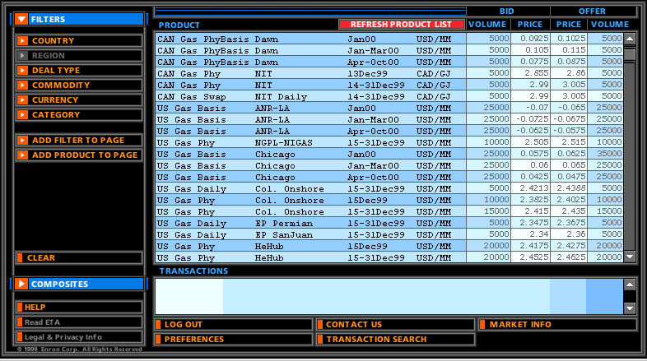
Successful Transaction
Putting the Energy into e-commerceTM

Slide 27
EnronOnline Statistics
Total Life to Date Transactions > 169,000
Currently > 52 % of Enron’s Transactions
Average Daily Transactions > 2,000
Life to Date Notional Value of Transactions > $78 billion
Daily Notional Value Approximately $1 Billion
Currently > 45% of Enron’s Notional Volume
Number of Products Offered - Approximately 820
Number of Currencies Traded in = 13
Development Time Approximately 7 Months
Announcement Date October 26, 1999
Launch Date November 29, 1999
As of 6/26/00

Slide 28
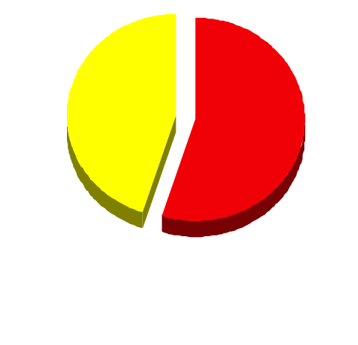
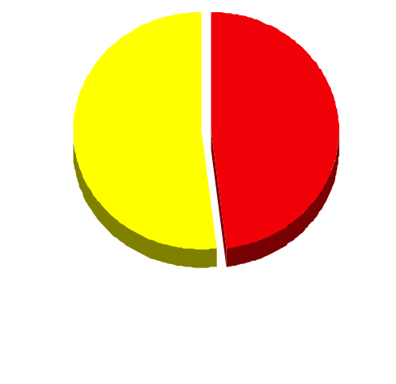
EnronOnline Versus Traditional Channels (Currently)
Volume
Transactions
45%
52%
48%
55%
EnronOnline
Traditional Channels
Putting the Energy into e-commerceTM

Slide 29
eCommerce Business Comparison
Value of Goods
(Millions)
Business To Consumer (B2C)
eBay
Amazon.com
Dell.com
$ 2,650
1,600
10,190
1999 Data*
Business To Business (B2B)
FreeMarkets
Cisco
Intel
Altrade
$ 1,400
9,480
10,500
12,000
2000 Est.**
EnronOnline
> $ 65,000
* Est. 1999 Annual Results
** Annualized Based on Results to Date
Putting the Energy into e-commerceTM

Slide 30
"EnronOnline was having problems this morning, so we were flying blind,"
Gas Daily April 11th, 2000
Putting the Energy into e-commerceTM

Slide 31
Putting the Energy into e-commerceTM

