Slide 1

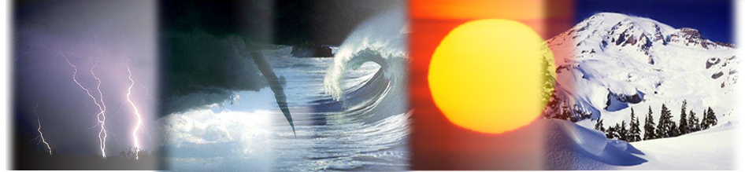
Vincent Kaminski
Enron Corp.
Analyzing Approaches to Weather Derivatives Valuation
NEW YORK, SEPTEMBER 11, 2000
© 1999 BJ-9010292-<number>

Slide 2
Outline
Definition of weather derivatives
Examples of transactions
Valuation paradigms

Slide 3
Everybody talks about the weather, but nobody does anything about it.
Charles D. Warner
Hartford Courant, 1890

Slide 4
Definition of weather derivatives

Slide 5
WHY IS ENRON IN
THE WEATHER BUSINESS?
Manage internal exposures
  Wholesale gas and power trading
  Residential gas and power trading (EES & Portland General)
  Transportation and Storage
  In-house meteorologists provide consolidated forecasts to support gas & power trading activity
Develop external customer base
  Both energy and non-energy businesses
Complete risk management portfolio
  Volume vs. Price

Slide 6
THE EVOLUTION OF THE WEATHER MARKET
Aug 1997
First weather-indexed commodity transaction (Utility and Enron)
Sep 1997
First financial transaction (Enron and Koch)
Sep 1998
First international transaction (Scottish Hydro and Enron)
Estimated 1,700 deals completed with a notional value of over $3.8 Billion
- 700+ deals completed by Enron with 43 counterparties
Aug 1999
Longer-term deals become standard
Weather futures trade
Weather-linked securities appear
FUTURE

Slide 7
Weather Derivatives
Financial instruments designed to transfer weather risk to a third party
Hybrid instruments combining features of a derivative contract and an insurance contract
In the energy industry, the weather risk is often associated with volume risk
  electricity or power sales to the end-users
  natural gas pipeline throughput
  volume and price risk often interact

Slide 8

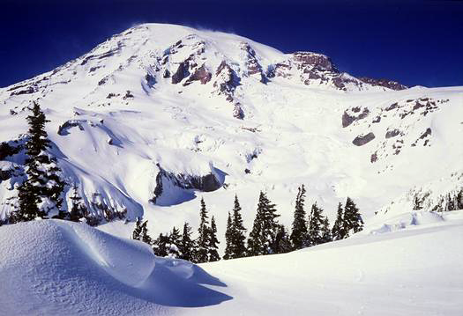
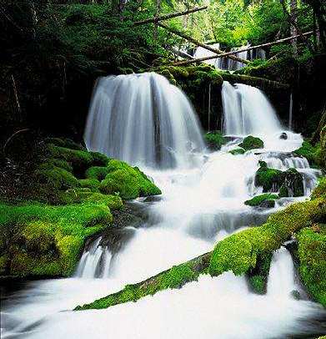
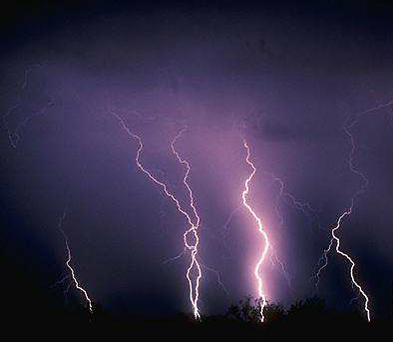

Weather Derivatives
Weather derivatives can be defined with respect to any environmental variable
  temperature (or its transformation - degree days)
  precipitation (inches, events)
  storm activity (intensity, frequency)
  snowfall (inches, events)
  perceived temperature (wind chill, heat index)
  weather event
  stream flow
  combinations (custom index, multiple trigger)

Slide 9
DEGREE DAYS
Cooling Degree Days (CDDs)
  Summer measure of average daily temperature above 65ºF (18ºC)
Heating Degree Days (HDDs)
  Winter measure of average daily temperature below 65ºF (18ºC)
CDD Example:
  If the average of the daily high and the daily low temperatures is 25ºC, then there are 7 CDDs for that day
  To determine # of CDDs for a summer season, add CDDs for each day of the period

Slide 10
WEATHER DERIVATIVES: TRANSACTION TYPES
Types of Contracts
  Swaps, Caps, Floors, Collars
Term
  Mainly seasonal
  Multi-year transactions
Size
  Up to $500,000/DD
Limits
  Transactions capped to reduce aggregate exposure
Locations
  Hundreds of weather stations
  Baskets (Multiple cities)
Hybrids
  Weather-linked financing transactions
  Securitizations

Slide 11
Examples of Transactions

Slide 12
PRICING EXAMPLE
Warm Weather Protection for HO Provider
Heating Degree Day Floor
(1999 Heating Season)
JFK Airport (WBAN#94789)
Notional = $5,000/HDD
Limit = $2,000,000
Strikes set 5% below 30-year average
TIME PERIOD AVG STRIKE PREMIUM
Jan 99 - Feb 99 1882 1788 $400,000
Jan 99 - Mar 99 2613 2482 $340,000

Slide 13
PRICING ILLUSTRATION
For an Jan-Mar floor, as HDDs drop below the strike, purchaser is compensated $5,000 per HDD by the floor up to a limit of $2,000,000. If temperatures are low, purchaser will retain the financial benefits of cold weather, paying only the floor premium of $340,000.
The floor is “active” where the line
is sloped and “inactive” where it is flat.

Slide 14
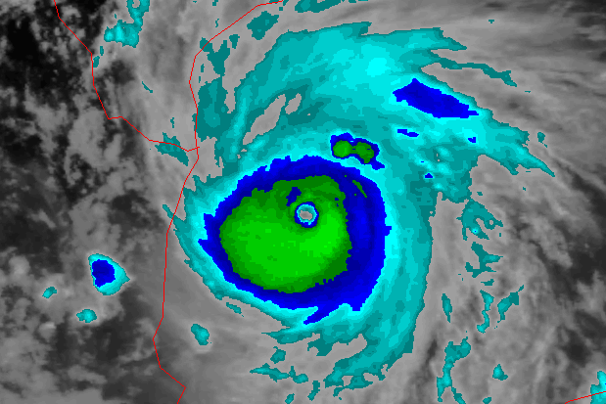
Horizon Offshore Contractors, Inc.
TROPICAL STORM PROTECTION

Slide 15
ENRON STORMBOARD
Unlike tropical storm insurance which requires proof of loss, ENRON STORMBOARD allows companies to cover costs and recapture lost income based solely on what the weather does
ENRON STORMBOARD is a financial product with concentric rings around a project’s worksite
  Storms are monitored by the National Hurricane Center and tracked every six hours
  Payouts increase as a storm moves closer to the project
N
Typical Structure
Term: Sep 99 - Nov 99
Location: 95.70 Longitude 26.00 Latitude
Notional: $250,000
Limit: $1,000,000
95.70 Lon 26.00 Lat.
500km
750km
1000km
100%
75%
50%

Slide 16
STRUCTURES
ENRON STORMBOARD can be customized to meet the unique dynamics of each project and its risk tolerances
Protection levels can be based on your project’s sensitivity to storm path
Variables
  Time period
  Number of risk areas
  Size of risk areas
  Risk factors
  Deductibles

Slide 17
Valuation Paradigms

Slide 18
VALUATION of WEATHER DERIVATIVES
Weather derivatives can be structured as any standard derivative (swap, call option, put option, a collar)
Does it mean that the pricing of weather derivatives should be based on the same principles as option pricing?
The prices of weather derivatives quoted by different market makers tend to vary significantly
The industry is slowly converging to the common valuation standards

Slide 19
Option Pricing Approach
Option pricing is based on a watertight theoretical argument: creation of a replicating portfolio
The replicating portfolio removes the market risk for a short instant of time
When the market conditions change, the replicating portfolio has to be rebalanced
The cost of creating and rebalancing the portfolio over time, when market conditions change, is the theoretical price of the option
In principle, a market maker can write a single option contract, as long as there is a liquid market in the underlying instrument

Slide 20
Insurance Approach
An insurance company provides protection for a large portfolio of similar risks
Premiums charged are based on actuarial principles: assessment of probabilities of occurrence of certain events over time
The required premiums are based on expected loss
An insurance company exploits the law of large numbers
The insurance premiums are invested and produce a profit resulting from the time difference between receipt of cash and settlement of losses
This approach requires a large portfolio of insured risks

Slide 21
The Law of Large Numbers
X₁, X₂, …, X_{n} - identically distributed random variables
S_{n} = X₁ + X₂ + … + X_{n}
If X₁, X₂, …, X_{n} are identically distributed random variables with mean EX_{i} = μ, then with probability 1, S_{n}/n converges to μ
The laws of large numbers tell us what happens in the long run, for sufficiently large samples

Slide 22
Black-Scholes Approach
Geometric Brownian Motion
dV = αVdt + σVdz
  V - value
  dt - infinitesimal time period
  α − drift
  σ − volatility
  dz - Wiener’s variable
    dz = ε(dt)^{1/2} , ε∼ N(0,1)
Replicating portfolio assumption

Slide 23
Pricing Contingent Claims
The value of an contingent claim F, F(V,t) is given by
  0.5σ²V²F_{VV} + (α-λσ)VF_{V} - F_{t} - rF + d = 0
    r - risk-free interest rate
    d - dividend rate
    λ - market price of risk
In case V is the price of a traded instrument, we have α + d - r = λσ, and the equation simplifies to
  0.5σ²V²F_{VV} + (r-d)VF_{V} - F_{t} - rF + d = 0
If we assume further, d = 0, the equation simplifies to the Black - Scholes equation
The expression α + d - r = λσ is the risk premium (an excess of total return over the risk-free rate) that investors require to hold a given asset

Slide 24
Pricing Contingent Claims
If the instrument underlying an option contract is not traded, its market price of risk equals the market price of risk of an equivalent market asset
  with price dependent on that variable and
  time
The implementation of the Black-Scholes approach depends on the ability to estimate the market price of risk

Slide 25
INDUSTRY CONVENTIONS
The industry has embraced actuarial approach to pricing weather derivatives
Relatively large differences in prices quoted by different market makers
Differences result from divergence of views regarding the empirical probability distributions of the weather variables
The reasons
  perceived weather trends
  human island phenomenon
  changes in measurement techniques used by the weather services
  portfolio effects and natural hedges

Slide 26
Debated Issues
Empirical Vs. Fitted distributions
  Pros: ability to price the option structures with strike prices outside the range of empirical data
  Cons: the distributions of certain variables may be difficult to fit
The use of forecasts and additional conditioning information in valuation of weather derivatives
  El Nino Vs. La Nina
  Long-term forecasts

