Slide 1

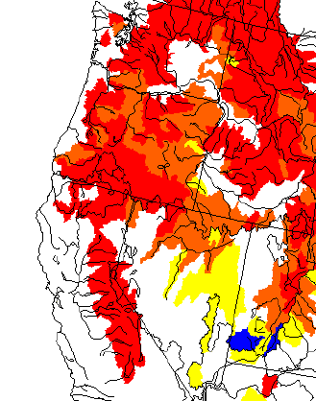
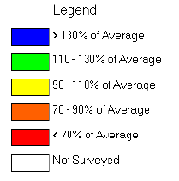


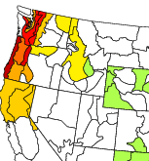

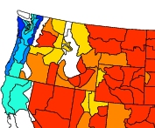


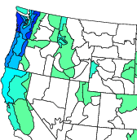

Northwest Hydrological Outlook
March 6, 2001
Stephen Bennett
Senior Meteorologist
Enron Research
2001 Bottom Line:
Current Conditions: The wet season of 2000/2001 has been abnormally dry from Northern California to the Pacific Northwest. Snowpack (Figure 1) from the Cascades of Oregon and Washington to the northern Sierra Nevada Mountains of California is currently between 50% and 70% of normal. Snowpack represents the “stored” liquid for hydrological runoff in the warm season. Accumulated liquid precipitation (Figure 2) during the 2000/2001 wet season reflects deficits between 10 and 30 inches from Northern California to the Northwest. Normal wet season precipitation (Figure 3) is between 40 and 80 inches.
Predicted Streamflows: The Northwest River Forecast Center is predicting that streamflows this summer will primarily be between 60% and 70% of normal. Statistically, April ends the wet season and forecasts for March continue to highlight below to much below normal precipitation. It seems clear that streamflows will be significantly below normal from June through October of 2001 (as little as 40% in some Northwest basins with only few basins reaching the 70% level).
Preliminary* Summer Power Generation Forecast: A preliminary look at the summer of 2001 presents a forecast of slightly warmer than normal temperatures in the Northwest with below normal rainfall. The summer will likely start off warmer than normal in the Southwest. There is a chance, however, that developing El Nino conditions late in the summer (August - October) may tend to bring temperatures back toward normal or below normal in the Southwest.
*This is primarily based on the National Climate Data Center’s summer outlook. A proprietal summer forecast will be issued by the Enron Research Weather Group late this week.
Historical Perspective:
The Past 5 Years: The period between January of 1995 and December of 1998 (Figure 4) showed a period of above normal precipitation. Each year featured precipitation between 10% and 50% above normal with 1996 being the wettest year. Drier than normal weather began in the wet season of 1999/2000 and has continued through the 2000/2001 season.
Columbia River - 1977: Focusing specifically on the Columbia River inflow at The Dalles - the only year that observed a volume lower than the volume forecast for January through July of 2001 was 1977. The National Weather Service in Portland is already warning that streamflow on the Columbia River will be historically low this summer.
Figure 1
Figure 2
Figure 3
Figure 4

