Slide 1

Assessing the Internal
Control Environment
The 2000-2001 Doorstep self-assessment

Slide 2
Index
Topic Page Number
Our corporate goal 3
How we meet our corporate goal 4
Guidelines of the assessment process 5
Current status 6-8
Going forward/time tables 9-15

Slide 3
Our Corporate Goal
To develop and maintain a world class internal control environment consistent with our business aspirations
It is necessary to have a self assessment process in place to develop & monitor a world class internal control environment
Definition of a world class internal control environment
1) Leader in the field - acknowledged in market place
2) Leveragable in commercial negotiations (asset, not liability)
3) Up to date with business developments
4) Regularly and independently monitored and assessed
5) Highly automated
6) Transparent at all levels within the organization

Slide 4
How we meet corporate goals
Goals of Project Doorstep:
Assess the operational risk of each location
Communicate key issues to upper management (quarterly)
Assess risks of commodities and trade types
Ensure that implementation of findings is performed
Assess all risks of Enron
Have Enron lead the process, direct planning, execution, and follow up

Slide 5
Guidelines of Assessment Process
The assessment process must be driven by Enron
Deliverables and goals need to be transparent
Processes must be ongoing and continually improved
Processes cannot be done in a vacuum - all assessments should work together
Design minimum standards
Implement minimum standards at all Enron companies
Establish a plan to test that minimum standards are met
Continuous improvement
Design
Implement
Test/Review
Reengineer/process improvement

Slide 6
Current status

Slide 7
Summary of observations
Additionally non-wholly owned subsidiaries are included in the doorstep reviews: including EOTT (in process) & Mariner (complete).

Slide 8
Key themes
Key findings (same findings reflected in review of MG)
Trading office vs origination offices
Segregation of duties
Capture of positions
What are we doing about it?
Ranking findings in accordance with immediacy of correction (red, yellow) - all findings still open are yellow
Global standards
daily, monthly reporting
Global office update letter (highlights new offices, new products)
monthly

Slide 9
Going forward

Slide 10
2000-2001 Project management team/Resources building block for Doorstep
Project Sponsors
Rick Causey, Rick Buy
Sally Beck, Ted Murphy, Fernley Dyson
Shona Wilson, Mike Jordan, regional controllers
Internal audit / BRM - Shawn Kilchrest
Oversite committee
(vision, direction)
Shona Wilson, Mike Jordan
Regional controllers, control senior managers
Implementation,
review, monitor
Note : This structure is considered “independent monitoring” because people independent of the day to day operations perform the reviews.
Execution team:
Leader: (manager/director) Risk Ops/RAC
Staff: Risk Ops/Rac or AA
Execution and local coordination
Business controllers

Slide 11
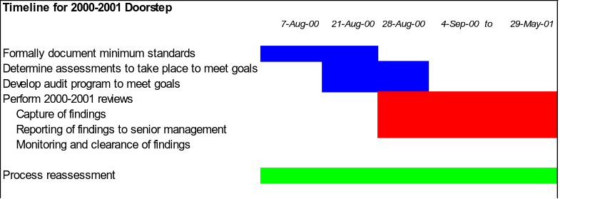
Timeline Overview

Slide 12
Visits by Date

Slide 13
Visits by Date

Slide 14
Visits by Date

Slide 15
Visits by Date

