Slide 1
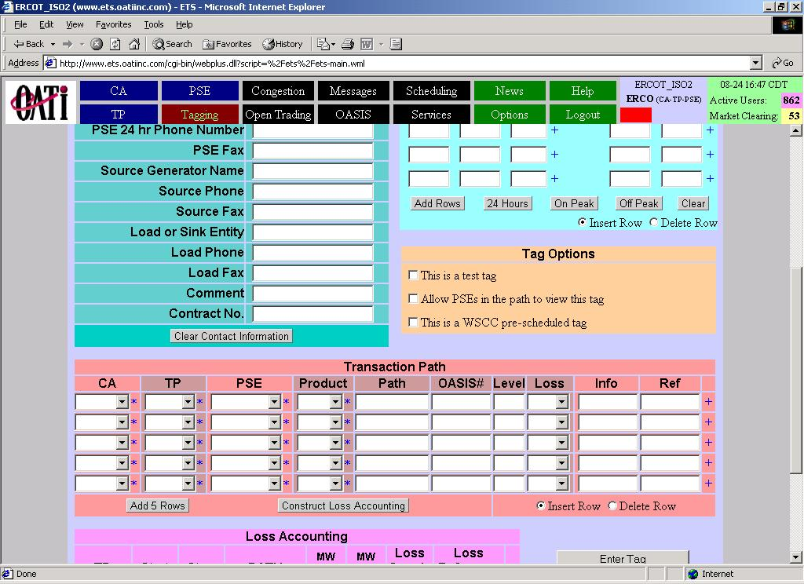
ERCOT DOES NOT GO HERE,
ERCOT DOES NOT OWN GENERATION
PUT THE QSE RESONSIBLE FOR THE
SPECIFIC RESOURCE IN THIS SPACE.
PLACE RESPOSIBLE QSE’S CONTACT
NUMBER IN THE SOURCE PHONE AND
FAX SPACES.
READ PROTOCOL 4.4.18.2
READ PROTOCOL 4.4.18.3
GENERATOR ALPHA
ABC POW. COMPANY
ERCOT DOES NOT GO HERE,
ERCOT IS A CONTROL AREA BUT
DOES NOT CONSUME ENERGY
AS DEFINED BY NERC. PUT THE
RESPOSIBLE QSE REPRESENTING
THE LOAD OR SINK IN HERE. PLACE
THE RESPONSIBLE QSE’S CONTACT
NUMBER IN THE LOAD PHONE AND FAX
SPACES.
ERCO
ERCOT AS A CONTROL AREA GOES AS
EITHER THE SENDING CONTROL AREA
OR THE RECEIVING CONTROL AREA
WHICHEVER IS APPROPRIATE, IN EITHER
OF THESE TWO SPOTS
ERCO

