Slide 1

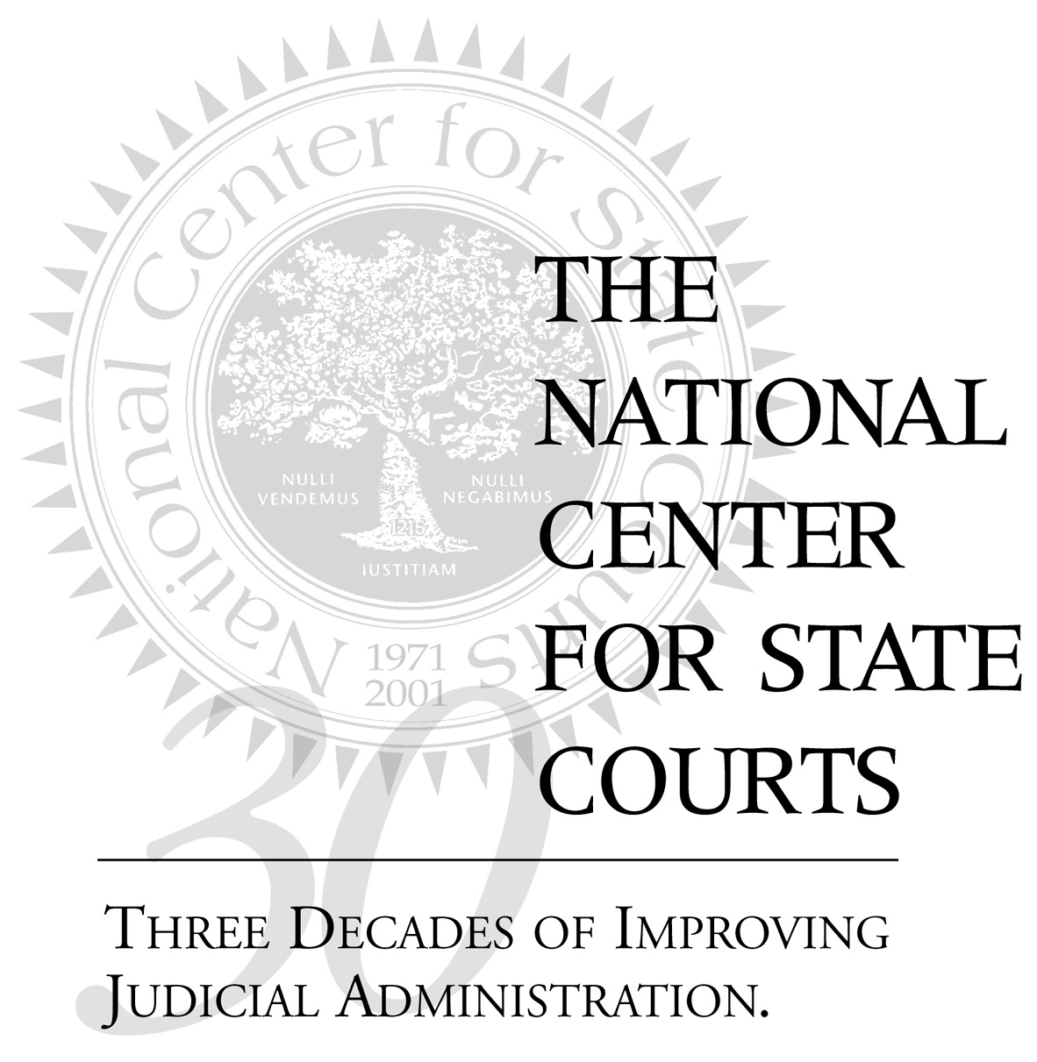
The National Center for State Courts General Counsel Committee Meeting November 15, 2001 3:00-4:30 pm Willard Intercontinental Washington

Slide 2
Introduction
98% of all litigation is in state courts
Focus of civil justice reform should be on state courts
The problem: Diversity of state court systems The solution: The National Center for State Courts (NCSC)

Slide 3
NCSC MISSION
“TO HELP THE STATE COURTS BETTER SERVE LITIGANTS”
ARTICLES OF INCORPORATION
“TO IMPROVE THE ADMINISTRATION OF JUSTICE THROUGH LEADERSHIP AND SERVICE TO STATE COURTS”
MISSION STATEMENT

Slide 4
NCSC Leadership Objectives
Serves as a NATIONAL THINK TANK to anticipate new developments, identify best practices, promote experimentation, establish performance standards, evaluate program performance, and foster adaptation to change
Provides a NATIONAL FORUM for discussion of issues affecting the administration of justice
Helps create a NATIONAL LEADERSHIP AGENDA for improving the administration of justice

Slide 5
NCSC Leadership Objectives (continued)
Serves as a NATIONAL VOICE for the needs and interests of the state courts
Promotes COLLABORATION AMONG NATIONAL COURT ASSOCIATIONS and related national organizations
Serves as a MODEL ORGANIZATION for the state courts

Slide 6
NCSC Core Competencies
Research
Education
Consulting
Information Clearinghouse
Association Services

Slide 7
Why the NCSC?
Historic contributions to civil justice reform
Independent, but connected
- Governed by state court leadership
- Supports 11 national judicial associations
Innovative

Slide 8
Why the NCSC? (continued)
Research-based, but practical
Collaborative approach
- Conference of Chief Justices
- Conference of State Court Administrators
- Partnerships and alliances with national organizations (e.g., ABA, FJC, NJC, AJS)
- Dialogue with general counsel, practicing attorneys, and other stakeholders

Slide 9
Dialogue and NCSC survey of general counsel revealed top civil justice problems
Cost, delay, and complexity
Lack of predictability in process and outcome
Politicization of judicial elections

Slide 10
Launch of NCSC’s Civil Justice Reform Initiative in 2000
A major reform initiative to improve America’s civil justice system
Administration of justice and court reform issues
vs.
substantive law or legislative reforms

Slide 11
Civil Justice Reform Initiative (CJRI)
Problem: Cost, delay, complexity
CJRI response: Promote the use of best practices
Problem: Lack of predictability in process and outcome
CJRI response: Promote more uniform procedures
Problem: Politicization of judicial elections
CJRI response: Promote merit-based judicial selection, retention,
and performance evaluation processes

Slide 12
CJRI Focus Areas in priority order (with projects proposed)
I. Discovery
A. Identify and disseminate best practices in judicial management of discovery
(include inventory of discovery problems; review use of quasi-judicial officers)
B. Develop model rules for electronic discovery
C. Reduce costs of discovery
What difference will it make?
Build foundation of practice and culture for more judicial control in discovery
Credible rules are considered by state judiciaries, setting “reasonableness” standard
Build common ground of understanding to combat costs

Slide 13
CJRI Focus Areas in priority order (with projects proposed)
II. Judicial selection
A. National program to advance reforms recommended by “Call to Action,” Summit on Improving Judicial Selection
(www.ncsc.dni.us/SummitCalltoAction.htm)
Reform areas: election structure, campaign conduct, voter awareness, campaign finance
B. Study the impact of judicial evaluation programs on voter choices and the quality of the judiciary
C. Symposium on Judicial Campaign Conduct and the First Amendment
D. Justice Roundtable 2001
What difference will it make?
Remedy abuses in judicial elections and promote a well qualified judiciary that enjoys the public’s trust

Slide 14
CJRI Focus Areas in priority order (with projects proposed)
III. Complex litigation
A. Develop an educational curriculum with FJC
supporting federal/state strategies in mass
torts*
B. Evaluation of the California Centers for Complex Litigation
What difference will it make?
Improved management, more uniformity in mass
tort litigation
*Conference of Chief Justices project underway
Notes:
What about class actions? Need to expand this area to include class action focus.

Slide 15
CJRI Focus Areas in priority order (with projects proposed)
IV. Science and the law
A. Study juror understanding of complex evidence and the
impact of new trial innovations
B. Study use of special masters
C. Assessment of how judges and trial courts are
responding to science and law cases
D. Study feasibility of applying federal work to state
What difference will it make?
More understanding of juror comprehension
Improved handling of science and law cases

Slide 16
CJRI Focus Areas in priority order (with projects proposed)
V. Juries
A. Jury Summit 2001
B. National program (with AJS) to expand public
understanding of jury service
C. National technical assistance program to apply
reforms and innovations
(follow-on to Jury Summit 2001)
What difference will it make?
Expanded juror participation and service
Improved jury management operations
Improved juror comprehension

Slide 17
CJRI Focus Areas in priority order (with projects proposed)
VI. Civil trial court network (data collection from 45 of the nation’s largest counties)
A. Use case data to study costs of litigation
B. Use case data to guide refinement of differentiated case management systems
What difference will it make?
Understanding and combating the real costs of litigation
Improved case management (matching appropriate process to case)

Slide 18
Expected CJRI outcomes
More efficient courts
Lower litigant costs
Less delay
Greater predictability and uniformity of procedure

Slide 19
Expected CJRI outcomes (continued)
Better prepared judges
More competent jurors
Greater litigant satisfaction
Greater public confidence (fairness & quality)

Slide 20
How can general counsel be involved?
NCSC General Counsel Committee
Statement of Purpose
The General Counsel Committee was formed by the National Center for State Courts to involve the general counsel of America’s leading corporations in the work and programs of the National Center for State Courts. Committee members serve in a leadership role on behalf of corporate America with a commitment to—

Slide 21
NCSC General Counsel Committee Statement of Purpose (continued)
build public understanding of the need for a strong and independent judiciary
support the mission of the National Center for State Courts to improve the administration of justice through leadership and service to state courts
participate actively in the development and implementation of The National Center’s programs and initiatives, including its Civil Justice Reform Initiative (CJRI)

Slide 22
NCSC General Counsel Committee Statement of Purpose (continued)
create and participate in opportunities for dialogue with state court leaders on judicial reform issues
encourage corporate financial support for The National Center’s programs and initiatives

Slide 23
What difference will your involvement make?
State court leaders will be more informed and more responsive
Reform work will be focused through the NCSC to produce real results in state courts

Slide 24
The National Center for State Courts General Counsel Committee Meeting November 15, 2001 3:00-4:30 pm Willard Intercontinental Washington www.ncsconline.org

