Slide 1

Hub Establishment
North American and International Hubs:
Vancouver
Antwerp
Terneuzen
Hong Kong
Montreal
Green Bay
LaRochelle
Seattle
Monfalconi
New Orleans
Sao Paolo
Mobile
Rio de Janeiro
Santiago
Confidential

Slide 2
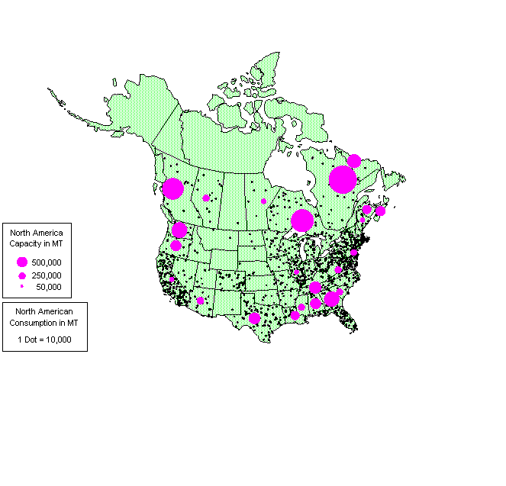
North American Newsprint Capacity,
Consumption & EIM Hubs
EIM Hubs
New England/Northeast
San Francisco
Mid-Atlantic
Los Angeles
Denver
Chicago

