Slide 1

Market Participant Readiness Tracking
Ted Hailu
ERCOT Client Relations Manager
November 15, 2000

Slide 2

What is Readiness Tracking?
Realization of the ERCOT Market Implementation Plan as approved by TAC
Comprehensive inventory of readiness activities and tests
Process that tracks Market Participant readiness to complete operational and market transactions with ERCOT on June 1, 2001

Slide 3
What is Readiness Tracking?
Facilitates QSE qualification process by
  Providing a common point of reference for readiness activities of all Market Participants
  Producing easy-to-use reports and scorecards for key readiness requirements (Green, Yellow, Red)

Slide 4
Process
For each readiness requirement, the respective area Lead supports and tracks Market Participant readiness
ERCOT Client Relations Team consolidates readiness data, produces reports, and follows-up with Market Participant for any requested assistance
Program Management reviews readiness report, takes action and makes recommendations as applicable
The Client Relations Team is responsible for the Readiness Tracking Process

Slide 5
Example: EDI Technical Connectivity
EDI Technical Connectivity is listed on the ERCOT Market Implementation Plan as a requirement for some Participants; for instance for QSEs during the month of February, 2001
The following example shows how readiness can be tracked and reported for this requirement for a given Participant that is scheduled to complete it in October-November, 2000

Slide 6
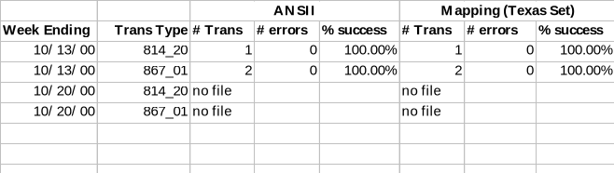
Example: Lead Tracks and Supports
EDI Technical Connectivity tracking by EDI Lead for Market Participant “MP-1” is recorded as follows
Data indicates that although testing was successful on the week of 10/13, “MP-1” did not continue testing during the following week

Slide 7
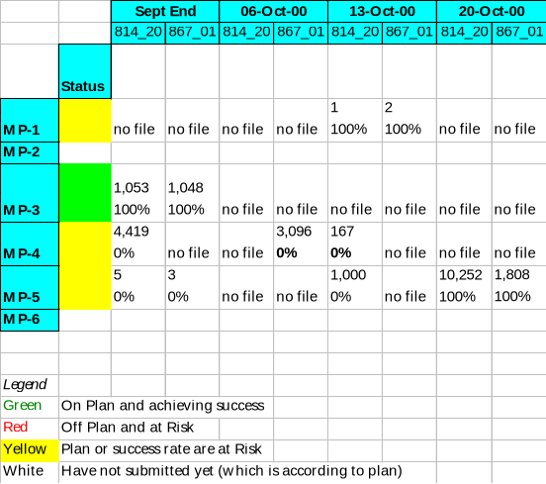
Example: Lead Reports
“MP-1” EDI Technical Connectivity readiness status is thus reported as Yellow by the EDI Lead
“MP-1” readiness status is Yellow for EDI Technical Connectivity

Slide 8
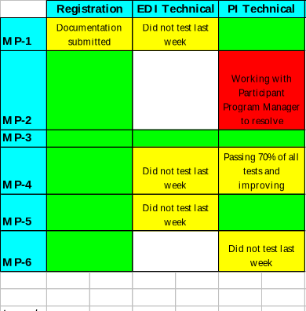
Example: Readiness Scorecard
(Partial) Scorecard for the week ending 10/20 as submitted by Client Relations Team to Program Management
Reports EDI Technical Connectivity status along with all other readiness criteria in a comprehensive scorecard

Slide 9
What’s Next?
Complete Readiness Tracking items testing criteria
Secure input from Market Participants
Present to TAC and at MRS
Begin Readiness Tracking

Slide 10
Your Client Relations Representatives
Client Relations Representatives are available to support you throughout this process
  Patrick Cook
  Mark Patterson
  Pat Moast
Reminders of upcoming key dates

