Slide 1
Project Rock

Slide 2
The Rationale
Measurement assets/operations are critical, but not core, to ECT activities ( i.e. provides no competitive advantage in a low cost, highly competitive environment)
Outsourcing of measurement and related functions will lead to efficiency gains and reduced costs over the long run
By selling our meters, separators, dehydrators and other above ground equipment located at the meter sites, HPL will be able to free-up approximately $40-50 MM in cash and recognize a one-time gain of $15-20 MM
Development of a new business entity to provide measurement equipment and services to others in the natural gas production and pipeline industries will further enhance cost effectiveness and service levels. The new company will lever off the expertise and customer/industry contacts of HPL and Hanover

Slide 3
Measurement Services Agreement Status
OBJECTIVE: Maintain/enhance existing level of measurement service to HPL
Personnel - Approximately 60 measurement and communications specialists - Preliminary organization and incentive/severance/benefit plans being developed
Assets - Asset records clean-up for 70% (by value) of location - ROW clean-up and meter ownership clarification limited with HPL retaining responsibility
Control Issues - Facility additions/deletions and communication issues resolution pending upon final structure approval - Facilitation of asset split, security of data, integrity of existing communication channels, and cost effective replacement critical
LAUF and Fee Structure - Considering alternate LUAF incentive using 0.30% loss as a base (no range) - Fee structure for MSA to be established upon final cost determination - Will include third party facility responsibility
General Pipeline Operation - Maintain cost effective transparent, safe, and reliable operations - Standards and protocols being established - Customer service orientation to be maintained - HPL liaison function for issue resolution - HPL retains environmental, ROW, liquids handling, product specification, etc. liabilities

Slide 4
Project Rock - Proposed Structure
Debt
Equity
97%
3%
Boulder Trust
HPL
SPE
Sale of
99.999%
Middle Rock
Interest
[$X million]
[$X million]
Middle Rock LLC
Issuance of 99.999% LLC Membership Interests
Little Rock LLC
SPE
SPE
[$X million]
100%
20% LP Interest
.001% Membership Int
HPL
[$X million]
79.998% LP Interest
.001% GP
HPL
79.998% LP Interest
Meter Acquisition LP
20% LP Interest
Hanover SPE
.001% GP
Assets
[$X mil note]
Fee
Service (exec contract)
Enron
HPL
O&M Service Contract (Exec)
Performance Guaranty
Fee
X% LP; X% GP
Hanover
X% LP
Stone Measurement LP
$X million
HPL
Personnel, Service Equipment
X% LP; X% GP
1) HPL contributes assets worth $X MM into Meter Acquisition in exchange for 80%LP Interest and a Note Receivable of $X MM
2) Hanover assumes Meter Acquisition Note Payable (to HPL) in exchange for 20% LP
3) HPL and Hanover monetize interest
4) HPL contributes personnel and expertise to Stone in exchange for non-controlling LP interest
5) Hanover makes capital contribution to Stone Measurement
$X million
MeterCo

Slide 5
Project Rock - Alternative Structure
($X million investment)
Hanover
HPL
Certain LP rights
No capital outlay
X% GP
Y% LP Interest
Investment ($X MM)
People, Expertise, etc.
$X million
Stone Measurement LP
$X million
HPL
Bank
Sale of Equipment and operations personnel
P & I
Service Fee
Measurement
Service
Monthly
Fee $
Services
A Co
HPL
B Co
10 - 15 year agreement
Parent guaranty (?)
Executory contract
C Co

Slide 6
The Structure
Benefits of FAS125 structure:
Through its .001% GP interest, HPL maintains a voting interest in Meter Acquisition Co, the owner of the transferred HPL equipment
May reduce the need to have all the property records cleaned up prior to the transaction and provide some flexibility in moving equipment in and out of the partnership (avoids security interest issues)
Institutional investors are passive investors
Separates the financing component of the transaction from the operating/new business opportunity
Transaction is tax efficient compared to the outright sale of equipment (tax benefits = $10-15 MM)
Potential ‘sales tool’ for other major pipelines

Slide 7

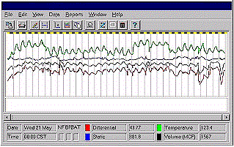
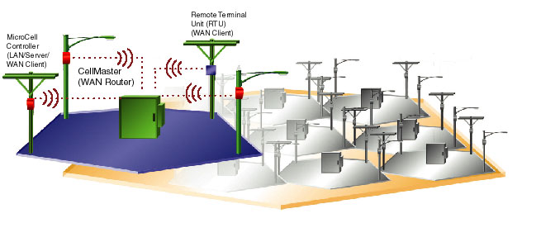
An Assessment of the Measurement Industry...

Slide 8
The Flow of Information
Real-time info Monthly info
Transmitter
Communication Network
Measurement Info/ Physical Conditions
Safety
Deliveries/Receipts
Operation/Balancing/Billing
Gas Control
Pipeline needs to retain for integrity/safety purposes
Risk Management/ Pricing
Data Source
Manual Transfer of Info
Back Room
MIPS
Monthly Reports
Unify
Satara
Billing/ Payments
Noms/ Scheduling

Slide 9
Existing Physical Flow of Measurement Information
Legal - Contracts
Commercial
Gas Control
Scheduling
Field Operations
Gas Accounting
Financial Accounting
Billing
EFM
Meters
Measurement Dept
Shipper Imbalances
Chart
The Concept
Producers
Network
System
(Internet based)
Marketers
Information
Meter
End-Users
Pipelines
Billing, Reporting, Accounting

Slide 10
Measurement Industry - The Segments
Tech/Info
Msrmnt Tech Innovation
Communication equip
Data transmission service
Data pooling/aggregation
Interface system development
Internet based
Access to info
Field Ops
Operate all msrmnt equip
Install msrmnt equip
Maintenance/Troubleshooting
Financial Services
Business Application software development
Backroom ops/data flow
Gas Accounting
Cash Management
Noms/Billing

Slide 11
Lower Growth Cost Efficiency/Operations
Higher Growth Tailored Solutions/Information/Sales
Operations based
Few barriers to entry
Regional mom and pop operations
Possibility of consolidation
Equipment manufacturers
Capital intensive
R&D
Long lead time
Barriers to entry
Few big players
SCADA/AMR systems
Web-based interactive interfaces
Scope driven - ‘turnkey’ solutions
Competitive
Highly sophisticated
Alliance w/ data transfer company
Long lead times
Capital intensive
Capital intensive
Barriers to entry
Large existing infrastructure in place
Scale driven
Few big players
Field Services
Msrmnt Tech
Data Transfer
Info Access
Back Room Systems
Alliance
Daniel
Equimeter
Bristol
CellNet
Skylemetry
AT&T
Energy.com
Utility.com
Energy Tracking Inc
Metretek
SEN*Net (Columbia)
Praxis
Coastal Flow
Southern Flow
EDS
Unify

Slide 12
Given the nature of the industry, current players and market structure, WHERE should Stone play and WHO should be its partners?
Stone
Hanover
HPL
Meter Co.
Successful outsourcing business
Recognized leaders in compression/production equipment industry (low rate of tech change)
Aggressive, talented management team
Strong relationship with producers, pipelines, and processors
Brand name recognition
Little experience in msrmnt/pipeline ops
High quality operations experience and personnel
Technical expertise in measurement
Relationships w/ tech and commercial vendors
Existing contracts for outsourcing (marquis contract for Stone)
Many strong relationships in industry
Depends on where:
Technology expertise
Sales force talent
Strong relationship with producers, pipelines, processors
Brand name recognition
Credibility
Trust

Slide 13
Why Hanover?
Hanover is the market leader in full-service natural gas compression and a leading provider of contract natural gas handling service, fabrication and equipment
Hanover’s philosophy is that outsourcing provides the customer greater financial and operating flexibility by minimizing the customer’s investment in equipment. Outsourcing typically provides the customer with more timely and technically proficient service and necessary maintenance which often reduces operating costs
Extensive field service network. Unique in its industry in that its sales and field service organizations enjoy managerial parity within the Company.
Through its subsidiary, Hanover Smith, Hanover designs, engineers, fabricates, and either sells or rents a broad range of oil and gas production equipment designed to treat, separate, dehydrate, and measure crude oil and natural gas.
Customer base consists of over 600 U.S. and international companies engaged in all aspects of the oil and gas industry
The production equipment business is a highly fragmented business with approximately eight substantial U.S. competitors. Hanover is among the top three oil and gas production equipment fabricators in the U.S.

