Slide 1
Texas Energy Market
September 27, 2001
Chairman Max Yzaguirre
Public Utility Commission of Texas

Slide 2
Texas - Doing it Right
Favorable electric supply and demand situation
Insignificant imports from other states
Solid legal framework
utilities not forced to sell all generation and buy spot market power
use of long-term wholesale contracts shields Texas customers from price volatility
Robust transmission grid that adequately bridges generation and consumption points
no constraints that have threatened reliability
Promotes investment and efficient siting of power plants
have added over 13,000 MW since 1995, with an additional 31,000 MW on the way
two to three years to build a power plant in Texas versus seven to eight years in California
Natural gas production basin and effective pipeline infrastructure to fuel power plants
power generation fuel costs have recently decreased

Slide 3
6
60
New Electric Generating
Plants in Texas
21
82
22
71
85
58
32
11
88
68
76
66
56
38
7
10
78
44
55
3
34
63
28
83
37
18
Ellis County
9
29
53
65
24
45
47
73
8
72
80
35
48
86
46
33
1
23
30
62
57
31
69
43
15
40
52
36
70
26
51
59
49
16
27
74
Harris County
4
12
5
20
39
77
81
42
50
61
25
64
67
75
39 Generation projects completed since 1995 totaling 13,141 MW
14
19
87
20 Generation projects under construction totaling 13,879 MW
79
54
29 Generation projects announced and in the planning stage
41
84
13
17
2
09-04-01

Slide 4
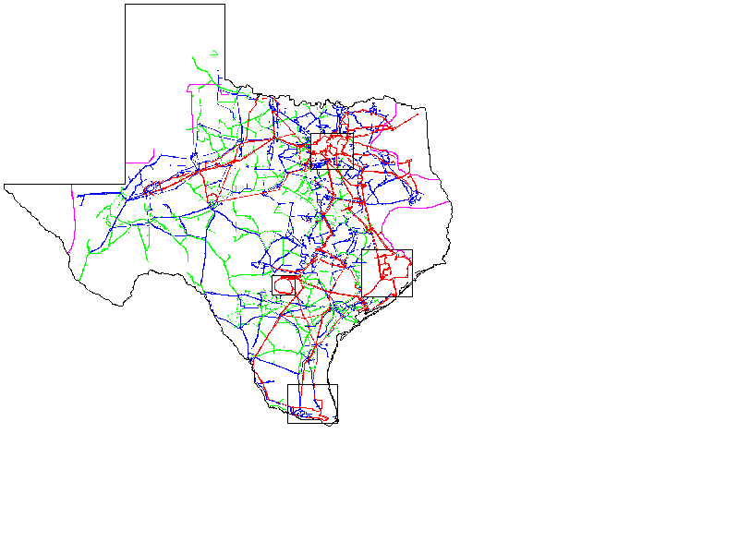
Major Transmission Projects
Completed Summer 2001
1. Monticello - Farmersville 345 kV
2. Limestone - Watermill 345 kV
4
1
3
Currently Under Construction
3. Graham - Jacksboro 345 kV CCN June 2001 In Service December 2002
4. Farmersville - Anna 345 kV CCN January 2001 In Service December 2002
5. Morgan Creek - Comanche Switch 345 kV CCN June 2001 In Service December 2002
6. San Miguel - Pawnee 345 kV CCN November 2000 In Service May 2002
7. Pawnee - Coleto Creek 345 kV CCN December 2000 In Service March 2002
8. Rio Grande Valley Series Capacitor Line Compensation In Service September 2001
2
5
6
7
8

Slide 5
Pilot Project Participation
Residential (Number of Customers)
Commercial (kW)
Industrial (kW)

Slide 6
Energy Efficiency Programs
Texas is the only state with a legislatively-mandated energy efficiency goal
Utilities administer programs with funds from base rates, but services provided by competitors
Utilities must meet 10% of their annual growth in demand through energy efficiency programs
Use market-based standard offer programs or market-transformation programs
The PUC provides oversight and adopted rules and procedures to ensure that the goal is achieved by January 1, 2004
Programs are available to all customer classes
5% of goal must be from hard-to-reach customers (defined as up to 200% of poverty level)
Additional targeted programs to households at or below 125% of poverty level

Slide 7
Renewable Energy Mandate
PURA 39.904 mandates that an additional 2,000 MW of generation capacity from renewable technology be installed in Texas between 1999 and 2009
Majority of renewable energy in Texas relies on wind generation
Since 1999, 389 MW of wind generation has been completed in Texas
590 MW of wind generation is currently under construction
754 MW of wind generation has been announced, and 32 MW of landfill gas generation has been announced

