Slide 1
WHAT IS ENRON CREDIT?
Markus Fiala December 2000

Slide 2
Org Chart
EEL - Enron Credit
Risk Resources
Markus Fiala
Risk
Director
Joe Dance - Project.Manager
Business Analyst(2)
Trading - risk to be controlled out of London
Information Management
Strategic Solutions
Americas
Asia
Europe
Quants
Credit Research
Senior Trader TBD
Paul Pizzolato - Dir
Seung-Taek Oh - Assoc.
Nick Stephan - Assoc.
Reza Rezeian - Analyst
Trading Support
Akasah Redrick - Assoc..
Chetan Paipanadiker - Analyst
TBD
Senior Trader TBD
Simon Brooks - Assoc.
Robert Diprose - Assoc.
Jean-Sebastien Fontaine - Analyst
Trading Support
Sally Golden
Mike Mumford - Dir
Data Management
Senior Analyst - TBD
Matt Codd - Specialist
Adrian Rasmussen - Temp
Specialist - TBD
Data Research / 3rd Party Tools
Rachel Curtin
Associate - TBD
Nigel Price
Ben Parsons
George Albanis
Quant-Analysts
Ilan Hershkovitz
Katherine Sigg
Anatasios Astyfidis
Senior Analyst - TBD
Tomas Valnek - Sr.
Jr. Analyst - TBD
Jr. Analyst - TBD
Jr. Analyst - TBD

Slide 3

Current Mindset...
CONTAGIOUS DISEASE ANALOGY… It will never happen to me Not my problem but somebody else’s
Not my problem once the trade/ contract is executed
BUT…
Not so especially in today’s market to market gains and losses

Slide 4
Business Model
Corporate Customers
Counter party risk: commodity not financial
Own this
RISK
Enron Credit
Bond Market
Hedging Price Discovery
Syndication
Credit Default Market
RISK
Risk Distribution
Price discovery Proprietary trading
Hedging
Own this
ENE BUSINESS MODEL IS TO OWN THE LIQUIDITY ON BOTH THE BID AND OFFER SIDE

Slide 5
Credit Default Swap
MARKET
Bond and loan driven market: predominantly a regulatory arbitrage
Primarily financial institute to financial institute market
ENE only corporate In the interbank market
Market reluctant to accept ENE as counter party
First trade - April 2000
Now have approx 18 CPs
Lack of liquidity
large bid / offer spreads
low transparency

Slide 6
Bankruptcy Market Modeling
BARRIERS TO ENTRY
Number of Companies
1. DATA FEEDS
Bloomberg
Reuters
S&P
Moody’s
KMV - Equity model
2. MODELING
Bond
Equity
Statistical - Company Fundamentals & Equity
Fair Market Curves
Neural Net - (non linear modeling)
3. MANAGING 10,000 NAMES REQUIRES:
Alerts
Equity/price
Volume
M&A
Ratings
KMV
Results
Notes:
E.G Out of 10,000 names how much M&A activity
How many are going bankrupt
Release of results/ forecast results
Monitoring equity market on 10,000

Slide 7
Portfolio Trades
Synthetic long portfolio positioning
Exit strategy for when we have written protection

Slide 8
Enron Credit - What We’re About
Massive Scalability
Maximum Market & Trader Leverage
Unrivalled Price Management

Slide 9
Leverage and Competitive Advantage
Total Knowledge Greater Than Sum of Parts
Critical Mass
Market Power
Velocity
Price Management System
First-Mover Data Access
Process and Market Leader Advantage
Knowledge Capture
Data and Analytical Advantage
Multiple Data Sources
Cost Advantage and Barrier to Entry
Single Market Data Feeds
No Advantage

Slide 10
Enron Credit- Pricing System
Systematic Pricing Approach
Consolidate & Synthesize Credit information
DEVELOPED TO SCALE IN A MASSIVE WAY
Interactive Trader Interface

Slide 11
Systematic Commercial Pricing Approach
Sector Pricing
Credit Default Swap and Bond Prices
Manual Trader Adjustment
Sector Prices
Bankruptcy Swap Price (mid-point)
Generic Credit Spread off FMC ------------------------ ( 1 – Recovery Rate)
( 1 – Event Discount)
=
X
Additional Factors Considered
Rating Volatility EDF Country Market Cap DPS EBITDA Total Assets
Individual Placement
+/-
Liquidity Adjustment
+/-
Peer Group Adjustments
Individual Movement Within Day
Trader Alerts and Real-Time Price Adjustments
Knowledge Capture
Management Control Review

Slide 12
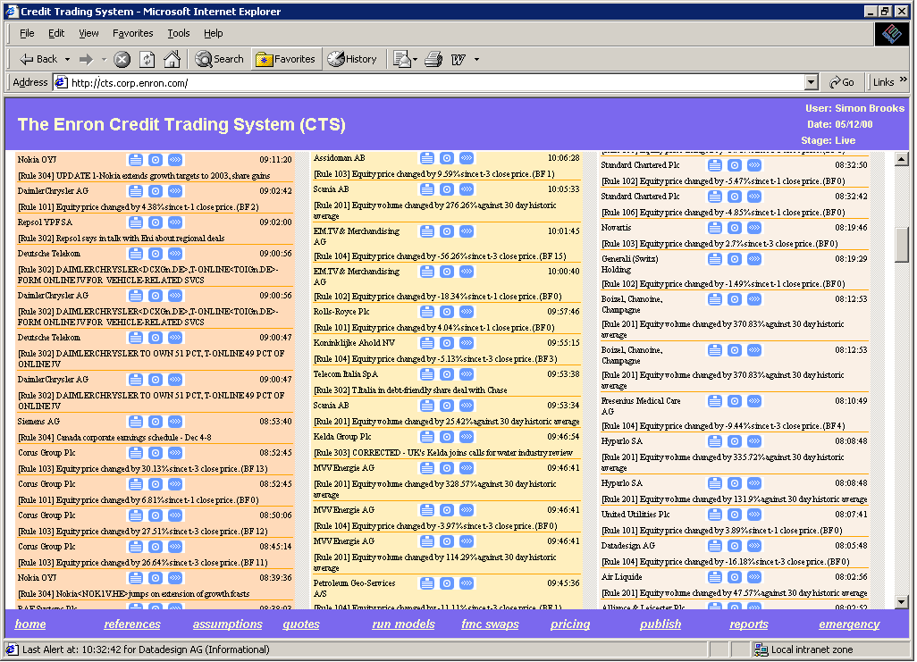
Trader Interface – Alert/Price Movement System
Easy Access to Related Pricing Information
Alerts Grouped by Company
Prioritized High to Low

Slide 13
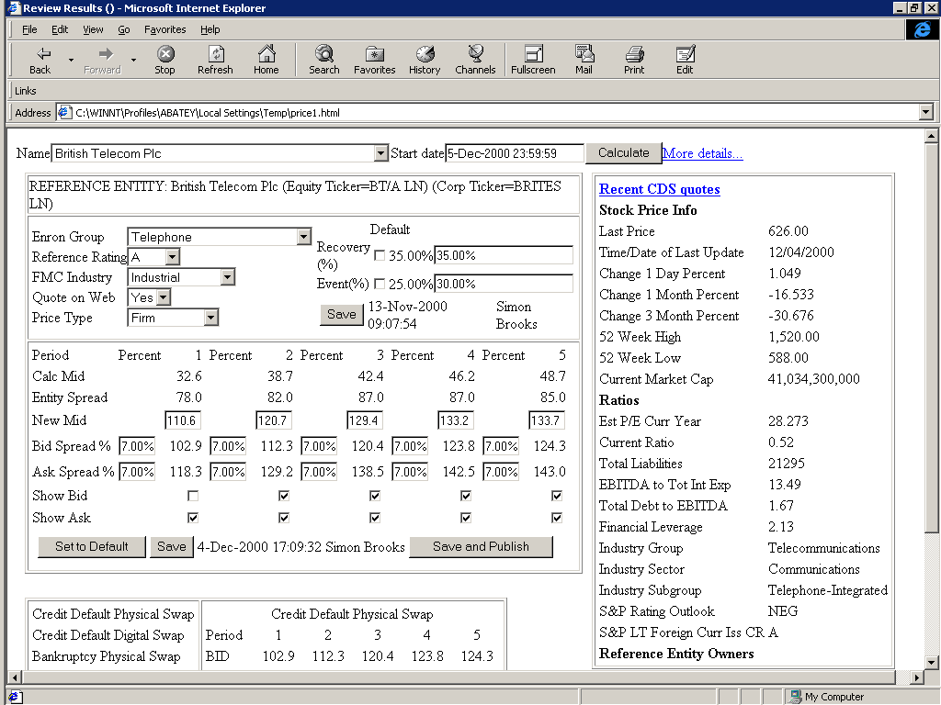
Trader Interface – Individual Price Management
Peer Group Associations and Default Over-rides
Peer Group Relationships and Price Management
Information Links

Slide 14
Pricing System
COMPETITIVE ADVANTAGE
SCALABILITY
SUSTAINABILITY
OF ADVANTAGE
Number of Names We Cover
Automated Price Movement Model with Continuous Learning
First Mover Access to Information
Depth & Breadth of Information
Business Process
Technology Architecture
Very High Trader Leverage
Automation of Data and Models
Substantial Cost to Replicate Business Model
Depth of Model Calibration Data

Slide 15
Documentation
Existing credit products documentation are legally extensive
defining credit events
delivery of bonds and loans
Existing insurance products complicated
demonstrate loss
paid well after loss has occurred
Bankruptcy documentation simplified
one well defined credit event
no delivery

Slide 16
THE FUTURE

Slide 17
How We Will Trade This Product
SINGLE NAMES
BASKET TRADES
MIGRATION TRADES
BASIS TRADING
PORTFOLIO TRADES

Slide 18
How We Will Trade This Product- Tools
PLACEMENT MODEL
ALERTS
FMC
MOVEMENT MODEL

Slide 19
How This Will Be Managed
Live & Real Time Banking
International Risk
Front Arena
Risk Management
PVOI
DVOI

Slide 20
If you are interested in joining Credit Trading contact:
Markus Fiala on # 34576

