Slide 1
September 26, 2000
Confidential & Proprietary
Management Presentation
Enron Generation Overview

Slide 2
Table of Contents
Overall Transaction Investment Merits
Peakers:
Generation Overview
Facility Strengths
Development Timeline
Equipment Overview
Regional Overview
Site Overview
Site Layout
Plant Picture
Performance Results
Warranty Provisions
Plant Org. Chart
Interconnection Agreements
Gas Supply & Transportation
Power Markets Opportunities
Control Area Status
Expansion / Conversion Details
O&M Costs
State/Local Taxes
Legal/Lease Structures

Slide 3
Transaction Investment Merits
First Mover Advantage in Midwest and Southeast Markets
Portfolio of Assets with Extensive Market Reach
Attractive Power Market Fundamentals
Each Plant is currently its own Control Area and has the hardware to create new control area
Peaking Plants Ideal for Power Marketing
Peakers are located at favorable points along the gas grid
Significant Upside Potential with Conversion Capabilities

Slide 4
Gleason Overview
Project Gleason

Slide 5
Overview
Gleason Overview
Plant Description: 555 MW (nominal) natural gas-fired, simple cycle facility
Location: 60 acre tract in Gleason, Tennessee, in the TVA subregion of SERC
Gas interconnect: ANR Pipeline (ANR Pipeline ML2-Weakley Interconnect)
Power interconnect: TVA (Johnsonville - Weakley 500kV)
Commercial Operation Date: June 21, 2000
Altitude:

Slide 6
Facility Strengths
Gleason Overview
Plant has a “first-mover advantage opportunity” inside TVA
TVA and the surrounding areas have historically experienced extreme power price volatility
Ideally suited to capitalize on gas/power arbitrage opportunities
Expansion and conversion potential
Site has room for additional gas turbines
Technology of turbines allows for easy conversion to combined-cycle
Access to water
Site has room for conversion to combined cycle
Conversion request has been filed with TVA
30 Minute normal unit ramp from cold to full load

Slide 7
Development Timeline
Gleason Overview
Land Optioned: October 1999
Land Purchased: September 1999
Start of Construction: September 1999
Receipt of Air Permit: December 1999
Testing: May 2000
Commercial Operation: June 2000

Slide 8
Equipment Overview
Gleason Overview
Turbines: 1 Westinghouse 501 FC turbine (w/ evap cooling), 2 Westinghouse 501 FD turbines (w/ evap cooling)
Summer (90 F) Rating: 185 MW (nominal)
Winter (20 F) Rating: 185 MW (nominal)
Switchyard Equipment: ABB, HV Interconnect breakers
Switchyard Configuration: Ring Bus
Transformers: ABB (_______ MVA)
3 Winding and _____ MVA 2 Winding
Control System: WDPF
Generator Circuit Breakers: ABB HGC (7000A)
Generator Voltages: (13.8 kV (FD) and 18 kV (FC))
Distribution Voltages: (4160V and 480V)

Slide 9
Performance Results
Gleason Overview

Slide 10
Warranty Provisions
Gleason Overview
Manufacturer: Siemens Westinghouse Power Corp.
Turbines Warranty: The earlier of the occurrence of 8,000 equivalent operating hours or June 1, 2001

Slide 11
Environmental Issues
Gleason Overview
Discharge Permit: Not Required
Air Permit: Non-PSD
NOx Control Method: Water injection
Compliance Method: CEMS
Limits: 249 T NOx per year
249 T CO per year
Actual Commission NOx: <25 ppm

Slide 12
Regional Overview
Gleason Overview
Drop in Map from IM

Slide 13
Site Overview
Gleason Overview

Slide 14
Site Layout
Gleason Overview
Add map of site by CAD file from Hoff - Plot survey

Slide 15
Plant Picture
Gleason Overview
Add picture from Don Miller

Slide 16
Power Interconnection
Gleason Overview
Interconnected to 500 kV TVA line that traverses the site
Shelby Interconnection Upgrade - See Interconnection Agreement Sec. 4.8
TVA found that in the absence of the Gleason Plant a Network Upgrade would have been needed in 2009
Gleason Power provided actual upgrade costs of <Amount>
Gleason receives monthly credits equal to any network, firm point-to -point, or non-firm point-to-point transmission charges to Gleason
On 12/31/09 TVA will reimburse Gleason Power the difference between original capital cost and sum of monthly transmission credits
Transmission credits have totaled <Amount> through <Date>
Projected credits from present to 12/31/09 are <Amount>

Slide 17
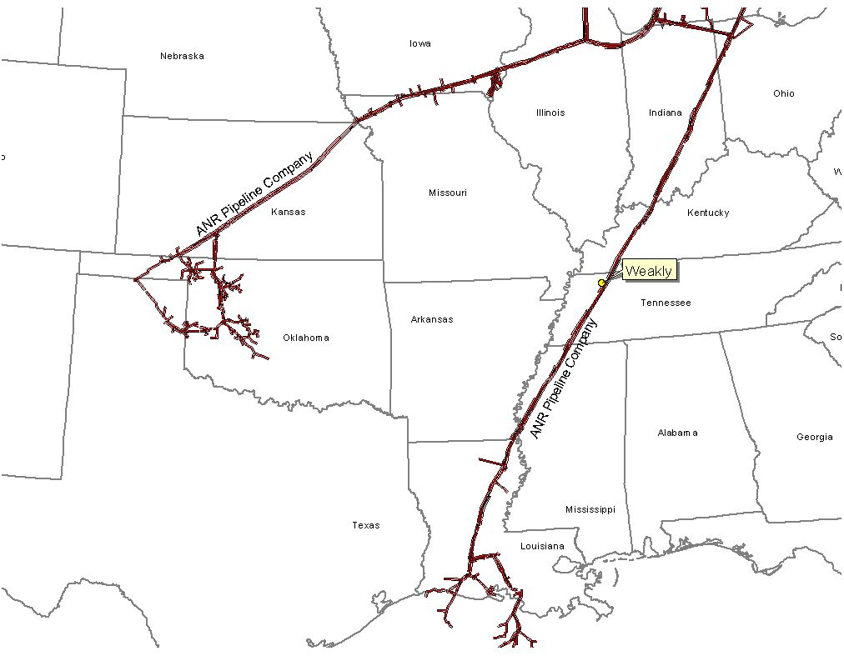
Gas Transportation
Gleason Overview
Pipeline: ANR Pipeline
Delivery Point: ANR ML2
Base Contract:
Service: ITS-3/IPLS
Term: 10 years (Apr.-Oct.)
Volume: 93,000 MMBtu/d
Rate: $.1122 plus fuel from Chicago or SE LA
$.0322 plus fuel from Gleason Plant-gate to Brownsville hub
$.0222 plus fuel from Brownsville Hub to Gleason Plant - gate
Fuel: 0.0% on Backhaul; 2.69% on forward haul
Receipt Points: SE Area, LA/Joliet, Il. Brownsville Hub, Gleason Plant-gate
Balancing: $.02 per MMBtu/d balancing up to 93,000 MMBtu years 1 to 10
Backup Contract: None in place; however, capacity release or seasonal firm can be utilized
Balancing: IPLS service subject to economic dispatching and pipeline operational conditions; Balancing in-kind; Allows for uneven hourly flow at plant delivery point with even 24 hour supply flow
Other: ANR will maintain lateral and meter for $6,000 year; ANR will construct interconnect and own hot tap & EMS; Reasonable effort to provide 560 pressure. If pressure below 560 on day Genco nominates gas using IT agmnt, ANR will waive IPLS for volumes parked

Slide 18
Power Markets Opportunities
Gleason Overview
Gleason Power I, L.L.C. is qualified as a exempt wholesale generator (“EWG”) under the Public Utilities Holding Company Act of 1935, thus the plant has the authority to sell energy and capacity at market-based rates
TVA’s extensive 500 kV system provides system users excellent transmission reliability
The Plant’s location in TVA and its access to the eastern U.S. electricity market provides sales opportunities in the wholesale power markets
Gleason provides access to the TVA system with direct connections to 12 surrounding sub-regions and markets
Gleason is 2 utility wheels away from _____ sub-regions and markets

Slide 19
Control Area Status
Gleason Overview
The control area is designated ENGL
ENGL has been designated a control area in accordance with NERC policy
Control area designation is valuable for point to point power sales and scheduling of power
After purchasing, control area services could be provided by TVA or the purchaser could re-establish a control area in accordance with NERC procedures
Enron affiliate, control area & scheduling services

Slide 20
Expansion/Conversion Opportunity
Gleason Overview
The Gleason Plant has been designed to facilitate a future plant expansion or conversion to combined-cycle
An interconnect request for conversion has been filed with TVA
The stated net heat could go from 10,900 Btu/kWh (HHV) to 6,800-7,500 (HHV) depending on equipment
The stated net output of the plant could go from 546 MW (nominal) to 850 MW (nominal)
The conversion of the Gleason plant could take approximately 18 to 24 months
Installation of an SCR should facilitate getting a PSD permit for combined cycle operation

Slide 21
O&M Costs
Gleason Overview
Variable O&M of $1.50 ($/MWh) - includes estimates on water costs and variable maintenance expenditures
Fixed O&M of $1,242 ($000) - includes estimates of payroll expenses and other fixed O&M
Major Maintenance of $3,000 ($/Start/Turbine) - includes estimated accrual for future major maintenance on a per turbine basis, assuming 100 starts/year, using OEM recommended maintenance schedule
Owner’s Expense of $322 ($000) - includes estimates of insurance, utilities, interconnection fees, gas pipeline metering costs and miscellaneous expenses
Property Tax Liability of $92 ($000) - may vary based on abatement programs and other local issues

Slide 22
State/Local Taxes
Gleason Overview
See Patrick Malloy’s Group

Slide 23
Legal/Lease Structures
Gleason Overview
Gleason Power I, L.L.C. leases the facility (including the real property) from the Industrial Development Board of Weakley County for a term of 15 years beginning on September 16, 1999
Gleason Power I, L.L.C. is a single member Delaware limited liability company and is 100% owned by Enron North America
Gleason Power I, L.L.C. has the right to buy the facility at any time during the term of the lease or within 90 days after the expiration thereof for $500.00

