Slide 1
September 26, 2000
Confidential & Proprietary
Management Presentation
Enron Generation Overview

Slide 2
Table of Contents
Overall Transaction Investment Merits
Peakers:
Generation Overview
Facility Strengths
Development Timeline
Equipment Overview
Regional Overview
Site Overview
Site Layout
Plant Picture
Performance Results
Warranty Provisions
Plant Org. Chart
Interconnection Agreements
Gas Supply & Transportation
Power Markets Opportunities
Control Area Status
Expansion / Conversion Details
O&M Costs
State/Local Taxes
Legal/Lease Structures

Slide 3
Transaction Investment Merits
First Mover Advantage in Midwest and Southeast Markets
Portfolio of Assets with Extensive Market Reach
Attractive Power Market Fundamentals
Each Plant is currently its own Control Area and has the hardware to created new control area
Peaking Plants Ideal for Power Marketing
Peakers are located at favorable points along the gas grid
Significant Upside Potential with Conversion Capabilities

Slide 4
Gleason Overview
Project Gleason

Slide 5
Generation Overview
Gleason Overview
Plant Description: 546 MW (nominal) natural gas-fired, simple cycle power generation facility
Owner: Gleason Power I, L.L.C., an indirect wholly owned subsidiary of Enron North America
Located on an approximate 60 acre tract of land at 1156 James Mill road in Gleason, Tennessee
Located in the TVA subregion of SERC
Gas interconnect: ANR (ANR Pipeline ML2-Weakley Interconnect)
Power interconnect: TVA (Johnsonville - Weakley 500kV)

Slide 6
Facility Strengths
Gleason Overview
Plant has a “first-mover advantage opportunity” inside TVA
TVA and the surrounding areas have historically experienced extreme power price volatility
Ideally suited to capitalize on gas/power arbitrage opportunities
Expansion potential at existing sites
Site has room for additional gas turbines
Technology of turbines allows for easy expansion opportunities
Access to sufficient water usage

Slide 7
Development/Historical Timeline
Gleason Overview
Land Optioned:
Land Purchased:
Rezoning Permit:
Receipt of Air Permit: August 1999
Start of Construction: September 1999
Testing: May 2000
Commercial Operation: June 2000

Slide 8
Equipment Overview
Gleason Overview
One Westinghouse Model 501 FC gas turbine
Two Westinghouse Model 501 FD gas turbines
Rated at 182 MW and 182 MW, respectively (nominal)
Switchyard Equipment:
Switchyard Configuration:
Transformers: ABB
EVAP Coolers:
Foggers:
Control System: WDPF
Circuit Breakers:
Primary Voltages:
Secondary Voltages:
Winding Setup: 2 or 3

Slide 9
Performance Results
Gleason Overview
Add Mitch Robinson

Slide 10
Warranty Provisions
Gleason Overview

Slide 11
Regional Overview
Gleason Overview

Slide 12
Site Overview
Gleason Overview

Slide 13
Site Layout
Gleason Overview
Add map of site by CAD file from Hoff - Plot survey

Slide 14
Plant Picture
Gleason Overview
Add picture from Don Miller

Slide 15
Interconnection Agreements
Gleason Overview
Interconnected to a 500 kV TVA line that traverses the site
Shelby Interconnection Upgrade - See Interconnection Agreement Sec. 4.8
TVA found that in the absence of the Gleason Plant a Network Upgrade would have been needed in 2009
Gleason Power provided actual upgrade costs of <Amount>
Gleason receives monthly credits equal to any network, firm point-to -point, or non-firm point-to-point transmission charges
On 12/31/09 TVA will reimburse Gleason Power the difference between original capital cost and sum of monthly transmission credits
Transmission credits have totaled <Amount> through <Date>
Projected credits from present to 12/31/09 are <Amount>

Slide 16
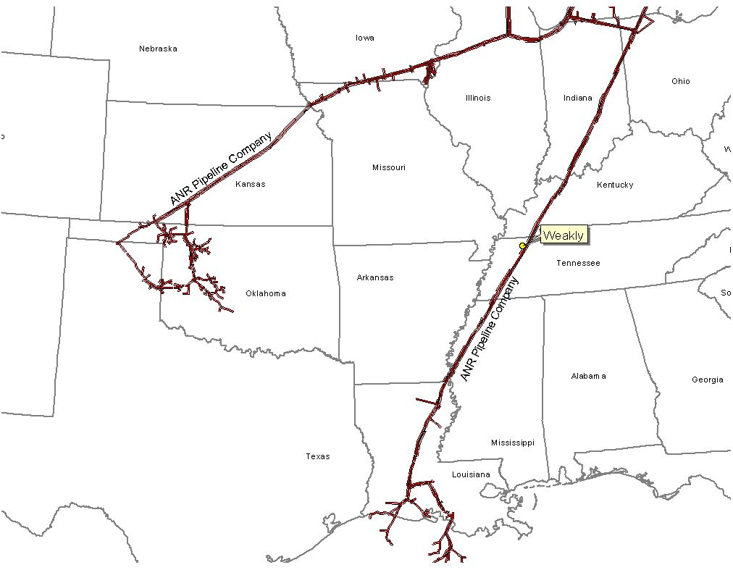
Gas Transportation
Gleason Overview
Pipeline: ANR Pipeline
Delivery Point: ANR ML2
Base Contract:
Service: ITS-3/IPLS
Term: 10 years (Apr.-Oct.)
Volume: 93,000 MMBtu/d
Rate: $.1122 plus fuel from Chicago or SE LA
$.0322 plus fuel from Gleason Plant-gate to Brownsville hub
$.0222 plus fuel from Brownsville Hub to Gleason Plant - gate
Fuel: 0.0% on Backhaul; 2.69% on forward haul
Receipt Points: SE Area, LA/Joliet, Il. Brownsville Hub, Gleason Plant-gate
Balancing: $.02 per MMBtu/d balancing up to 93,000 MMBtu years 1 to 10
Backup Contract: None in place; however, capacity release or seasonal firm can be utilized
Balancing: IPLS service subject to economic dispatching and pipeline operational conditions; Balancing in-kind; Allows for uneven hourly flow at plant delivery point with even 24 hour supply flow
Other: ANR will maintain lateral and meter for $6,000 year; ANR will construct interconnect and own hot tap & EMS; Reasonable effort to provide 560 pressure. If pressure below 560 on day Genco nominates gas using IT agmnt, ANR will waive IPLS for volumes parked

Slide 17
Power Markets Opportunities
Gleason Overview
Gleason Power I, L.L.C. is qualified as a exempt wholesale generator (“EWG”) under the Public Utilities Holding Company Act of 1935, thus the plant has the authority to sell energy and capacity at market-based rates
The Plant’s location in TVA and its access to the eastern U.S. electricity market provides sales opportunities in the wholesale power markets

Slide 18
Control Area Status
Gleason Overview
The control area is designated ENGL
The Gleason Plant has been designated a control area in accordance with NERC policy
Control area designation is valuable for point to point power sales, scheduling of power and parking and hubbing

Slide 19
Expansion/Conversion Opportunity
Gleason Overview
The Gleason Plant has been designed to facilitate a future plant expansion or conversion to combined-cycle
An interconnect request for conversion has been filed with TVA
Permit timeline estimate?

Slide 20
O&M Costs
Gleason Overview
Variable O&M of $1.50 ($/MWh) - includes estimates on water costs and variable maintenance expenditures
Fixed O&M of $1,242 ($000) - includes estimates of payroll expenses and other fixed O&M
Major Maintenance of $3,000 ($/Start/Turbine) - includes estimated accrual for future major maintenance on a per turbine basis, assuming 100 starts/year
Owner’s Expense of $322 ($000) - includes estimates of insurance, utilities, interconnection fees, gas pipeline metering costs and miscellaneous expenses
Property Tax Liability of $92 ($000) - may vary based on abatement programs and other local issues

Slide 21
State/Local Taxes
Gleason Overview
See Patrick Malloy’s Group

Slide 22
Legal/Lease Structures
Gleason Overview
Owned by Gleason Power I, L.L.C., a Delaware limited liability (“GPI”)
GPI is owned 100% by ENA
GPI leases the facility (including the real property) from the Industrial Development Board of Weakley County for a term of 15 years beginning on September 16, 1999
GPI has the right to buy the facility at any time during the term of the lease or within 90 days after the expiration thereof for $500.00

