Slide 1
September 28, 2000
Confidential & Proprietary
Management Presentation
Enron Generation Overview

Slide 2
Transaction Investment Merits
First Mover Advantage in Midwest and Southeast Markets
Portfolio of Assets with Extensive Market Reach
Attractive Power Market Fundamentals
Each Plant is currently its own Control Area and has the hardware to created new control area
Peaking Plants Ideal for Power Marketing
Peakers are located at favorable points along the gas grid
Significant Upside Potential with Conversion Capabilities

Slide 3
Gleason Overview
Gleason Plant

Slide 4
Overview
Gleason Overview
Plant Description: 546 MW (nominal) natural gas-fired, simple cycle facility
Location: 60 acre tract in Gleason, Tennessee, in the TVA subregion of SERC
Gas interconnect: ANR Pipeline ML2-Weakley Interconnect
Power interconnect: TVA 500kV line
Commercial Operation Date: June 21, 2000
Approx. Max. Annual MWh: 532,992 @ 59ºF
Approx. Run Hours: 915
NOx (per unit): <25 ppm
CO (per unit): <30 ppm

Slide 5
Facility Strengths
Gleason Overview
Plant commenced commercial operations June 1, 2000
Plant has a “first-mover advantage” inside TVA
TVA and the surrounding areas have historically experienced extreme power price volatility
Plant is ideally suited to capitalize on gas/power arbitrage opportunities
Plant has expansion and conversion potential
Site has room for additional gas turbines
Technology and layout of turbines allow for easy conversion to combined-cycle
Request for interconnect expansion submitted to TVA August 2000
Access to water with onsite wells
30 minute normal unit ramp from cold to full load

Slide 6
Development Timeline
Gleason Overview
Milestone Date
Land Purchased: September 1999
Start of Construction: September 1999
Receipt of Air Permit: December 1999
Commercial Operation: June 2000

Slide 7
Plant Picture
Gleason Overview
Add picture from Don Miller

Slide 8
Equipment Overview
Gleason Overview
Turbines: 1 Westinghouse 501 FC turbine (w/ evap cooling), 2 Westinghouse 501 FD turbines (w/ evap cooling)
Turbine Warranty Expiration: June 1, 2001
Switchyard Equipment: ABB, HV Interconnect breakers
Switchyard Configuration: Ring Bus
(3) ABB _____ MVA, single-phase 3 winding transformers (FDs)
(1) ABB _____ MVA, 2 winding 3 phase transformer (FC)
Control System: WDPF
Generator Circuit Breakers: ABB HGC (7000A)
Generator Voltages: 13.8 kV (FC (hydrogen cooler)) and 18 kV (FD (air cooled))
Plant Distribution Voltages: (4160V and 480V)
GLEASON
ENGL
500 kV
TVA
Johnsonville
B
B
Switchyard
G1
B
B
GSU1A
,1B,1C
B
G2
B
B
G3
TVA
GSU2
Weakley
B
B
Substation
Summer
Nominal
Winter
Unit MW Rating:
182
182
182 FC
175
182
182 FD
B = Breaker
GSU = Generator Step-up Unit

Slide 9
Performance Results
Gleason Overview
Unit 1
Unit 2
Unit 3
Life-to-Date Run Hours
179.5
247.0
276.4
Life-to-Date Starts
44
40
55
Performance Test Data
Output (MW)
Corrected to 90 F
178.2
182.0
180.6
Heat Rate (LHV)
Corrected to 90 F
9,908
9,821
9,888
Heat Rate (HHV)
Corrected to 90 F
10,998
10,901
10,976
NOx Emissions (ppm)
Corrected to 15% O₂
24.45
24.25
23.90

Slide 10
Site Overview
Gleason Overview

Slide 11
Power Interconnection
Gleason Overview
Interconnected to 500 kV TVA line (Johnsville-Weakley 500 kV) that traverses the site
Shelby Interconnection Upgrade
TVA found that in the absence of the Gleason Plant a Network Upgrade would have been needed in 2009
Gleason Power I, L.L.C. reimburses actual upgrade costs to TVA
Gleason receives monthly credits equal to any network, firm point-to -point, or non-firm point-to-point transmission charges to Gleason
On 12/31/09 TVA will reimburse Gleason Power the difference between total capital cost and sum of monthly transmission credits
Construction reimbursements have totaled $2.6 million through August 2000
Transmission credits have totaled $772,000 through August 2000
Estimated remaining construction costs are $24.9 million from October 2000 through September 2002

Slide 12
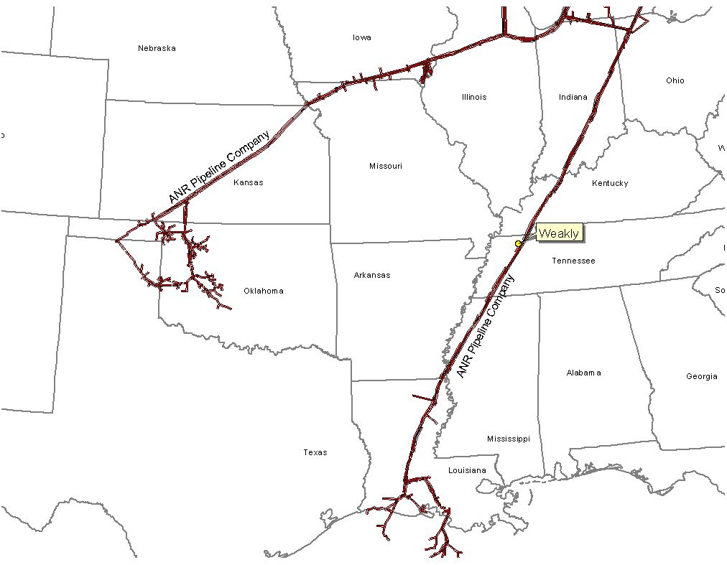
Gas Transportation
Gleason Overview
Pipeline: ANR Pipeline
Delivery Point: ANR ML2
Base Contract:
Service: ITS-3/IPLS
Term: 10 years (Apr.-Oct.) through 2009
Volume: 93,000 MMBtu/d
Rate: $.11 plus fuel and AGA from Chicago or SE LA
$.03 plus fuel and AGA from Gleason Plant-gate to Brownsville hub
$.02 plus fuel and AGA from Brownsville Hub to Gleason Plant-gate
Fuel: 0.0% on Backhaul; 2.69% on forward haul
Receipt Points: SE Area, LA/Joliet, Il. Brownsville Hub, Gleason Plant-gate
Balancing: $.02 per MMBtu/d balancing up to 93,000 MMBtu years 1-10
Backup Contract: Capacity release or seasonal firm can be used. Additionally, Gleason is party to a Precedent Agreement with ANR Pipeline providing Gleason the ability to purchase 80,000 of Firm Capacity from Chiacgo to the plant-gate.
Balancing: IPLS service subject to economic dispatching and pipeline operational conditions; Balancing-in-kind; Allows for uneven hourly flow at plant delivery point with even 24-hour supply flow
Other: ANR will maintain lateral and meter for $6,000 per year; ANR constructed the interconnect and owns the hot tap and EMS; Reasonable effort to provide 560 pressure. If pressure is below 560 on day Genco nominates gas using IT agreement, ANR will waive IPLS for volumes parked.

Slide 13
Control Area Status
Gleason Overview
The Gleason Plant control area, ENGL, has been designated a control area in accordance with NERC policy
Control area designation is valuable for point to point power sales and scheduling of power
Following the sale, options for purchaser include:
control area services could be provided by TVA;
the purchaser could re-establish a control area in accordance with NERC procedures;
an Enron affiliate could provide control area and scheduling services under separate contract

Slide 14
Expansion/Conversion Opportunity
Gleason Overview
The Gleason Plant has been designed to facilitate a future plant expansion and/or conversion to combined-cycle
Request for interconnect expansion submitted to TVA August 2000
The net heat could go from 10,900 Btu/kWh (HHV) currently to 7,000 (HHV), depending on equipment
The net output of the plant could go from 546 MW (nominal) to 850 MW (nominal), depending on equipment
The conversion of the Gleason Plant should take approximately 18 to 24 months
Installation of an SCR should facilitate getting a PSD permit for combined cycle operation

Slide 15
Regional Overview
Gleason Overview
Add in map from IM

Slide 16
Power Market Opportunities
Gleason Overview
Gleason Power I, L.L.C. is qualified as a Exempt Wholesale Generator and has the authority to sell energy and capacity at market-based rates
TVA’s extensive 500 kV system provides system users excellent transmission reliability and reach
The Plant’s location in TVA and its access to the eastern U.S. electricity market provide sales opportunities into the wholesale power markets
Gleason provides access to the TVA system with direct connections to 12 surrounding control area markets
Gleason is two utility wheels away from over 70 control area markets

Slide 17
Environmental Issues
Gleason Overview
Discharge Permit: Not Required
Air Permit: Non-PSD
NOx Control Method: Water injection
Compliance Method: CEMS
Limits: 249 T NOx per year
249 T CO per year
Actual Commission NOx: <25 ppm
Estimated Run Hours: 915

Slide 18
Operating Costs
Gleason Overview
Variable O&M of approximately $1.50 ($/MWh) - includes estimates on water costs and variable maintenance expenditures
Fixed O&M of approximately $1,242,000 - includes estimates of payroll expenses and other fixed O&M
Major Maintenance of $3,000 ($/Start/Turbine) - includes estimated accrual for future major maintenance on a per turbine basis, assuming 100 starts/year, using OEM recommended maintenance schedule
Owner’s Expense of approximately $322,000 - includes estimates of insurance, utilities, interconnection fees, gas pipeline metering costs and miscellaneous expenses
Property Tax Liability of approximately $92,000 - may vary based on abatement programs and other local issues

Slide 19
Plant Organizational Chart
Gleason Overview
Plant is currently operated by Operational Energy Corp (“OEC”), an Enron affiliate
It is anticipated that at closing, O&M contract will be terminated
OEC will entertain O&M discussions with Purchaser
Plant personnel are employees of OEC

Slide 20
Legal Structure
Gleason Overview
Gleason Power I, L.L.C. leases the facility (including the real property) from the Industrial Development Board of Weakley County for a term of 15 years beginning on September 16, 1999
Gleason Power I, L.L.C. is a single member Delaware limited liability company and is 100% owned by Enron North America Corp
Gleason Power I, L.L.C. has the right to buy the facility at any time during the term of the lease or within 90 days after the expiration thereof for $500.00
The purchaser will acquire all of the member interests in Gleason Power I, L.L.C.

Slide 21
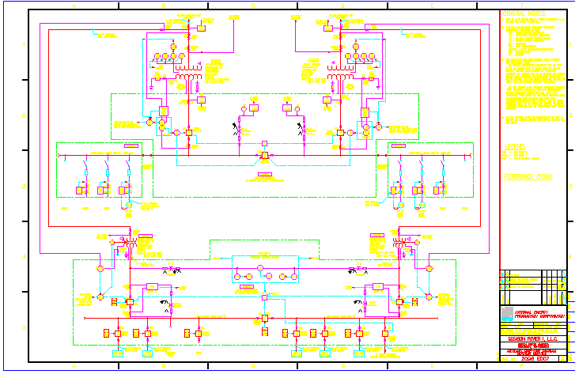
Site Layout
Gleason Overview

Slide 22
Wheatland Overview
Wheatland Plant

Slide 23
Overview
Wheatland Overview
Plant Description: 508 MW (nominal) natural gas-fired, simple cycle facility
Location: 60-acre tract in Wheatland, Indiana, in the Southern ECAR subregion of ECAR
Gas interconnect: Midwestern Gas (Midwestern Pipeline - Westfork Interconnect)
Power interconnect: Duel Interconnect with Indianapolis Power & Light 345 kV & Cinergy 345 kV
Commercial Operation Date: June 1, 2000
Approx. Max. Annual MWh: 461,313 at 59ºF
Approx. Run Hours: 902
NOx (per unit): <25 ppm
CO (per unit): <25 ppm

Slide 24
Facility Strengths
Wheatland Overview
Plant commenced commercial operations June 1, 2000
Plant has a “first-mover advantage” in a key Midwest market
ECAR has historically experienced extreme power price volatility
Ideally suited to capitalize on gas/power arbitrage opportunities
Expansion/conversion potential at existing site
Site has room for additional gas turbines
Technology and layout of turbines allow for conversion to combined cycle
Access to water through owned lake, potential back-up municipal supply
30 minute normal unit ramp up from cold to full load

Slide 25
Development Timeline
Wheatland Overview
Milestone Date
Rezoning Permit: July 1999
Receipt of Air Permit: September 1999
Land Purchased: October 1999
Start of Construction: October 1999
Commercial Operation: June 2000

Slide 26
Plant Picture
Wheatland Overview
Add picture from Don Miller

Slide 27
Equipment Overview
Wheatland Overview
Turbines: 4 Westinghouse 501 D5A turbines (w/ evap cooling)
Turbine Warranty Expiration: June 1, 2001
Switchyard Equipment: ABB, 345 kV Interconnect breakers
Switchyard Configuration: Dual Ring Bus
(2) ABB 300 MVA, 3 winding transformers
Control System: WDPF
Generator Circuit Breakers: ABB HGC (7000A)
Generator Voltages: 13.8 kV
Plant Distribution Voltages: (4160 V and 480 V)
WHEATLAND
ENWI / ENWC
345 kV
B
G1
CINERGY
B
Gibson
B
B
CINERGY
B
GSU T1
B
G2
Qualitech
Bus 1
Bus 2
AEP
B
Breed
B
G3
B
B
IPL
B
Petersburg
GSU T2
B
G4
Summer
Nominal
Winter
Unit MW Rating:
120
127
134
B = Breaker
GSU = Generator Step-up Unit

Slide 28
Performance Results
Wheatland Overview
Unit 1
Unit 2
Unit 3
Unit 4
Life-to-Date Run Hours
97.8
116.9
132.0
60.5
Life-to-Date Starts
46
44
34
24
Performance Test Data
Output (MW)
Corrected to 90 F
119.4
120.2
116.1
119.2
Heat Rate (LHV)
Corrected to 90 F
10,540
10,451
10,465
10,433
Heat Rate (HHV)
Corrected to 90 F
11,699
11,601
11,616
11,581
NOx Emissions (ppm)
Corrected to 15% O₂
23.0
24.3
22.3
23.7

Slide 29
Site Overview
Wheatland Overview

Slide 30
Power Interconnection
Wheatland Overview
Interconnected to two 345 kV lines. The plant has an interconnect agreement with both Cinergy Services Inc. (“Cinergy”) into the Qualitech-Gibson 345 kV line, and Indianapolis Power & Light (“IPL”) into the Petersburg-Breed 345 kV line
With the dual interconnect, the plant has the option of dispatching into the Cinergy and/or IPL systems

Slide 31
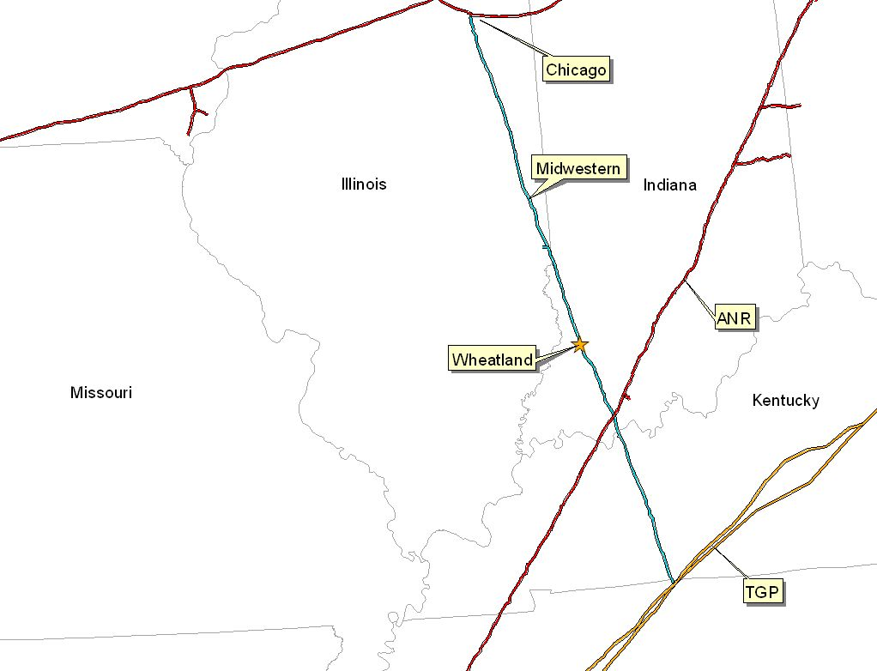
Gas Transportation
Wheatland Overview
Pipeline: Midwestern Gas Transmission
Delivery Point: Plant-Gate
Base Contract:
Service: IT
Term: 8 years (Apr-Oct)
Volume: 85,200 MMBtu/d
Rate: 1st 3 Bcf: $0.0709 MMBtu/d
Rate: 3 to 5 Bcf: $0.0422 MMBtu/d
Rate: 5 Bcf & Up: Max. Tariff Rate
Fuel: 0.05% on Backhaul; 1.0% on forward haul
Volume Commit: None
Receipt Points: MGT - Joliet & TGP - Portland
Backup Contract: None in place; however, capacity release or seasonal firm can be utilized under the terms of the deal
Balancing: Via OBA, with Midwestern subject to tariff imbalance parameters (5% end of month; 10% daily imbalance limit if daily variance implemented). Allows for uneven hourly flow at plant delivery point with even 24 hour supply subject to pipeline operating conditions

Slide 32
Control Area Status
Wheatland Overview
The Wheatland Plant control areas, ENMI and ENWC, have been designated control areas in accordance with NERC policy
Both Cinergy and IPL allow scheduling of energy into and out of each control area, giving the Wheatland Plant the option of generating power or filling the scheduled energy delivery commitment from the market when market economics warrant. This enables playing day ahead vs intra-day hourly market to maximize optionality. This added flexibility ensures that the plant is reserved for operation only during periods of economic dispatch.
Following the sale, options for purchaser include:
control area services could be provided by IPL and/or Cinergy;
the purchaser could re-establish a control area in accordance with NERC procedures;
an Enron affiliate could provide control area and scheduling services under separate contract

Slide 33
Expansion/Conversion Opportunity
Wheatland Overview
The Wheatland Plant has been designed to facilitate a future plant expansion and/or conversion to combined-cycle
The net heat could go from 11,500 Btu/kWh (HHV) to approximately 7,800 (HHV), depending on equipment
The net output of the plant could go from 508 MW (nominal) to 850 MW (nominal), depending on the equipment
The conversion of the Wheatland Plant should take approximately 18 to 24 months
Installation of an SCR should facilitate getting a PSD permit for combined cycle operation

Slide 34
Regional Overview
Wheatland Overview
Add in map

Slide 35
Power Market Opportunities
Wheatland Overview
West Fork Land Development Company, L.L.C. is qualified as an Exempt Wholesale Generator and has the authority to sell energy and capacity at market-based rates
The Wheatland Plant’s location in Southern ECAR and its access to the eastern U.S. electricity market will provide sales opportunities into the wholesale power markets
The Plant’s interconnection into two 345 kV lines provides the plant the option of dispatching into the Cinergy and/or IPL systems
The Plant’s location provides access into the ECAR region with direct access to over 30 control area markets within two utility wheels from the Wheatland Plant

Slide 36
Environmental Issues
Wheatland Overview
Discharge Permit: Not Required
Air Permit: Non-PSD
NOx Control Method: Water injection
Compliance Method: CEMS
Limits: 250 T NOx per year
250 T CO per year
Actual Commission NOx: <25 ppm
Approximate Run Hours 902

Slide 37
Operating Costs
Wheatland Overview
Variable O&M of approximately $3.00 ($/MWh) - includes estimates on water costs and variable maintenance expenditures
Fixed O&M of approximately $1,516,000 - includes estimates of payroll expenses and other fixed O&M
Major Maintenance of $1,500 ($/Start/Turbine) - includes estimated accrual for future major maintenance on a per turbine basis, assuming 100 starts/year
Owner’s Expense of approximately $306,000 - includes estimates of insurance, utilities, interconnection fees, gas pipeline metering costs and miscellaneous expenses
Property Tax Liability of approximately $203,000 - may vary based on abatement programs and other local issues

Slide 38
Plant Organizational Chart
Wheatland Overview
Plant is currently operated by Operational Energy Corp (“OEC”), an Enron affiliate
It is anticipated that at closing, O&M contract will be terminated
OEC will entertain O&M discussions with Purchaser
Plant personnel are employees of OEC

Slide 39
Legal Structure
Wheatland Overview
West Fork Land Development Company, L.L.C., a single member Delaware limited liability company, owns a fee simple ownership in the facility (including the real property)
The lake, which provides water to the plant is owned by Lake Acquisition Company, L.L.C., a single member Delaware limited liability company
Lake Acquisition Company, L.L.C. and West Fork Land Development Company, L.L.C. have entered into a lease pursuant to the lake property which is leased to West Fork Land Development Company, L.L.C.

Slide 40
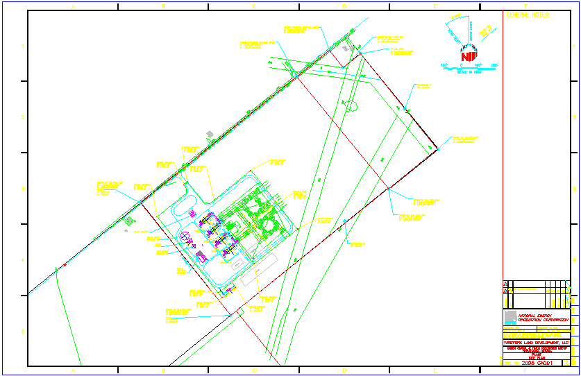
Site Layout
Wheatland Overview

Slide 41
Lincoln Energy Center Overview
Lincoln Energy Center

Slide 42
Overview
Lincoln Energy Center Overview
Plant Description: 656 MW (nominal) natural gas-fired, simple cycle facility
Location: 50 acres tract in Manhattan, Illinois, in the ComEd subregion of MAIN
Gas interconnect: Northern Border Pipeline - near Manhattan South Interconnect
Power interconnect: ComEd Wilton Center Substation
Commercial Operation Date: June 1, 2000
Approx. Max. Annual MWh: 2,002,000 at 59ºF
Annual Run Hours: 3250
NOx (per unit): <9 ppm
CO (per unit): <25 ppm

Slide 43
Facility Strengths
Lincoln Energy Center Overview
Plant commenced commercial operations June 21, 2000
Plant has a “first-mover advantage ” in a key Midwest market
MAIN and Chicago area have historically experienced extreme power price volatility
Flexible gas arrangements in Chicago area allow access to ANR Pipeline Company and Northern Border Pipeline Company and other arbitrage opportunities
Expansion/conversion potential at existing site
Site has room for additional gas turbines
Technology and layout of turbines allow for easy conversion to combined cycle
Access to water, with onsite wells

Slide 44
Development Timeline
Lincoln Energy Center Overview
Milestone Date
Land Purchased: December 1998
Rezoning/Special Use Permit: May 1999
Receipt of Air Permit: August 1999
Start of Construction: September 1999
Commercial Operation: June 2000

Slide 45
Plant Picture
Lincoln Energy Center Overview
Add picture from Don Miller

Slide 46
Equipment Overview
Lincoln Energy Center Overview
Turbines : 8 General Electric 7EA gas turbines (w/ evap cooling)
Turbine Warranty Expiration: June 1, 2001
Switchyard Equipment: ABB, 345 kV Interconnect breakers
Switchyard Configuration: Radial
(4) ABB 200 MVA 3 winding transformers
Control System: General Electric Mark V
Generator Circuit Breakers: ABB HGC (7000A)
Generator Voltages: 13.8 kV
Distribution Voltages: 4160 V and 480 V
LINCOLN CENTER
ENLC
345 kV
B
G8
345 kV line to:
B
Com
-
Ed
GSU T34
B
G7
Substation
B
G6
B
GSU
T33
B
G5
B
G4
B
GSU T32
B
G3
B
G2
B
GSU T31
B
G1
Unit MW Rating:
Summer
Nominal
Winter
79
82
88
B = Breaker
GSU = Generator Step-up Unit

Slide 47
Performance Results
Lincoln Energy Center Overview
Unit 1
Unit 2
Unit 3
Unit 4
Unit 5
Unit 6
Unit 7
Unit 8
Life-to-Date Run Hours
300.8
266.8
229.8
279.0
147.7
177.4
150.0
178.5
Life-to-Date Starts
47
48
38
39
28
33
24
30
Performance Test Data
Output (MW)
Corrected to 90 F
78.2
77.7
76.5
76.7
77.3
78.4
78.4
77.7
Heat Rate (LHV)
Corrected to 90 F
10,622
10,641
10,545
10,650
10,717
10,641
10,690
10,694
Heat Rate (HHV)
Corrected to 90 F
11,790
11,812
11,705
11,822
11,896
11,812
11,866
11,870
NOx Emissions (ppm)
Corrected to 15% O₂
9.60
9.34
8.91
8.69
8.19
9.53
7.65
7.12

Slide 48
Site Overview
Lincoln Energy Center Overview

Slide 49
Power Interconnection
Lincoln Energy Center Overview
The Lincoln Energy Center is connected directly to the ComEd Substation (Lincoln Center - Wilton Center 345 kV Radial Tie)
The ComEd Substation is connected to five transmission lines: three 345 kV lines (ComEd) and two 765 kV lines (AEP)
Each of the 765 kV lines has significant available transmission capacity during periods of peak load
The interconnection provides direct access to ComEd’s service territory
The ComEd Substation also has direct access to eastern markets (such as AEP) via the 765 kV line

Slide 50
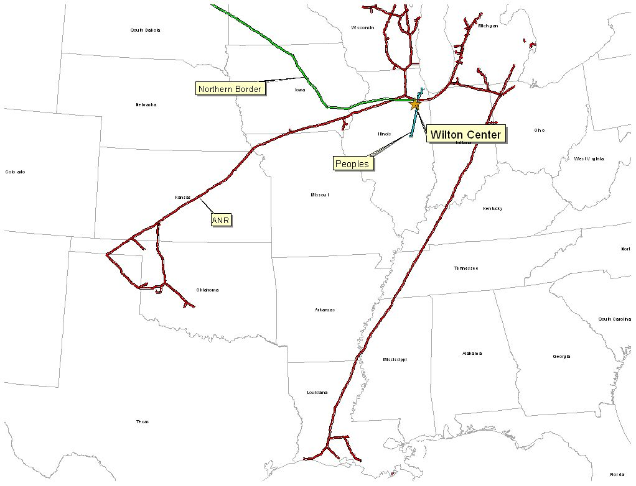
Gas Transportation
Lincoln Energy Center Overview
Pipeline: Northern Border
Delivery Point: Manhattan Station
Base Contract:
Service: IT-1 Transport
Term: 2 Year Term beginning March 1, 2000
Volume: 200,000 MMBtu/d
Rate: Maximum Tariff Rate, currently 4.038 cent per 100 dekatherm mile
Fuel: Varies depending on haul
Receipt Points: Master Receipts on Northern Border
Back-up Contract: ANR - IWS ($0.01) and IPLS ($0.03) for up to 115,000/day
Balancing: Via OBA, with Northern Border. Off system balancing provided via the IPLS and IWS Agreements with ANR

Slide 51
Control Area Status
Lincoln Energy Center Overview
The Lincoln Energy Center control area, ENLC, has been designated a control area in accordance with NERC policy
Control area designation is valuable for point to point power sales and scheduling of power
Following the sale, options for purchaser include:
control area services could be provided by ComEd;
the purchaser could re-establish a control area in accordance with NERC procedures;
an Enron affiliate could provide control area and scheduling services under separate contract

Slide 52
Expansion/Conversion Opportunity
Lincoln Energy Center Overview
The Lincoln Energy Center has been designed to facilitate a future expansion and/or conversion to combined-cycle
The net heat could go from 11,900 Btu/kWh (HHV) to approximately 8,000 (HHV) depending on equipment
The net output of the plant could go from 656 MW (nominal) to approximately 1,000 MW (nominal) depending on the equipment
The conversion of the Lincoln Energy Center should take approximately 18 to 24 months
Installation of an SCR with combined cycle conversion should facilitate modifying PSD permit for increased run beyond the existing permitted 3250 hours.

Slide 53
Regional Overview
Lincoln Energy Center Overview
Add in map from IM

Slide 54
Power Market Opportunities
Lincoln Energy Center Overview
Des Plaines Green Land Development, L.L.C. is qualified as an Exempt Wholesale Generator and has the authority to sell energy and capacity at market-based rates
Pursuant to a contractual agreement, the owner of the Lincoln Energy Center will be obligated to sell capacity and energy to _____
The Plant’s location in ComEd and its access to Chicago and other Midwestern and Eastern electricity markets provide sales opportunities into the wholesale power market
ENLC is within two utility wheels from over 30 control areas

Slide 55
Environmental Issues
Lincoln Energy Center Overview
Discharge Permit: Not Required
Air Permit: PSD
NOx Control Method: GE Dry Low - NOx Combustor
NOx Compliance Method: CEMS
Actual Commission NOx: <9 ppm
Actual Commission CO: <25 ppm
Permitted CO Limit: <25 ppm
NOx Permit Limits
Hourly: <15 ppm
Monthly: <12 ppm
Annually: <9 ppm

Slide 56
Operating Costs
Lincoln Energy Center Overview
Variable O&M of approximately $2.00 ($/MWh) - includes estimates on water costs and variable maintenance expenditures
Fixed O&M of approximately $1,449,000 - includes estimates of payroll expenses and other fixed O&M
Major Maintenance of $1,000 ($/Start/Turbine) - includes estimated accrual for future major maintenance on a per turbine basis, assuming 100 starts/year
Owner’s Expense of approximately $401,000 - includes estimates of insurance, utilities, interconnection fees, gas pipeline metering costs and miscellaneous expenses
Property Tax Liability of approximately $334,000 - may vary based on abatement programs and other local issues

Slide 57
Plant Organizational Chart
Lincoln Energy Center Overview
Plant is currently operated by Operational Energy Corp (“OEC”), an Enron affiliate
It is anticipated that at closing, O&M contract will be terminated
OEC will entertain O&M discussions with Purchaser
Plant personnel are employees of OEC
Merle Churchill
Plant Manager
Sherry Patterson
Administrative Assistant
Brent Colbert
Plant Supervisor
Dave Pottorff
Mark Lane
Damian Jerome
Tim Reisner
TECH III
TECH III
TECH II
TECH II
TECH II

Slide 58
Legal Structure
Lincoln Energy Center Overview
Des Plaines Green Land Development, L.L.C. (“Des Plaines”) is a single member Delaware limited liability company and is 100% owned by Enron North America Corp.
Energy Finance Company, L.L.C. (“EFC”) is a single member Delaware limited liability company and is 100% owned by Enron North America Corp.
Des Plaines has fee simple ownership of the facility (including the real property)
Des Plaines and EFC have entered into an Equipment Sale Agreement
IL Sales/Use Tax due on the equipment is deferred over fifteen years
Early payments are primarily interest (which is exempt from Sales/Use Tax), thus increasing present benefit of deferral

Slide 59
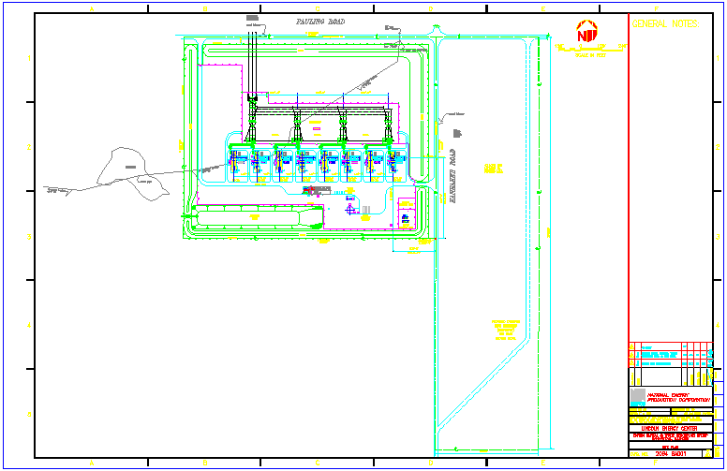
Site Layout
Lincoln Energy Center Overview

