Slide 1
September 27, 2000
Confidential & Proprietary
Management Presentation
Enron Generation Overview

Slide 2
Table of Contents
Overall Transaction Investment Merits
Peakers:
Overview
Facility Strengths
Development Timeline
Equipment Overview
Regional Overview
Site Overview
Site Layout
Plant Picture
Performance Results
Environmental Issues
Plant Organizational Chart
Power Interconnection
Gas Transportation
Power Market Opportunities
Control Area Status
Expansion / Conversion Details
Operating Costs
State/Local Taxes
Legal/Lease Structures

Slide 3
Transaction Investment Merits
First Mover Advantage in Midwest and Southeast Markets
Portfolio of Assets with Extensive Market Reach
Attractive Power Market Fundamentals
Each Plant is currently its own Control Area and has the hardware to created new control area
Peaking Plants Ideal for Power Marketing
Peakers are located at favorable points along the gas grid
Significant Upside Potential with Conversion Capabilities

Slide 4
Gleason Overview
Project Gleason

Slide 5
Overview
Gleason Overview
Plant Description: 555 MW (nominal) natural gas-fired, simple cycle facility
Location: 60 acre tract in Gleason, Tennessee, in the TVA subregion of SERC
Gas interconnect: ANR Pipeline (ANR Pipeline ML2-Weakley Interconnect)
Power interconnect: TVA (Johnsonville - Weakley 500kV)
Commercial Operation Date: June 21, 2000
Altitude:
Approx. Max. Annual MWh: 532,992
NOx (per unit): <25 ppm
CO (per unit): <30 ppm

Slide 6
Facility Strengths
Gleason Overview
Plant has a “first-mover advantage” inside TVA
TVA and the surrounding areas have historically experienced extreme power price volatility
Plant is ideally suited to capitalize on gas/power arbitrage opportunities
Plant has expansion and conversion potential
Site has room for additional gas turbines
Technology of turbines allows for easy conversion to combined-cycle
Conversion request has been filed with TVA
Access to water
30 minute normal unit ramp from cold to full load

Slide 7
Development Timeline
Gleason Overview
Milestone Date
Land Optioned: October 1999
Land Purchased: September 1999
Start of Construction: September 1999
Receipt of Air Permit: December 1999
Commercial Operation: June 2000

Slide 8
Equipment Overview
Gleason Overview
Turbines: 1 Westinghouse 501 FC turbine (w/ evap cooling), 2 Westinghouse 501 FD turbines (w/ evap cooling)
Turbine Warranty Expiration: June 1, 2001
Switchyard Equipment: ABB, HV Interconnect breakers
Switchyard Configuration: Ring Bus
Transformers: ABB (_______ MVA)
3 Winding and _____ MVA 2 Winding
Control System: WDPF
Generator Circuit Breakers: ABB HGC (7000A)
Generator Voltages: (13.8 kV (FD) and 18 kV (FC))
Distribution Voltages: (4160V and 480V)
GLEASON
ENGL
500 kV
TVA
Johnsonville
B
B
Switchyard
G1
B
B
GSU1A
,1B,1C
B
G2
B
B
G3
TVA
GSU2
Weakley
B
B
Substation
Summer
Nominal
Winter
Unit MW Rating:
185
185
185
185
185
185
B = Breaker
GSU = Generator Step-up Unit

Slide 9
Performance Results
Gleason Overview

Slide 10
Environmental Issues
Gleason Overview
Discharge Permit: Not Required
Air Permit: Non-PSD
NOx Control Method: Water injection
Compliance Method: CEMS
Limits: 249 T NOx per year
249 T CO per year
Actual Commission NOx: <25 ppm

Slide 11
Plant Organizational Chart
Gleason Overview

Slide 12
Regional Overview
Gleason Overview
Add in map from IM

Slide 13
Site Overview
Gleason Overview

Slide 14
Site Layout
Gleason Overview
Add map of site by CAD file from Hoff - Plot survey

Slide 15
Plant Picture
Gleason Overview
Add picture from Don Miller

Slide 16
Power Interconnection
Gleason Overview
Interconnected to 500 kV TVA line that traverses the site
Shelby Interconnection Upgrade - See Interconnection Agreement Sec. 4.8
TVA found that in the absence of the Gleason Plant a Network Upgrade would have been needed in 2009
Gleason Power provided actual upgrade costs of <Amount>
Gleason receives monthly credits equal to any network, firm point-to -point, or non-firm point-to-point transmission charges to Gleason
On 12/31/09 TVA will reimburse Gleason Power the difference between original capital cost and sum of monthly transmission credits
Transmission credits have totaled <Amount> through <Date>
Projected credits from present to 12/31/09 are <Amount>

Slide 17
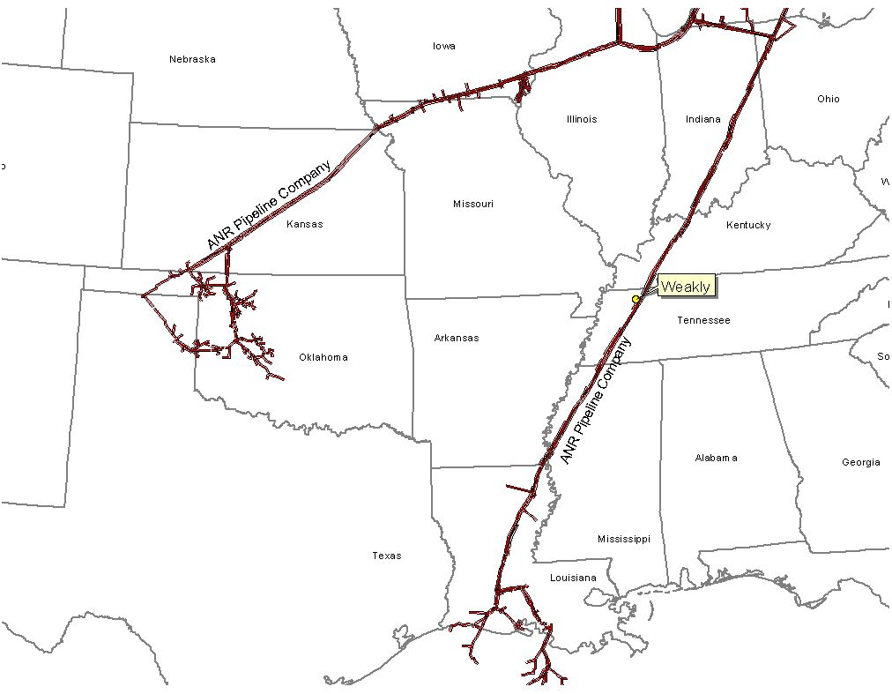
Gas Transportation
Gleason Overview
Pipeline: ANR Pipeline
Delivery Point: ANR ML2
Base Contract:
Service: ITS-3/IPLS
Term: 10 years (Apr.-Oct.)
Volume: 93,000 MMBtu/d
Rate: $.11 plus fuel and ACA from Chicago or SE LA
$.03 plus fuel and ACA from Gleason Plant-gate to Brownsville hub
$.02 plus fuel and ACA from Brownsville Hub to Gleason Plant-gate
Fuel: 0.0% on Backhaul; 2.69% on forward haul
Receipt Points: SE Area, LA/Joliet, Il. Brownsville Hub, Gleason Plant-gate
Balancing: $.02 per MMBtu/d balancing up to 93,000 MMBtu years 1-10
Backup Contract: Capacity release or seasonal firm can be used. Additionally, Gleason is party to a Precedent Agreement with ANR Pipeline providing Gleason the ability to purchase 80,000 of Firm Capacity from Chiacgo to the plant-gate.
Balancing: IPLS service subject to economic dispatching and pipeline operational conditions; Balancing-in-kind; Allows for uneven hourly flow at plant delivery point with even 24-hour supply flow
Other: ANR will maintain lateral and meter for $6,000 per year; ANR constructed the interconnect and owns the hot tap and EMS; Reasonable effort to provide 560 pressure. If pressure is below 560 on day Genco nominates gas using IT agreement, ANR will waive IPLS for volumes parked.

Slide 18
Power Markets Opportunities
Gleason Overview
Gleason Power I, L.L.C. is qualified as a exempt wholesale generator under the Public Utilities Holding Company Act of 1935, thus the plant has the authority to sell energy and capacity at market-based rates
TVA’s extensive 500 kV system provides system users excellent transmission reliability
The Plant’s location in TVA and its access to the eastern U.S. electricity market provides sales opportunities in the wholesale power markets
Gleason provides access to the TVA system with direct connections to 12 surrounding sub-regions and markets
Gleason is 2 utility wheels away from _____ sub-regions and markets

Slide 19
Control Area Status
Gleason Overview
The Gleason Plant control area, ENGL, has been designated a control area in accordance with NERC policy
Control area designation is valuable for point to point power sales and scheduling of power
Following the sale, control area services could either be provided by TVA, the purchaser could re-establish a control area in accordance with NERC procedures, or an Enron affiliate could provide control area and scheduling services

Slide 20
Expansion/Conversion Opportunity
Gleason Overview
The Gleason Plant has been designed to facilitate a future plant expansion and/or conversion to combined-cycle
An interconnect request for conversion has been filed with TVA
The stated net heat could go from 10,900 Btu/kWh (HHV) currently to 6,800-7,500 (HHV), depending on equipment
The stated net output of the plant could go from 555 MW (nominal) to 850 MW (nominal), depending on equipment
The conversion of the Gleason plant should take approximately 18 to 24 months
Installation of an SCR should facilitate getting a PSD permit for combined cycle operation

Slide 21
Operating Costs
Gleason Overview
Variable O&M of $1.50 ($/MWh) - includes estimates on water costs and variable maintenance expenditures
Fixed O&M of $1,242,000 - includes estimates of payroll expenses and other fixed O&M
Major Maintenance of $3,000 ($/Start/Turbine) - includes estimated accrual for future major maintenance on a per turbine basis, assuming 100 starts/year, using OEM recommended maintenance schedule
Owner’s Expense of $322,000 - includes estimates of insurance, utilities, interconnection fees, gas pipeline metering costs and miscellaneous expenses
Property Tax Liability of $92,000 - may vary based on abatement programs and other local issues

Slide 22
Legal Structure
Gleason Overview
Gleason Power I, L.L.C. leases the facility (including the real property) from the Industrial Development Board of Weakley County for a term of 15 years beginning on September 16, 1999
Gleason Power I, L.L.C. is a single member Delaware limited liability company and is 100% owned by Enron North America
Gleason Power I, L.L.C. has the right to buy the facility at any time during the term of the lease or within 90 days after the expiration thereof for $500.00
The purchaser will acquire all of the member interests in Gleason Power I, L.L.C.

Slide 23
Wheatland Overview
Project Wheatland

Slide 24
Overview
Wheatland Overview
Plant Description: 508 MW (nominal) natural gas-fired, simple cycle facility
Location: 60-acre tract of land in Wheatland, Indiana, in the Southern ECAR, a subregion of ECAR
Gas interconnect: Midwestern Gas (Midwestern Pipeline - Westfork Interconnect)
Power interconnect: Indianapolis Power & Light 345 kV / Cinergy 345 kV
Commercial Operation Date: June 2000
Altitude:
Approx. Max. Annual MWh: 461,313
NOx (per unit): <25 ppm
CO (per unit): <25 ppm

Slide 25
Facility Strengths
Wheatland Overview
Plant was commissioned new in Summer 2000
Plant has a “first-mover advantage” in a key Midwest market
ECAR has historically experienced extreme power price volatility
Ideally suited to capitalize on gas/power arbitrage opportunities
Expansion potential at existing sites
Site has room for additional gas turbines
Technology of turbines allows for easy expansion opportunities
Access to water through owned lake
30 minute normal unit ramp up from cold to full load

Slide 26
Development Timeline
Wheatland Overview
Milestone Date
Land Optioned: February 1999
Rezoning Permit: July 1999
Receipt of Air Permit: September 1999
Land Purchased: October 1999
Start of Construction: October 1999
Commercial Operation: June 2000

Slide 27
Equipment Overview
Wheatland Overview
Turbines: 4 Westinghouse 501 D5A turbines (w/EVAP cooling)
Turbine Warranty Expiration: June 1, 2001
Switchyard Equipment: ABB, HV Interconnect breakers
Switchyard Configuration: Ring Bus
Transformers: ABB (_______ MVA)
3 Winding and _____ MVA 2 Winding
Control System: WDPF
Generator Circuit Breakers: ABB HGC (7000A)
Generator Voltages: (____ kV (FD) and ___ kV (FC))
Distribution Voltages: (____V and ___V)
WHEATLAND
ENWI / ENWC
345 kV
B
G1
CINERGY
B
Gibson
B
B
CINERGY
B
GSU T1
B
G2
Qualitech
Bus 1
Bus 2
AEP
B
Breed
B
G3
B
B
IPL
B
Petersburg
GSU T2
B
G4
Summer
Nominal
Winter
Unit MW Rating:
120
127
134
Gas Transporter:
Tennessee
Gas Daily Index:
Tenn., 500 Leg / Chicago LDC's
B = Breaker
GSU = Generator Step-up Unit

Slide 28
Performance Results
Wheatland Overview

Slide 29
Environmental Issues
Wheatland Overview
Discharge Permit: Not Required
Air Permit: Non-PSD
NOx Control Method: Water injection
Compliance Method: CEMS
Limits: 250 T NOx per year
250 T CO per year
Actual Commission NOx: <25 ppm

Slide 30
Plant Organizational Chart
Wheatland Overview

Slide 31
Regional Overview
Wheatland Overview
Add in map

Slide 32
Site Overview
Wheatland Overview

Slide 33
Site Layout
Wheatland Overview
Add map of site by CAD file from Hoff - Plot survey

Slide 34
Plant Picture
Wheatland Overview
Add picture from Don Miller

Slide 35
Power Interconnection
Wheatland Overview
Interconnected to two 345 kV lines. The plant has an interconnect agreement with both Cinergy Services Inc. (“Cinergy”) into the Qualitech-Gibson 345 kV line, and Indianapolis Power & Light (“IPL”) into the Petersburg-Breed 345 kV line
With the dual interconnect, the plant has the option of dispatching into the Cinergy or IPL systems
Both Cinergy and IPL allow scheduling of energy into and out of each control area, giving the Wheatland Plant the option of generating power or filling the scheduled energy delivery from the market when market economics warrant. This enables playing day ahead vs intra-day hourly market to maximize optionality
This added flexibility ensures that the plant is reserved for operation only during periods of economic dispatch

Slide 36
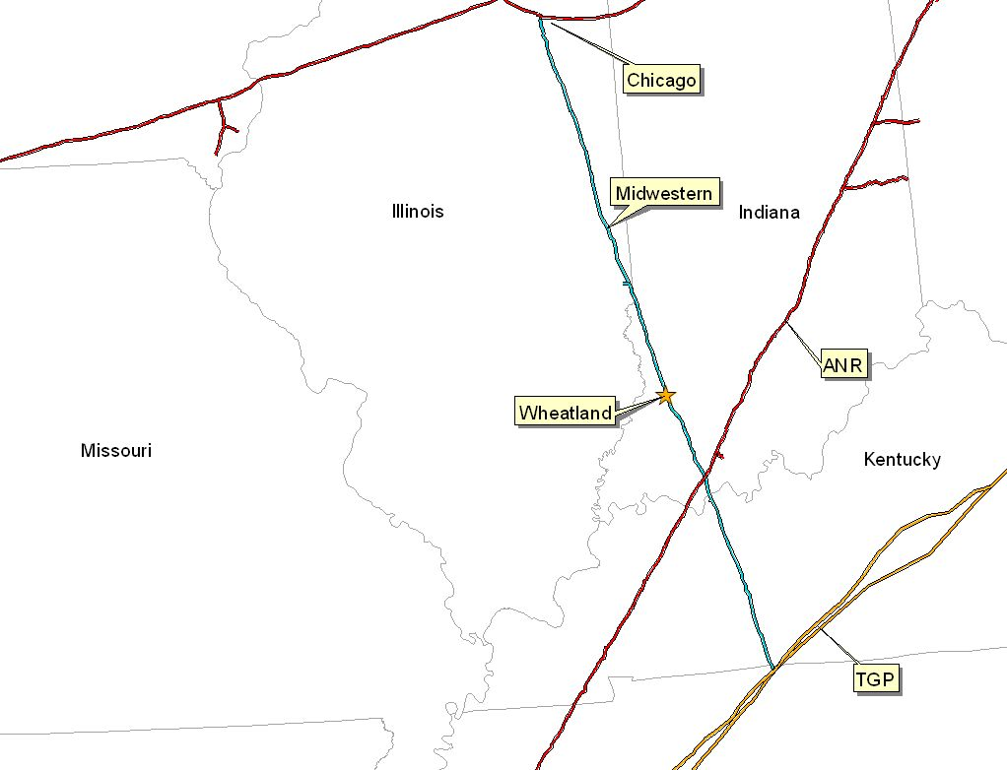
Gas Transportation
Wheatland Overview
Pipeline: Midwestern Gas Transmission
Delivery Point: Plant-Gate
Base Contract:
Service: IT
Term: 8 years (Apr-Oct)
Volume: 85, 200 MMBtu/d
Rate: 1st 3 Bcf - $0.0709 MMBtu/d
Rate: 3 to 5 Bcf - $0.0422 MMBtu/d
Rate: 5 Bcf & Up - Max. Tariff Rate
Fuel: 0.05% on Backhaul; 1.0% on forward haul
Volume Commit: None
Receipt Points: MGT - Joliet & TGP - Portland
Backup Contract: None in place; however, capacity release or seasonal firm can be utilized under the terms of the deal
Balancing: Via OBA, with Midwestern subject to tariff imbalance parameters (5% end of month; 10 % daily imbalance limit if daily variance implemented) Allows for uneven hourly flow at plant delivery point with even 24 hour supply subject to pipeline operating conditions

Slide 37
Power Markets Opportunities
Wheatland Overview
West Fork Land Development Company, L.L.C., is qualified as an Exempt Wholesale Generator, and has the authority to sell energy and capacity at market-based rates.
The Wheatland Plant’s location in Southern ECAR, and its access to the eastern U.S. electricity market will provide sales opportunities in the wholesale power markets
Interconnected into 2 345 kV lines enables the plant the option of dispatching into the Cinergy and IPL systems
Wheatland provides access into the ECAR region w/direct connection to _____ surrounding sub-region and markets

Slide 38
Control Area Status
Wheatland Overview
The Wheatland Plant control areas, ENMI and ENWC, have been designated a control areas in accordance with NERC policy
Control area designation is valuable for point to point power sales and scheduling of power
Following the sale, control area services could either be provided by ECAR, the purchaser could re-establish a control area in accordance with NERC procedures, or an Enron affiliate could provide control area and scheduling services

Slide 39
Expansion/Conversion Opportunity
Wheatland Overview
The Wheatland Plant has been designed to facilitate a future plant expansion and/or conversion to combined-cycle
The stated net heat could go from 11,500 Btu/kWh (HHV) to 6,800 - 7,500 (HHV), depending on equipment
The stated net output of the plant could go from 508 MW (nominal) to ___ MW (nominal), depending on the equipment
The conversion of the Wheatland plant sould take approximately 18 to 24 months
Installation of an SCR should facilitate getting a PSD permit for combined cycle operation

Slide 40
Operating Costs
Wheatland Overview
Variable O&M of $3.00 ($/MWh) - includes estimates on water costs and variable maintenance expenditures
Fixed O&M of $1,516,000 - includes estimates of payroll expenses and other fixed O&M
Major Maintenance of $1,500 ($/Start/Turbine) - includes estimated accrual for future major maintenance on a per turbine basis, assuming 100 starts/year
Owner’s Expense of $306,000 - includes estimates of insurance, utilities, interconnection fees, gas pipeline metering costs and miscellaneous expenses
Property Tax Liability of $203,000 - may vary based on abatement programs and other local issues

Slide 41
Legal/Lease Structures
Wheatland Overview
West Fork Land Development Company, L.L.C., a single member Delaware limited liability company, owns a fee simple ownership in the facility (including the real property)
The lake, which provides water to the plant is owned by Lake Acquisition Company, L.L.C., a single member Delaware limited liability company (“Lake”)
Lake Acquisition Company, L.L.C.and West Fork Land Development Company, L.L.C. have entered into a lease pursuant to the lake property which is leased to West Fork Land Development Company, L.L.C.
West Fork Land Development Company, L.L.C has a fee simple ownership in the facility (including the real property)

Slide 42
Lincoln Energy Center Overview
Lincoln Energy Center

Slide 43
Overview
Lincoln Energy Center Overview
Plant Description: 656 MW (nominal) natural gas-fired, simple cycle facility
Location: 50 acres tract in Manhattan, Illinois, in the Com Ed subregion of MAIN
Gas interconnect: Northern Border Pipeline - near Manhattan South Interconnect
Power interconnect: Com Ed 345 kV line
Commercial Operation Date: June 1, 2000
Altitude:
Approx. Max. Annual MWh: 2,002,000
NOx (per unit): <9 ppm
CO (per unit): <25 ppm

Slide 44
Facility Strengths
Lincoln Energy Center Overview
New plant, commissioned in summer 2000
Plant has a “first-mover advantage ” in a key Midwest market
MAIN and Chicago area has historically experienced extreme power price volatility
Flexible gas arrangements in Chicago area allow access to ANR Pipeline Company and Northern Border Pipeline Company and other arbitrage opportunities
Expansion potential at existing sites
Site has room for additional gas turbines
Technology of turbines allows for easy conversion to combined cycle
Access to water, with onsite wells

Slide 45
Development Timeline
Lincoln Energy Center Overview
Milestone Date
Land Purchased: December 1998
Rezoning/Special Use Permit: May 1999
Receipt of Air Permit: August 1999
Start of Construction: September 1999
Commercial Operation: June 2000

Slide 46
Equipment Overview
Lincoln Energy Center Overview
Turbines : 8 General Electric 7EA gas turbines (w/ evap cooling)
Warranty Expiration: June 1, 2001
Switchyard Equipment: ABB, HV Interconnect breakers
Switchyard Configuration: Ring Bus
Transformers: ABB (_______ MVA)
3 Winding and _____ MVA 2 Winding
Control System: General Electric
Generator Circuit Breakers: ABB HGC (7000A)
Generator Voltages: (____ kV (FD) and ___ kV (FC))
Distribution Voltages: (____V and ____V)

Slide 47
Performance Results
Lincoln Energy Center Overview

Slide 48
Environmental Issues
Lincoln Energy Center Overview
Discharge Permit: Not Required
Air Permit: PSD
NOx Control Method: Water injection
Compliance Method: CEMS
Actual Commission NOx: <9 ppm

Slide 49
Plant Organizational Chart
Lincoln Energy Center Overview
PLANT MANAGER
Merle Churchill
Administrative Assistant
Sherry Patterson
PLANT SUPERVISOR
Brent
Colbert
TECH III
TECH III
TECH II
TECH II
TECH II
Dave
Pottorff
Mark Lane
Damian Jerome
Tim
Reisner

Slide 50
Regional Overview
Lincoln Energy Center Overview
Add in map from IM

Slide 51
Site Overview
Lincoln Energy Center Overview

Slide 52
Site Layout
Lincoln Energy Center Overview
Add map of site by CAD file from Hoff - Plot survey

Slide 53
Plant Picture
Lincoln Energy Center Overview
Add picture from Don Miller

Slide 54
Power Interconnection
Lincoln Energy Center Overview
The Lincoln Energy Center is connected directly to the ComEd Substation (Lincoln Certen - Wilton Center 345 kV Radial Tie)
The ComEd Cubstation is connected to five transmission lines: three 345 kV lines (ComEd) and two 765 kV lines (AEP)
Each of the 765 kV lines has significant available transmission capacity during periods of peak load
The interconnection provides direct access to Commonwealth Edison's service territory
The ComEd Substation also has direct access to eastern markets (such as AEP) via the 765 kV line

Slide 55
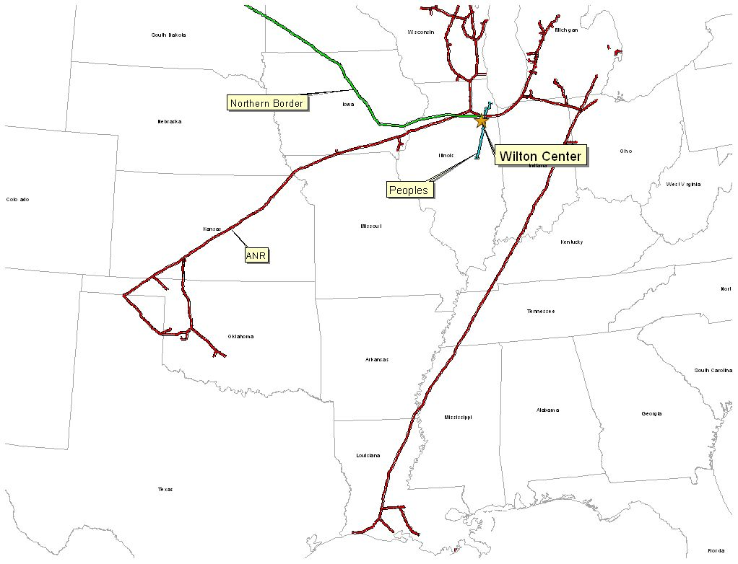
Gas Transportation
Lincoln Energy Center Overview
Pipeline: Northern Border
Delivery Point: Manhattan Station
Base Contract:
Service: IT-1 Transport
Term: 2 Year Term beginning March 1, 2000
Volume: 200,000 MMBtu/d
Rate: Maximum Tariff Rate, currently 4.038 cent per 100 dekatherm mile
Fuel: Varies depending on haul
Receipt Points: Master Receipts on Northern Border
Back-up Contract: ANR - IWS ($0.01) and IPLS ($0.03) for up to 115,000/day
Balancing: Via OBA, w/ Northern Border. Off system balancing provided via the IPLS and IWS Agreements with ANR

Slide 56
Power Market Opportunities
Lincoln Energy Center Overview
Des Plaines Green Land Development, L.L.C. is qualified as an Exempt Wholesale Generator, and has the authority to sell energy and capacity at market-based rates
Pursuant to a contractual agreement, the owner of the Lincoln Energy Center will be obligated to sell capacity and energy to _____
The Plant’s Location in ComEd and its access to Chicago and other Midwestern and Eastern electricity markets provides sales opportunities in the wholesale power market

Slide 57
Control Area Status
Lincoln Energy Center Overview
Lincoln Energy Center’s control area, ENLC, has been designated a control area in accordance with NERC policy
Control Area designation is valuable for point to point power sales and scheduling of power
Following the sale, control area services could either be provided by MAIN, the purchaser could re-establish a control area in accordance with NERC procedures, or an Enron affiliate could provide control area and scheduling services

Slide 58
Expansion/Conversion Details
Lincoln Energy Center Overview
The Lincoln Energy Center has been designed to facilitate a future expansion and/or conversion to combined-cycle
The stated net heat could go from 11,900 Btu/kWh (HHV) to 6,800 - 7,500 (HHV) depending on equipment
The stated net output of the plant could go from 656 MW (nominal) to ___ MW (nominal) depending on the equipment
The conversion of the Lincoln plant should take approximately 18 to 24 months
Installation of an SCR should facilitate getting a PSD permit for combined cycle operation

Slide 59
Operating Costs
Lincoln Energy Center Overview
Variable O&M of $2.00 ($/MWh) - includes estimates on water costs and variable maintenance expenditures
Fixed O&M of $1,449,000 - includes estimates of payroll expenses and other fixed O&M
Major Maintenance of $1,000 ($/Start/Turbine) - includes estimated accrual for future major maintenance on a per turbine basis, assuming 100 starts/year
Owner’s Expense of $401,000 - includes estimates of insurance, utilities, interconnection fees, gas pipeline metering costs and miscellaneous expenses
Property Tax Liability of $334,000

Slide 60
State/Local Taxes
Lincoln Energy Center Overview
See Patrick Malloy’s Group

Slide 61
Legal Structure
Lincoln Energy Center Overview
Des Plaines Green Land Development, L.L.C., is a single member Delaware limited liability company (“DPGL”) and is 100% owned by Enron North America
Energy Finance Company, L.L.C., is a single member Delaware Limited Liability company (“EFC”) and is 100% owned by Enron North America
DPGL has fee simple ownership of the facility (including the real property)
DPGL and EFC have entered into an Equipment Sale Agreement

