Slide 1
October 2000
Confidential & Proprietary
Management Presentation
Gleason Overview

Slide 2
Overview
Gleason Overview
Plant Description: 546 MW (nominal) natural gas-fired, simple-cycle facility
Location: 60-acre tract in Gleason, Tennessee, in TVA subregion of SERC
Power Interconnect: TVA 500 kV line
Gas Interconnect: ANR Pipeline ML2-Weakley Interconnect
Start of Construction: September 1999
Commercial Operation Date: June 21, 2000
Approx. Max. Annual MWh: 532,992 @ 59ºF
Approx. Run Hours: 915
NOx (per unit): <25 ppm
CO (per unit): <30 ppm

Slide 3
Facility Strengths
Gleason Overview
“First-mover advantage” inside TVA
TVA and surrounding areas have historically experienced extreme power price volatility
Ideally suited to capitalize on gas/power arbitrage opportunities
Expansion/conversion potential
  Site has room for additional gas turbines
  Turbine technology and layout allow for easy conversion to combined cycle
  Request for interconnect expansion submitted to TVA August 2000
  Access to water with onsite wells
30-minute normal unit ramp-up from cold to full load

Slide 4
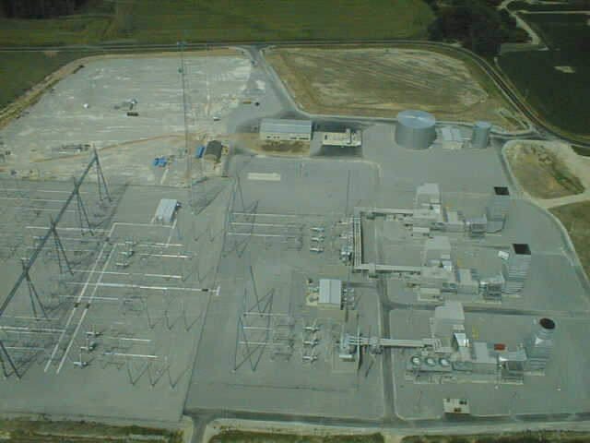
Plant Picture
Gleason Overview

Slide 5
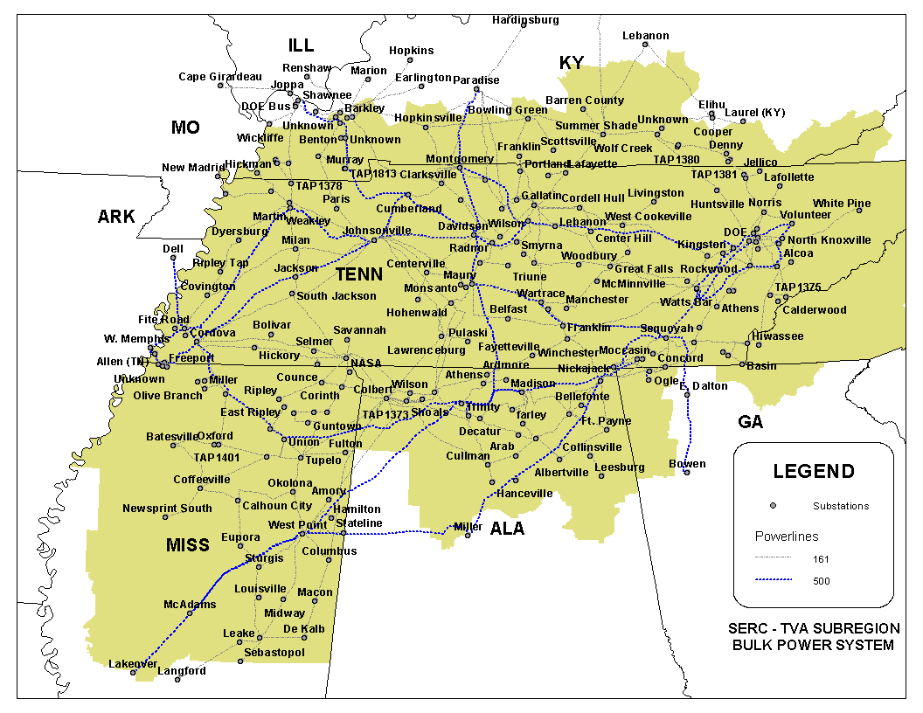
Regional Overview
Gleason Overview
Gleason Plant

Slide 6
Power Market Opportunities
Gleason Overview
Gleason Power I, L.L.C. is qualified as an Exempt Wholesale Generator and has authority to sell energy and capacity at market-based rates
TVA’s extensive 500 kV system provides system users excellent transmission reliability and reach
Gleason’s location in TVA and access to eastern U.S. electricity market provide sales opportunities into the wholesale power markets
Gleason provides access to TVA system with direct connections to 12 surrounding control area markets
Gleason is two utility wheels away from over 70 control area markets

Slide 7
Equipment Overview
Gleason Overview
Turbines: 1 Westinghouse 501 FC turbine and 2 Westinghouse 501 FD turbines with evap. cooling
Turbine Warranty Expiration: June 1, 2001
Switchyard Equipment: ABB, high-voltage interconnect breakers
Switchyard Configuration: single ring bus
Transformers: (3) ABB 160 MVA, 3 winding, single-phase, 18.0 kV/500 kV (2 FD) and (1) ABB 240 MVA, 2 winding, 3 phase, 13.8kV/500kV (1 FC)
Control System: WDPF
Generator Circuit Breakers: (3) ABB (11,500A)
Generator Voltages: 13.8 kV (FC (hydrogen cooled)) and 18 kV (FD (air cooled))
Plant Distribution Voltages: 4160V and 480V
GLEASON
ENGL
500 kV
TVA
Johnsonville
B
B
Switchyard
G1
B
B
1B,1C
B
G2
GSU1A
B
B
G3
TVA
GSU2
Weakley
B
B
Substation
Summer
Nominal
Winter
Unit MW Rating:
182
182
182 FD
175
182
182 FC
B = Breaker
GSU = Generator Step-up Unit

Slide 8
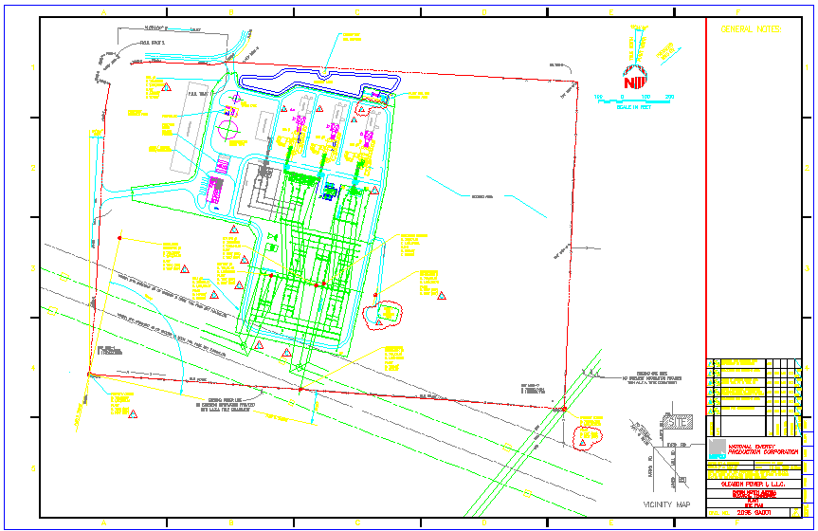
Plant Layout
Gleason Overview

Slide 9
Performance Results
Gleason Overview

Slide 10
Power Interconnection
Gleason Overview
Interconnected to 500 kV TVA line (Johnsville-Weakley) that traverses the site
As part of Gleason interconnection agreement, TVA required an upgrade of the Shelby substation:
  Gleason reimburses estimates of upgrade costs incurred by TVA on a quarterly basis
  Gleason receives credits dollar-for-dollar, in the amount of any Upgrade Costs paid which may be used to pay TVA for network, firm point-to-point, or non-firm point-to-point transmission charges
  On December 31, 2009, TVA will pay to Gleason an amount equal to the difference between total Upgrade Costs paid by Gleason and sum of transmission credits used to date
  Through September 2000, Gleason has paid to TVA $2.6 million of Upgrade Costs and transmission credits in the amount of $772,000 have been used
  Estimated remaining construction costs are $24.9 million, to be paid from October 2000 through September 2002
  Gleason’s purchaser will assume obligation to pay future upgrade costs and will be entitled to receive all existing and future credits and December 31, 2009 payment

Slide 11
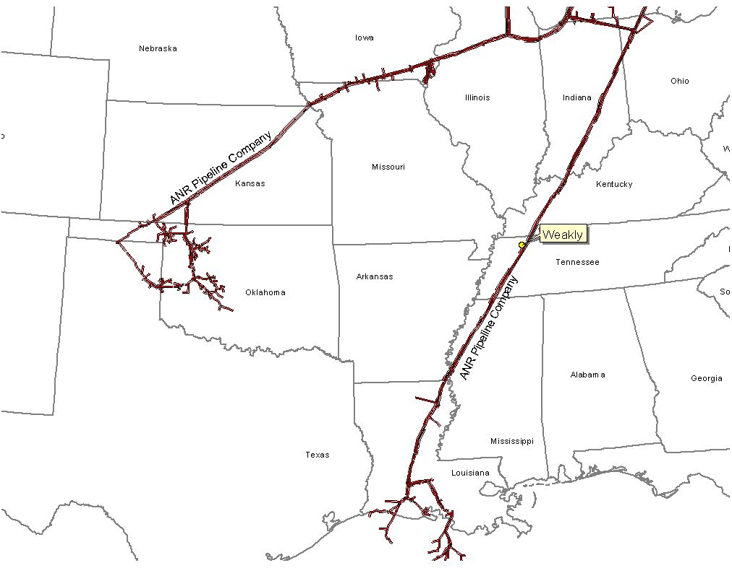
Gas Transportation
Gleason Overview
Pipeline: ANR Pipeline (“ANR”)
Delivery Point: ANR ML2 - Weakley County Interconnect
Base Contract:
  Service: ITS-3/IPLS
  Term: 10 years (Apr-Oct) beginning March 1, 2000
  Volume: 93,000 MMBtu/d
  Rate: $0.11 plus fuel and ACA from Chicago or SE LA
  Fuel: 0.0% on backhaul; 2.69% on forward haul
  Receipt Points: SE LA Header and Joliet, Ill.
  Balancing: $0.02 per MMBtu/d balancing up to 93,000 MMBtu
Backup Contract: Capacity release or seasonal firm can be used. Additionally, Gleason is party to a Precedent Agreement with ANR providing Gleason ability to purchase 80,000 MMBtu of firm capacity from Chicago to Gleason plant-gate
Balancing: IPLS service subject to economic dispatching and pipeline operational conditions; balancing-in-kind; allows for uneven hourly flow at plant delivery point with even 24-hour supply flow
Other: ANR will maintain lateral and meter for $6,000 per year; ANR constructed interconnect and owns hot tap and Electronic Measurement System; reasonable effort to provide 560 psi; if pressure is below 560 psi on day Gleason nominates gas using ITS-3 agreement, ANR will waive IPLS for volumes parked

Slide 12
Plant Location
Gleason Overview

Slide 13
Control Area Status
Gleason Overview
Gleason control area, ENGL, has been designated a control area in accordance with NERC policy
Control area designation is valuable for point to point power sales and scheduling of power
Control area options for Gleason purchaser include:
  control area services provided by TVA
  control area re-established by purchaser in accordance with NERC procedures
  control area and scheduling services provided by Enron affiliate under separate contract

Slide 14
Expansion/Conversion Opportunity
Gleason Overview
Gleason designed to facilitate future plant expansion and/or conversion to combined cycle
Request for interconnect expansion submitted to TVA in August 2000
Net heat rate could go from 10,900 Btu/kWh (HHV) currently to 7,000 (HHV), depending on equipment
Net output could go from 546 MW (nominal) currently to 850 MW (nominal), depending on equipment
Gleason conversion should take approximately 18 to 24 months
Installation of an SCR should facilitate getting a PSD permit for combined cycle operation

Slide 15
Environmental Specifications
Gleason Overview
Discharge Permit: Not Required
Air Permit: Non-PSD
NOx Control Method: Water injection
Compliance Method: CEMS
Limits: 249 T NOx per year
249 T CO per year
Actual Commission NOx: <25 ppm
Estimated Run Hours: 915

Slide 16
Operating Costs
Gleason Overview

Slide 17
Organizational Chart
Gleason Overview
Gleason is currently operated by Operational Energy Corp (“OEC”), an Enron Corp. subsidiary
It is anticipated that at closing, O&M contract with OEC will be terminated
Gleason personnel are employees of OEC

Slide 18
Legal Structure
Gleason Overview
Gleason Power I, L.L.C. (“Gleason Power”) leases the facility (including real property) from the Industrial Development Board of Weakley County for a term of 15 years beginning on September 16, 1999
Gleason Power has the right to buy the facility at any time during the term of the lease or within 90 days after the expiration thereof for $500.00
Gleason Power is a Delaware limited liability company and is 100% owned by Enron North America Corp.
Purchaser will acquire 100% of member interests in Gleason Power

Slide 19
October 2000
Confidential & Proprietary
Management Presentation
Wheatland Overview

Slide 20
Overview
Wheatland Overview
Plant Description: 508 MW (nominal) natural gas-fired, simple-cycle facility
Location: 60-acre tract in Wheatland, Indiana, in southern subregion of ECAR
Power Interconnect: Dual interconnect with Indianapolis Power & Light 345 kV and Cinergy 345 kV
Gas Interconnect: Midwestern Gas Transmission Pipeline - Westfork Interconnect
Start of Construction: October 1999
Commercial Operation Date: June 1, 2000
Approx. Max. Annual MWh: 461,313 at 59ºF
Approx. Run Hours: 902
NOx (per unit): <25 ppm
CO (per unit): <25 ppm

Slide 21
Facility Strengths
Wheatland Overview
“First-mover advantage” in a key Midwest market
ECAR has historically experienced extreme power price volatility
Ideally suited to capitalize on gas/power arbitrage opportunities
Expansion/conversion potential
  Site has room for additional gas turbines
  Turbine technology and layout allow for conversion to combined cycle
  Access to water through owned lake, potential back-up municipal supply
30-minute normal unit ramp-up from cold to full load

Slide 22
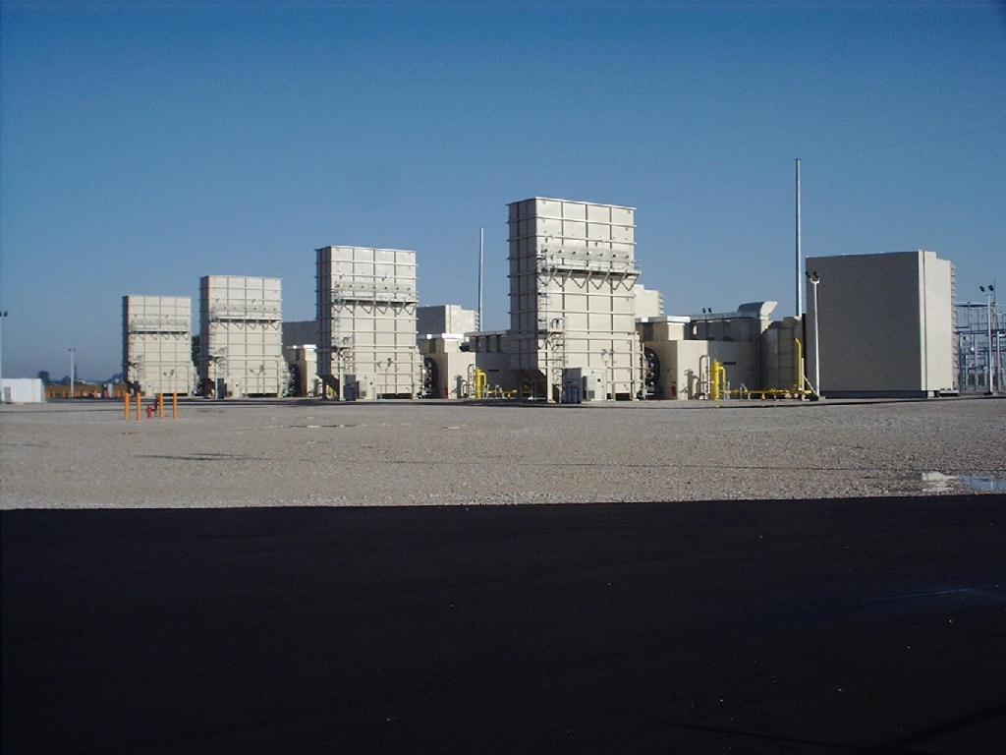
Plant Picture
Wheatland Overview

Slide 23
Regional Overview
Wheatland Overview
Wheatland Plant

Slide 24
Power Market Opportunities
Wheatland Overview
West Fork Land Development Company, L.L.C. is qualified as an Exempt Wholesale Generator and has authority to sell energy and capacity at market-based rates
Wheatland’s location in southern ECAR and access to eastern U.S. electricity market provide sales opportunities into wholesale power markets
Wheatland’s interconnection into two 345 kV lines provides option of dispatching into Cinergy Services Inc. and/or Indianapolis Power and Light systems
Wheatland’s location provides access into ECAR region with direct access to over 30 control area markets within two utility wheels

Slide 25
Equipment Overview
Wheatland Overview
Turbines: 4 Westinghouse 501 D5A turbines with evap. cooling
Turbine Warranty Expiration: June 1, 2001
Switchyard Equipment: ABB, 345 kV interconnect breakers
Switchyard Configuration: dual ring bus
Transformers: (2) ABB 333 MVA, 3 winding, 3 phase, 13.8 kV/345 kV
Control System: WDPF
Generator Circuit Breakers: (4) ABB HGC (7,500A)
Generator Voltages: 13.8 kV
Plant Distribution Voltages: 4160 V and 480 V

Slide 26
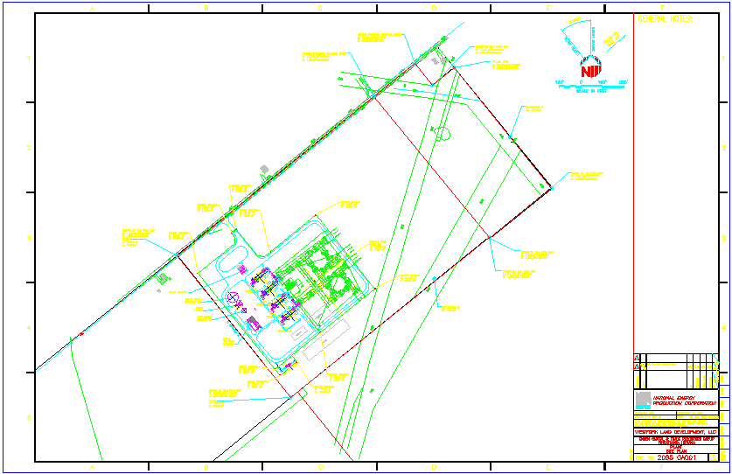
Plant Layout
Wheatland Overview

Slide 27
Performance Results
Wheatland Overview

Slide 28
Power Interconnection
Wheatland Overview
Interconnected to two 345 kV lines
Interconnection agreements with:
  Cinergy Services Inc. (“Cinergy”) into Qualitech-Gibson 345 kV line
  Indianapolis Power & Light (“IPL”) into Petersburg-Breed 345 kV line
With dual interconnect, Wheatland has option of dispatching into Cinergy and/or IPL systems

Slide 29
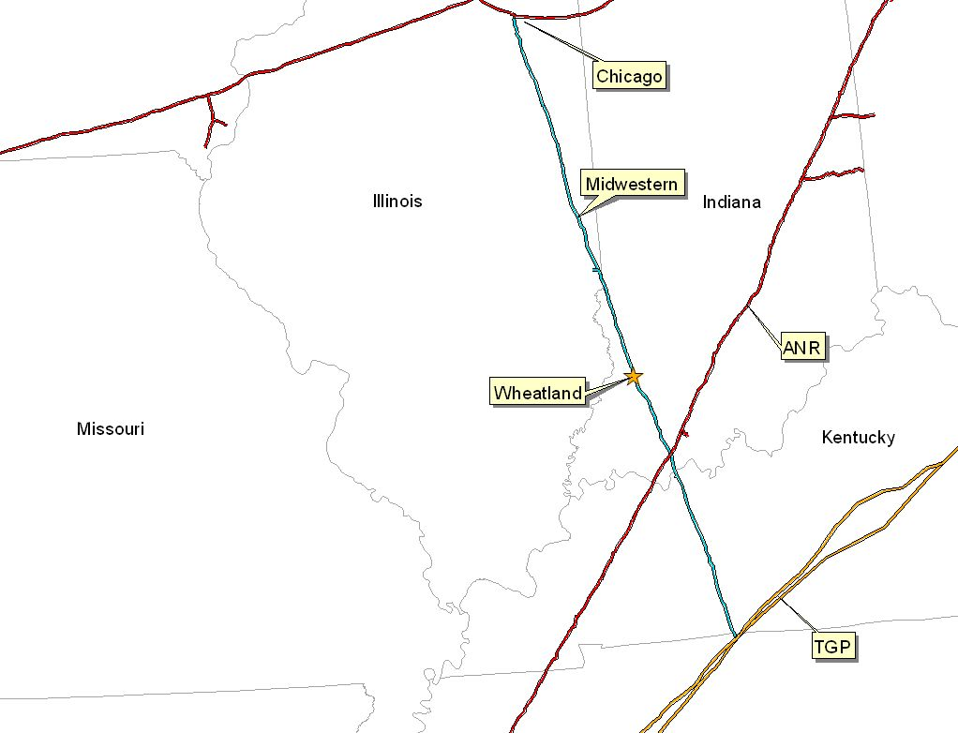
Gas Transportation
Wheatland Overview
Pipeline: Midwestern Gas Transmission Pipeline
Delivery Point: Wheatland Plant-gate
Base Contract:
  Service: IT
  Term: 8 years (Apr-Oct) beginning December 16, 1999
  Volume: 85,200 MMBtu/d
  Rate: 1st 3 Bcf: $0.0709 MMBtu/d
  3 to 5 Bcf: $0.0422 MMBtu/d
  5 Bcf & Up: Max. tariff rate, currently at $0.0781 per dekatherm mile
  Fuel: 0.05% on backhaul; 1.0% on forward haul
  Volume Commitment: None
  Receipt Points: Chicago and Tennesse Gas Pipeline - Portland Interconnect
Backup Contract: None in place; however, capacity release or seasonal firm can be utilized under terms of agreement
Balancing: Via OBA, with Midwestern Gas subject to tariff imbalance parameters (5% end of month; 10% daily imbalance limit if daily variance implemented). Allows for uneven hourly flow at plant gate with even 24 hour supply subject to pipeline operating conditions

Slide 30
Plant Location
Wheatland Overview

Slide 31
Control Area Status
Wheatland Overview
Wheatland control areas, ENMI and ENWC, have been designated control areas in accordance with NERC policy
Both Cinergy and IPL allow scheduling of energy into and out of each control area, giving Wheatland option of generating power or filling scheduled energy delivery commitment from market when market economics warrant
  enables playing day-ahead versus intra-day hourly market to maximize optionality
  added flexibility ensures that plant is reserved for operation only during periods of economic dispatch
Control area options for Wheatland purchaser include:
  control area services provided by IPL and/or Cinergy
  control area re-established by purchaser in accordance with NERC procedures
  control area and scheduling services provided by Enron affiliate under separate contract

Slide 32
Expansion/Conversion Opportunity
Wheatland Overview
Wheatland designed to facilitate future plant expansion and/or conversion to combined cycle
Net heat rate could go from 11,500 Btu/kWh (HHV) currently to approximately 7,800 (HHV), depending on equipment
Net output could go from 508 MW (nominal) currently to 850 MW (nominal), depending on equipment
Wheatland conversion should take approximately 18 to 24 months
Installation of an SCR should facilitate getting a PSD permit for combined cycle operation

Slide 33
Environmental Specifications
Wheatland Overview
Discharge Permit: Not Required
Air Permit: Non-PSD
NOx Control Method: Water injection
Compliance Method: CEMS
Limits: 250 T NOx per year
250 T CO per year
Actual Commission NOx: <25 ppm
Estimated Run Hours: 902

Slide 34
Operating Costs
Wheatland Overview

Slide 35
Organizational Chart
Wheatland Overview
Wheatland is currently operated by Operational Energy Corp (“OEC”), an Enron Corp. subsidiary
It is anticipated that at closing, O&M contract with OEC will be terminated
Wheatland personnel are employees of OEC

Slide 36
Legal Structure
Wheatland Overview
West Fork Land Development Company, L.L.C. (“West Fork”) has fee simple ownership of facility (including real property)
West Fork is a single member (Enron North America Corp.) Delaware limited liability company and is 100% owned by Enron North America Corp.
The lake, which provides water to the plant, is owned by Lake Acquisition Company, L.L.C. (“Lake Acquisition”), a single member Delaware limited liability company, and is leased to West Fork
Purchaser will acquire 100% of member interests in both West Fork and Lake Acquisition

Slide 37
October 2000
Confidential & Proprietary
Management Presentation
Lincoln Energy Center Overview

Slide 38
Overview
Lincoln Energy Center Overview
Plant Description: 656 MW (nominal) natural gas-fired, simple-cycle facility
Location: 50-acre tract in Manhattan, Illinois, in ComEd subregion of MAIN
Power Interconnect: ComEd Wilton Center Substation
Gas Interconnect: Northern Border Pipeline - near Manhattan South Interconnect
Start of Construction: September 1999
Commercial Operation Date: June 1, 2000
Approx. Max. Annual MWh: 2,002,000 at 59ºF
Annual Run Hours: 3,250
NOx (per unit): <9 ppm
CO (per unit): <25 ppm

Slide 39
Facility Strengths
Lincoln Energy Center Overview
“First-mover advantage ” in a key Midwest market
MAIN and Chicago area have historically experienced extreme power price volatility
Flexible gas arrangements in Chicago area allow access to ANR Pipeline Company and Northern Border Pipeline Company and other arbitrage opportunities
Expansion/conversion potential
  Site has room for additional gas turbines
  Turbine technology and layout allow for easy conversion to combined cycle
  Access to water with onsite wells

Slide 40
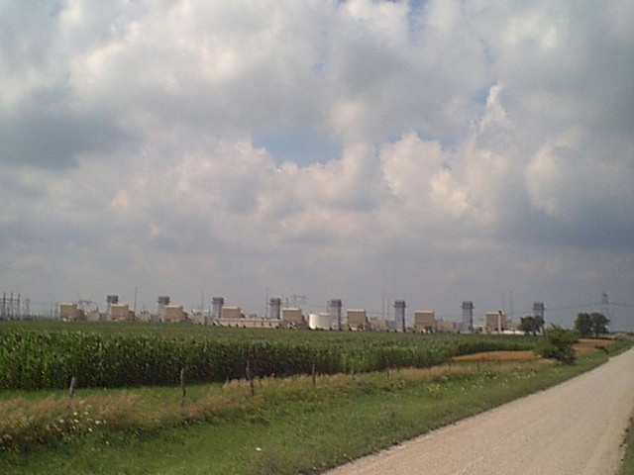
Plant Picture
Lincoln Energy Center Overview

Slide 41
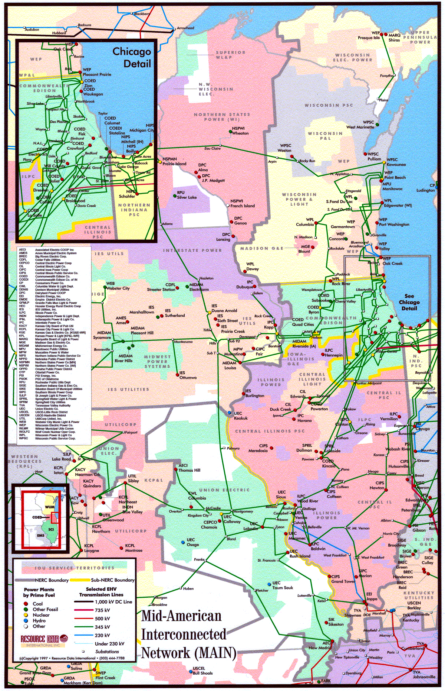
Regional Overview
Lincoln Energy Center Overview
Lincoln Energy Center

Slide 42
Power Market Opportunities
Lincoln Energy Center Overview
Des Plaines Green Land Development, L.L.C. is qualified as an Exempt Wholesale Generator and has authority to sell energy and capacity at market-based rates
Lincoln’s location in ComEd and access to Chicago and other Midwestern and eastern electricity markets provide sales opportunities into wholesale power market
ENLC is within two utility wheels from over 30 control areas

Slide 43
Equipment Overview
Lincoln Energy Center Overview
Turbines : 8 General Electric 7EA gas turbines with evap. cooling
Turbine Warranty Expiration: May 30, 2001
Switchyard Equipment: ABB, 345 kV interconnect breakers
Switchyard Configuration: radial
Transformers: (4) ABB 208 MVA, 3 winding, 3 phase, 13.8 kV/345 kV
Control System: General Electric Mark V
Generator Circuit Breakers: (8) ABB HGC (7,500A)
Generator Voltages: 13.8 kV
Distribution Voltages: 4160 V and 480 V
LINCOLN ENERGY CENTER
ENLC
345 kV
B
G8
345 kV line to:
B
Com
Ed
GSU T34
B
G7
Substation
B
G6
B
GSU
T33
B
G5
B
G4
B
GSU T32
B
G3
B
G2
B
GSU T31
B
G1
Unit MW Rating:
Summer
Nominal
Winter
79
82
88
B = Breaker
GSU = Generator Step-up Unit

Slide 44
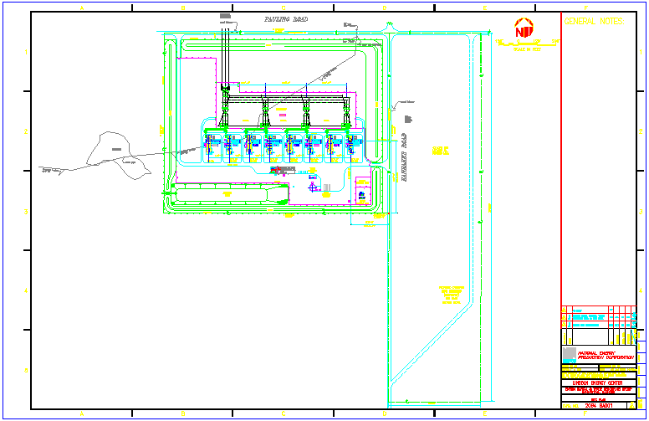
Plant Layout
Lincoln Energy Center Overview

Slide 45
Performance Results
Lincoln Energy Center Overview

Slide 46
Power Interconnection
Lincoln Energy Center Overview
Connected directly to the ComEd Wilton Center Substation (via a 345 kV generator lead)
ComEd Wilton CenterSubstation is connected to five transmission lines: three 345 kV lines (ComEd) and two 765 kV lines (AEP)
Each 765 kV line has significant available transmission capacity during periods of peak load
Interconnection provides direct access to ComEd’s service territory
ComEd Wilton Center Substation also has direct access to eastern markets (e.g. AEP) via 765 kV line

Slide 47
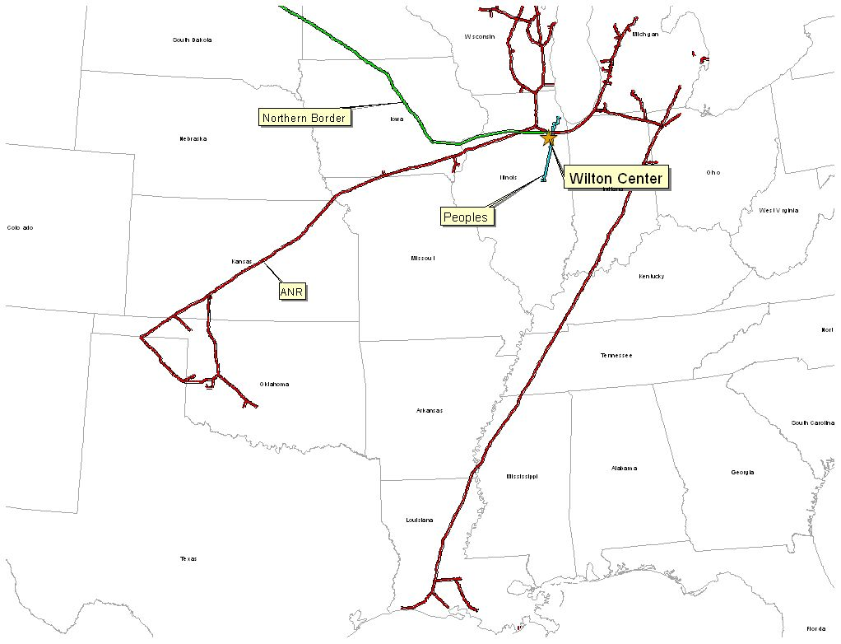
Gas Transportation
Lincoln Energy Center Overview
Pipeline: Northern Border Pipeline (“Northern Border”)
Delivery Point: Manhattan Station
Base Contract:
  Service: IT-1 Transport
  Term: 2 Years beginning March 1, 2000
  Volume: 200,000 MMBtu/d
  Rate: Maximum Tariff Rate, currently $0.04038 per 100 dekatherm mile
  Fuel: Varies depending on haul
  Receipt Points: Master receipts on Northern Border
Back-up Contract: ANR - IWS is $0.01/dth/day and IPLS is $0.03/dth/day up to 115,000 MMBtu/dth/day. Beginning November 2000, IWS will increase to $0.1575/dth/day while IPLS goes to $0.2894/dth/day. Contract will expire in April 2001.
Balancing: Via OBA, with Northern Border. Off system balancing provided via IPLS and IWS agreements with ANR Pipeline

Slide 48
Plant Location
Lincoln Energy Center Overview

Slide 49
Control Area Status
Lincoln Energy Center Overview
Lincoln Energy Center control area, ENLC, has been designated a control area in accordance with NERC policy
Control area designation is valuable for point to point power sales and scheduling of power
Control area options for Lincoln Energy Center purchaser include:
  control area services provided by ComEd
  control area re-established by purchaser in accordance with NERC procedures
  control area and scheduling services provided by Enron affiliate under separate contract

Slide 50
Expansion/Conversion Opportunity
Lincoln Energy Center Overview
Lincoln Energy Center designed to facilitate future expansion and/or conversion to combined cycle
Net heat rate could go from 11,900 Btu/kWh (HHV) currently to approximately 8,000 (HHV), depending on equipment
Net output could go from 656 MW (nominal) currently to approximately 1,000 MW (nominal), depending on equipment
Lincoln Energy Center conversion should take approximately 18 to 24 months
Installation of an SCR should facilitate modifying PSD permit for increased run hours beyond the existing 3,250 hour permit

Slide 51
ComEd Contract Terms
Lincoln Energy Center Overview
Lincoln Energy Center has sold 600 MW of regulatory capacity and energy to ComEd
  Term of the contract is for the summer periods, June 1 through September 30, 2000 through 2002
  Capacity Payments total $12 million per year, paid each calendar month during the summer periods at $5.00 / kw-month
  A maximum of 600 MWs of capacity/energy is to be supplied at ComEd’s election either from the Lincoln Energy Center or from the market
  Energy is priced based upon a “market price” which is determined in accordance with the terms of the agreement
  Lincoln Energy Center purchaser will assume all obligations under the agreement

Slide 52
Environmental Specifications
Lincoln Energy Center Overview
Discharge Permit: Not Required
Air Permit: PSD
NOx Control Method: GE Dry Low - NOx Combustor
NOx Compliance Method: CEMS
Actual Commission NOx: <9 ppm
Actual Commission CO: <25 ppm
Permitted CO Limit: <25 ppm
NOx Permit Limits
Hourly: <15 ppm
Monthly: <12 ppm
Annually: <9 ppm
Estimated Run Hours: 3,250

Slide 53
Operating Costs
Lincoln Energy Center Overview

Slide 54
Organizational Chart
Lincoln Energy Center Overview
Lincoln Energy Center is currently operated by Operational Energy Corp (“OEC”), an Enron Corp. subsidiary
It is anticipated that at closing, O&M contract with OEC will be terminated
Lincoln Energy Center personnel are currently employees of OEC

Slide 55
Legal Structure
Lincoln Energy Center Overview
Des Plaines Green Land Development, L.L.C. (“Des Plaines”) is a Delaware limited liability company and is 100% owned by Enron North America Corp.
Des Plaines has fee simple ownership of facility (including real property)
Energy Finance Company, L.L.C. (“EFC”) is a Delaware limited liability company and is 100% owned by Enron North America Corp.
Des Plaines and EFC have entered into Equipment Sale Agreement
  Illinois sales/use tax due on equipment is deferred over fifteen years
  early payments primarily interest (which is exempt from sales/use tax), thus increasing present benefit of deferral
Purchaser will acquire 100% of member interest in both Des Plaines and EFC

