Slide 1
Technical Overview
(Draft – Typically conducted as a separate or follow-on technical discussion)

Slide 2
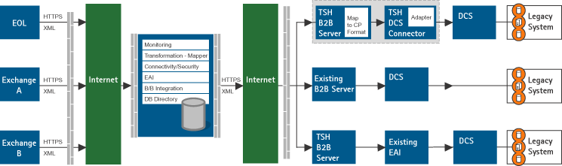
Technical Overview
The proposed technical overview below summarizes the Hub’s Straight Through Processing (STP) capability.

Slide 3
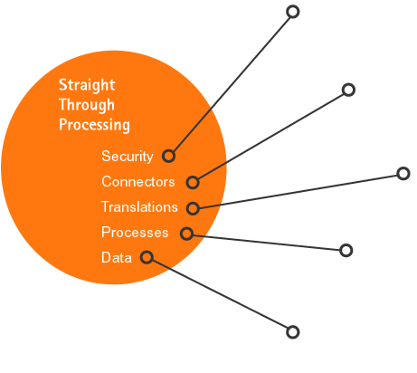
STP Components
The STP capability will be comprised of key components to ensure integrity, reliability, and availability.
A flexible security layer ensures the right information gets reliably to only the right counterparty
Connectors provide connectivity between counterparty applications/devices
A translation layer converts common data and processes into and out of internal view regardless of the originating data standard
Common processes are the internal workflows and business rules that are to be used for all interactions
A common data model acts as the common language for all conversations

Slide 4
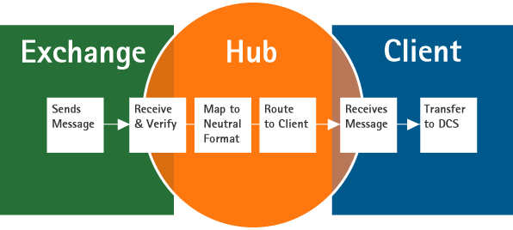
Common Processes and Data Model
The role of the Hub is to facilitate the establishment of common neutral formats and processes to enable interaction between trading partners.

Slide 5
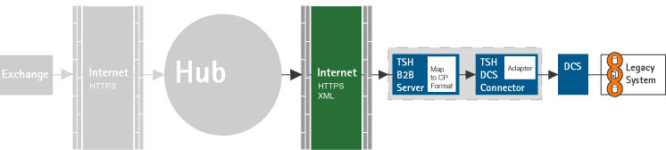
Connector and Translations
To facilitate CP communicating to the Hub we will maintain connectors to leading DCS packages.

Slide 6
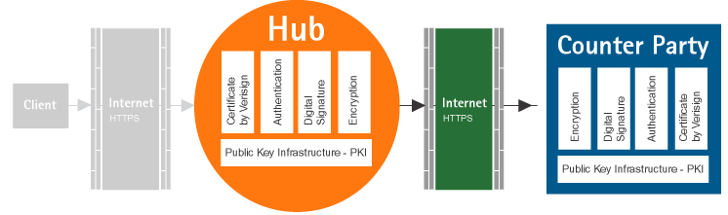
Security
A combination of HTTPS, digital signatures, and certificates will enable authentication and encryption. In addition, RNF compliant enveloping will be used for routing messages.

Slide 7
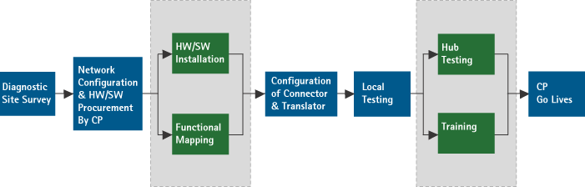
Approach
Our comprehensive approach is aimed at integrating quickly and efficiently.

