Slide 1

MID YEAR 2001 PRC & PEP
EMPLOYEE & SUPERVISOR GUIDE
Shape Your Future
http: //pep.enron.com

Slide 2
Scope – Employee Training
An Overview of the PRC Process
A Chronological Walk-Thru of the PEP System

Slide 3
What is PRC?
PRC = Performance Review Committee
  A panel of business unit managers who determine an employee’s overall rating based on performance feedback and performance relative to their peers
The PRC Process
  allows Enron to evaluate employee performance and determine an overall performance rating across functional groups, departments and business units worldwide
  is a tool used to determine
    promotion potential
    career development
    various compensation elements

Slide 4
What is PEP?
PEP = Performance Evaluation Process System
  a web-based application that automates the PRC communications to employees
  a vehicle for gathering performance feedback
  a repository for statistical data and consolidated feedback which assist supervisors in developing and delivering comprehensive performance evaluations to employees

Slide 5
How does it work?
A 360° feedback process allows employees
to receive feedback from
selected reviewers on established criteria.
The PRC members evaluate
employee performance and
determine an overall,
relative rating in the
PRC meeting.
A one-on-one evaluation meeting
with your supervisor
is conducted, in which you
receive performance feedback.

Slide 6
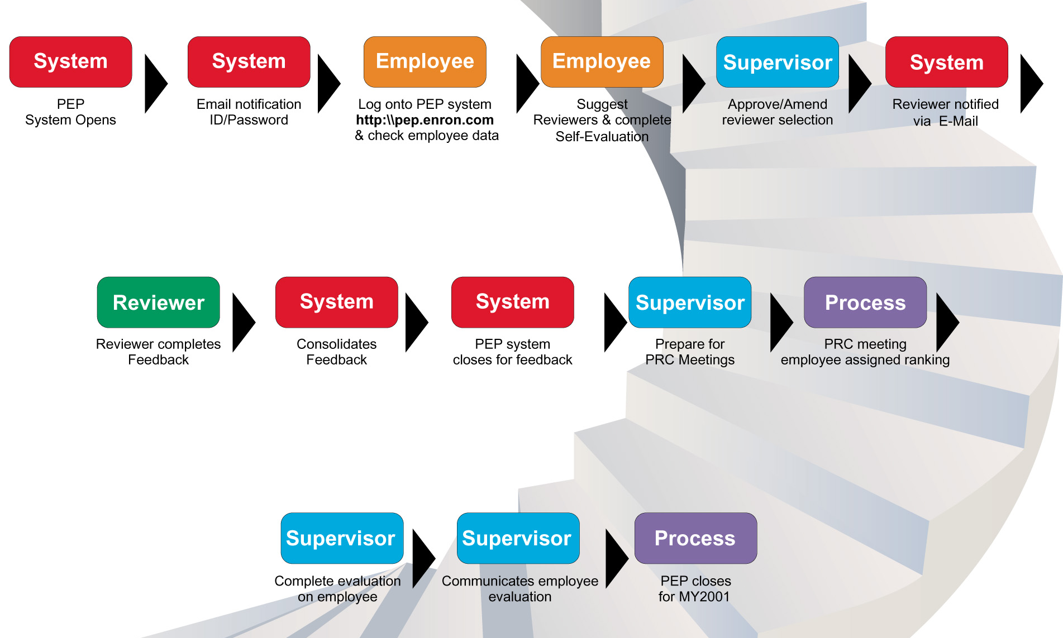
PEP Steps – The Process

Slide 7
Welcome to PEP
When the PRC Process opens for feedback, each employee will receive an email containing everything they need to get started.
Website
Address
PEP Initial
Password
PEP
User ID
Your initial password is randomly generated; you will be required to change it at your initial login.

Slide 8
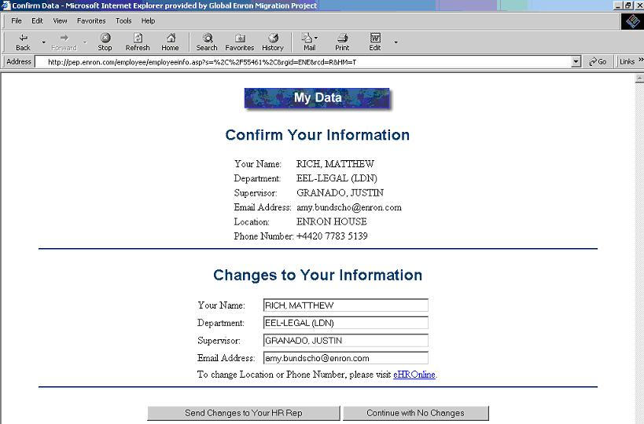
Check Your Data
When you log onto the PEP system at
http://pep.enron.com
you will be asked to
check your employee data

Slide 9
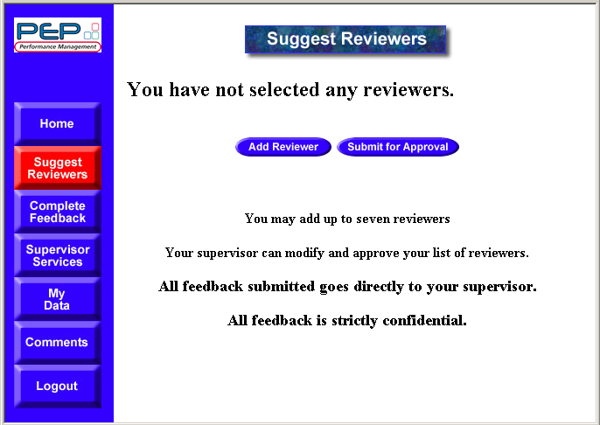
Carefully Choose Reviewers
Suggest reviewers who can provide
substantial and meaningful
feedback on your performance.
We recommended
a minimum 5 reviewers
1 Manager
1 Subordinate
3 Peers
Maximum number of reviewers is 7

Slide 10
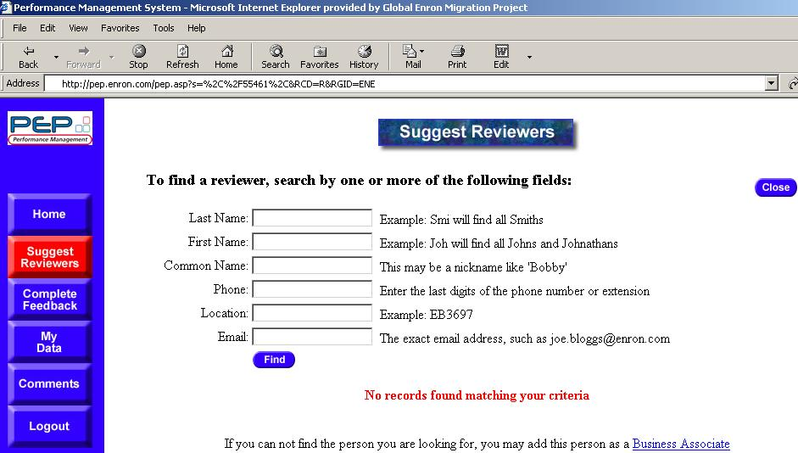
Searching for Reviewers
Search for reviewers by various
categories such as name,
location, and email address.

Slide 11
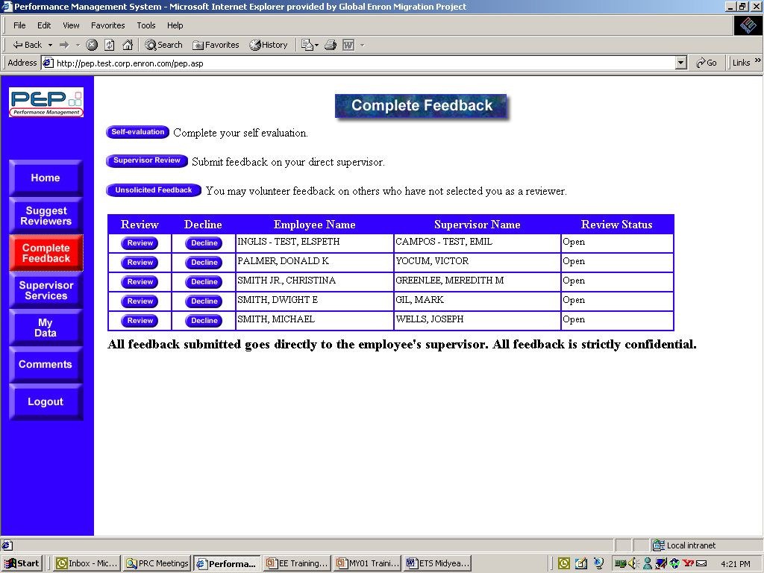
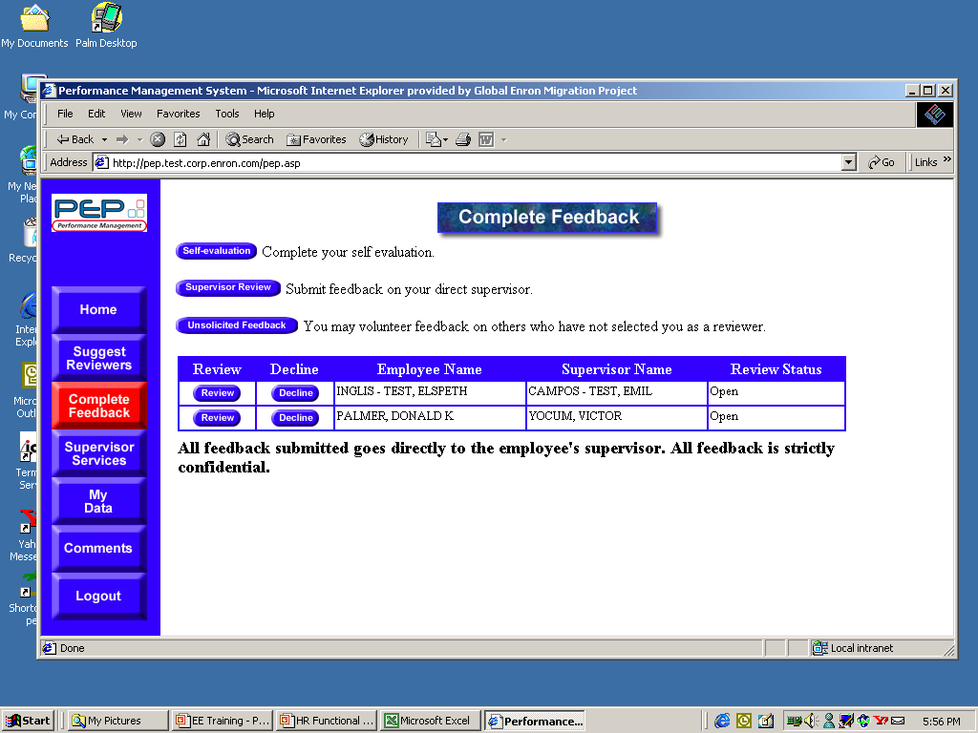
Completing Your Self Evaluation
The Self Evaluation allows you to list
up to 5 accomplishments achieved
during the review period.
Shape
Your
Future
The accomplishments you list
can be viewed during
a PRC meeting.

Slide 12
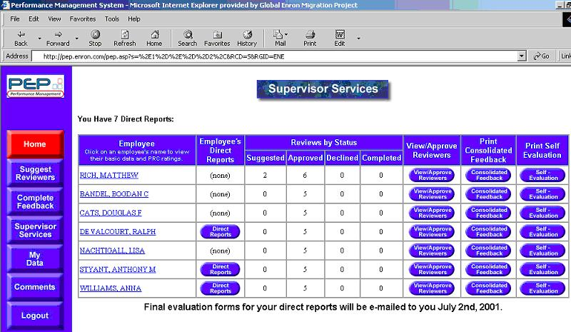
Supervisor Approves Reviewers
Feedback statistics
can be viewed
in PRC meetings.
Supervisor
Supervisor
Promptly make any
modifications to the list
of suggested reviewers.
Requests for feedback cannot be generated
until the supervisor has approved
an employee’s list of reviewers.

Slide 13
Reviewers Complete Feedback
Can you provide
specific examples to illustrate
his/her performance?
Do you know how the
person performs
his/her role?
Carefully consider these
points before accepting
to review someone.
Are you available and
willing to share your knowledge
of his/her performance?
Can you respond
in a timely manner?

Slide 14
PEP Notifies Selected Reviewers
If you choose to decline, please do so
quickly, so that the employee’s supervisor
is able to choose another reviewer.
Supervisor
Supervisor
Process

Slide 15
Unsolicited Feedback
You may provide unsolicited feedback
on an employee that has not selected you
as a reviewer.
Supervisor
Supervisor
Process

Slide 16
Supervisor Feedback
You may provide feedback
on your supervisor even if you have not
been formally selected to review him/her.

Slide 17
PEP Closes for Feedback
PEP closes
For feedback on
MAY 25, 2001
Supervisor
Supervisor
Process
Be sure to complete your Self Evaluation
and any outstanding reviews before
the system closes.

Slide 18
Preparing for PRC Meetings
Prepare meaningful examples
of an employee’s performance.
Be sure to give the PRC representative
sufficient time to review employee
materials if you will not be present
in the PRC meetings.
Review each employee’s
Consolidated feedback and Self
Evaluation in advance of the meeting.
Prepare a preliminary rating
for each employee
before the meeting.
Take this supporting information into
the PRC meeting or deliver to the
employee’s PRC representative.

Slide 19
Preparing Written Evaluations
At the end of the PRC process, a performance evaluation
is given by the supervisor to the employee.
Evaluation
Consolidated
Feedback
Supervisor’s
Observations
PRC Meetings’
Relative Ranking
Feedback should be relevant,
appropriate and substantiated with
specific examples
Be open, factual and detailed

Slide 20
One-on-One Evaluation
SUPERVISORS
EMPLOYEES
The key to an
effective evaluation
meeting is preparation!
Make a list of the items
you wish to discuss
before the meeting.
Make a list of the items
you wish to discuss
before the meeting.
Actively listen – give the employee
the opportunity to contribute
to the discussion.
Actively listen and
acknowledge what is said.
Maintain focus on feedback
that is relevant and fair.
Ask questions. If you do not
understand what is being said, ask
for clarification and examples.
Discuss specific
areas for development and
performance goals.

Slide 21
Mid Year 2001 PRC is Complete
All employee evaluations should
Be communicated to employee
And returned to HR by
August 31, 2001

