Slide 1
Alberta Power Purchase Arrangements (PPA)
(The Next Phase in the Deregulation of the Alberta Power Market)

Slide 2
Alberta Power Purchase Arrangements (PPA)
The Alberta Government is auctioning off 75% (6400 MW) of the total generation capacity in the province in the form of 12 PPAs on August 2, 2000.
The current generators (Transalta, ATCO and Edmonton Power) will continue to own and operate the facilities and will be guaranteed payments if they meet certain volume commitments.
The buyer of the PPA owns the output of the plant and has dispatch rights over the facility.
The government has set minimum opening bids which we believe will eliminate certain PPAs from the process, leaving 4200-5500 MW’s available for purchase.
No one buyer can purchase more than 20% or 1390 MW’s. Therefore a minimum of 4 participants will win a PPA.
Currently, there are only 7 invited bidders.

Slide 3
Alberta Power Purchase Arrangements (PPA)

Slide 4
Key Alberta Fundamentals
Alberta is the most fiscally responsible province, which is leading to significant economic expansion.
Growth in power demand has been 2.8% per year over the last four years, with 3.9% growth over the past twelve months.
There is one major tie-line to/from British Columbia that provides an outlet to the US Northwest market if Alberta overbuilds. (Currently only 100 MW can exit during peak hours, but 400 MW can be exported during off peak hours.)
There is also a 150 MW tie-line to/from Saskatchewan.
Only 500 MW of new generation is expected to be built over the next few years.
The coal units are large relative to the size of the market (roughly 5% for a 350 MW unit), leading to price spikes when unexpected outages occur.
All demand in Alberta will be exposed to the pool price when the term of the PPA begins. (Potential hedgers)

Slide 9
Example of PPA
Unit Term Fuel Capacity Target Variable Fixed Total
Commitment Availability Cost* Cost
Sundance B 2020 Coal 706 MW 86% $11.28 $19.50 $30.78
*Includes Transmission Costs
Swap Bid Equals $35/MW PPA Auction Bid $229,000,000
→ Paid to the Balancing Pool Up Front

Slide 10
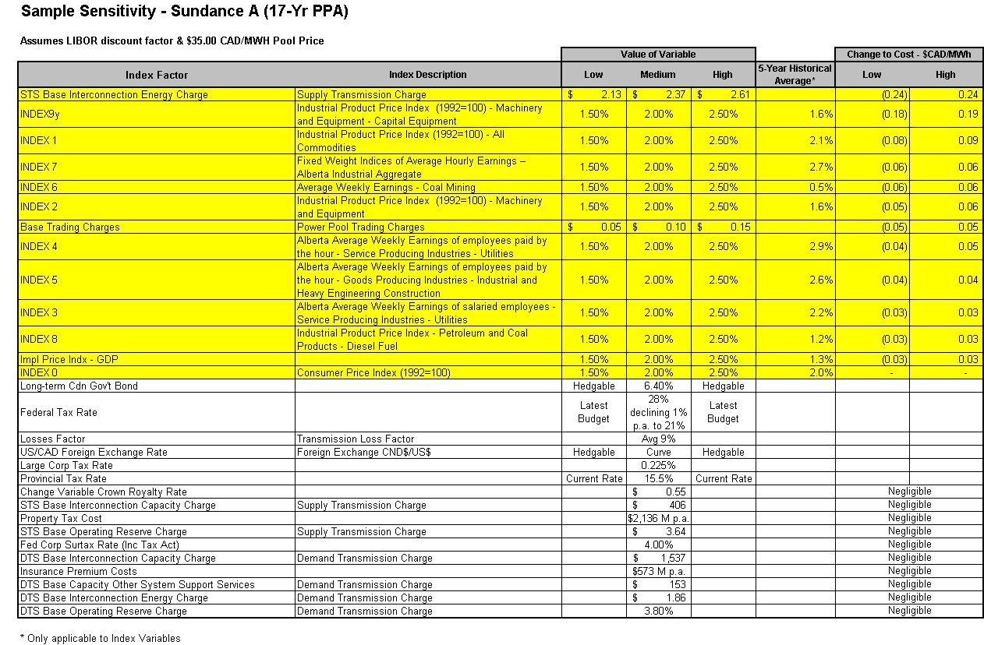
Sample Sensitivity - Sundance A (17-Year PPA)

Slide 11
Alberta PPA Summary

Slide 12
Pros/Exit Strategy
An unusual structure has led to few participants in the auction - opportunity to buy a PPA with significant value.
PPA auction rules allow for progressive bidding.
There may be opportunities to monetize a PPA position in the future, with natural buyers in Alberta who were too small to participate in the auction.
There may be opportunities to monetize in the future with players that were not familiar enough with the Alberta market to participate.
Output can be sold into the pool.
The PPAs present an opportunity to establish a dominate position in the Alberta electricity market.
If actual Calendar 2001 Alberta pool prices equal the Mid-C forward curve (i.e. 76.00 CAD/MWh), Enron will make $150 - $220 MM CAD depending on the unit for Calendar 2001.
Enmax transaction.

Slide 13
Enmax Energy Transaction
Enron is attempting to purchase a 10-year put option with a strike price of $40.00 CAD/MWh, on 200 MW/h.
The Enmax transaction provides a floor for a portion of any PPA transaction.
The combination of this put and Enron’s potential long PPA position forms a synthetic call.
Payment to Enmax of $19 MM CAD.
Theoretical value of $30 MM CAD - $50 MM CAD.
Next steps
  July 18, 2000 - Accounting treatment/ Compliance discussions
  Completion of ISDA
  Funding vehicle
  July 24, 2000 - Enmax Board meeting for approval

Slide 14
Cons
The Government has the option to accept or decline bids even if they are higher than the minimum opening bid. (All or none provision - must accept either all or none of the bids received over the minimum bid.)
Non delivery on the generators part results in a payment vs. the average pool price over a 30 day period rather than the specific hour they did not deliver (not as valuable as firm power).
Fixed and variable costs can change.
Legal
Credit

Slide 15
Legal Issues
Enforceability.
  There is no signed purchase contract or asset purchase agreement. Therefore, as a buyer we would enforce our rights under Alberta Government regulations, governing the PPAs.
Non-market nature of PPA regulations.
  Analogous to a unit contingent, non-firm physical power purchase arrangement.
  Broad force majeure provisions.
  Termination provisions without the “replacement contract” concept.
Buyers recourse limited to the Seller (Generator).
  Financial covenants have been made by neither the Generator, nor the Alberta Government.
Interpretation and enforcement of PPAs.
  Political considerations will likely impact the interpretation and enforcement of the PPAs - especially when power prices are high.
The above risks require any bid to be discounted to no more than __% of the value.

Slide 16
Credit Issues

Slide 17
Strategy/To Do
Get approval to bid on some or all units up to a pre-determined level (Currently assuming $35.00 CAD/MWh).
Bid level will have significant value to cover legal risks, credit risks, as will as provide significant margin.
Check models internally.
Check models externally (ideally with the government).
Answer coal questions.
Applicable accounting treatment (i.e. executory contract status).
Complete due diligence.
Funding

