Slide 1

E-Commerce is the Future
Mike S. McConnell
President & CEO
Enron Global Markets
Coal Market Strategies
October 24, 2000
Scottsdale, Arizona

Slide 2
“ It is Not the Strongest of the Species
That Survives, Not the Most Intelligent,
but the Most Responsive to Change.”
Charles Darwin
The Origin of the Species

Slide 3
Enron Global Markets Coal Group
Formed in 1997 to leverage commodity expertise in the domestic and overseas coal markets
Currently the largest domestic coal trader with 25 million tons shipped in 1999 and over 80 million tons transacted in 2000 including over 28 million tons under contract for delivery
International coal trading and finance group formed in January 1999 with 1.7 million tons shipped in 1999 and over 30 million tons transacted in 2000 including 20 million tons under contract for delivery in 2000
Leader in risk management products and services, producer finance, E- commerce and OTC markets

Slide 4
Enron Global Coal Offices
London
Frankfurt
Pittsburgh
Charleston
Tokyo
Houston
Singapore
Johannesburg
Sydney

Slide 5
U.S. eCommerce Growth
B2B
B2C
Source: Forrester Research, Inc.

Slide 6
Worldwide eCommerce Growth
Source: Forrester Research, Inc.

Slide 7
“ In five years time, all companies will be
internet companies, or they won’t be
companies at all.”
Andrew Grove
Chairman, Intel Corp.

Slide 8
Current Online Products
Coal - Domestic
Coal - International
FFA - Vessels
Currency Hedge
Credit Protection
Weather Hedge

Slide 9
What are the Production Costs of “E” Coal?
Transaction Costs - Zero
Transmission Costs - Zero
Speed - Instantaneous
Marginal Cost of Production - Zero
More information and more transparency equals increasing volatility and risk.

Slide 10
Standardized Contracts - Market Advantages
Standardized contracts allow:
Increased liquidity - Any player can be both a buyer and a seller
Physical and financial risks are eliminated with true back-to-back trades
Reduced transaction costs - OTC-minimal ; EOL-zero
Transparent pricing in support of pricing indices - The key to a liquid forward market
Explicit valuation of embedded options - Option value still hidden in most transactions
Generic specifications facilitate development of basis trades - minimizing transportation risks and stocking costs
Active market place allows generators and producers to better manage short term needs in changing market conditions
Smaller contract size promote broader participation in the market
Generators
Producers
Traders
Financial Players

Slide 11
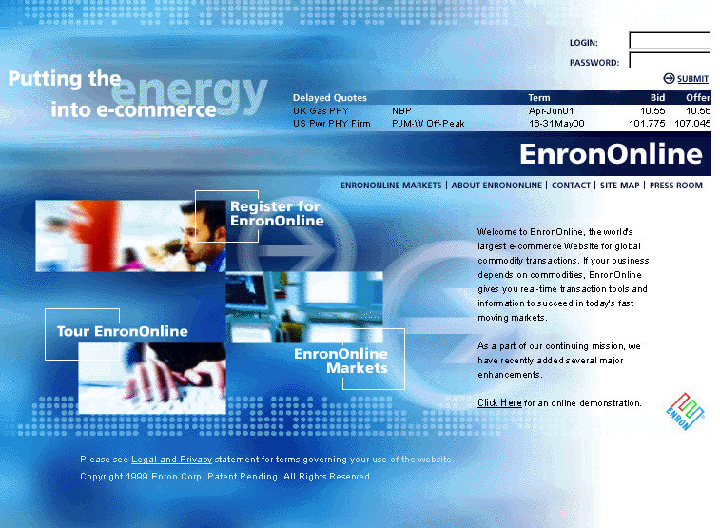
www.EnronOnline.com - B2B In a Commodity Market

Slide 12
EnronOnline Statistics
General
Number of Products - Approximately 1,000
Number of Transactions - 373,000
Dollar Volume - $197 billion
Number of Currencies - 13
Coal
Number of Products - 37
Number of Transactions - 1450
(Dec 1999 to Date)

Slide 13
Utilization of EnronOnline All Products
(% of AllTransactions)
Traditional Channels
EnronOnline

Slide 14
EnronOnline Coal Transactions
(% of Coal Transactions)

Slide 15
Increasing Monthly Volatility
NYMEX - Look Alike

Slide 16
Domestic EOL and OTC Markets - YTD
NYMEX - Look Alike
PRB
YTD Trades
YTD Tons
Annualized Tons
YTD Trades
YTD Tons
Annualized Tons
EOL*
1035
26,036,000
31,243,000
417
20,108,000
24,130,000
OTC**
391
17,250,000
20,700,000
244
28,750,000
34,500,000
Total
1,426
43,286,000
51,943,000
661
48,858,000
58,630,000
YTD Trades
YTD Tons
Annualized Tons
Total
2,087
92,144,000
110,573,000
* EOL since Dec 99
** Estimate

Slide 17
Other B2B Coal Markets
Inter-Continental Exchange -Trading Platform
Trade-Spark - Trading Platform
Dynegydirect - Trading Platform
Freemarkets - Auction Platform
DealBench - Auction Platform

