Slide 1
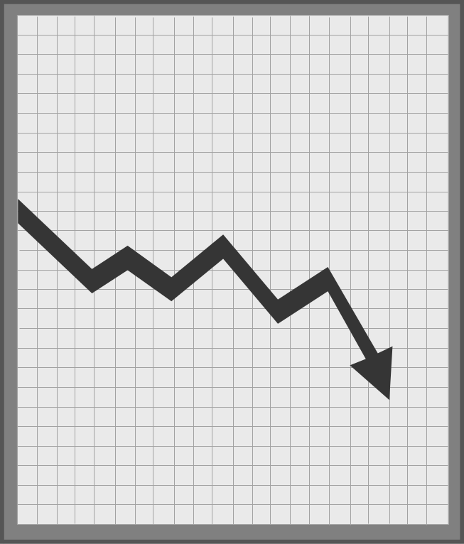
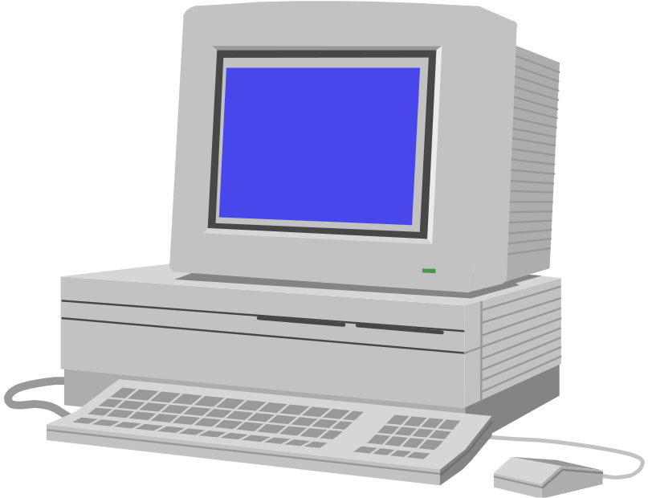
MDMAv2.1 BACK END
(UNIX, Sun Solaris 2.6)
Account & AccountMeter, Usage
LEGACY for
CA
PECO
STAT
Data Push
Process Using
Trigger
STAT file
(Account/Meter data)
Account
Data
Account &
UsageForecast for CA market
Enron
Forecasting
Group
California UDC WEB
(PG&E, SDG&E, SCE), CMEP Format
MDMA Batch
Export(FTP)
UDC
Usage dB for
CA Market
EDI Conversion & Push
Process
EDI 867 Files(consumption data)
PECO, PG&E, SCE and SDG&E
Usage for Non UDC Meter for CA market
EDI Conversion & FTP
Process
DLF and DLP files feed
MDMA Batch
Import
Usage dB
MV90 files(consumption data from Enron Meter)
UsageEDI
EDI Files (consumption data)
PECO (UDC)
WAN or GISB(after Jun 30)
Data Push
Process
MV90
Usage Data
MV90 Conversion
MDMA dB
(Oracle 8.x)
ISO
(MDEF Format)
MMS Batch Update
MDMA - UDC WEB SITE (INTERNET, Windows NT/IIS)
HTTP Request
(http://web site)
All legal and business guidelines apply to this web server for
California market
Data Pull
Process
Account meter
mapping
for MV90
MMS tables
<HTML>
<% ASP Code %>
<HTML>
Gets Page
CSC Fire Wall, Dublin, OH
MDMAv2.1 APPLICATION (FRONT END) (Intranet)
Interprets
ASP Code
Metering
information
for
Non UDC
Meter
Data
<HTML>
MDMA/MMS
</HTML>
Server Response
Gets Page
<HTML>
<% ASP Code %>
<HTML>
NT / IIS WEB Server
HTTP Request
(http://web site)
Enron IDR or Cogent Meters
Interprets
ASP Code
(Reads Data every 15 minutes)
NT/IIS WEB Server
<HTML>
MDMA/MMS
</HTML>
Server Response
IE Browser creates the web page
MDMA/MMS
MDMAv2.1 System Flow Diagram
Business Users (Houston)
(Version 1.0, dated 6/20/00)
Prepared By:nbhatt

