Slide 1

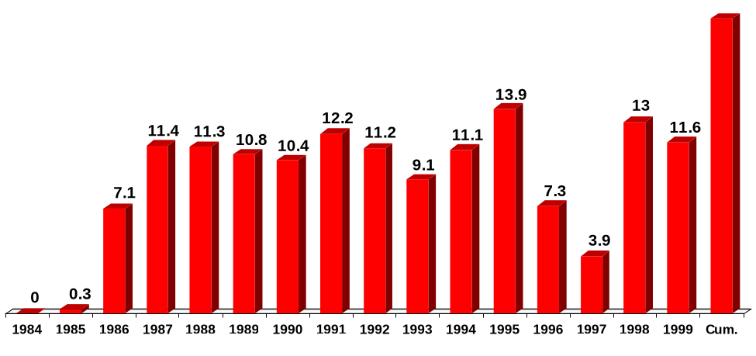
U.S. Natural Gas Deregulation Trends
Decrease Natural Gas Costs at the City Gate Since 1984
($ Billions in Nominal 1984 Dollars)
The cumulative decrease in U.S. natural gas prices at the city gate since 1984 are $144.6 Billion dollars in nominal terms
$144.6
Source: U.S. DOE Natural Gas Annual, Natural Gas Monthly, May 2000

Slide 2

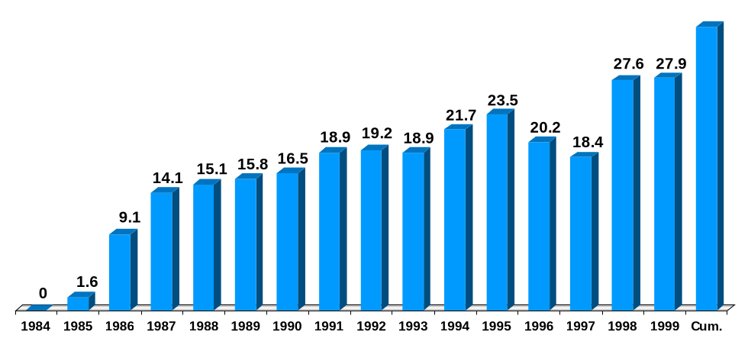
U.S. Natural Gas Deregulation Trends
Decrease Natural Gas Costs at the City Gate Since 1984
($ Billions in Real 1984 Dollars)
The cumulative decrease in U.S. natural gas prices at the city gate since 1984 are $268.5 Billion dollars in real terms
$268.5
Source: U.S. DOE Natural Gas Annual, Table 21, and Natural Gas Monthly, May 2000

Slide 3
West Texas Intermediate Crude Oil Prices
($/Bbl)
Saudis increase not yet seen
Low mogas stocks spike prices in west
Low mogas stocks surge midwest pricees
Saudi Arabia plans increase by 500 MBD
Asian oil use grows spurring global demand and driving prices up
July
1999
Aug
1999
Sept
1999
Oct
1999
Nov
1999
Dec
1999
Jan
2000
Feb
2000
Mar
2000
Apr
2000
May
2000
June
2000
July
2000
Aug
2000
Source: DOE EIA, Monthly Energy Review, August 2000

Slide 4
Onshore Louisiana Natural Gas Prices
(In $ MMBTU -- Nominal Dollars)
storage deficit grows
Both gas prices and demand in 1999
were below prior year levels
weather induced bullishness
storage 31% full
Northeast chill blast; prices jump
strong storage pull
hurricane threats ease offshore
gas storage low/hydro reserves low with west hot weather spikes
production concerns
June
1999
July
1999
Aug
1999
Sept
1999
Oct
1999
Nov
1999
Dec
1999
Jan
2000
Feb
2000
Mar
2000
Apr
2000
May
2000
June
2000
July
2000
Source: Natural Gas Week and Natural Gas Monthly, May 2000

Slide 5

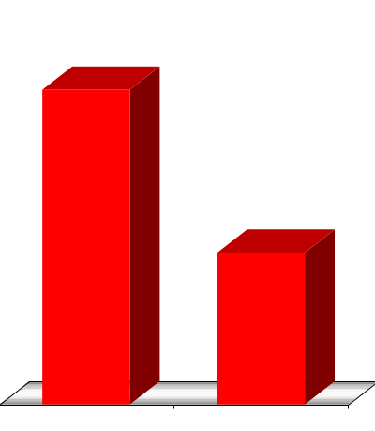
U.S. Commercial and Industrial Electricity
Customers Cost Savings From Utility Sales
Since 1992 Due to Deregulation and Competition
$57.9 Billion
$55.9 Billion
$46.7 Billion
3.5% decrease
$42.5 Billion
9% decrease
1992
Commercial
Customers
1992
Industrial
Customers
1998
Commercial
Customers
1998
Industrial
Customers
Source: Edison Electric Institute, 1999, Tables 42 and 63
Note: Volume held constant at 1992 levels; with higher 1998 volumes savings 2% greater

Slide 6
Megawatt Daily Electricity
Average Pricing at Palo Verde
On Peak vs. Off Peak ($MWH)
Heat drives San Diego price spikes; wants ability to hedge prices
PG&E rolling blackouts to meet demand
Key:
Sustained heat in west
On Peak
Off Peak
500.4
BPA buying hikes prices
336.6
209.5
California reports 6.5% summer reserve margin
69.3
47.6
39.9
29.9
32.8
33.6
29.4
30.7
30.2
33.5
60.0
29.0
60.0
43.4
45.0
33.5
21.0
23.0
24.0
23.0
19.0
15.3
16.0
22.0
16.25
July
1999
Aug
1999
Sept
1999
Oct
1999
Nov
1999
Dec
1999
Jan
2000
Feb
2000
Mar
2000
Apr
2000
May
2000
June
2000
July
2000
Aug
2000
Source: Megawatt Daily

