Slide 1
Enron North America Wholesale Business Volumes
1997 - 2000
By Quarter
Physical Electricity (MM-MWH)
Physical Natural Gas (1000 BBTU/day)
1998
1998
1998
1998
1999
1999
1999
1999
2000
2000
2000
ENA electricity sales peaked in 3Q in each of the last 3 years; gas sales peaked in 3Q 2000
Source: Enron Government Affairs, 10/23/00

Slide 2
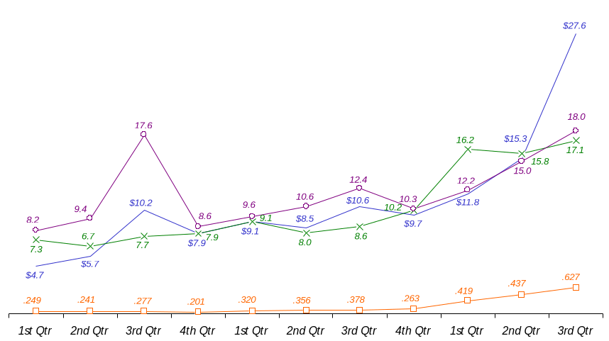
Enron North America Wholesale Business
1997 - 2000
By Quarter
149.9
114.9
60.0
EnronOnline outpaced gas and electricity volume growth
ENA Wholesale Gas & Electricity Revenues ($Billions)
EnronOnline Transactions (in 000s)
ENA Gas Volumes (in ‘000 BBTU/day)
ENA Electricity Volumes (in ‘000 BBTU/day)
Income Before Interest and Taxes ($ Billion) (IBIT)
5.0
1998
1998
1998
1998
1999
1999
1999
1999
2000
2000
2000
Source: Enron Government Affairs, 10/23/00

Slide 3
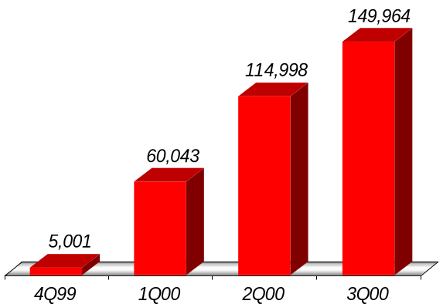
EnronOnline
Number of Transactions
+31%
Source: Enron Government Affairs, 10/23/00

Slide 4
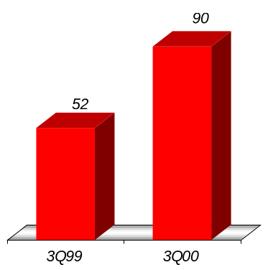
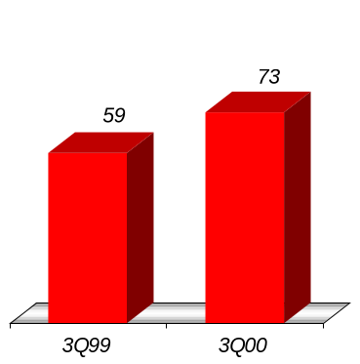
Enron’s Wholesale Power Network
West Volumes
(Millions MWh)
East Volumes
(Millions MWh)

Slide 5
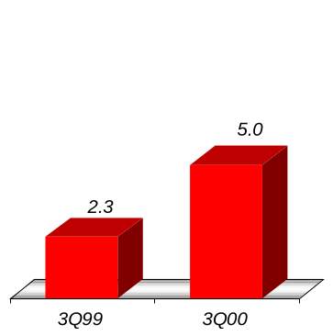
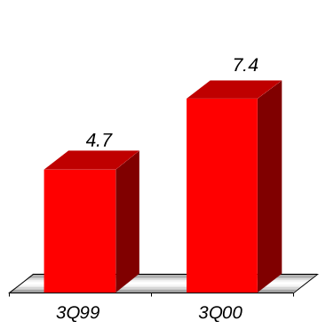
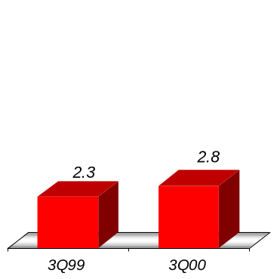
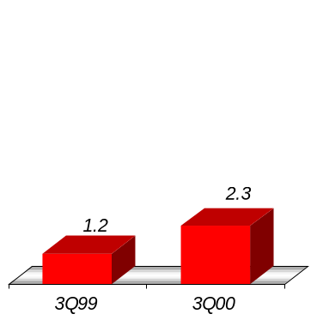
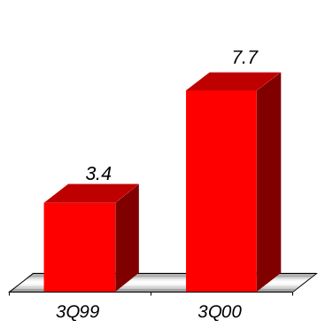
Enron’s Wholesale Gas Network
Canada Volumes
(Bcf/d)
Central Volumes
(Bcf/d)
Texas Volumes
(Bcf/d)
East Volumes
(Bcf/d)
West Volumes
(Bcf/d)

