Slide 1


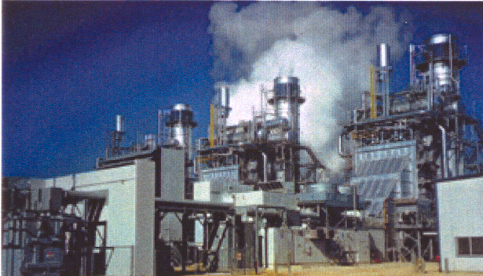
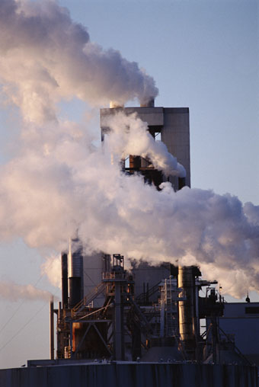

To Generate or Not to Generate
Forward Markets and Hedging
July 11, 2001

Slide 2
To Generate or Not to Generate
Build it?
Run It?

Slide 3
To Generate or Not to Generate…Build It?
Incentives | Disincentives
High Prices | Low Prices
Cover Capital Costs | Price Caps
Known Profit Margin | Unknown build economics
 | Market Influence
Confidence in market | Market Manipulation
 | Regulatory Risk
Liquid Market | Illiquid Market
Quick siting/permitting | Long lag time
Relaxed environmental | Restrictive Environmental
Profitable/
Economical
Risk
Other

Slide 4
To Generate or Not to Generate
Economics of power generation are governed by the relationship between fuel prices and power prices. Other items to consider in total profitability:
  Operations and Maintenance
  Emissions costs
  Start up Costs
  Financing costs
  Overhead
  Ancillary revenues
  Efficiency (Heat Rate)
Spark Spread = Gross operating margin of a generator
  Power Price per MWh – Fuel Price per MWh

Slide 5
Generation: To Build or Not to Build
Forward Market role in decision to build
  Planning tool. Sends a price signal in time for generation to be built
  Price Transparency. Comfort that transactions are at fair market prices with any buyers and sellers transacting at given price points.
  Enables hedging:
    Protect against price exposure
    Lock in profit margins
    Increase financial flexibility
    Lower cost of capital
    Price certainty for growth strategy
Disaster Insurance
Meet budget/earning expectations
Equalize cash-flows
Ensure financial health

Slide 6
Electricity Prices $/MWh April 2000- June 2001
Cinergy Prices (Firm On-Peak) – 4/00-6/01
California-Oregon Prices (Firm On-Peak) – 4/00-6/01
Entergy Prices (Firm On-Peak) – 4/00-6/01
NY Zone J Prices (Firm On-Peak) – 11/00-6/01

Slide 7

Hedging Instruments

Slide 8

Swap
Fixed Price
Generator
Market Price
Energy
Market Price (Index)
Pool
Characteristics:
  Provides 100% protection against price risk exposure
  Allows a generator to convert an unknown (floating) price to a known fixed price
  No Cost
  No benefit if price moves in your favor
  Can maintain existing physical arrangements

Slide 9
Swap
Swap
    Hedge Payout Hedge Performance
Market View | Inferior Superior
Very Bearish
Bearish
Neutral
Bullish
Very Bullish
Volatile
Generator pays Enron
Enron pays Generator
Market Swap

Slide 10
Floor
Characteristics:
  Provides 100% protection from a fall in prices below the strike.
  Fee to purchase option
  Guarantees worst case scenario and still maintain potential to benefit from high price environments
Upfront Fee
Generator
Floating Market Price (Index)
Energy
When market price < strike,
Enron buys energy (physical) at strike, or pays generator the difference between strike and market (financial).
Pool

Slide 11
Floor
    Hedge Payout Hedge Performance
Market View | Inferior Superior
Very Bearish
Bearish
Neutral
Bullish
Very Bullish
Volatile
Generator receives Market Price
Enron buys energy at strike (physical) or pays Generator
Market Cap

Slide 12
Collar:
Characteristics:
  Designates a specific price range within which a generator will sell its power.
  Provides a hedge against adverse price move at the lower band.
  Receives 100% of a price increase to the upper band.
Market Price shortfall of Lower Band
Generator
Market Price in Excess of Upper Band
Energy
Market Price (Index)
Pool

Slide 13
Collar
    Hedge Payout Hedge Performance
Market View | Inferior Superior
Very Bearish
Bearish
Neutral
Bullish
Very Bullish
Volatile
Generator pays Enron
Generator Receives Market Price
Enron pays generator
Market Collar

Slide 14
Spark Spread Swap
Gas
Supplier
Heat rate = 10MMBtu/Whr
Gas swap = $3.50/MMBtu=$35/MWh
Power swap=$40/MWh
Locks in the difference between
gas and power of $5/MWh
Appalachian Index
Gas
Fixed Price($40)
Appalachian Index
Generator
Gas Swap
Power Swap
Fixed Price
($35)
PJM
Energy
PJM
Pool
Characteristics
  Lock into margin between fuel cost and power sales price
  Volume of gas and power match as determined by heat rate
  Can be consolidated into a cross commodity swap where the generator pays the power index and receives the natural gas index plus the spark spread

Slide 15
Spark Spread Swap
Gas
Supplier
Heat rate = 10MMBtu/Whr
Gas swap = $3.50/MMBtu=$35/MWh
Power swap=$40/MWh
Locks in the difference between
gas and power of $5/MWh
Appalachian Index
Gas
Appalachian Index
Generator
Spark Spread
Swap
PJM –
$5MWh
Energy
PJM
Pool
  Can be structured as a tolling arrangement, where gas costs, power revenues, O&M, and overhead are taken into consideration, and the plant is “leased”, and a capacity payment is received.

Slide 16
To Generate or Not to Generate
Use spark spreads to determine when implied heat rate in market prices drop below the heat rate of the generator, thus being more effective to shut down generator and buy power
  Pool’s clearing price forecast at $30MWh
  Natural Gas marginal fuel at $2.50
  Market heat rate 30/2.50 = 12,000

Slide 17
To Generate or Not to Generate
 | COAL | GAS
Heat Rate | 10,659 | 12,000
Fuel Cost | $2.20/MMBtu | $2.50/MMBtu
Fuel Cost/MWh | $23.45 | $30.00
Spark Spread | $6.55/MWh | $0.00/MWh
Variable Costs | $2.00/MWh [1200 heat rate] | $1.00/MWh [600 heat rate]
Spark Spread adjusted by VC | $4.55/MWh | $<1.00>/MWh
Fixed Costs | $3.00/MWh | $1.50/MWh
Net Profit | $1.55/MWh | $<2.50>/MWh
Generate? | 10,659<10,800 YES | 12,000>11,400 NO

