Slide 1

®
West Gas Origination Group
Presentation To
Long Beach Gas & Electric
April 26, 2001
Barry Tycholiz, Vice President, Marketing, Western U.S.
Kim Ward, Manager, Marketing, Western U.S.

Slide 2
Presentation Overview
Enron Overview
Western Gas Market Outlook
Long Beach Load Analysis
ENA Proposal
Next Steps

Slide 3
I. Enron Overview

Slide 4







Who We Are
Enron manages efficient, flexible networks to reliably deliver physical products at predictable prices. In 2000 Enron used its networks to deliver a record amount of physical natural gas, electricity, bandwidth capacity and other products. With our networks, we can significantly expand our existing businesses while extending our services to new markets with enormous potential for growth.

Slide 5

The Transformation of Enron
Enron Today
Power Trading
Natural Gas Trading
Powerplant Construction
Weather Derivatives
Pulp & Paper Derivatives
Broadband Services
Energy Outsourcing
Gas Transportation Services
e-Commerce Initiatives
Enron 1985
Natural Gas Transmission
Exploration & Production
$2 Billion Market Cap
$50 Billion Market Cap

Slide 6

Achievements and Awards
Fortune Magazine Most Innovative Company of the Year (1996 – 2001)
Among the Fortune Most Admired Companies (2000)
  #1 In Quality of Management
  #2 In Ability to Attract, Develop, and Retain Employee Talent
  Overall top-rated energy company
FT Energy Energy Company of the Year (2000)
Risk Magazine Energy/Commodity Derivatives House of the Year (1999)
Global Finance Best Global Energy Company (1999)

Slide 7
Enron At a Glance
Transportation
&
Distribution
Wholesale
Services
Retail
Energy
Broadband
Services
Natural Gas
Transportation and Electric Distribution
Marketing and Delivery
of Commodities Worldwide
Energy Outsourcing
to Commercial and
Industrial Customers
Bandwidth Intermediation and Content Services
Portland General
Northern Border
Northern Natural Gas
Transwestern
Florida Gas Transmission
Enron North America
Enron Online
Enron Europe
Japan & Australia
Global Markets
Industrial Markets
Emerging Markets
Enron Wind
Enron Energy Services
Enron Broadband Services

Slide 8
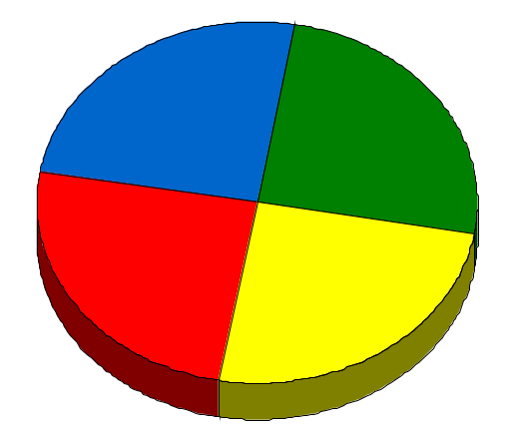
Enron’s Wholesale Services Model
Origination
Physical
e-Commerce
Financial
Enron uniquely combines its origination, physical, financial and
e-Commerce capabilities to provide wholesale commodity services

Slide 9
Enron North America’s
Energy Network
Industrials
Power Plants /IPPS
$
$
People
Technology
Contractual Assets
Owned Assets
$
Products & Services
Products & Services
Information
Information
Financial Market
$
$
Marketers
Products & Services
Products & Services
Information
Information
Producers
$
$
Utilities
Products & Services
Products & Services
Information
Information
Rapid Capture of Real Time Market and Grid Information
Quickly Disseminated and Acted Upon By Enron
Clear Information and Liquidity Advantage for Customer

Slide 10
Enron’s Wholesale Gas Network
(Volumes in Bcf/d)
Canada
Central
6.3
4.4
5.9
2.3
43%
156%
1999
2000
1999
2000
West
East
2.4
7.4
1.1
4.1
118%
Henry
80%
Henry
Henry
Henry
Hub
Hub
Hub
Hub
1999
2000
1999
2000
Texas
Marketing Offices
Leased Capacity
NYMEX
Leased Storage
Gas Marketing Activity
2.7
2.0
35%
1999
2000

Slide 11
Enron’s Wholesale Power Network
(Volumes in Million MWh)
239
West
MAPP
MAIN
ECAR
NPCC
COB
ComEd
Hub
PJM
Hub
Hub
MAAC
Cinergy
Cinergy
Cinergy
Hub
Hub
Hub
97%
WSCC
Cinergy
SPP
Hub
2000
East
1999
2000
SERC
340
Palo
Palo
Palo
Palo
Verde
Verde
Verde
Verde
Hub
Hub
Hub
Hub
TVA
Hub
260
Entergy
Entergy
Entergy
Hub
Hub
Marketing Offices
NYMEX
Marketing Hub
ERCOT
Hub
FRCC
Power Plants
31%
In Operation
In Operation; Sale Pending
Under Development
1999
2000
Power Marketing Activity
Transmission Grid

Slide 12
North America
Enron’s Leading Market Position
Third Quarter 2000
(TBtue/d)
40.5
37.4
Power
Gas
1999
19.2
15.0
14.1
13.3
13.2
13.1
12.3
10.9
9.9
Enron
FY00
Enron
Duke
Aquila
AEP
PG&E
Reliant
Dynegy
Southern
Coral
Sempra
3QYTD
Source: Gas Daily, Power Markets Week, Oil Daily

Slide 13
II. West Gas Market Outlook

Slide 14
Bearish Summer Fundamental Issues
Sustained high NYMEX prices
Unprecedented basis “blowouts”
Demand continues to outpace supply
Canadian production growth is flat
Deep storage drawdowns
Poor hydro conditions in Pacific Northwest
Transportation constraints

Slide 15
Nymex Daily Close
High of $9.98 on 12/27/00

Slide 16
Nymex Daily Close versus SoCal Border
December Basis Blowout

Slide 17
Nymex Daily Close versus Malin
December Basis Blowout

Slide 18
United States Supply and Demand Picture
Consumption Continues to Outpace Production
NOTE: 2000E Based on Preliminary EIA Data Through July

Slide 19
Increased Power Needs Driving California Gas Demand
Expected New Gas Fired Generation Projects 2001 - 2004
12,853 MWs of New Generation
Source: ENA Long Term Fundamentals

Slide 20
Increased Power Demand Driving Western Gas Fundamentals
California Will Account for the Majority of New WSCC Gas Fired Generation
36,829 Total MWs between
2001-2004

Slide 21
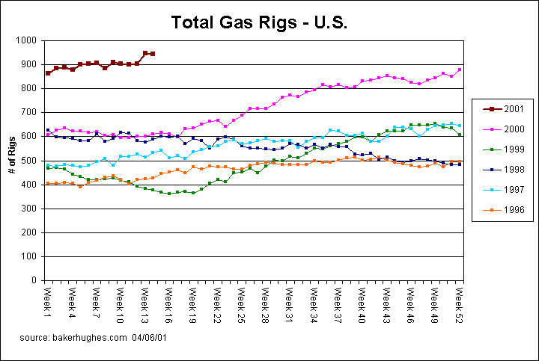
Western United States Supply Picture
The U.S. Rig Count Is Well Above The Rig Count for Previous Years

Slide 22
United States Supply Picture - Rockies
Despite Rig Counts, With The exception of Wyoming, Decline Curves Continue to Decrease Significantly.
Note: Data is Through July 2000
Source: ENA Gas Fundamentals

Slide 23
United States Supply Picture - Texas
Texas Production Area Decline Curves Are Also Decreasing
Note: Data is Through September 2000
Source: ENA Gas Fundamentals

Slide 24
United States Supply Picture – On and Off-Shore Gulf
Main Strength Coming From Deep Water Gulf
Note: Offshore Production Data is Through January 2000. On-Shore is Through July 2000.
Source: ENA Gas Fundamentals

Slide 25
United States Supply Picture – Net Imports
A Tight U.S. Market Has Contributed To Growing Canadian Imports
9.22% CAGR in Canadian Imports
Source: U.S. Energy Information Administration

Slide 26
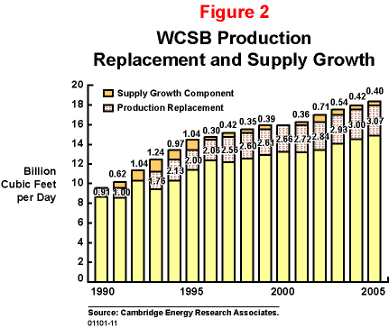
Western Canada Gas Supply Doubts Exist
However, Flat WCSB Growth Will Add to Tightness of U.S. Market
Drilling boom has focused on low risk, low production development activity
Little exploration of larger reserve, higher productivity potential of the Western Canadian Sedimentary Basin
Will result in only modest increases in gas supply growth rates, while adversely affecting decline rates
Production of 15.9 Bcf in 2000 was flat relative to 1999. Supply is expected to increase to 18.4 Bcf per day by 2005

Slide 27
United States Storage Picture
AGA Storage Total Working Gas
Winter
Summer
Working gas is at its lowest level since 1995/96
Given the low level of inventory leaving the winter heating season, injections must start out strong this year.
To reach last year’s end of October storage number of 2,712 Bcf, daily injections will have to be 10.20 Bcf/day starting the week ending
April 8.
This will be the highest average injection rate in the U.S. since 1994.

Slide 28
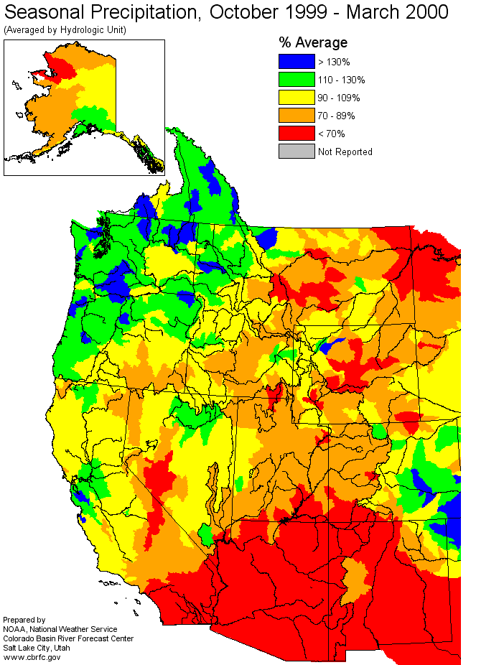
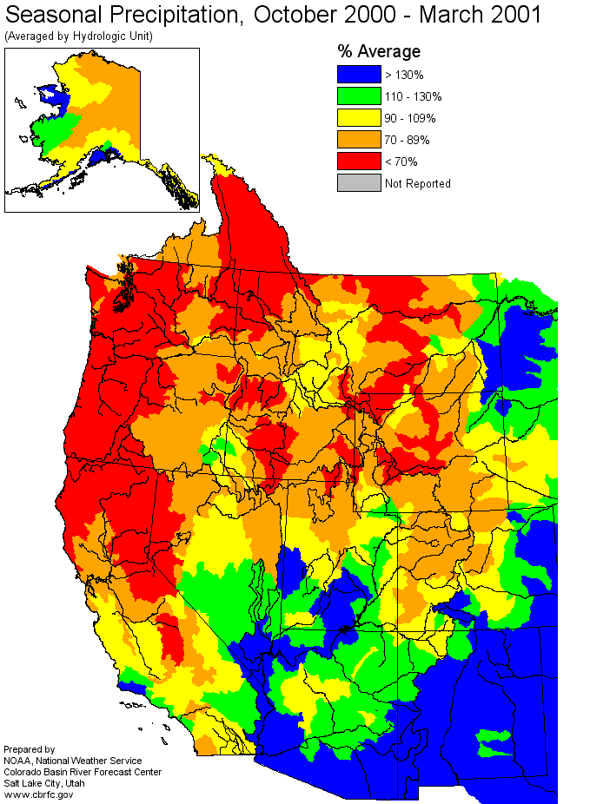
U.S. Hydro Conditions
The West Continues to Struggle With a Dry Weather Pattern
Last Season….
This Season….

Slide 29
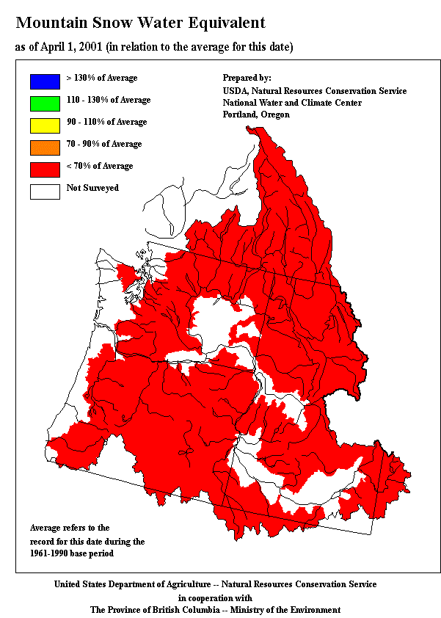
U.S. Weather – PNW Snowpack
More Bearish Fundamentals for Hydro
California imports almost 25% of electricity from hydro sources
The PNW is a vital source of hydro generation
Snowpack above the Grand Coulee dam on the Columbia is near 50% of average – below the minimum snowpack of record
Note: According to the USDA, many of these areas are, in fact, below 50% of average, including central, western and southwestern Oregon, southern Washington, southern, central and northern Idaho, northwestern Montana, and southern British Columbia.

Slide 30
Transportation Infrastructure is a Key Factor
Expansion projects will be mired in political and regulatory uncertainty
Changes to capacity subscriptions driven by power generation market
Controversy continues over El Paso’s scheduling and allocation practices
El Paso may be over subscribed as well
Take-away capacity from the Rockies needs to expand

Slide 31
III. Long Beach Load Profile Analysis

Slide 32
City of Long Beach
Until winter 2001, the Long Beach Historical WACOG operated within 10 – 15% of SoCalGas
SoCalGas, envisioning a period of rising prices, outperformed Long Beach by using a number of risk management strategies and products.
Outperformance of the SoCal WACOG creates its own element of speculative buying.
Instead, Enron proposes to implement a 3-5 year risk management program for Long Beach customers that will provide a far higher rate of return.
So Cal Monthly Index
Long Beach WACOG
SoCalGas Core Procure

Slide 33
Long Beach WACOG vs. SoCalGas Core Procure
So Cal Monthly Index
Long Beach WACOG
SoCalGas Core Procure
So Cal Monthly Versus So Cal Daily Index
So Cal Monthly Index
So Cal Daily Index

Slide 34
Risk Management
Reduces volatility, improving budget certainty and cost expectations
Utilities must forecast and manage numerous variables to arrive at the correct price
Load Balancing Reconciliations
Monthly Load
Daily Load
Utility Risk Factors
Price Risk
Transport
Payables
Receivables
Heating Load
A/C Load
Alternative Suppliers

Slide 35
IV. Enron North America Proposal

Slide 36
Enron North America Proposal
ENA can assist by creating a risk management program designed for:
Monthly versus Daily Exposure
Storage Utilization
Portfolio Management
Hedging Strategies
Profit Sharing Mechanisms and Incentives for You and Your Customer

Slide 37
Steps to Manage Risk
Smooth out monthly to daily price swings
Optimize storage (cycle every day)
Incorporate
  30% of portfolio with fixed price (short and long term)
  30 – 40% derivatives
  30% monthly to daily
Create incentives for non-core load to shed when market spikes
  Get customer buy-in for next 3 years
  Beat index with low cost supply (beating SoCalGas does not imply a low price)
  Fixing your price may get you the price certainty, but not necessarily the optimal price you were looking for

Slide 38
Your Relationship With Enron
Enron does not want to be your decision maker on pricing or have exclusive sources to supply
We will set up a risk management program:
  Timing mechanisms and forecasting models
  Monthly “Team” meeting to access all the moving parts and adjust strategy as new market information becomes available
  Create incentive/share mechanism that pays Enron for its role in the successfully evolving program

Slide 39
IV. Next Steps

Slide 40
Next Steps
Enron North America will submit a formal Master Services Agreement proposal that incorporates:
Storage Optimization Proposal
Risk Management Proposal
3 - 5 Year Incentive Agreement

Slide 41
Contacts
Barry Tycholiz, Vice President, Marketing, Western U.S.
Enron North America
Phone: (713)853-1587
Fax: (713)853-2391
E-Mail: barry.tycholiz@enron.com
Kim Ward, Manager, Marketing, Western U.S.
Enron North America
Phone: (713)853-0685
Fax: (713)853-2391
E-Mail: kim.ward@enron.com
®

