Slide 1
October 2000
Confidential & Proprietary
Management Presentation
Lincoln Energy Center Overview

Slide 2
Overview
Lincoln Energy Center Overview
Plant Description: 656 MW (nominal) natural gas-fired, simple-cycle facility
Location: 50-acre tract in Manhattan, Illinois, in ComEd subregion of MAIN
Power Interconnect: ComEd Wilton Center Substation
Gas Interconnect: Northern Border Pipeline - near Manhattan South Interconnect
Start of Construction: September 1999
Commercial Operation Date: June 1, 2000
Approx. Max. Annual MWh: 2,002,000 at 59ºF
Annual Run Hours: 3,250
NOx (per unit): <9 ppm
CO (per unit): <25 ppm

Slide 3
Facility Strengths
Lincoln Energy Center Overview
“First-mover advantage ” in a key Midwest market
MAIN and Chicago area have historically experienced extreme power price volatility
Flexible gas arrangements in Chicago area allow access to ANR Pipeline Company and Northern Border Pipeline Company and other arbitrage opportunities
Expansion/conversion potential
Site has room for additional gas turbines
Turbine technology and layout allow for easy conversion to combined cycle
Access to water with onsite wells

Slide 4
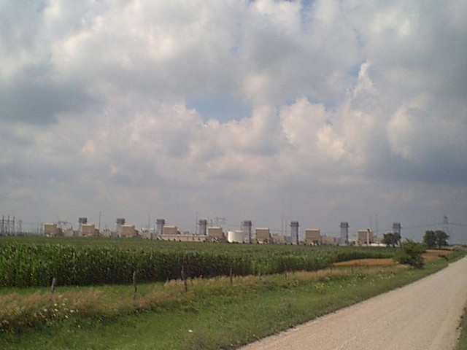
Plant Picture
Lincoln Energy Center Overview

Slide 5
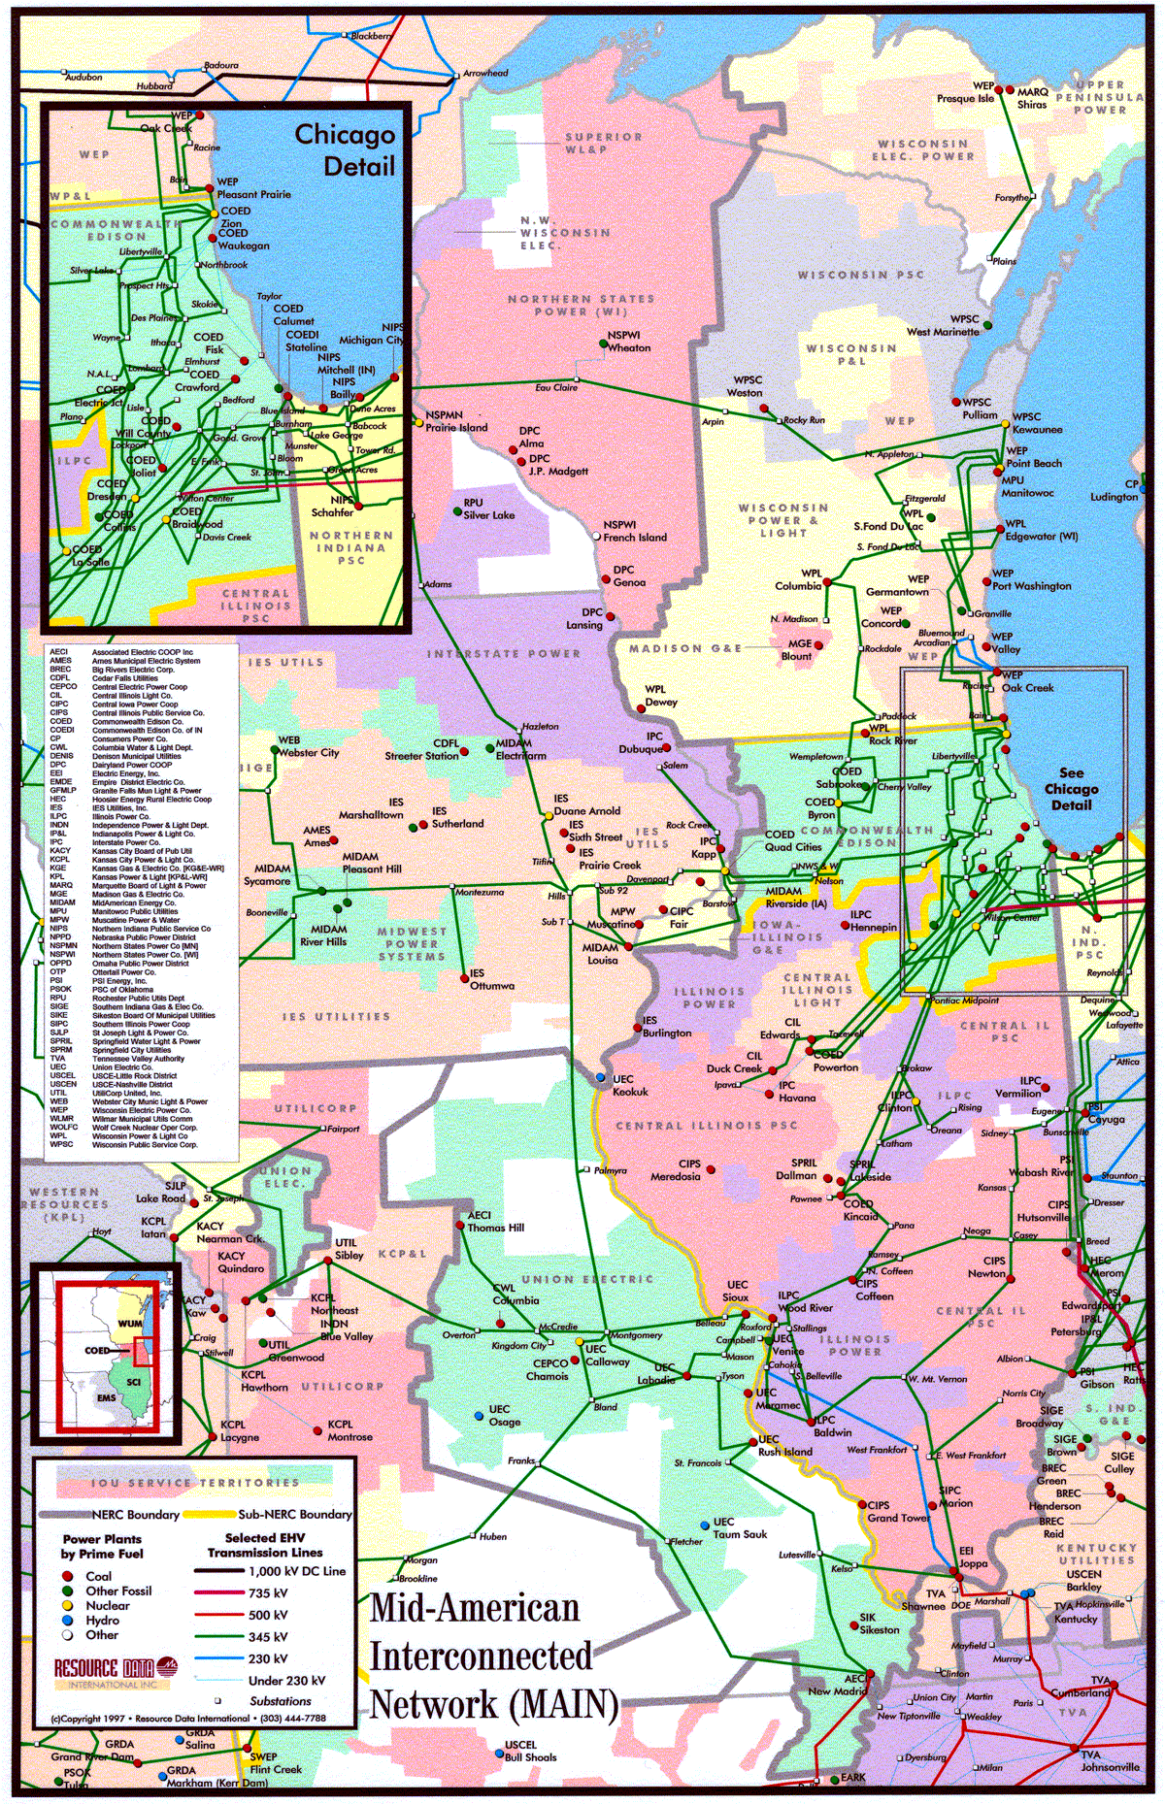
Regional Overview
Lincoln Energy Center Overview
Lincoln Energy Center

Slide 6
Power Market Opportunities
Lincoln Energy Center Overview
Des Plaines Green Land Development, L.L.C. is qualified as an Exempt Wholesale Generator and has authority to sell energy and capacity at market-based rates
Lincoln’s location in ComEd and access to Chicago and other Midwestern and eastern electricity markets provide sales opportunities into wholesale power market
ENLC is within two utility wheels from over 30 control areas

Slide 7
Equipment Overview
Lincoln Energy Center Overview
Turbines : 8 General Electric 7EA gas turbines with evap. cooling
Turbine Warranty Expiration: May 30, 2001
Switchyard Equipment: ABB, 345 kV interconnect breakers
Switchyard Configuration: radial
Transformers: (4) ABB 208 MVA, 3 winding, 3 phase, 13.8 kV/345 kV
Control System: General Electric Mark V
Generator Circuit Breakers: (8) ABB HGC (7,500A)
Generator Voltages: 13.8 kV
Distribution Voltages: 4160 V and 480 V
LINCOLN ENERGY CENTER
ENLC
345 kV
B
G8
345 kV line to:
B
Com
Ed
GSU T34
B
G7
Substation
B
G6
B
GSU
T33
B
G5
B
G4
B
GSU T32
B
G3
B
G2
B
GSU T31
B
G1
Unit MW Rating:
Summer
Nominal
Winter
79
82
88
B = Breaker
GSU = Generator Step-up Unit

Slide 8
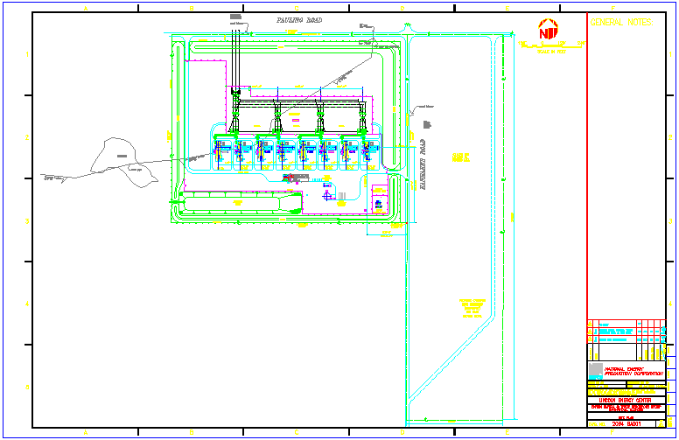
Plant Layout
Lincoln Energy Center Overview

Slide 9
Performance Results
Lincoln Energy Center Overview

Slide 10
Power Interconnection
Lincoln Energy Center Overview
Connected directly to the ComEd Wilton Center Substation (via a 345 kV generator lead)
ComEd Wilton Center Substation is connected to five transmission lines: three 345 kV lines (ComEd) and two 765 kV lines (AEP)
Each 765 kV line has significant available transmission capacity during periods of peak load
Interconnection provides direct access to ComEd’s service territory
ComEd Wilton Center Substation also has direct access to eastern markets (e.g. AEP) via 765 kV line

Slide 11
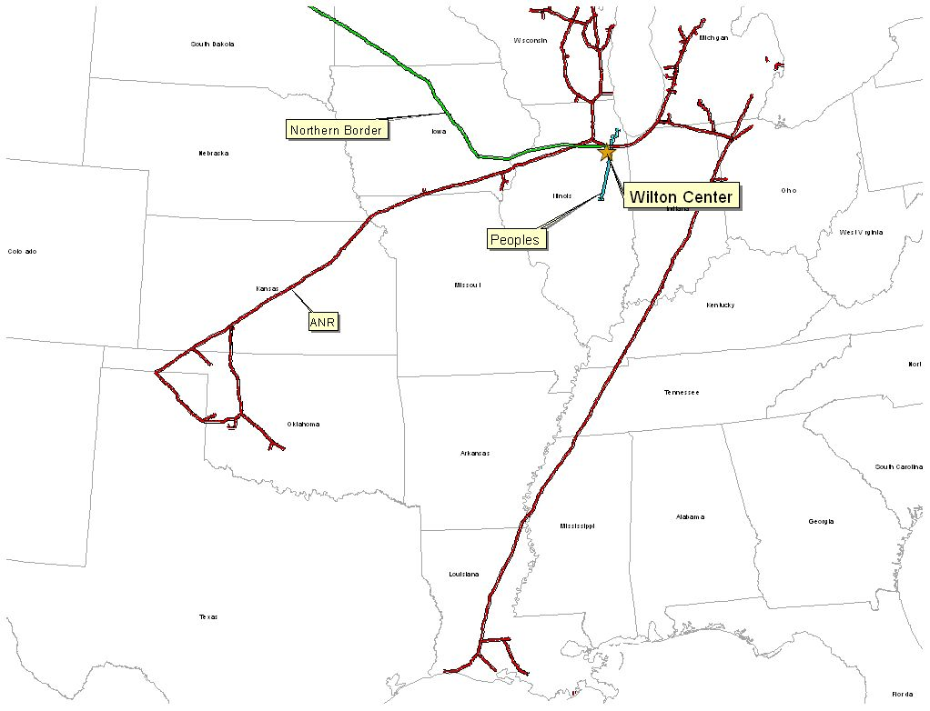
Gas Transportation
Lincoln Energy Center Overview
Pipeline: Northern Border Pipeline (“Northern Border”)
Delivery Point: Manhattan Station
Base Contract:
Service: IT-1 Transport
Term: 2 Years beginning March 1, 2000
Volume: 200,000 MMBtu/d
Rate: Maximum Tariff Rate, currently $0.04038 per 100 dekatherm mile
Fuel: Varies depending on haul
Receipt Points: Master receipts on Northern Border
Back-up Contract: ANR - IWS is $0.01/dth/day and IPLS is $0.03/dth/day up to 115,000 MMBtu/dth/day. Beginning November 2000, IWS will increase to $0.1575/dth/day while IPLS goes to $0.2894/dth/day. Contract will expire in April 2001.
Balancing: Via OBA, with Northern Border. Off system balancing provided via IPLS and IWS agreements with ANR Pipeline

Slide 12
Plant Location
Lincoln Energy Center Overview

Slide 13
Control Area Status
Lincoln Energy Center Overview
Lincoln Energy Center control area, ENLC, has been designated a control area in accordance with NERC policy
Control area designation is valuable for point to point power sales and scheduling of power
Control area options for Lincoln Energy Center purchaser include:
control area services provided by ComEd
control area re-established by purchaser in accordance with NERC procedures
control area and scheduling services provided by Enron affiliate under separate contract

Slide 14
Expansion/Conversion Opportunity
Lincoln Energy Center Overview
Lincoln Energy Center designed to facilitate future expansion and/or conversion to combined cycle
Net heat rate could go from 11,900 Btu/kWh (HHV) currently to approximately 8,000 (HHV), depending on equipment
Net output could go from 656 MW (nominal) currently to approximately 1,000 MW (nominal), depending on equipment
Lincoln Energy Center conversion should take approximately 18 to 24 months
Installation of an SCR should facilitate modifying PSD permit for increased run hours beyond the existing 3,250 hour permit

Slide 15
ComEd Contract Terms
Lincoln Energy Center Overview
Lincoln Energy Center has sold 600 MW of regulatory capacity and energy to ComEd
Term of the contract is for the summer periods, June 1 through September 30, 2000 through 2002
Capacity Payments total $12 million per year, paid each calendar month during the summer periods at $5.00 / kw-month
A maximum of 600 MWs of capacity/energy is to be supplied at ComEd’s election either from the Lincoln Energy Center or from the market
Energy is priced based upon a “market price” which is determined in accordance with the terms of the agreement
Lincoln Energy Center purchaser will assume all obligations under the agreement

Slide 16
Environmental Specifications
Lincoln Energy Center Overview
Discharge Permit: Not Required
Air Permit: PSD
NOx Control Method: GE Dry Low - NOx Combustor
NOx Compliance Method: CEMS
Actual Commission NOx: <9 ppm
Actual Commission CO: <25 ppm
Permitted CO Limit: <25 ppm
NOx Permit Limits
Hourly: <15 ppm
Monthly: <12 ppm
Annually: <9 ppm
Estimated Run Hours: 3,250

Slide 17
Operating Costs
Lincoln Energy Center Overview

Slide 18
Organizational Chart
Lincoln Energy Center Overview
Lincoln Energy Center is currently operated by Operational Energy Corp (“OEC”), an Enron Corp. subsidiary
It is anticipated that at closing, O&M contract with OEC will be terminated
Lincoln Energy Center personnel are currently employees of OEC

Slide 19
Legal Structure
Lincoln Energy Center Overview
Des Plaines Green Land Development, L.L.C. (“Des Plaines”) is a Delaware limited liability company and is 100% owned by Enron North America Corp.
Des Plaines has fee simple ownership of facility (including real property)
Energy Finance Company, L.L.C. (“EFC”) is a Delaware limited liability company and is 100% owned by Enron North America Corp.
Des Plaines and EFC have entered into Equipment Sale Agreement
Illinois sales/use tax due on equipment is deferred over fifteen years
early payments primarily interest (which is exempt from sales/use tax), thus increasing present benefit of deferral
Purchaser will acquire 100% of member interest in both Des Plaines and EFC

