Slide 1
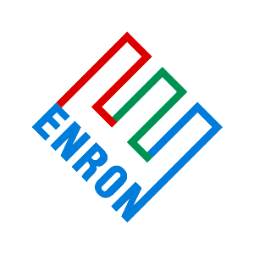
ENRON ENGINEERING & OPERATIONAL SERVICES
2002 PLAN REVIEW
November 8, 2001

Slide 2
ENRON ENGINEERING & OPERATIONAL SERVICES
Table of Contents
EEOS – Brian Stanley
EEOS-1 2002 Plan
EEOS-2 2002 Goals & Objectives
EEOS-3 NEPCO IBIT by Quarter
EEOS-4 NEPCO Project Projections
EEOS-5 NEPCO Summary 2001 Income Statement
EEOS-6 NEPCO 2001 Plan vs. Actual Variances
EEOS-7 NEPCO Cash Flow by Project
EEOS-8 NEPCO Guarantees & SLC’s

Slide 3
Enron Engineering and Operational Services
2002 Plan
(millions)
2002
Plan
Projects
Accro Selldown
CIGSA
Bad Debt Expense (Severnaya)
Deferred Profit Amortization
Other Misc. projects
Subtotal Project Margin
G&A Expense
Other Income
Total IBIT – EECC
NEPCO
Total IBIT - EEOS
18.6
(7.5)
(0.9)
0.5
(2.0)
(8.7)
(9.7)
1.0
-
-
-
EEOS - 1

Slide 4
Enron Engineering and Operational Services
2002 Goals & Objectives
Support Enron’s exit from India
- Potential exposure estimated at $150 million. (Part of the $1.2 billion Enron exposure)
Provide technical support as needed to Nepco to ensure portfolio profit maintained.
Complete EEOS “for profit” portfolio:
- Close last Mexico Project ($7.5 million of exposure)
- Advance Arcos development ($3.5 million of development costs)
- Provide support for Cuiaba project issues ($9.0 million of exposure)
- Shaw Receivable ($4.5 million of exposure)
- Accroven Change Order ($5.0 million of exposure)
Provide technical support (development and operations) to EWS,
EES and Global Services, adjusting headcount to demand.
5. No earnings assumed for EEOS Houston activities as we transition to cost center.
EEOS - 2

Slide 5
EEOS - 3

Slide 6
EEOS - 4

Slide 7
EEOS - 5

Slide 8
EEOS - 6

Slide 9
EEOS - 7

Slide 10
EEOS - 8

