Slide 1
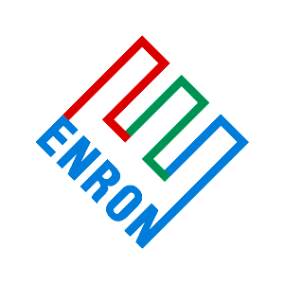
Total Assets: $30 Billion
Total Revenues: $31.2 Billion
Enron
Oil & Gas
Company
Enron
Gas Pipeline
Group
Enron
Ventures
Corp.
Enron
International
Enron
Capital & Trade
Resources
Enron
Renewable
Energy Corp.
Enron Energy
Services
Azurix
Portland
General
One of the largest independent oil and gas companies in U.S.
  Majority-owned by Enron
  2.8 Tcfe Reserves
Increasing inter-national activity:
  Trinidad
  India
  Venezuela
  Qatar
  Mozambique
Operates Enron’s interstate pipelines
  One of the largest natural gas transmission systems in the world
Provides world-wide engineering and construction services
- NEPCO
EOTT Energy Partners
Clean fuels activities
Wessex Water
Leading developer and provider of merchant and finance services for integrated energy projects
ECT
North America
Leading low-cost supplier of renewable energy utilizing, solar and wind power resources
Encompasses Enron’s joint venture solar activities with Amoco
Charged with developing and implementing Enron's retail business in deregulating markets
- Bentley
Group
Poised to Become the Major Global Water Company in a $300 Billion Market
Wessex:
  1.1 Million Water Customers
  2.5 Million Wastewater Customers
  Regarded as Most Efficient Operator in England
Portland General Electric (PGE) is Enron’s electric utility that provides electricity to nearly 700,000 customers (1.4 million people) in Oregon
PGE’s service territory covers more than 3,000 square miles
Generating capacity 2,119 MW
Commodity &
Trade Services
Responsible for conducting trading and risk management transactions involving domestic natural gas, electricity, coal, oil & weather
Responsible for global risk management overseeing Enron’s commodity and interest rate positions worldwide
Enron Global
Power & Pipelines
Owns and manages power plants and natural gas pipelines in developing markets
Energy & Finance Services
Focused on developing physical and financial products and services and developing long-term relationships with domestic customers
Includes:
  Upstream Finance
  ECT Canada
  Utility Solutions
  Transportation Services
  Industrial Services
ECT Europe
Responsible for growing Enron’s business in the United Kingdom and Europe as energy markets open
03 Org Chart 5/99

Slide 2
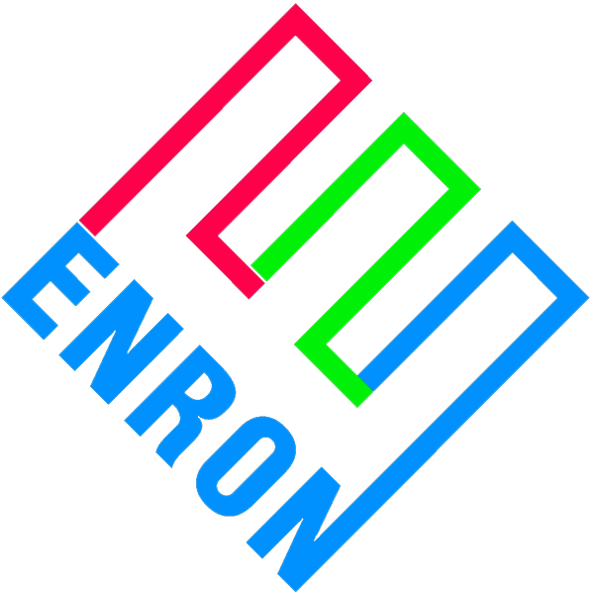
Exploration
and
Production
Transportation
and
Distribution
Wholesale
Energy
Operations
and Services
Retail
Energy
Services
New
Businesses
Enron Oil & Gas Company
One of the largest independent oil and gas companies in U.S.
- Majority owned by Enron
- 2.8 Tcfe Reserves
Increasing international activity:
- Trinidad
- Venezuela
- Qatar
- Mozambique
- China
Gas Pipeline Group
Operate Enron’s interstate pipelines
- One of the largest natural gas transmission systems in the world
Portland General Electric
Portland General Electric (PGE) is Enron’s electric utility that provides electricity to nearly 700,000 customers (1.4 million people in Oregon)
ECT North America
Commodity & Trade Services
Responsible for conducting trading and risk management transactions involving domestic natural gas and electricity
Responsible for global risk management
overseeing Enron’s commodity and interest
rate positions worldwide
Energy & Finance Services
Focused on developing physical &
financial products and services and
developing long-term relationships with
domestic customers
Includes:
- Upstream Finance
- ECT Canada
- Utility Solutions
- Transportation Services
- Industrial Services
Emerging Opportunities
Charged with developing new business
opportunities such as coal, pulp & paper,
plastics and weather derivatives
ECT Europe
Responsible for Enron’s business in the UK
and Europe as energy markets open
Enron International
Leading developer and provider of merchant
and finance services for integrated energy
projects in Europe, Asia, Latin America
- Premier energy company in S. America
• Bolivia to Brazil Pipeline
• Electra-Elec. Utility in Brazil
• Agro-Elec. Utility in Venezuela
- Largest foreign investor in India
• 2,470 MW Dabhol Power Project
- Enron Engineering & Construction
Enron Global Power & Pipelines
Owns and manages power plants and natural gas pipelines in developing markets
Enron Energy Services
Develop Enron’s retail business in deregulating markets offer energy commodities & services to end users
Targeting commercial & light industrial customers
- Pactel
- University of California & California State University
- Federal Cable
Bentley Group
Enron Communications
Focused on delivering high quality, high bandwidth applications to businesses (video) - screen to screen.
Created the first network solely for, and capable of, delivering these business applications today.
  National Capability
  Pure IPSM
  Low Cost
Azurix
Poised to Become the Major Global Water Company in a $300 Billion Market Wessex:
  1.1 Million Water Customers
  2.5 Million Wastewater Customers
  Regarded as Most Efficient Operator in England
04 Org Chart 99

Slide 3
ECT-NA’s Competitive Advantages
BTU Products
Convergence of Natural Gas and Power
Physical
Financial
Natural Gas
Power
Continental Scope and Scale
Well-Established Trade and Customer Relationships
Well-Developed Risk Management Systems and Processes
Flexible, Well-Located Pipelines
Creative, Competent People With Diverse Experience
Continental Scope and Scale
Expanded Trade and Customer Relationships
Beneficiary of a Decade of System Investments Transferable From Gas
Flexible, Well-Located Generation
Beneficiary of a Pool of Enron-Experienced People
Multi-Commodity Expertise
04 General

Slide 4
ECT North America’s Capabilities
Physical
Commodities
Risk Management
Financing
Energy Marketer
Development
Electricity, Natural Gas
Liquids (Gas & Oil)
Renewable Energy
Petrochemicals
& Feedstocks
Equity Structures
Debt Structures
Equipment Financing
Project Finance
Engineering & Construction
Long-Term Fixed Price Contracts
Swaps/Options/Hybrids
Product Development
Sales and Marketing
Technology
Reliable Delivery
Predictable Prices
Low-Cost Funding
International Infrastructure
Retail Products
and Services
Wholesale
Customers
06 NA Capabilities

Slide 5
Physical Volumes & Financial Settlements
Physical Volumes
Financial Settlements
Crude & Liquids
Electricity Sales
Gas Sales/ Transportation
29,275
94,974
27,300
22,400
75,266
69,918
17,970
49,082
11,931
35,259
1st Qtr
1st Qtr

Slide 6
1998 North American Gas & Power Merchants
22.1
Gas
Electricity
13.4
13.1
11.6
10.8
BBtue/day
10.5
8.5
8.1
7.6
6.6
Source: Natural Gas Week, Feb 22, 1999
Power Markets Weekly, Feb 22, 1999

Slide 7
Cash/Physical
Largest Power Marketer 400 MWh, 1998
Largest Gas Marketer 12.7 Bcf/d, 1998
Strong Presence in Crude/Liquids 300 Mbod, 1998
Largest SO₂ Credit Marketer 4.14 million tons,1998
Strong Presence in NO₂ Credit 2,530 tons, 1998
Largest Pulp & Paper Marketer 6.6 million tonnes, 1998
Largest Coal Marketer 100 million tons,1998

Slide 8
Development of ECT’s Position Books
Gas Swaps & Options
Interest Rates
Gas Basis
Crude Swaps & Options
Crude Basis
Gas Index
Canadian Gas
Canadian Basis
Canadian Dollar
Propane
EFP
Omicron*
Ethane
Normal Butane
Isobutane
Natural Gasoline
Finance
Unleaded Gasoline
Resid
Methanol
MTBE
Canadian Oil
Electricity Swaps & Options
Heating Oil
British Pound
Gas, U.K.
Power, U.K.
Aluminum
Chemicals/Plastics
Coal
Pulp & Paper
Weather-DDD
Australia
Bandwidth
Financial Books
Hybrid Books
1992
1993
1994
1995
1996
1997
1998
*Omicron for electricity book started 8/94

Slide 9
Global Energy Risk Magazine Rankings
Enron Ranking
1999
Electricity-NA
#1 ECT
Natural Gas-NA
#1 ECT
Weather Derivatives
#1 ECT
Emissions
#2 ECT
Coal
#1 ECT
Source: Global Energy Risk Magazine, 1999

Slide 10
Power Plant Update
In 1 year ECT has
more generation
capacity than PGE
5,772
5,022
3,985
Megawatts Capacity
2,260
1998
1999
2000

Slide 11
ECT - North America
Energy Network Today
CALGARY
PORTLAND
TORONTO
New York City
COB
Hub
Wilson Center
Bayonne
Pittsburg
OMAHA
Pittsburgh
Linden
SAN FRANCISCO
Cinergy
Hub
Camden
DENVER
Wheatland
Nymex
Coal
Charleston
Calvert City
Marketing Offices
Gas Pipelines
Palo
Verde
Hub
Brownsville
New Albany
Electric Grid
Entergy
Hub
NYMEX Trading
Caledonia
Henry
Hub
Leased Gas Storage
HOUSTON
Owned Gas Storage
Unannounced Projects
Monterrey
Generation Assets
Mexico City
Coal Facility

