Slide 1
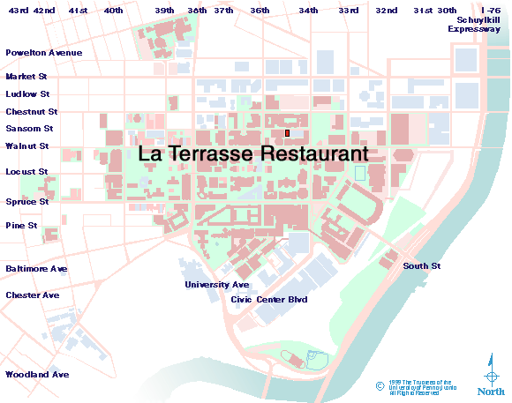
Wharton Risk Management and Decision Processes Center
Advisory Committee Dinner
December 6, Thursday 6:30 p.m. - 8:30 p.m.
La Terrasse Restaurant, Tree Room
3432 Sansom Street, Philadelphia, PA 19104
Tel: 215-386-5000
“Tree
Room”

