Slide 1
LNG Deals in Enron
Dabhol Phase I & II are matched with LNG Purchase agreements with Oman LNG L.L.C. and Adu Dhabi Gas L.C.L (AdGas)
EcoElectrica is matched with Cabot LNG Corp.
Petronas (COI) will supply MetGas (Negotiation Stage) via Dabhol (re-gasification) (4th Tank & Pipeline to be built).

Slide 2
Dabhol FSA & PPA
Contracts match well.
Contract volumes match up.
Prices pass through.
Force Majeure clauses balance between contracts.

Slide 3
EcoElectrica FSA & PPA
First 12 Months LPG is un-hedged.
Summer and Shoulder Month LNG match well. Winter Month Cargoes are short one LNG cargo or 2 LPG cargoes.
Rest of the contract matches.Not as well worked out as Dabhol.

Slide 4
Petronas / MetGas Proposal
Five bottlenecks to completing the Deal
Completing GSA’s (Gas Supply Agreements)
Completing LNG Supply Agreement w/Petronas.
Sending out Section 3.1 right of way information.
Section 6.1 - Laying the Pipe.
4th LNG tank @ Dabhol.

Slide 5
Global LNG Picture

Slide 6
Dabhol I & II - Oman LNG & AdGas

Slide 7
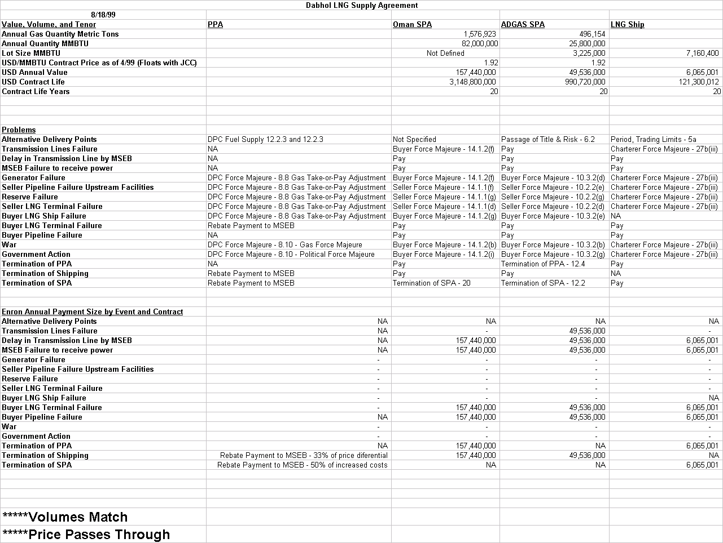

Slide 8
EcoElectrica L.P. - Cabot LNG Corp.

Slide 9
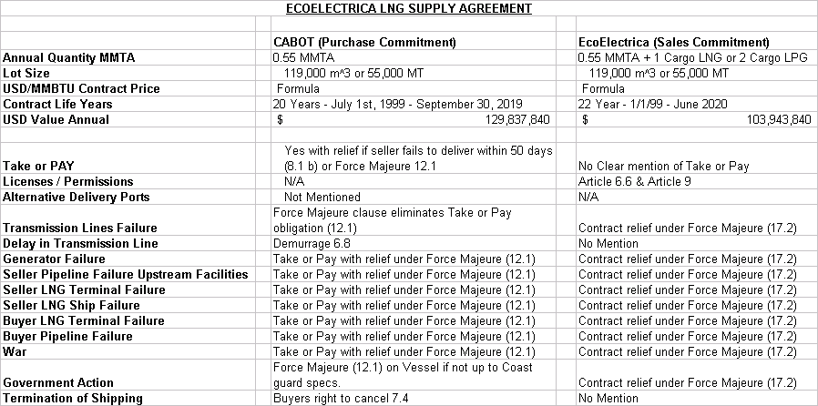

Slide 10
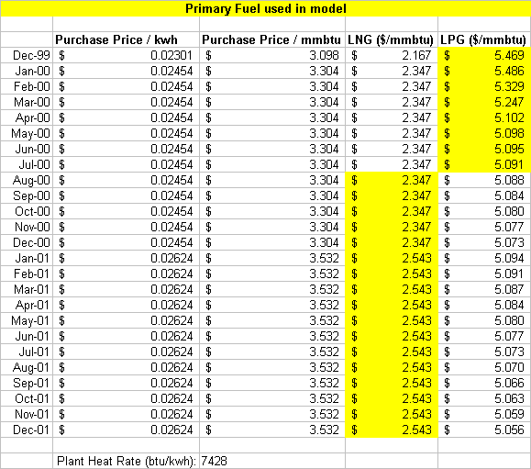

Slide 11
MetGas - PetroNas

Slide 12
