Slide 1

Endesa Iberdrola:
A global leader
October 2000

Slide 2


Agenda
A unique opportunity
A solid starting point
Operating optimization
Asset divestiture process
Strategic repositioning: re-investment plans and future strategy
Closing remarks

Slide 3
Key terms of the merger
General
Issues
Friendly merger
Iberdrola’s shareholders will receive 18 Endesa shares plus 25 ptas for every 23 Iberdrola shares
The current shareholders of Endesa will hold 60% of the resulting entity. Iberdrola’s shareholders will hold the remaining 40%
The name of the new company will be Endesa Iberdrola, S.A.
Headquartered in Madrid
Closing date expected in Q2 2001
Financial
Issues
Merger through absorption - no goodwill generated
Economically and financially effective from January 1, 2001
Dividends for 2000 set:
Endesa: +10.2%
Iberdrola: +9.6%
EPS accretive from 2003
Higher weightings in key indices: IBEX 35, DJ Euro Stoxx 50, FTSE 100 Eurotop

Slide 4
Governance and management structure
Mr. Rodofo Martín Villa
Mr. Iñigo de Oriol
2 Co-Chairmen
Board of
Directors
30 members: 18 Endesa / 12 Iberdrola
Mr. Rafael Miranda
Single CEO

Slide 5
Merger timetable
Effective merger of companies
Competition approval process
Proposal submitted to SDC
Request to TDC
Approval from Government
Corporate approval process
Merger approval from both Boards of Directors
Approval by General Shareholders Meeting
Filing in the Register
Shares exchange
Oct 2000
Nov 2000
Feb 2001
Mar/Apr 2001
May/Jun 2001
Endesa and Iberdrola continue operating separately (no exchange of business information)
Merger Committee and Working Groups
Integration
Divestitures
Re-Investments

Slide 6
Unique opportunity to position ourselves in the new environment
Spanish market
European market
Global market
Small size and limited interconnection with Europe
Limited growth opportunities
Accelerated liberalization process
Irrevocable liberalization process
Increasing concentration
Process towards a single European electricity market (supply, trading and customers)
Consolidation around a few global operators
Need to be present in every market and have access to multinational customers

Slide 7
An optimum starting point for growth ...
52,600 MW of installed capacity
37 million customers
Present in 15 countries
Third largest worldwide electricity utility by enterprise value
Annual cash flow > €6 bn

Slide 8
… and value creation
Three sources of value creation
Operating optimisation
Clear management structure and corporate reorganisation
Three business lines
Pre-tax operating synergies of €500 mm
Divestitures
Optimisation of the asset base
Crystallisation of the asset values
Greater regulatory stability
Strategic expansion
Focused on value creation
More balanced asset base:
Geographically
Business lines
Energy
Telecoms / New technologies
Services and other business

Slide 9
Our objectives 2000 - 2005
Business
Financial
Energy: leadership and international expansion:
> 75,000 MW capacity
> 40 million customers
4th largest trader world-wide
Telecoms:
> 30% of corporate value
> 12 million customers
Growth in new technologies and multi-services
EPS >10% CAGR
ROE >15%
Rating A+; AA-/Aa3; A1
Pay-out ratio: 50% - 55%
Investments: Average IRR = WACC (of the project) + 4.5%
€100 bn intrinsic value

Slide 10
Agenda
A unique opportunity
A solid starting point
Operating optimization
Asset divestiture process
Strategic repositioning: re-investment plans and future strategy
Closing remarks

Slide 11
A solid starting point
Size
Human Capital
Financial Strength
+
Complementary Assets

Slide 12
Size
Global electricity industry
Installed capacity (‘000 MW)
Number of electricity customers (Millions)
Endesa + Iberdrola⁸
Endesa + Iberdrola²
Endesa⁸
Iberdrola⁸
⁴
Endesa²
⁴
⁵
Iberdrola
⁶
⁷
⁹
Note: Data from last fiscal year
Source: Annual Reports
¹ Capacity as of 31/12/98
² Includes Endesa’s capacity in Latin America
³ Aggregate of FPL and Entergy
⁴ Includes VEW
⁵ Includes EPON’s capacity (4,647 MW)
⁶ Source: Hoover’s
⁷ Includes Turbogas
⁸ Includes Latin-American customers
⁹ Number of households served

Slide 13
Size
Enterprise value ranking (€ bn)
EBITDA ranking (€ bn)
Endesa + Iberdrola
Endesa + Iberdrola
Endesa
Endesa
Iberdrola
Iberdrola
Source: Datastream, as of October 13, 2000 and Annual Reports
¹ Includes VEW

Slide 14
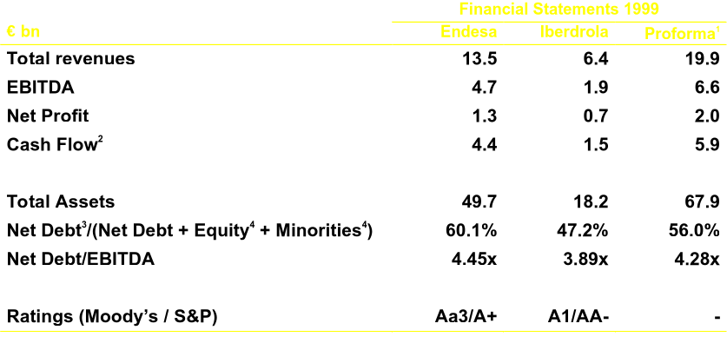
Financial strength
Source: Annual Report
¹ Sum of the consolidated Financial Statements
² Cash flow from operations
³ Net debt as of 30/06/00. Does not include pension liabilities
⁴ Book value as of 30/06/00

Slide 15
Complementary assets in the Spanish electricity market
Optimization of electricity assets
Combined generation mix¹
Generation
MW
Greater efficiency of the resulting asset base
Lower volatility of earnings
Greater capability to adjust the generation mix to competitors’ moves
Higher coverage of changes in the load curve
Thermal 41%
Hydro 40%
Nuclear 19%
¹ Before divestments

Slide 16
Complementary assets in the Spanish electricity market
Optimization of electricity assets
Distribution market growth
Distribution/Supply
MW
Base 100
Leader in distribution and supply
Neighboring markets
Operating efficiencies
Cost reduction
High growth markets
Complementary commercial networks

Slide 17
Complementary assets in Latin America
Exceptional position in the region
18 mm customers
13,800 MW¹
Endesa
Guatemala
Iberdrola
Mexico
EEGSA (D)
CCGT Monterrey (G)
Dominican Republic
Brazil
Brazil
Cepm (G/D)
CEG (GA)
Riogas (GA)
Coelba (D)
Cosern (D)
Celpe (D)
Itapebi (G)
Tele Leste (T)
Tele Sudeste (T)
Tele Sp (T)
CRT (T)
Cerj (D/G)
Coelce (D)
Cachoeira Dourada (G)
Cien (Tr)
Colombia
Colombia
Gas Bogotá (GA)
Gas Oriente (GA)
Emgesa (G/D)
Codensa (D)
Betania (G)
Perú
Edelnor (D)
Etevensa (G)
Piura (G)
Edegel (G)
Bolivia
Uruguay
Electropaz (D)
Elfeo (D)
Aguas de Maldonado (W)
Chile
Chile
Argentina
Ibener (G)
Essal (W)
Enersis (H)
Chilectra (D)
Rio Maipo (D)
Endesa Chile (G)
Transelec (Tr)
Gas Atacama (GA)
Edesur (D)
Dock Sud (G)
Costanera/CBA (G)
Chocón (G)
Edenor (D)
Yacilec (Tr)
G = Generation, D= Distribution, Tr = Transmission, GA = Gas, T = Telecom, H = Holding Company, W = Water
¹ Operating capacity

Slide 18
Complementary in telecoms
Endesa
Iberdrola
Position
Spain
Auna
Retevisión: fixed line
Amena: wireless
eresMas: ISP
Cable operators
Quiero TV: DTT
Hispasat: satellite
Euskaltel: telephony
Cable operators
Optic fibre network in Spain and Portugal
Second largest full-service operator in Spain
Latin America
SmartCom: mobile
Teleleste
Tele Sudeste
Telesp
CRT
Presence in wireless and internet industry in Latin America

Slide 19
Complementary in other business areas
Endesa
Iberdrola
Position
New Technologies
Endesa Net Factory:
Opciona.com (B2B)
Endesa web hogar (B2C)
Kristina IBS
Leader B2B
“Shaper”
Renewables & Co-generation
Endesa Cogeneración y Renovables
Iberdrola Renovables
Gamesa
Leadership
2,700 MW
Gas
Endesa Gas
Iberdrola Gas
Second largest gas operator in Spain

Slide 20
Human capital
Management team with proven expertise
Focus on value creation
Experience in business integration
Guarantee of Merger Success
Leadership in international expansion

Slide 21
Agenda
A unique opportunity
A solid starting point
Operating optimization
Asset divestiture process
Strategic repositioning: re-investment plans and future strategy
Closing remarks

Slide 22
Corporate reorganization around three business lines
Endesa + Iberdrola
Energy
Telecoms and New Technologies
Services and other businesses
Energy Spain
Energy Europe
Energy America
South America
North America

Slide 23
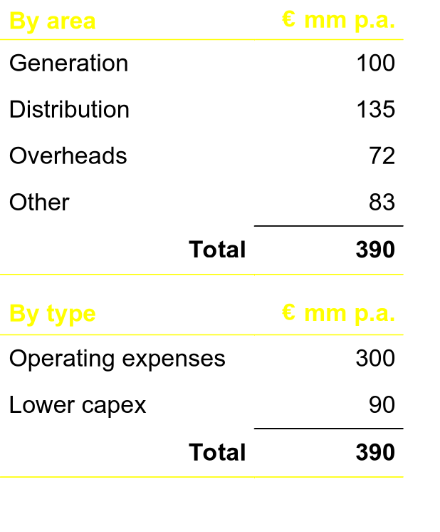
Synergies and value creation
Reduction of costs and capex in Spain (after divestitures)
Implementation over 3 years (30% in 2001; 75% in 2002 and 100% in 2003)
Does not include revenue synergies, estimated at €110 mm p.a.
Estimated reorganization costs of €1,000 mm
Operating synergies are in addition to those previously announced

Slide 24
Cost reduction program: 2001 - 2004
Operating costs reduction after divestments
€ bn
20% reduction of manageable costs

Slide 25
Agenda
A unique opportunity
A solid starting point
Operating optimization
Asset divestiture process
Strategic repositioning: re-investment plans and future strategy
Closing remarks

Slide 26
Divestitures rationale
Adjusting market share to competition requirements
Optimization of the generation asset base
Crystallising the value of assets by profiting from the existing interest in the Spanish electricity market
Opportunity to enter new markets
Greater regulatory stability

Slide 27
Process overview
Generation
Current capacity: maintain Endesa’s current size by selling approx. 15,000 MW
Future capacity: build new CCGTs up to Iberdrola’s authorized volume of approximately 2,600 MW
Distribution
Divestment of approximately 25,000 GWh
Supply
Self-limitation of new contracts: < 50% through 2003

Slide 28
Expected evolution of the Spanish electricity sector
Current situation
Resulting situation
Generation¹ MW
HC 5%
Elcogás 1%
NE3
UF 13%
NE2
Endesa 45%
Endesa+ Iberdrola
Iberdrola 37%
NE1
Elcogás
HC
Unión Fenosa
Distribution GWh
HC 5%
NE1
NE2
NE3
UF 15%
HC
Endesa 41%
Unión Fenosa
Iberdrola 39%
Endesa+Iberdrola
Supply GWh
HC 3%
Enron 1%
UF 11%
Endesa 44%
Self-limitation of new contracts: <50% through 2003
Iberdrola 41%
Note: NE= New Entrant
¹ Peninsular generation without IPPs

Slide 29
Evolution of the generation mix
Optimization of the generation mix by divesting a portfolio which is equivalent to the combined entity
Endesa¹
Endesa + Iberdrola (after divestitures)²
Hydro 30%
Thermal 52%
Thermal 40%
Hydro 40%
Endesa + Iberdrola
Nuclear 18%
Nuclear 20%
Total = 20,273 MW
Thermal 41%
Hydro 40%
Total = Aprox. 20,300 MW
Iberdrola
Divestitures/shut down²
Nuclear 19%
Thermal 28%
Hydro 52%
Total = 36,314 MW
Thermal 40%
Hydro 40%
Nuclear 20%
Nuclear 20%
Total = 16,041 MW
Total = Aprox. 16,000 MW
¹ Peninsular system only
² Estimate

Slide 30
Divestitures process
Flexible process managed by the new company to maximize value
Structured via companies/bundle of assets that are highly attractive in terms of size and mix
Process open to the best operators: sale or asset swaps
Separated management of assets run by high quality teams
Flexibility in the timing of the divestments due to independent management of assets to be divested

Slide 31
Agenda
A unique opportunity
A solid starting point
Operating optimization
Asset divestiture process
Strategic repositioning: re-investment plans and future strategy
Closing remarks

Slide 32
Strategic repositioning
Vision
Advantages
Become an industry leader in energy and services actively involved in the industry consolidation process
Reach an excellent strategic position in telecommunications by specialising in specific segments with high growth and return
Maximize value of our customer base and skills building a profitable business based on new technologies
Obtain more balanced asset base
Geographically
By business line
Divestitures allow for an effective and quick way to penetrate other markets
Rapid repositioning for higher value creation

Slide 33
Electricity business
Global strategy leveraged on domestic leadership in Spain and Latin America
Spain and Portugal
South America
Europe
North
America
Reinforce leadership
Multi-energy & multi-service
Presence in every customer segment
Efficiency leadership
Consolidate leadership: market share 10%-12%
18 million customers in the main cities
Increasing presence in Brazil
International interconnections, supply and trading
Rapid penetration via potential asset swaps
Leadership in Southern Europe-Mediterranean
Selective investments in the rest of Europe
Active player in trading
Selective investments in U.S. and Mexico
Preference for:
Generation/ distribution integration
Strong customer base
Development of trading activities
Integrated operator
Integrated operator
Specialist
Regional focus

Slide 34
Telecoms
Flexible strategy to build an optimal business base
Spain
Latin America
Europe
Integrated operator: fixed-line, wireless, internet and digital TV
Own local loop and broad band network
Focus on Internet and interactive services
Exploit our existing customer base and solid presence in 6 countries
Leverage our own networks (OF & PLC)¹
New mobile and WLL licences
Advance data and Internet services through broad band
Selective strategy
Grow along the “core” business, profiting from European positions
Focus on data and broad band services
Integrated operator
Customer base/
mobile and WLL specialist
Taking opportunities
¹ Optic fibre and Power Line Communication

Slide 35
New technologies
Enhancement of intangibles and optimization of customer
relationship
B2B
Leadership in the electricity and services industry
Opciona.com
B2C
Endesa + Iberdrola “web hogar”: services for 40 million customers
Value added services for small/medium companies
Internet-ization of commercial activity
New Technologies
Leverage of our capabilities and technological innovation
PLC, Enertech, Kristina ISB, ...

Slide 36
Services and other businesses
Gas
Second largest gas operator in Iberia: imports, re-gasification, transportation, commercialization and distribution (strategic agreements with Gas Natural and ENI)
Latin America: transportation and distribution
Europe and US: distribution, commercialization and trading
Purchase of strategic reserves
Renewables and
Co-generation
Spain: 70% market share in renewables and co-generation
Latin-America: development will depend on market conditions
Other markets: niche strategy
Water and
Environment
Participate in privatizations and purchase of distribution companies to profit from synergies with the electricity business

Slide 37
Investment plan
Cash flow origination
Investment plan (2001-2005)
Endesa + Iberdrola annual generation of FCF
Divestitures of assets:
Generation
Distribution
Divestitures of non-strategic assets (Repsol, 10% REE, … )
Average IRR = WACC (of project) + 4.5%

Slide 38
Strategic repositioning
Controlled assets breakdown - 2000
Controlled assets breakdown -2005
Business line
Business line
Geographic
Geographic

Slide 39
Agenda
A unique opportunity
A solid starting point
Operating optimization
Asset divestiture process
Strategic repositioning: re-investment plans and future strategy
Closing remarks

Slide 40
Closing remarks
Emergence of a leader in the energy and services industries
Focus on profitability and growth through:
Operating optimization
Asset divestments
Strategic expansion in energy, telecoms, new technologies and other services
Maximising the return for our shareholders

Slide 41
Endesa Iberdrola:
A global leader
October 2000

Slide 42
FORWARD–LOOKING STATEMENTS This presentation contains statements that constitute “forward–looking statements” within the meaning of the Private Securities Litigation Reform Act of 1995, such as statements that include the words “expect”, “project”, “anticipate”, “believe”, “plan”, “intend”, “probability”, “risk”, “target”, “goal”, “objective”, “estimate”, “future” and similar expressions or variations on such expressions. These statements appear in a number of places in this presentation and include statements regarding our belief, objectives, plans or current expectations with respect to, among other things: (1) the approval of the terms of the merger by the relevant authorities, (2) the requisite corporate approvals of merger its implementation, (3) the expected effect of the merger on future results of operations, financial ratios used in analyzing our business and on our financial condition, and (4) expansion opportunities and potential future acquisitions and dispositions. Such forward–looking statements are not guarantees of future performance and involve risks and uncertainties. Actual results may differ materially from those in the forward–looking statements as a result of various factors. These factors include: inability to access the capital markets of the United States, Spain or other countries in which members of the resulting Group operate in a timely manner and under favorable market conditions; an increase in the market rates of interest in the United States, the United Kingdom or elsewhere; adverse decisions by government regulators in Spain or other countries in which members of the resulting Group operate; potential adverse economic conditions in countries in which the resulting Group operates the risk that the merger companies businesses will not be integrated successfully; the costs related to the merger; the inability to obtain, or meet conditions imposed for, governmental approvals for the Merger; and other factors generally affecting the businesses of the combined company , the inability of achieving the cost reductions arising from the synergies generated by the merger; the possibility that the Company may not find interested buyers at an acceptable price for an asset that is expected to be sold, or that regulators may interfere adversely in the sale of such asset; (or other countries in which members of the resulting Group operate in a timely manner and under favorable market conditions that adversely affect our revenues or expenses); our ability to manage the risks involved in the foregoing; and other factors described in our Annual Report on Form 20-F or in that of our subsidiaries Enersis S.A. or Endesa Chile. You are cautioned not to place undue reliance on those forward–looking statements, which speak only as of their dates. We undertake no obligation to release publicly the result of any revisions to these forward–looking statements which may be made to reflect events or circumstances after the dates thereof, including, without limitation, changes in merger, our business strategy or planned capital expenditures, or to reflect the occurrence of unanticipated events.

