Slide 1
Transwestern Station 1 Heat Recovery Project
Proposal to Mohave Electric Cooperative
August 30, 2001

Slide 2
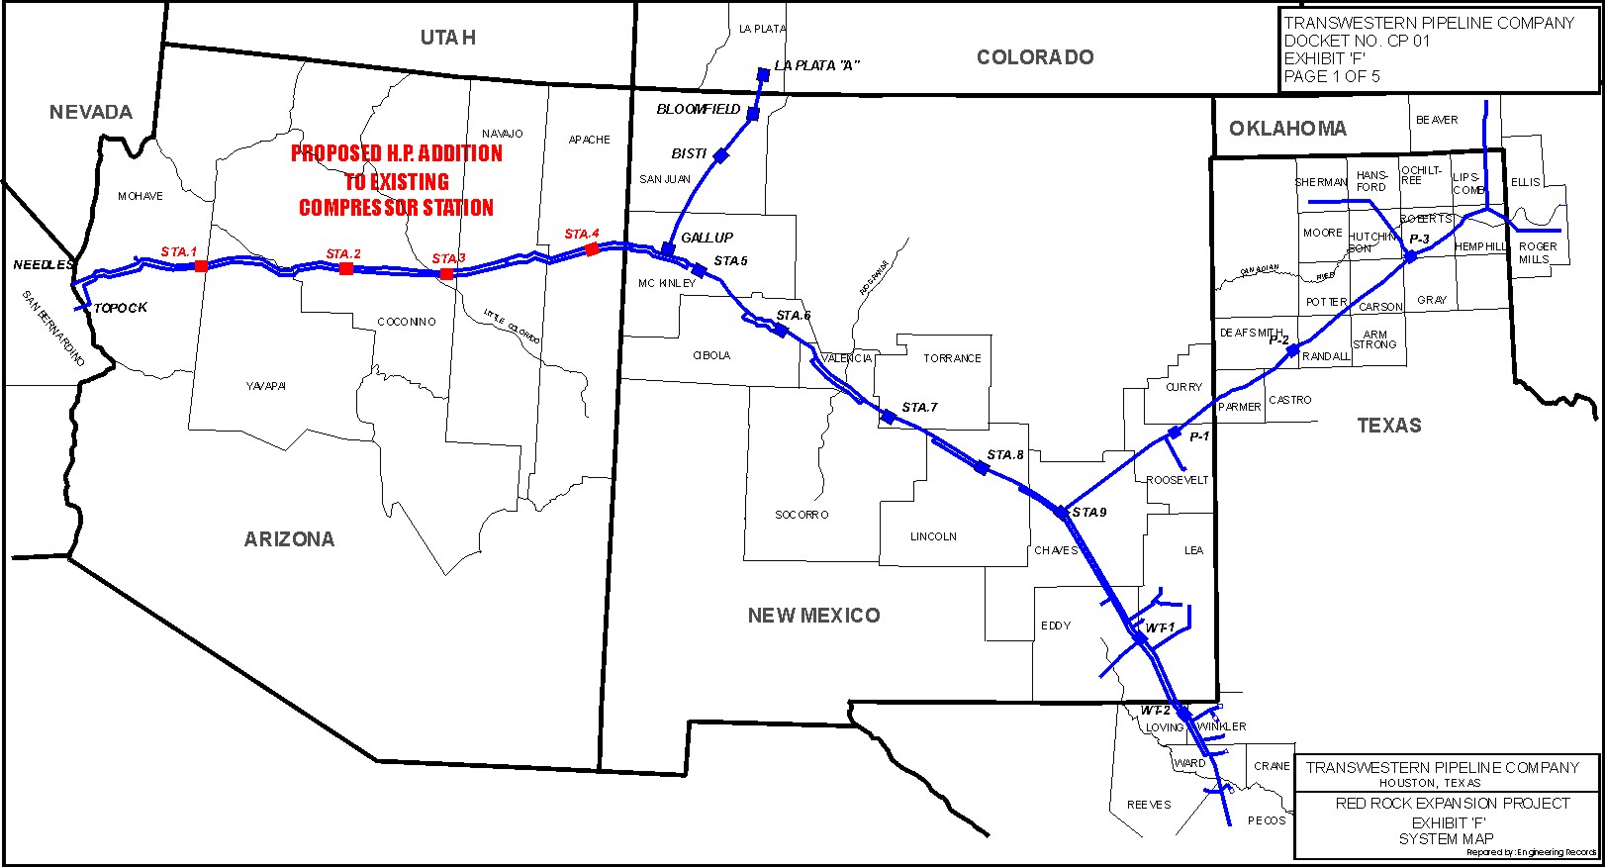
Transwestern Pipeline
STA.1A
STA.2A
STA.3A
STA.4A
-
-
.
-
-
-

Slide 3
Red Rock Expansion Project
Repowering stations 1, 2, and 3
Retiring existing reciprocating engines and compressors
Installing new compressor and gas combustion turbine model GE LM 2500+PR
Adding 100MMcfd capacity
In-service date June 2002

Slide 4
Heat Recovery Proposal
Recover waste heat from LM 2500 turbine to make steam and generate electricity
Create a special purpose, non-regulated company to own power plant assets
Find counter party for a 15 year PPA, lease, or tolling agreement

Slide 5
Proposed Plant
exhaust
LM2500 Gas Turbine (existing)
duct burner
Once-Through Steam Generator
natural gas
water
superheated steam
Water System
water
electricity
spent steam
Condenser
Steam Turbine/Generator
Grid Connection
proven technology to generate low-cost power

Slide 6
Plant Output
Output varies with ambient temperature, but site conditions allow for efficient operation most of the year.

Slide 7
Assumptions
LM 2500 will be operated at full load
LM 2500 will be available 98% of the time
No unusual permits required
Plenty of electric grid capacity
others

Slide 8
Contracts/Agreements
Agreement | Buyer | Seller | Purpose
PPA/Tolling | Utility | Plant | Power sales
Gas Supply | Utility | Gas Supplier | Gas supply for duct burner
Gas Transp | Utility | Transwestern | Gas transp for duct burner
Waste Heat | Plant | Transwestern | Exhaust supply for OTSG
Land Use | Plant | Transwestern | Property lease for plant
O&M | Plant | Transwestern | Field operations for plant

Slide 9
Plant Schedule
Order equipment 10/1/01
Equipment delivered 12/01/02
Equipment erected 1/1/03
I&E, mechanical complete 3/1/03
Pre-commissioning complete 4/1/03
Tie-in and final commissioning 4/03
Start-up 5/1/03

Slide 10
Pricing
PPA for constant unfired output of 7 MW @ $40/MW (approx $2.4MM/yr)
Tolling option for additional 7 MW @ $11 per kW*month (approx $0.92MM/yr)
Index price for additional output above 7MW unfired and 14MW fired

