Slide 1
E-Commerce: An Enron View
Mike S. McConnell
Chief Operating Officer
Enron Net Works
Key Ex Conference
Scottsdale, Arizona
April 27, 2000

Slide 2
Presentation Summary
eBusiness Trends
Enron Philosophies
EnronOnline.com
Conclusions

Slide 3
“It Is Not the Strongest of the Species That Survives, Not the Most Intelligent, but the Most Responsive to Change.”
Charles Darwin
The Origin of the Species

Slide 4
Today’s New Economy
New Economy Business Model is Fundamentally Different than Old Economy Model
Successful Companies are Increasingly Knowledge-Based Businesses (with Increasing Incremental Returns)
Network-Based Businesses Lead to Market Share Gains and Continued Scale Advantages
Technology, Innovation, and Intellectual Capital are Critical
Metcalfe’s Law
“Winner-Take-All” Outcomes are More Frequent
Internet is Changing Everything

Slide 5
“Winner Takes All”
1966
1998
100
90
80
70
60
50
40
30
20
10
0
80
70
60
50
40
30
20
10
0
The goal
Frequency
Frequency
-26
-9
5
9
18
28
38
-10
0
4
8
12
16
20
100
200
ROE (%)
ROIC (%)
Source: Financial Strategy, William E. Fruhan, Jr. 1979
Based on 1,448 Compustat Companies
Source: CFSB estimate. Based on S&P Industrial Avg.

Slide 6
Management Strategy: Tight and Loose
Tight Controls
Financial accounting
Risk management
Performance reviews
Legal obligations
Loose Controls
Creativity/new business ideas
Dress code
Time clock
Performance should drive protocol, not vice versa

Slide 7
Two Energy Models
20th Century Energy Company
Capital-intensive
Vertically integrated
Geographically dominant
Commodity price dependent
Hierarchical
21st Century Energy Company
Intellectual capital intensive
Network integrator
Differentiation dependent
Entrepreneurial culture

Slide 8
Industry Trends
Return on Sales
47
Market
Share Gain
Increase
in Sales
7.4
4.8
0
1.8
- 4
% Difference by
Economic Measures
Source: McKinsey & Company

Slide 9
Industry Trends
Technology has Slashed the
Price of doing Global Business
The Cost of a 3-Minute Phone
Call From New York to London
‘30
‘50
‘70
‘90
‘98
Source: New York Times 2/15/99

Slide 10
Transaction Costs
…and Radically Lowered
Transaction Costs
Average Cost per Transaction
Retail Banking by Channel
Branch
Telephone
ATM
Internet
Source: Downes, Larry and Chunka Hui, Unleashing the Killer App., Boston: Harvard Business School Press, 1998, pp.44-45

Slide 11
E-Business
The Effects of Increasing
Internetworking
Business-to-Business
Business-to-Consumer
Source: Forrester Research, Inc

Slide 12
eBusiness Trends
The Internet is a Disintermediary
The Internet Cannibalizes Existing Business
Law of Diminishing Returns
The Internet Allows for Mass Customization
Barriers to Enter Markets are Dramatically Changing

Slide 13
Enron Philosophies
Run Technology as a Business
Develop and Implement Enron’s Global E-Business Strategy
Spending Focused on Achieving Competitive Advantage
Highly Robust and Flexible Infrastructure
Develop Several Proprietary Applications

Slide 14
Enron Philosophies Continued
Expansion and Extension of our Existing Business
Enabler of Unparalleled Information Dissemination
Incubator of New Ideas and Business Models
Challenge Existing Ideas and Beliefs

Slide 15
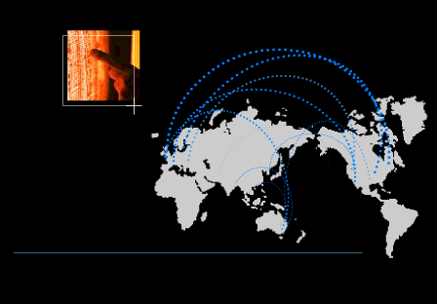
eCommerce is Becoming Core to the Global Energy Business
01010
91919
01382
83710
91817
01010
91919
01382
83710
91817
01010
91919
01382
83710
91817
01010
91919
01382
83710
91817
91919
010102374621985712398571928509129759812659821598601010237462198571239857192850912975981265982159860101023746216
010102374621985712398571928509129759812659821598601010237462198571239857192850912975981265982159860101023746298
global networks

Slide 16
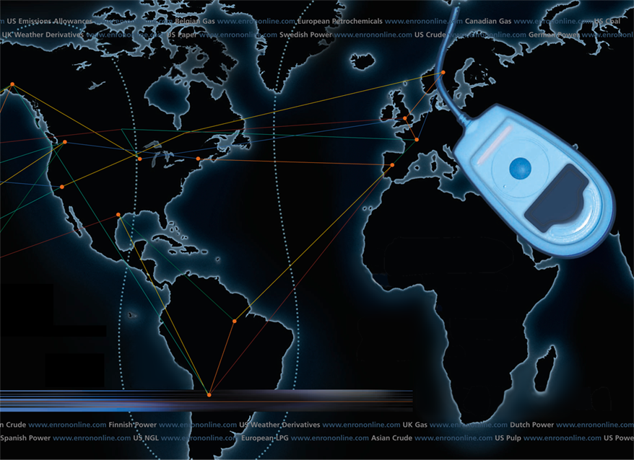

Putting the Energy into e-commerce
EnronOnline
TM
TM

Slide 17

What is EnronOnline?
A Free, Internet-based, Global Transaction System Which Allows Counterparties to View Real Time Prices From Enron’s Traders and Transact Instantly Online
click & transact

Slide 18
Benefits of EnronOnline
Free of charge
Real-Time Pricing Information
Access to complementary markets and product information
Simple access via the Internet
Easy to use
Fast and Secure Execution
Enron’s Best Prices

Slide 19
Enron’s global wholesale transaction business ….……..moves online
November 1999 US Natural Gas
Canadian Natural Gas
December 1999 Coal
Nordic Power
Plastics
Pulp & Paper
US Power
January 2000 Continental European Power
Continental European Gas
Emissions
LPG
Oil & Refined Products
Petrochemicals
UK Gas
UK Power
Weather
February 2000 EnBank Virtual Storage Auction (UK)
March 2000 Credit Derivatives
Enron Emissions Auctions (US)
Australian Power
Summer 2000 Bandwidth
European Coal
Clicks & Mortar

Slide 20
Web-Site Visitors
Producers & Marketers
Aquila
Bank of Montreal
Bord Gais
Chevron
Dynegy
Entergy
Goldman Sachs
Koch Industries
Louis Dreyfus
Morgan Stanley
Phibro
Shell
Texaco
Toronto Dominion Bank
Williams Energy
End Users
Dow Chemicals
International Paper
Lafarge
Pepsico Inc.
Terra
Utilities
British Energy
Detroit Edison
Duke Energy
Electricite de France
Electrobras
Florida Power & Light
PG&E
Reliant Energy
SNAM
Competitors
Altra Energy
Bloomberg
IPE
Nymex
Technologists
Microsoft
UUNet Technologies, Inc.
Compaq
Lucent
IBM
CISCO
Consultants
McKinsey
AT Kearney
Price Waterhouse Coopers
Arthur Andersen
Research
CERA
Columbia University
Harvard Business School
Meta Group
Misc.
Turner Entertainment
US Senate
Army & Navy
Brokers
All of them………
From over 30 countries

Slide 21
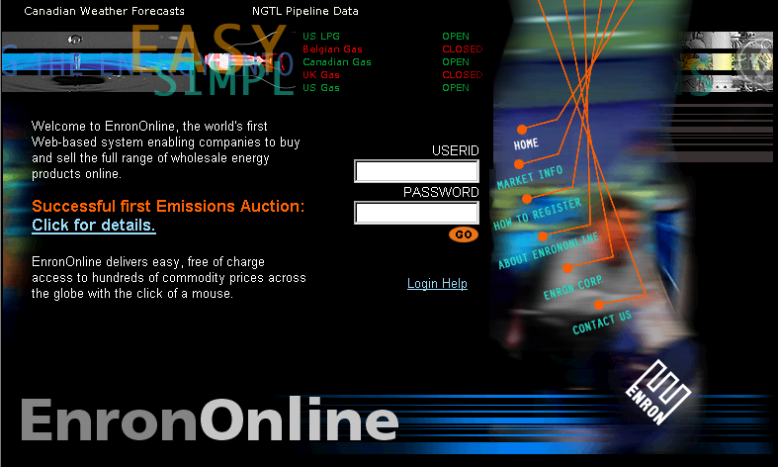
www.EnronOnline.com
New User
*******

Slide 22
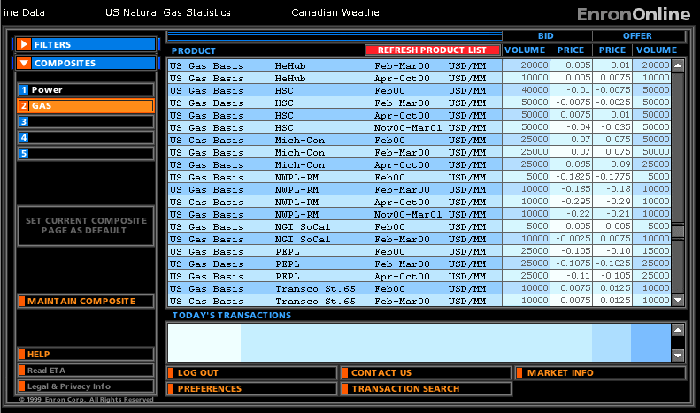
Click on Bid or Offer Price

Slide 23
Submission Screen

Slide 24
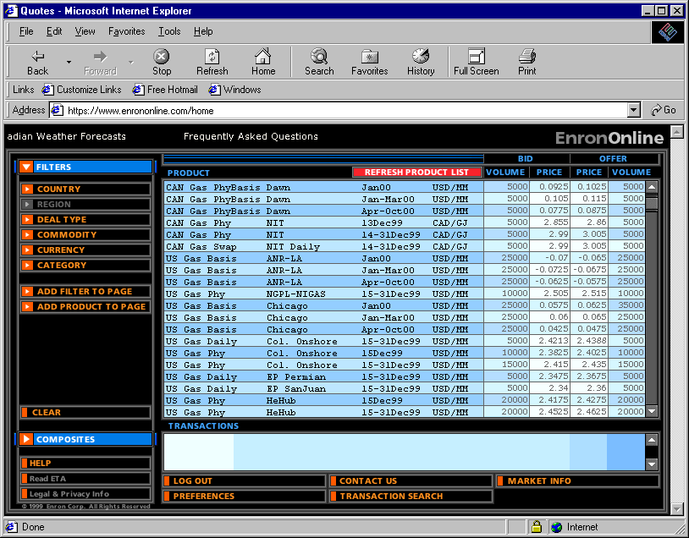
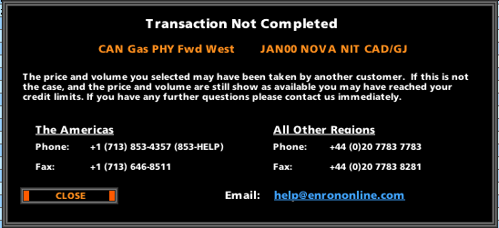
Failed Transaction

Slide 25
Successful Transaction

Slide 26
EnronOnline Statistics
Total Life to Date Transactions > 65,000
> 35 % of Enron’s Transactions
Average Daily Transactions > 1,000
Life to Date Notional Value of Transactions > $25 billion
Daily Notional Value Approximately $400 Million
24% of Enron’s Notional Volume
Number of Products Offered - Approximately 650
Development Time Approximately 7 Months
Announcement Date October 26, 1999
Launch Date November 29, 1999

Slide 27
Transactions via EnronOnline (Weekly Cumulative)

Slide 28


EnronOnline Versus Traditional Channels
Volume
Transactions
24%
37%
76%
63%
EnronOnline
Traditional Channels

Slide 29
eCommerce Business Comparison
Value of Goods
(Millions)
Business To Consumer (B2C)
eBay
Amazon.com
Dell.com
$ 2,805
1,640
10,435
1999 Data*
Business To Business (B2B)
FreeMarkets
Cisco
Intel
Altrade
$ 2,700
9,500
10,500
12,000
2000 Est.**
EnronOnline
> $ 40,000
* Actual 1999 Results: eBay, Amazon.com, Dell.com, FreeMarkets
Est. 1999 Annual Results: Cisco, Intel, Altrade
** Annualized Based on Results to Date

Slide 30
Conclusions
Technology is More than Just Support
Must Move Quickly
Must Change the Culture
It is a Matter of Survival

