Slide 1
WSCC Coal Overview
September 25, 2001

Slide 2
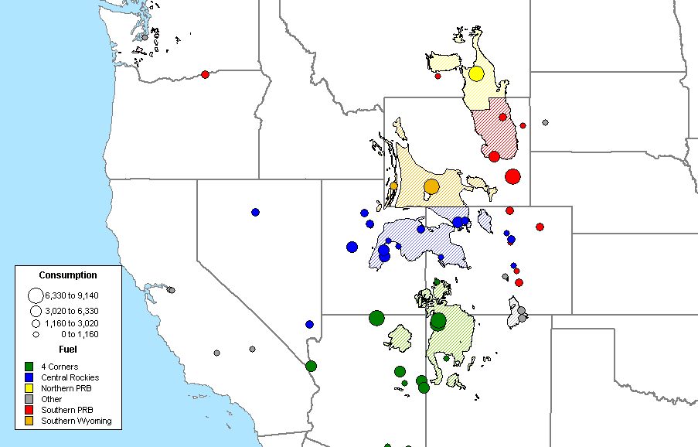
Plants and Mine Supply Regions of WSCC

Slide 3
Historical Coal Costs in WSCC
Delivered $/mmBTU by Supply Region
** “-” denotes no historical record of delivery

Slide 4
WSCC Coal Plant Profile
(Percentage)

Slide 5
WSCC Coal Plant Profile
(Tons)

Slide 6
Regional Breakdown of Mine Mouth Plants

