Slide 1
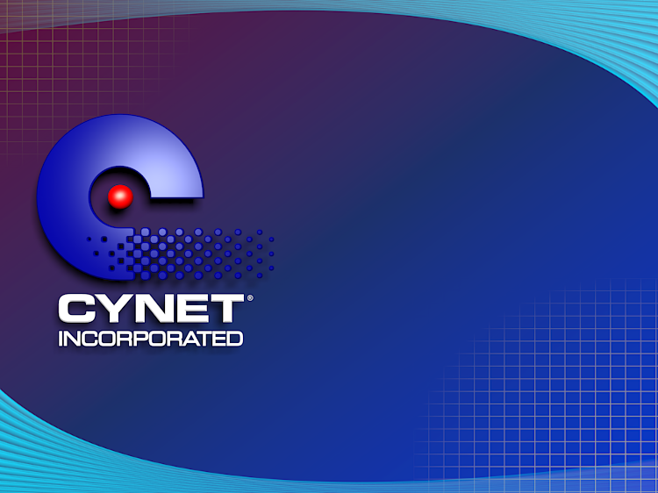
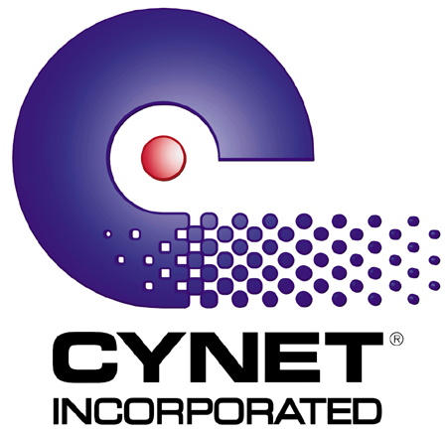
CYNET Progress Report
April 17, 2000- CYNET presented seven opportunities.
CYNET is executing on four.
Compaq is CYNET’s computer hardware partner.
The iPAQ expansion pack wireless bundle project.
Compaq invested $1 Million in the CYNET
Convergent Messaging Center and $1 Million
in Working Capital.
CYNET is working to bring Convergent
Messaging Services to Compaq Employees.

Slide 2
CYNET Progress Report
Impact of Compaq investment in CYNET
A. Compaq’s investment allowed CYNET to secure
the Enron project (rollout Jan 2001).
CYNET is negotiating with AT&T to provide
Convergent Messaging as a part of a
corporate-wide productivity solution package
for it’s employees.
Other Accounts (Rolling out 4Q 2000)
Downstream Energy
Maresk/Sealand.
Mirosoft Partnership initiatives for pocket pc and
wireless.

Slide 3
CYNET Bundled Package for the iPAQ
CYNET Convergent Messaging Service
In bound/out bound wireless messaging-
( fax, email & voice).
CYPAQ Expansion Pack.
CYNET Wireless Modem.
CYNET Dialer.

Slide 4
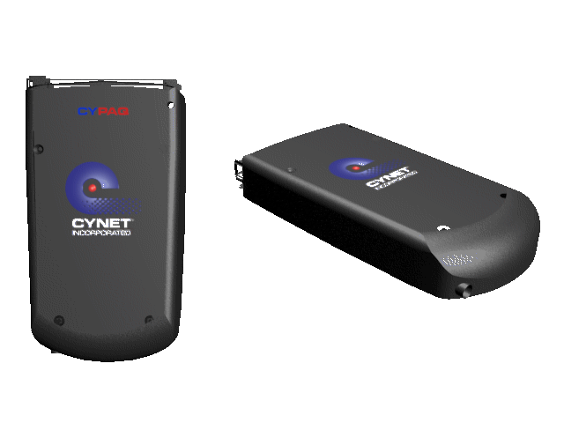
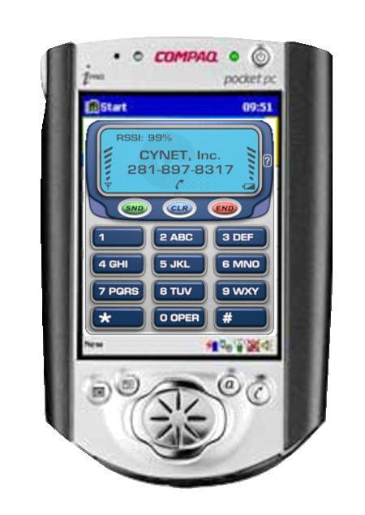
CYNET iPAQ Accessories
CYPAQ and Dialer

Slide 5
COMDEX REVIEW
Microsoft Partnership (Pocket PC & Wireless)
Media Coverage
  Microsoft Pocketpc.com
  Pocketpcpassion.com
  Brighthand.com
  Pocket PC Magazine
  Others
Analyst Coverage
  Dr. Zabrek
  Dale Coffing
  Mike
  Cliff Ansel
Distributors
  Datanywhere
  Angelnetworks
  Others

