Slide 1
Project 300M Follow Up
May 2001
Confidential and Proprietary

Slide 2
Proposed Communication Plan
June 15th Email from the Office of Chairman (Ken and Jeff)
Business Case may include : focus on Earnings, developing “one Enron” policies which leverage best practices from various Business Units ie EBS, ETS, etc.
All source departments should complete implementation and be prepared to answer detailed questions by this date.
Travel and entertainment and outside services are effective 7/1/01.
Severance Plan and Vacation Payout at Termination plans are effective 1/1/02.
Outstanding Item with timing of Severance Plan changes; may announce with Benefits Open Enrollment.
Executive Service Garage will not be included in this communication, nor will CAH.
Possibly, introduce the development of new Enron Anywhere portal to help others avoid duplication
Introduce email box for cost savings suggestions to employees
ESPEAK with Hannon?, Causey?, Skilling? (sometime between 6/15 and 7/1)
Need to decide who sponsors the Espeak.
Follow up Business Unit Leader Emails to show support to each. (sometime between 6/15 and 7/1)
GSS detailed communication items-if necessary ( 6/15 )
* Reviewed with Corporate PR 05/15/01.

Slide 3
Severance Plan
May 2001
Confidential and Proprietary

Slide 4
Background of Enron’s Severance Plan
Plan Last Amended and Restated in December 1992, effective January 1, 1993
Prior to January 1993, payments caps were 12 weeks for failure to meet performance objectives and 1 year for reduction in force and business reorganization. No waiver was required.
Shortly after the restatement, the company offered voluntary termination plans in ETS (formerly GPG) to approximately 300, and involuntarily terminated another 300; less than four lawsuits resulted.
There is no indication that the lawsuits resulted from the change in severance plan.
Redeployment
Commenced in early 2000
Redeployment is essentially an extension of the employee’s current compensation, as employees have gained another 45 days of paid compensation via redeployment.
Current Enron Plan
Cause: No severance benefit; two weeks pay when waiver is signed
Failure to Meet Performance Objectives: One week of base for each year of service or portion thereof, up to max of 6 weeks; the same amount is paid with signed waiver (total max of 12 weeks).
Reorganizations: One week of base for each year of service or portion thereof, plus one week for each $10k or portion thereof of base; the same amount is paid with signed waiver (total max of 52 weeks).

Slide 5
Enron’s Current Plan
Current Plan Recommended Change Mkt Indicator
Severance Pay Floor and Ceilings
Cause No Payment Same Market avg
Poor Performance (1) Min: 1 wk of base; max: 6 wks of base No Payment unless waiver is signed Market avg
Reduction in Force/Reorganizations (2) Min: 1 wk of base + 1 wk of 10K base; No Payment unless waiver is signed Market avg
Max: 26 wks of base No Payment unless waiver is signed Market avg
Payment when Waiver is Signed
Cause 2 wks of base; not defined as severance benefit Same Avg to Rich
Poor Performance Above (1) doubled up to a max of 12 wks Min (waiver): 2 wks (no chg); max 9 wks or Rich
Min (waiver): 2 wks (no chg); max 6 wks Rich
Reduction in Force/Reorganizations Above (2) doubled up to a max of 52 wks Min (waiver): 4 wks (no chg); max 39 wks or Middle of road
Min (waiver): 4 wks (no chg); max 26 wks Middle of road
Analyst/Associate Program Same as above Poor Performance: 3 wk cap Market avg
Reduction in Force: 4 wk cap for similar prog
Severance Pay Recipients
Regular Full-Time Yes Yes Market avg
Reduced hours/part-time No No Below market
Contractors No No Market avg
Method of Payment
Sec 3.2 – base pmts (1) and (2) Monthly No Payment unless waiver is signed Market avg
Sec 3.3 – waiver is signed; add’l benefit Lump sum Change from lump sum to monthly Market avg
Stock Treatment Vested options can be exercised up to 3 years Same Rich
after termination
Benefits Treatment Terminates at the end of term month Same Below market
COBRA up to 18 months (employee’s expense) Same Req’d by law
Portable coverage unlimited (employee’s expense) Same Rich
Portable is available to those with 5 yrs of service
and age of 40 yrs.
Relocation No severance benefit if employee declines
relocation offer
Summary of Recommendations:
Eliminate any severance payment unless waiver is signed
Reduce cap on failure to meet performance objectives and reduce cap on reorganizations
Eliminate lump sum payout and only payout periodically (i.e., monthly) to eliminate large adverse earnings impact and incent compliance of non-compete clauses
Create separate stipulation for Analysts and Associates
Eliminate severance benefit if employee receives offer or transfer of employment at employee’s same salary or accepts offer or transfer of employment at any salary from the Company or from a divested employer or another employer which at the time of transfer is affiliated by reasons of stock ownership, partnership or business venture with Enron Corp or one of its subsidiaries or affiliated companies.

Slide 6
Savings from Proposed Pay Cap Changes
Assumptions: $80,000 average annual base salary

Slide 7
Enron’s 2001 YTD Severance Payments
Total Severance Payment Dollars by Termination Reason
Total Severance Payment Dollars by Business Unit
Reorganization | 73%
Mutual Agreement / Other | 20%
Unsatisfactory Performance | 7%
Cause | 0%
EES | EBS | EWS | CORP | ETS
39% | 25% | 23% | 11% | 2%
Total Number of Employees Receiving Severance Payments
Total Severance Payments
Severance is generally a small part of the compensation and benefits budget, roughly less than one-half percent.
Enron spent 1% or $10M+ in the first quarter 2001.
For actual costs, BU’s may need to provide.
EES | EBS | EWS | CORP | ETS
31% | 37% | 20% | 9% | 3%

Slide 8
Severance Plan Trends
Who Receives Severance Payments*?
Employment Status:
48% offered severance to part-time employees
7% offered to temporary or contract staff
Enron - no severance for the above groups
Termination Reason:
96% for downsizing/job elimination
26% for poor performance
13% for cause
Enron: max of 52 weeks for reorganizations; max of 12 weeks for poor performance; no severance for cause
70% require a release in exchange for severance payments.*
Recent trends show while the money employees receive in severance packages has declined throughout the past decade, other benefits in the package have increased (i.e., stock options and tuition reimbursement).
Severance Pay Formula
Most employers use a formula based on years of service; some factor in salary and job level.
17% use a graduated scale, with weeks of severance increasing with tenure.
Those with employment agreements tend to have guaranteed severance payments not dictated by formulas (i.e., one year)
Most employers do not stop payments when the laid-off employee finds a new job.
 | Executives | Exempts | Non-Exempts
Minimum Amount (median)* | 4 wks | 2 wks | 2 wks
Maximum Amount (median)* | 26 wks | 26 wks | 26 wks
* “Severance and Separation Benefits,” Lee Hecht Harrison, 1998.

Slide 9
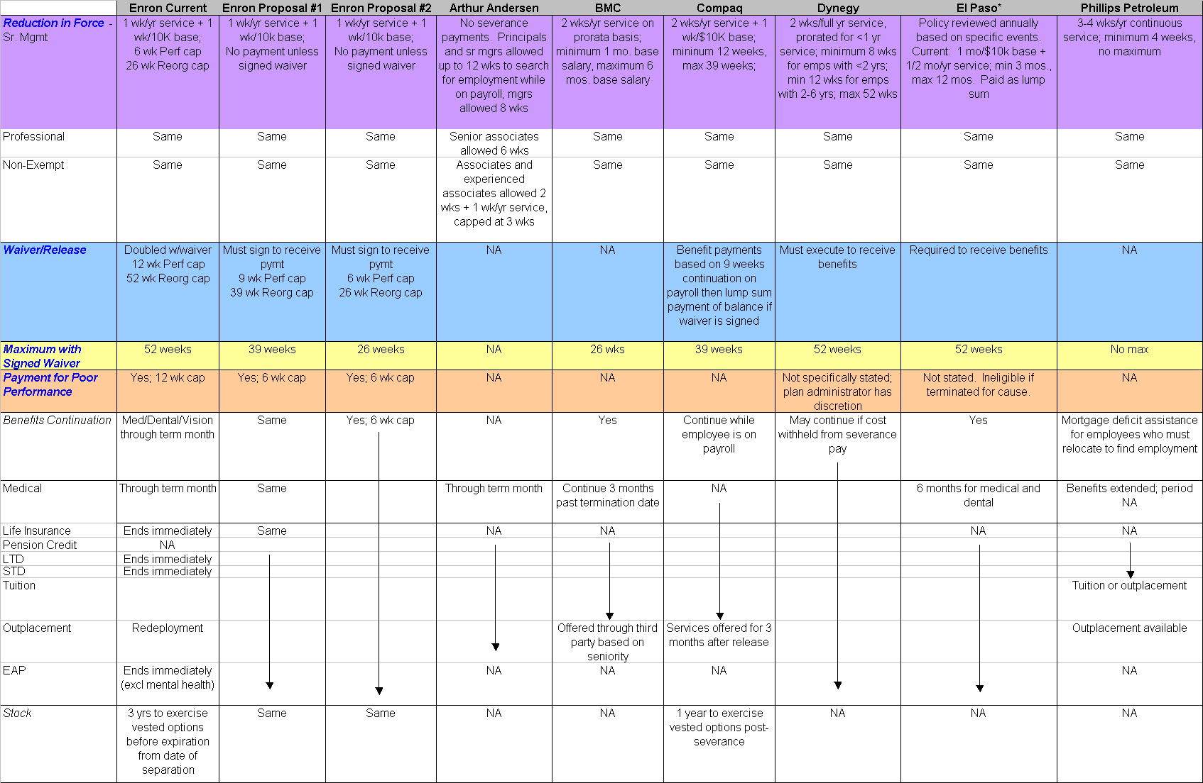
Severance Plan – Top Houston Employers
* Severance plan allows employees to modify terms.

Slide 10
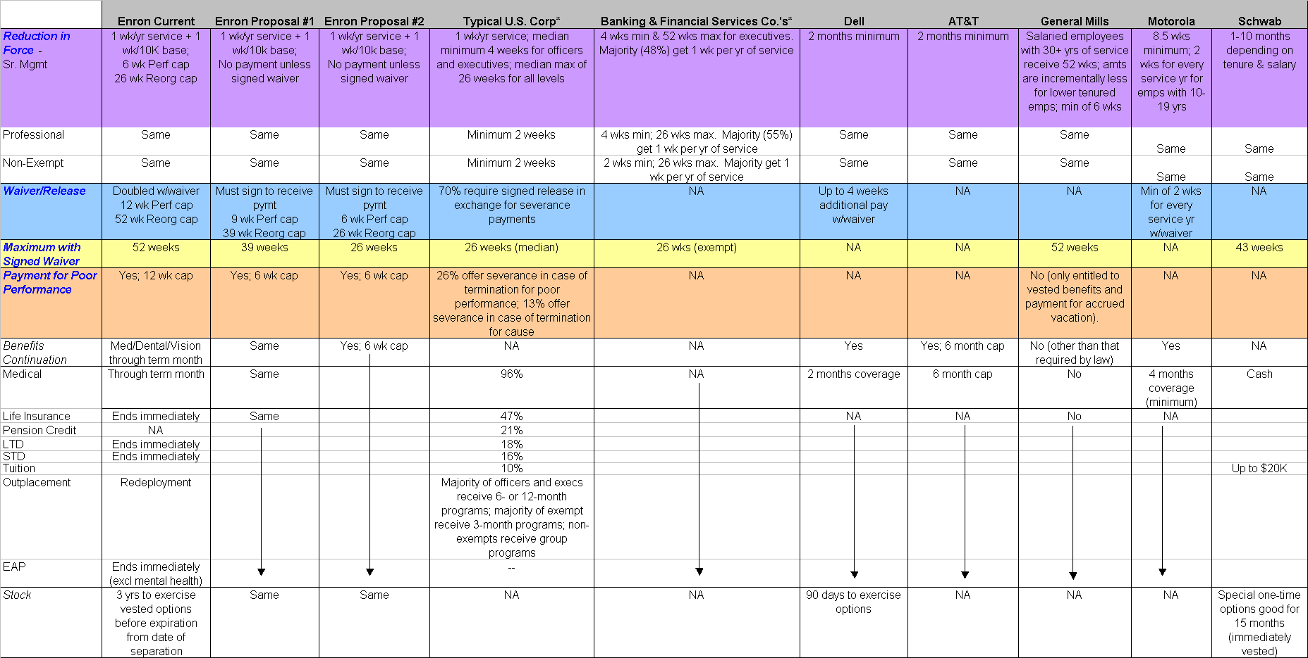
Severance Plan – Other Major Companies
* “Severance and Separation Benefits,” Lee Hecht Harrison, 1998. Survey based on 2,000 responses from human resource executives at
organizations of all sizes and in a wide range of industries.
** A significant number of employees come from consulting firms which traditionally provide little or no severance benefits.

Slide 11
Wrongful Termination Cost Considerations
How Do Severance Plan Changes Affect Overall Employee Proposition?
A severance plan may have an impact on public image and should be consistent with corporate culture.
Severance benefits alone do not help recruiting efforts unless they are very, very, very lucrative. Employees in high demand are more attracted by salary, benefits and advancement opportunities.
For executives and those in highly volatile jobs (i.e., dot-com’s), some applicants might be tempted by a guarantee of severance pay if they have been laid off previously.
How Do Severance Payments Adversely Impact Wrongful Termination Costs?
Enron had only three cases that were litigated last year. Companies of our size average 5 times that.
Typically, wrongful termination suits are brought as a result of the employee’s perception of mistreatment during employment or mistreatment that resulted in involuntary termination.
Litigation occurs to recover loss wages for retribution purposes.
Wrongful termination costs include outside counsel fees, inside counsel time,supervisor’s time and potential adverse publicity.
These costs start at $150K per event and range up to $M if you include punitive damages.

Slide 12
How Severance is Paid
Three Approaches
Lump Sum
Enron’s 2001 YTD severance payments have been made as follows:
49% periodic payments
32% lump sum (waiver amount)
19% agreements
High number of lump sum payments is an adverse impact to earnings management as it accelerates the expense treatment
The employee may receive an adverse personal tax as well.
Continuation of Salary
Continuation of salary entices employees to maintain contractual and plan agreements.
Employee’s choice between lump sum and continuation of salary
Fewer than 10% of other companies give employees a choice
How are Severance Payments Made?*
 | Executives | Exempts | Non-Exempts
Salary Continuation | 52% | 48% | 46%
Lump Sum | 44% | 49% | 51%
Employee’s Option | 8% | 8% | 8%
Both Lump Sum & Periodically | 7% | 6% | 6%
Periodically | 3% | 3% | 3%
* “Severance and Separation Benefits,” Lee Hecht Harrison, 1998.

Slide 13
Enron Anywhere Enterprise Portal

Slide 14
EnronAnywhere Enterprise Portal
Hard Savings ($M) before development costs
Increased Use of Existing Applications $17M
Web Application and Development 10
Web Marketing Collateral 6
HR Self Service 1
TOTAL 34M
Other savings opportunities may include corporate communications, elearning, call center resources, etc. These savings are very conservatively estimated.
Increased Usage of Existing/Planned Services
Providing all content and services through a single, personalized channel makes it easier for users to navigate within the web environment. In addition, providing only the relevant transactions in a consistent presentation format will increase the ease of executing transactions regardless of the back-office system providing the functionality. As a result, users will more easily find and use systems; therefore driving a related increase in the value realized by the service provider.
Each service provided through the portal will have its own value proposition, of which some will have associated hard dollars. The incremental value of the Enron Portal is the extension of this value to additional users. eProcurement and travel were selected as anecdotal case examples, and additional opportunities will be determined by the specific services offered in each release.
Marketing Collateral Cost Avoidance
Internal collateral marketing efforts could be dramatically reduced or eliminated if all new content and services are provided through a single channel.
Future Application Cost Avoidance
A single enterprise portal enables cost avoidance for web application development and support driven by standardized User Interface, Security, Access, Personalization, Search Engine, Content Management, Hardware, Operating Systems, System Management, Application Integration.
Consolidation of Planned “In-scope” Projects
In order to deliver enterprise portal functionality, multiple IT components are required. Some of these components such as content management systems, single sign-on security/profiles, remote connectivity might already be underway or planned as separate initiatives.

Slide 15
EnronAnywhere Enterprise Portal
Productivity Improvements
A primary benefit of enterprise portals is increased user productivity driven by navigation, logon, and personalized/ customizable role- and event-based content and services. While no hard dollars are directly associated with this benefit until/unless actual staff reductions or demonstrated revenue increases are identified, prior engagement experience in conjunction with the current Enron environment suggest that wasted time through inefficient navigation, limited search capabilities, and password/logon requirements could easily represent ten minutes or more per day (2%). Regardless of whether this opportunity is valued as a percent of loaded salary (up to $26M) or as missed revenue opportunities (up to $2B), the overall impact across the entire Enron organization is substantial.
Call Center Cost Reductions
A single enterprise portal dramatically simplifies the desktop/laptop image. In addition the integrated use of single sign-on through a single delivery channel dramatically reduces the number of passwords. The use of employee self-service through a streamlined work and life event framework will also reduce the less complex inquiries to functional support organizations. The specific financial opportunities can be analyzed based on evolving requirements after the initial release, and will be further refined during subsequent releases. However, current support requirements should be reduced overall, and the opportunity to move toward a more integrated shared-services model may provide further cost savings.
Printing and Distribution Cost Reductions
Additional opportunities exist to move printed materials such as pay stubs and benefits information to the web. The annual savings potential extends into millions of dollars.
Workflow
Streamlining business processes through centralized application integration and enterprise workflow may provide additional productivity benefits as the portal evolves.
Additional Hard Savings Opportunities
While the stated annual savings amount still provides for a rapid payback, prior experience indicates that additional hard savings opportunities are significant. Many affected costs are not specifically listed in department and project budgets, and not all release one services were evaluated for increased usage benefits.

Slide 16
EnronAnywhere Enterprise Portal
Initial research indicates $10M to 40M in duplicative costs for portal development, portal maintenance, marketing and support.
Over 84 portal projects are requested each year.
Soft benefits such as employee productivity gains are not included here.
First time ever enterprise wide portal strategy that leverages economies of scale, knowledge sharing, accessibility, ease and One Enron concept.
Critical enabler of cost effective practices (i.e., Online procurement tools and web-enabling other transactions).
First release coming in Fourth Quarter 2001
Consolidation of existing portals
Single sign-on for select applications
Enhanced search capabilities
People directory
Email and calendar integration
Syndication (news, weather, stocks)
Corporate communications
Online HR services
Online Procurement tools

Slide 17
FTE Ratios

Slide 18
Business Growth since 1999
Acquisitions during 2000 include:
Garden State (approximately 350 employees)
MG Metals (approximately 450 employees)
Torpy (approximately XX employees)
WarpSpeed
DSG
New Businesses or Product Lines Created in 2000 / 2001 include:
Enron Networks (April 2000)
EnronCredit.com
ClickPaper
Deal Bench
Commodity Logic
EnronOnline (late 1999)
EIM (Forest Products, Steel and other industrial products, Freight Market)
Commercialization efforts
Entertainment On-Demand (Blockbuster) Launch
Digital Delivery Platform
Expansion into European and Asian Markets
EBI (Enron Broadband Investments)
Bandwidth Risk Management - Capacity, Streams, Storage, Semiconductors
IP NetConnect Product Release
Enron Media Services

Slide 19
Business Growth since 1999
Active New Deals have increased 498% in total for gas, power, financial since 9/99
Other indicators of employee growth include:
New offices in Dubai and Tokyo
Houston-area workstation count increased over 3,000 stations with expansions in :
2 Allen Center,
3 Allen Center,
Jefferson buildings,
Pennzoil,
1201 Louisiana,
Shepard.

Slide 20
Headcount Changes in 2000 and 2001

Slide 21
Headcount Changes in 2000 and 2001

Slide 22
Current Ratios by Business Unit

Slide 23
All Rated Employees
If the remaining Needs Improvement and Issues employees left and these 169 positions were not filled, the ongoing savings would be $11M (base + bonus) without severance payments and $8M after severance payments if
involuntarily terminated. The positive effects to EPS dilution are not included.
Diligent performance management is necessary to remain competitive. There is not necessarily savings IF open positions are filled. The costs of turnover averages $60K (i.e., severance payment, new hire costs, lost productivity, etc). When positions are filled, filling slots from within is indeed the greatest motivator among employees. If positions are not filled, there would be savings, net of severance payment.
 | Satisfactory |  |  | Needs Improvement |  |  | Issues |  |  | Total
All Employees | # | *Base Salary | *Bonus | # | *Base Salary | *Bonus | # | *Base Salary | *Bonus | # | *Base Salary | *Bonus
Commercial | 453 | $45.39 | $13.36 | 31 | $2.39 | $.04 | 1 | $.33 | $.74 | 485 | $48.11 | $14.14
Commercial Support | 969 | $55.32 | $5.19 | 84 | $4.13 | $.04 | 5 | $.11 | $0 | 1,058 | $59.56 | $5.23
Specialized Technical | 371 | $28.17 | $2.26 | 26 | $1.58 | $0 | 1 | $.06 | $0 | 398 | $29.81 | $2.26
Technical | 356 | $26.85 | $2.08 | 20 | $1.19 | $.01 | 1 | $0 | $0 | 377 | $28.04 | $2.09
Total | 2,149 | $155.73 | $22.89 | 161 | $9.29 | $.09 | 8 | $.50 | $.74 | 2,318 | $165.52 | $23.72
Total Needs Improvement and Issues at 169 (or 0.9%) employees is $9.79M base, $0.830M bonus
*If satisfactory performance is not bonusable, savings $23M. The adverse impact to not funding satisfactory bonuses may be losing these employees who perform a necessary function and also, that some of these satisfactory employees may have been borderline Strong, in which case they would have received a bonus.
**Headcount data through May 7, 2001.

