Slide 1
EnronOnline
21 July 1999

Slide 2
Rationale for Click Trading
Electronic trading platforms will quickly dominate our markets
  Be the Leader
Fully automated click trading brings:
  Increased liquidity
  Stimulation of trading activity in the developing commodity markets
  Incremental volume, thus rapidly increasing our revenues
  Domination of the market
  Opportunity to Capitalize on Market Valuation of “Online Factor”
  Other secondary benefits include:
    Streamlined trading process as well as Back and Middle Office processes
    Reduced transactions costs
    Economies of scale through a fully scalable application

Slide 3

What are we aiming for with Online Trading?
EnronOnline represents true “click trading” and will be the “one stop shop” for wholesale energy trading worldwide.
  Global
  Web-based
  EIN enabled (dedicated line)
  Multi-commodity
  Multi-currency
  Multi-lingual (only contracts in Phase I)
  Fast
  Easy to use
  Tailored to customer needs
  Best Prices (critical success factor)

Slide 4
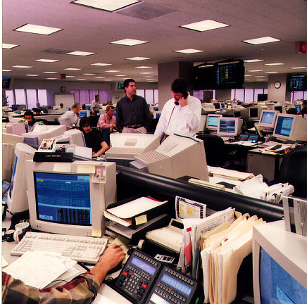
Products
The system facilitates trading of standardized products and initially will be geared toward “breadth vs. depth” in:
  Gas
  Power
  Coal
  Oil Products
  Liquids / Petrochemicals
  Pulp & Paper
  Weather Derivatives
  Emissions
  Bandwidth (end of the year)
Both physical and financial
Variety of Instruments:
  Swaps
  Options & Swaptions
  Capacity
Numbers of products
  342 in Europe
  344 in US

Slide 5
Global Coverage
Regions covered in Phase I include:
  North America: US, Canada
  Europe: UK, Germany, Switzerland, Norway, Finland, Sweden, Portugal, Spain, France, Italy, Belgium,
  Netherlands, Austria, Denmark, Poland, Slovenia,
  Croatia, Romania ...
  Asia: Singapore (Oil Markets)
  Australia: Phase 1 or 2
Future Phases will cover other countries in Asia, South America, and Africa

Slide 6

Market Developments & Competition
Everywhere you turn:
  Launched on July 8: HoustonStreet.com
Who is our competition? Who can offer a global trading platform?
  Only a JV between some counterparties would compete on a global basis with Enron
    Many combinations are possible - Bloomberg and Dynegy
  Others
    online energy exchanges (Bloomberg, Altra, SwapNet)
    Reuters
    traditional & new exchanges (NYMEX, IPE, Eurex)
    online stock brokers (Merrill Lynch)
    other energy companies (Coral Energy, energy.com)

Slide 7
Phase 1 Site
Home/Login Page
Audience: Any Internet User
Concepts/Content:
Selling the Vision
Provide “teasers”
Demo of trading
application
Trading Application
Audience: Registered Users ONLY
(post-login)
Concepts/Content:
Online Trading Application
- maximize volume
“Stickiness” factors

Slide 8
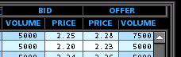
Execution Process
Customers will receive one page Password Application with marketing details and read only Username and Password
Customers return PA and are granted appropriate execution access
Login and accept the Electronic Trading Agreement (ETA)
Master agreements govern trade if in place between Enron and the counterparty otherwise counterparty has to accept General Terms and Conditions (GTCs) online
Click on a bid or an offer
Click Submit (2 clicks and you’re done)
Trade validated against Online database (Credit limits, valid contract, live price)
Transaction details appear in your summary list
Deals processed, settled, confirmed using existing Enron transaction systems and infrastructure

Slide 9
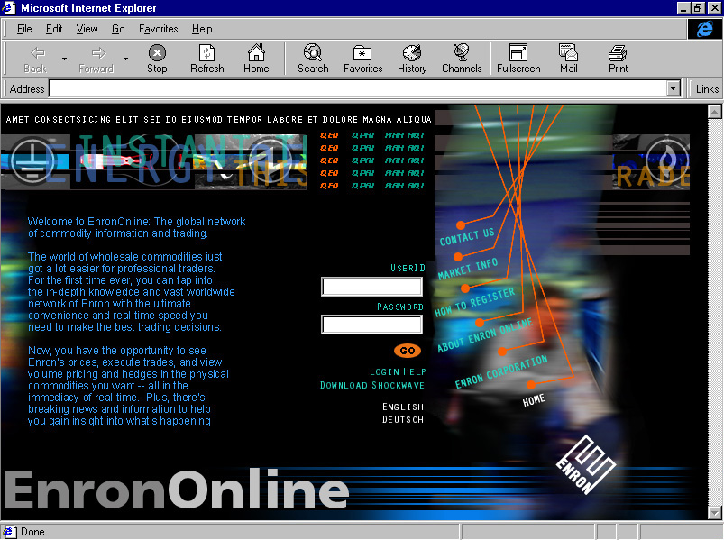
EnronOnline: Home Page & Login

Slide 10
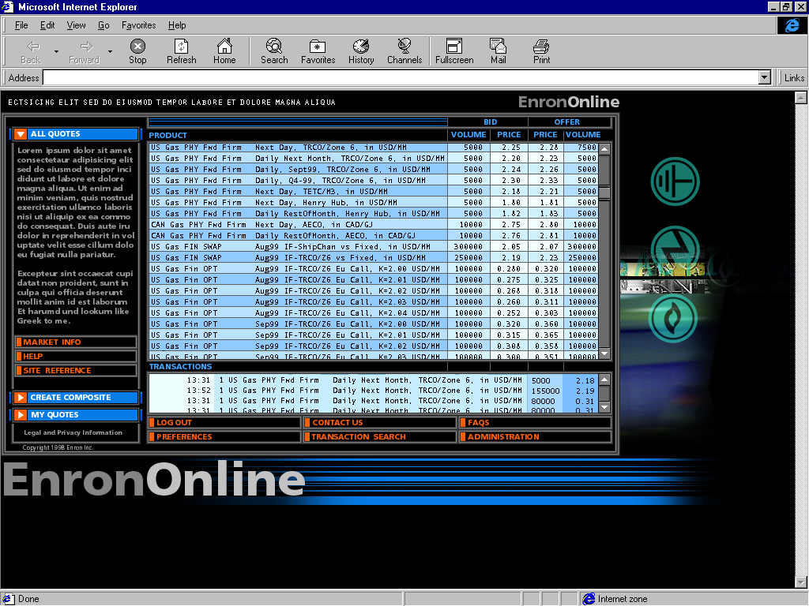
EnronOnline: All Quotes Page

Slide 11
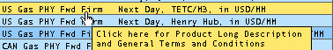
Product Short Description

Slide 12
Click on Bid or Offer Price

Slide 13
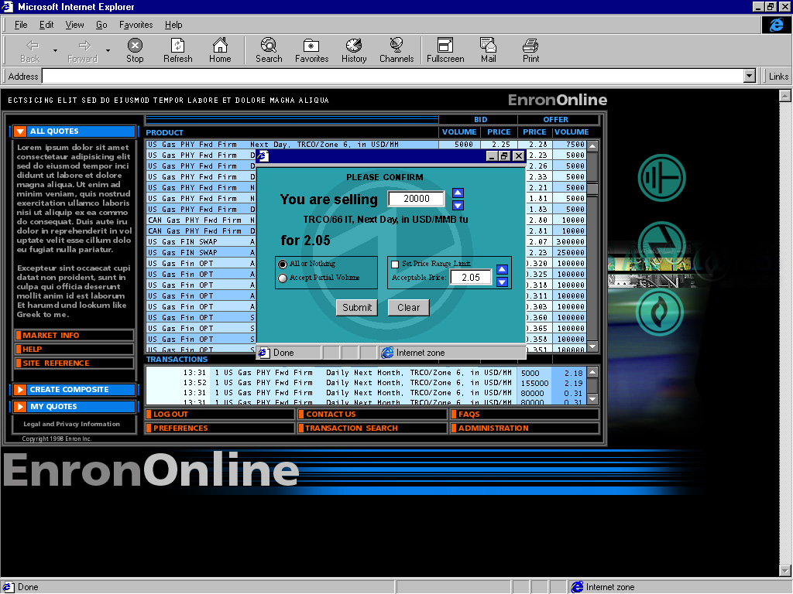
Confirmation Window
5000
2.18
2.18
2.18

Slide 14
Failed Transaction
Transaction Failed
Either:
1) The price has changed
2) You have reached your limits
3) You have not accepted the GTC governing this transaction.
View GTC

Slide 15
Successful Transaction

Slide 16
Enron Traders Process
Manage Bids/Offers Through a Price Stack Application within their Trader Authorisation
Stack allows traders to:
  build market depth
  add products
  change details (market hours)
  Pull Bids/Offers or All (PANIC BUTTON!)
Prices can be:
  Stand Alone
  Basis
  Syncopated (% of other price)
  Quoted versus Mid
  Currency Linked

Slide 17
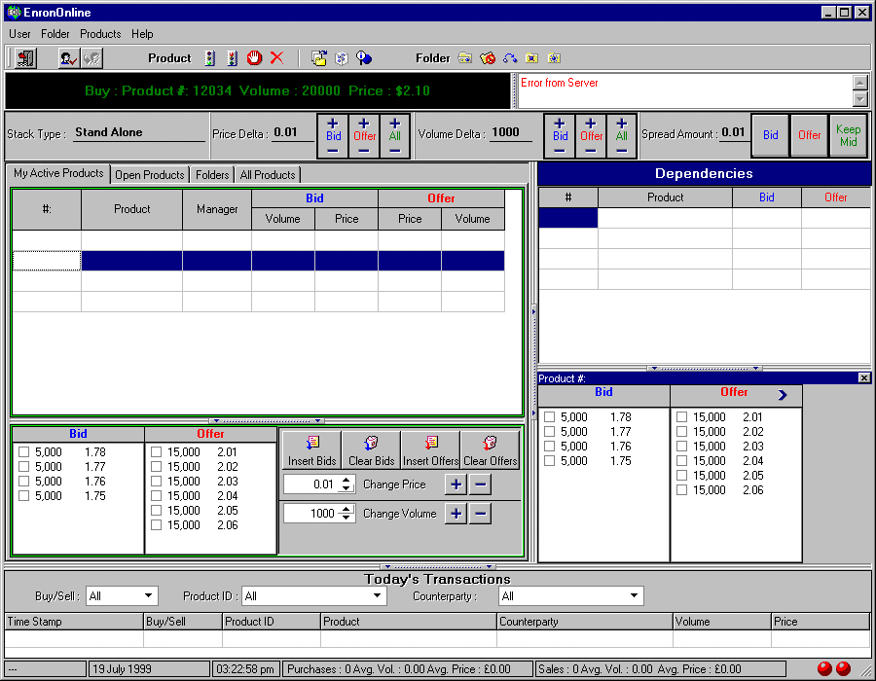

Slide 18
Vision
Make Enron “Your One Stop Shop for all energy related commodities and wholesale services - in your own language and in your own currency anywhere in the world!"
Portal Strategy
Vertical:
Energy Portal
“Your one stop energy shop”
Horizontal:
Trading Portal
“The click and trade
venue of choice”
EnronOnline

Slide 19
  You need to keep it sticky

Slide 20
“Owning the Eyeballs”
Strategy: Ensure EnronOnline is the trader’s primary screen, up at all times
  provide tools and features that augment and encourage more trading
    energy news
    Enron news (Phase 1)
    weather data
    Energy risk management glossary (Phase 1)
    sports
    Price indices
    My Enron - customized filters
    Time series data / Market data
    Integrated software sales (EnergyDesk.com)
    Video streaming (Enron Communications)
    Real time MTM
    Chat facilities
    CREATING THE PORTAL

Slide 21
Current Status
Currently in Project Week #9 of 18
Legal Issues
  Legal framework for site established
  Enabling Agreements completed for 20 different jurisdictions
  General Terms & Conditions (GTCs) for online trading completed and under final legal review
  Translation of above agreements and contractual terms commenced last week
  Legal advice on other parts of the site has been obtained (electronic links advice, generic disclaimers, privacy statement (data protection issues))
Regulatory
  Ongoing review across 20 jurisdictions of site
    Commodities (Financial/Physical)
    Website Issues
  EU e-commerce directive lobbying (Article 11.1)
  Monitoring progress of CFTC on e-commerce lobbying

Slide 22
Current Status
Technical
  External: Design phase underway - Agency.com, based in Dallas
  Internal: Internal application and database development in progress
    Web/System Latency work underway - Enron price changes should reach user within 0.5 seconds with 100,000 transactions per day (updates prices intelligently vs. blanket refresh)
  Working with Enron Communications to ensure utilization of ‘EIN’
Web Design & Content
  Basic “look-and-feel” determined
  Website business content to be edited by copywriters
  Online demo to be developed
  Legal review required on all site content
Marketing
  Draft marketing plan developed and launch strategy underway
  External copywriters hired
  Collateral materials including brochures to be developed

Slide 23
Current Status
Business Processes
  Processes near completion
    Tax
      Cost Sharing Agreement drafted, to be finalised
      Assessing foreign tax exposure
      redrafting of all financial General Terms & Conditions
    Credit
      Process agreed and aggregation process under design
    Transactions in currencies requiring hedging
    RAC/Limits
    Risk Management Reporting formulated
    Back Office processes underway
  Staffing commenced
Trading
  Product descriptions prepared and legal review complete
  Staffing underway
  Trader application in fourth design stage

Slide 24
Resourcing Summary
Full Time
Total Equivalents External
Legal & Regulatory
US 14 2.5 3
Europe & Asia 10 7 8
Trading
US 35 2.5
Europe 22 13
Tax 10 3.5
IT 29 20 20
PR 4 1
Website/Marketing Design 5 4 3
Credit 5 3
Research 1 0.5
Risk Management 20 8
____________________________
TOTAL 155 65 31
Total Cost Approx $10million (Phase 1)

Slide 25
EnronOnline: Home Page & Login

