Slide 1





Enron Japan
Website
May 15, 2001
<date/time>

Slide 2
Enron Japan Website - Goals
Get Enron message out into the marketplace
Establish a mean to communicate ideas and commercial products to a broad customer base
Feed a market generally starved of unbiased information
Means to establish commercial relationships

Slide 3
Enron Japan Website – Target Audience
Large industrials, commercials and industry groups
Utilities/trading houses
Financial institutions
Government and academics
Press
Investors
Potential Employees

Slide 4
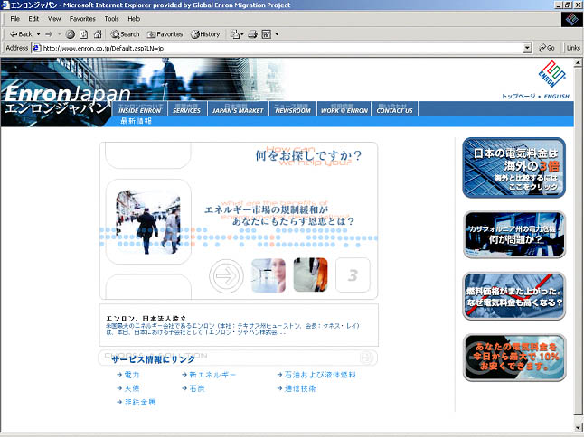
Enron Japan Homepage v.1
http://www.enron.co.jp

Slide 5
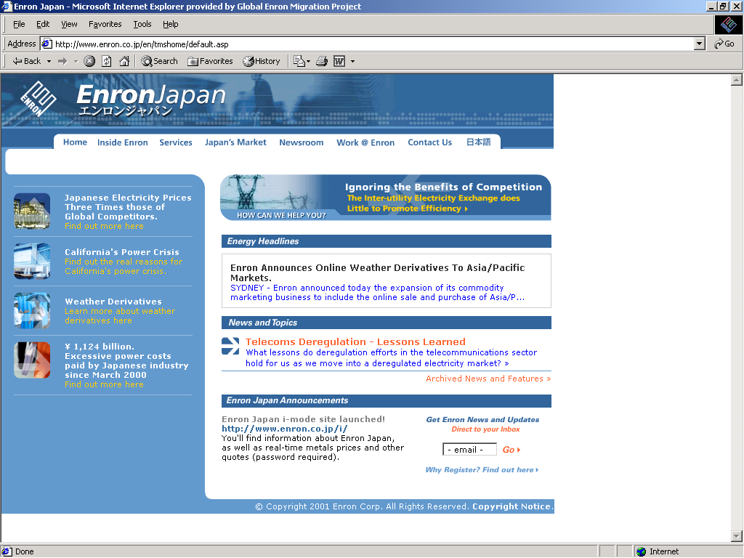
Enron Japan Homepage v.2 (launched May 15th)
Flash-based navigation system
New Content
Semi-permanent content
Site Announcements/Developments

Slide 6
Recent Statistics
Average Weekly Users: 600-900 people
Average Visitor Length: 10-13 minutes
Over 70 people registered for updates from target audiences:
  Large Industrials (Mitsui Chemicals, Toyota Trading, Johnson & Johnson, Fujitsu, Fujita)
  Industry (Tohoku Electric, Osaka Gas, Japan Oil Development Corp.)
  Media (Reuters, Yomiuri, Energy News Service)
I-Mode site receiving 3-400 hits per week in test environment

