Slide 1

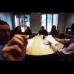

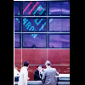
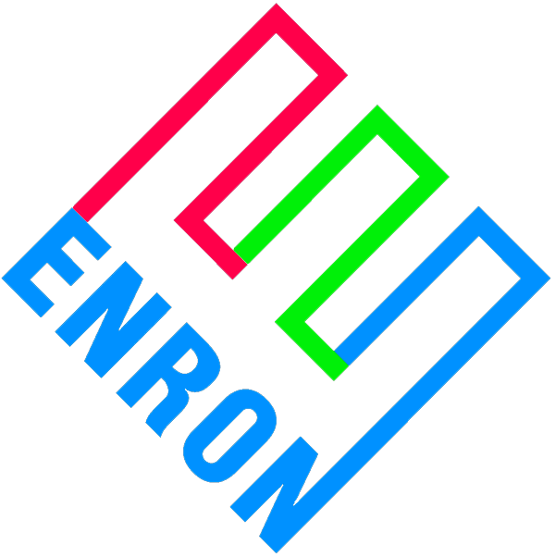
Enron Japan Public Affairs Public Relations Strategic Goals 2001
®
Enron Japan
May 15
Notes:
<number>
<footer>
<header>
<date/time>

Slide 2
PUBLIC RELATIONS
Notes:
<number>
<footer>
<header>
<date/time>

Slide 3
Current Environment –
Media is a powerful force in Japan

Slide 4
Media is Powerful Force in Japan
The Japanese media market has some 125 daily newspapers, over 6,000 trade papers and more than 2,000 magazines – 3.9 billion annual distribution
Per capita newspaper circulation rates in Japan are among the highest in the world. The major five newspapers – Yomiuri, Asahi, Mainichi, Sankei and Nikkei – account for around 60% of the total circulation
94% of population watches TV
Internet users should triple by 2003 to 60 million
Knowledge of trends, industry deregulations, market leaders, Japanese local mindset is a key to the success. Relationships with leading media and government officials are a critical factor.
Good media relations is central to Enron Japan’s strategy

Slide 5
Media Plays a Central Part In Communicating to the Multi-Faceted Japanese Public
Bureaucracy
METI/MPT/MOF
Academics
Media
Industry/Utilities
and Consumers
Politicians
Enron Japan
Media plays a central part in reaching the public

Slide 6
Press Club system is a unique aspect to the Japanese media practice
Press clubs are media groups attached to various government agencies and industry associations
Press club members have exclusive and immediate access to news, but they must proceed according to the restrictive rules of each club
The Press Club is notionally a working “beat” of reporters
As often as once every 18 months a journalist will be moved from covering the certain beat to another
Enron has been assigned to the Energy Press Club in Tokyo
Press Club Structure means constant journalist education

Slide 7
Securing Placement in Japanese Media is Competitive
In order to Win Large and Accurate News Coverage…..
Constant and Careful Education and Briefing to Journalists
Good Relationship with the Media
Firm and Steady Delivery of Key Messages
Press Club System Fosters Undifferentiated and Unadventurous Reporting.
Few Japanese Reporters are True Specialists in a Particular Field.

Slide 8
A Strategy for Education and Understanding

Slide 9
Progress in 2000
Enron’s initiatives commenced in October 2000 with:
Office opening and press conference
Enron Japan Website
More than brochureware: provides information to a market generally starved of information
Commenced Building Good Relationships with Key Media and Opinion Leaders
Commenced informal meetings with key journalists
Provided several one-on-one interviews with senior management to selected media
Accessing key opinion leaders such as academics and analysts
Established in-house media coverage system

Slide 10
Enron Japan 1 & 2 Quarters PR Strategic Goals
Stimulating Public Deregulation Debate is Key to Enron Japan’s Commercial Success
Insufficient public awareness about benefits of deregulation
Set Agenda for Deregulation Debate
High electricity prices
Economic benefits
California’s problems are not due to deregulation
Enron Sponsored Conference
Media Understanding of Enron
Enron is more than an energy company
Enron provides long term value for countries
Enron is customer focused
Clarify Enron Japan & E Power Situation
Boost Enron’s Visibility in Japanese Market by Expanded Enron Coverage in Top-Quality Media

Slide 11
2001 January-May Progress
Nikkei Business Cover Story
NHK (Kean, Hirl)
Asahi (Hirl)
Nikkei Business (Kean, Frevert)
MITI, JFTC, Diet finalize reports on Competition progress
Enron Deregulation White Paper finalized
AERA (Hirl)
Economist (O’Day)
Nikkei (Hirl)
Denki (Hirl)
Ministries Restructured
December
2000
February
April
January
March
December
2001
May
Denki Seminar
WRMA Seminar
METI, FEPC Release California reports
Incumbents utilize California in anti-liberalization media campaign
Nikkei (Kean)
Enron sponsored seminar on Deregulation
Nikkei Business (Hirl)

Slide 12
Major Key Messages in 1st & 2nd Quarters
Enron is customer focused. Enron’s success is based on offering its customers more choice, more flexibility and competitive prices.
Enron has practical experience in every liberalized market around the world.
Appropriate energy sector deregulation will lead to a stronger Japan.
Japanese industries’ ability to compete internationally is being seriously eroded high electricity prices.
Japan’s electricity prices are 300% of the OECD average and 400% of the US average (1998 IEA figures)
A 25% cut in electricity rates would equate to an injection into the Japanese economy of 4 trillion yen.
The right energy deregulation model can bring electricity prices down significantly while taking account of environmental considerations and security of supply. (California related)
Deregulating the energy sector and reducing electricity costs will help to determine the success or failure of the IT revolution here in Japan.

Slide 13
Enron Japan 1 & 2 Quarters PR Strategic Goals
Stimulating Public Deregulation Debate is Key to Enron Japan’s Commercial Success
Insufficient public awareness about benefits of deregulation
Set Agenda for Deregulation Debate
High electricity prices
Economic benefits
California’s problems are not due to deregulation
Enron Sponsored Conference
Media Understanding of Enron
Enron is more than an energy company
Enron provides long term value for countries
Enron is customer focused
Clarify Enron Japan & E Power Situation
Boost Enron’s Visibility in Japanese Market by Expanded Enron Coverage in Top-Quality Media

Slide 14
2001 January-May Progress
Nikkei Business Cover Story
NHK (Kean, Hirl)
Asahi (Hirl)
Nikkei Business (Kean, Frevert)
MITI, JFTC, Diet finalize reports on Competition progress
Enron Deregulation White Paper finalized
AERA (Hirl)
Economist (O’Day)
Nikkei (Hirl)
Denki (Hirl)
Ministries Restructured
December
2000
February
April
January
March
December
2001
May
Denki Seminar
WRMA Seminar
METI, FEPC Release California reports
Incumbents utilize California in anti-liberalization media campaign
Nikkei (Kean)
Enron sponsored seminar on Deregulation
Nikkei Business (Hirl)

Slide 15
2001 Enron Strategic PR Goals
Expansion of Enron Media Coverage:
from feature stories to cover stories
from coverage as ‘leading energy company’
to coverage as ‘leading company’

Slide 16
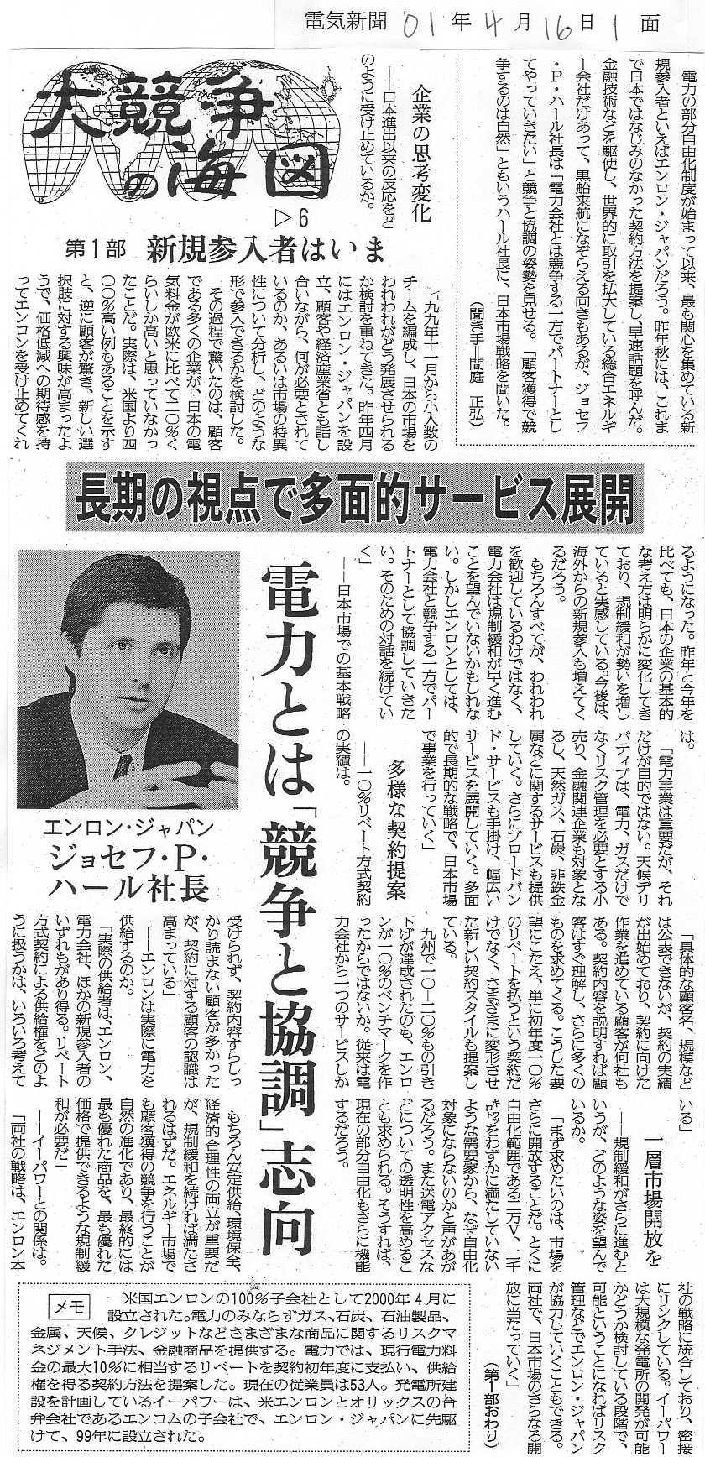
Denki Shimbun (April 16)

Slide 17
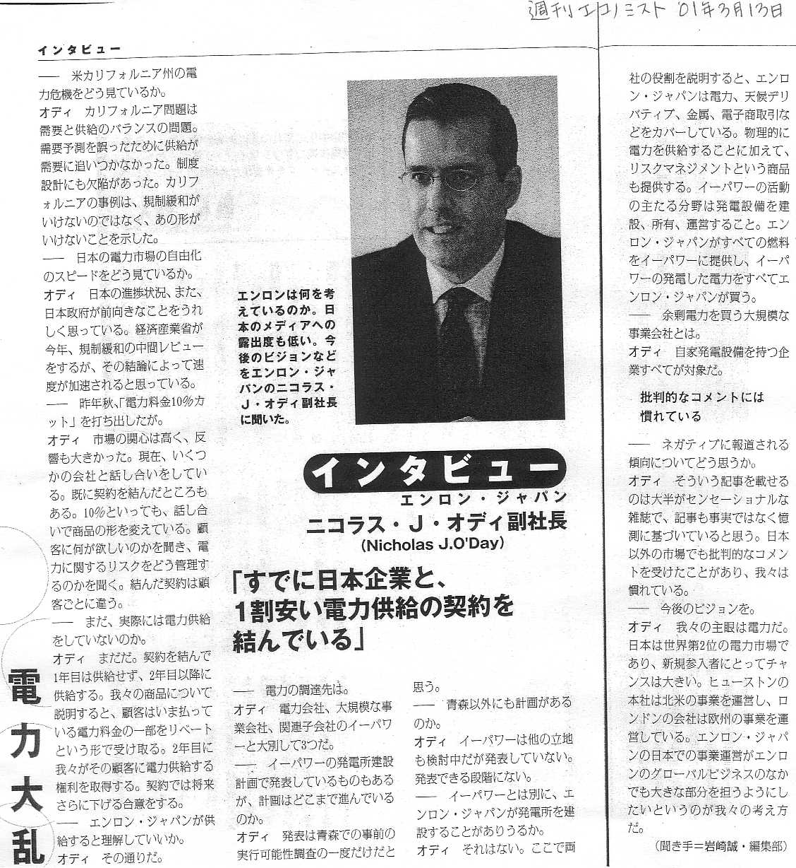
Magazine “Economist” (March 13)

Slide 18
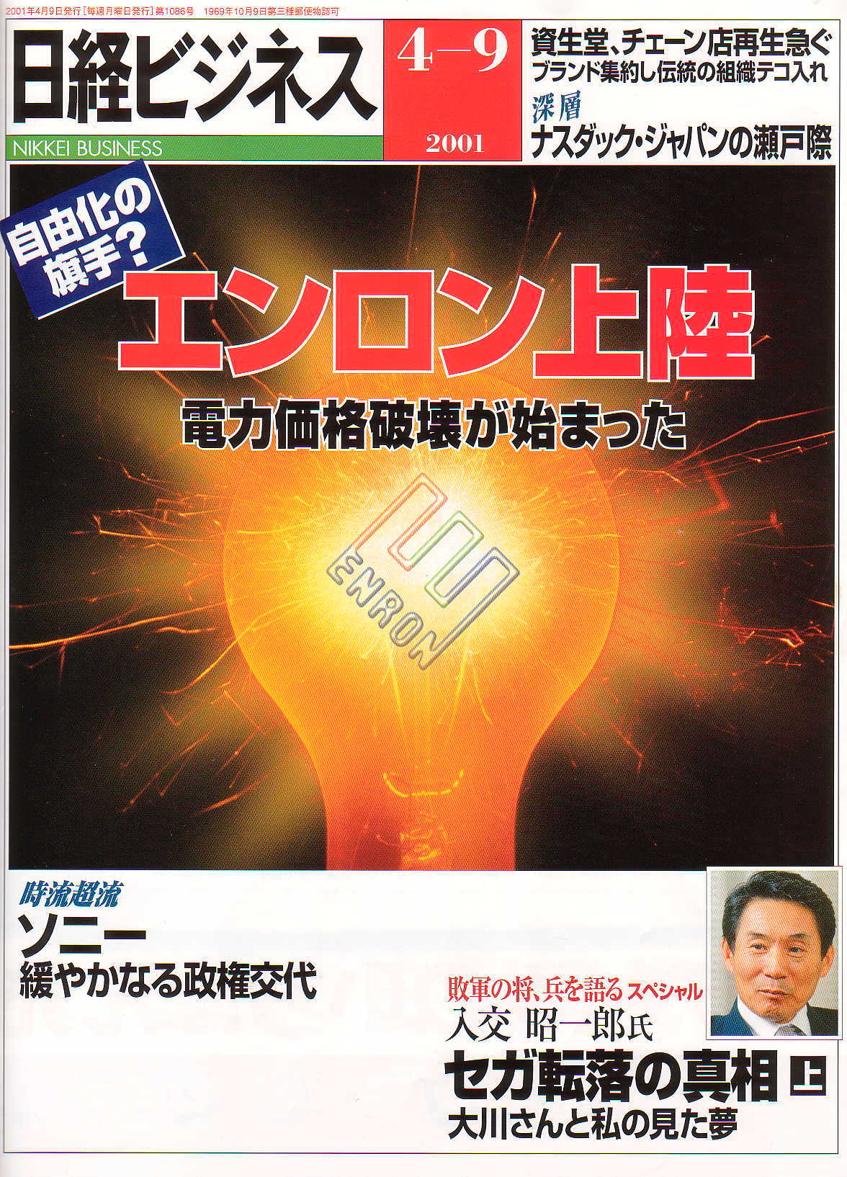
Enron in Japanese Top Magazine’s Cover Story
Nikkei Business
http://www.enron.co.jp
Notes:
<number>
<footer>
<header>
<date/time>

Slide 19
Enron Japan PR 2001 (3 & 4 Quarters) Goals
From coverage as ‘leading energy company’
to coverage as ‘leading company’
Stimulating Public Deregulation Debate is Key to Enron Japan’s Commercial Success
Continue Sending Regulatory Messages to Promote Deregulation
High electricity prices
Economic benefits to consumers
Lead and Adjust Public Recognition of Enron
Enron’s focus is more than electricity –Enron Global Market
Complex corporate structure
Enron in California
Enron lacks credibility
Build Enron Japan Information Archive/Database
Develop in-house online news archive
Track and follow regulatory environment, business trends and public recognition of Enron through analytical monitoring of the media coverage
Create an Environment for Two-Way Information Flow

Slide 20
Enron and the Japanese Market
Create multi-commodity merchant business with flexibility to capitalize on opportunities in newly opened electricity market, developing capital markets, rapidly expanding e-commerce, internet-based and broadband markets and other Enron-specialized capabilities in metals, pulp and paper, weather, credit, gas, coal, petroleum products and foreign exchange.
Notes:
<number>
<footer>
<header>
<date/time>
Enron Japan Reactive Statement Para. 1 (May 8 2001)
“Enron has taken the decision to temporarily suspend all further activities in power marketing in Japan. Though Japan continues to make progress towards a liberalized electricity market, significant barriers to electricity sales by new entrants remain under the arrangements introduced in March of last year. Those barriers include the absence of fair and non-discriminatory regulated access to the transmission network and the absence of an independent regulator with the power to regulate the market. “

Slide 21
Enron and the Japanese Market
Enron Japan
Electricity
Global Markets
Capital Markets
✓
Power
Development
✓
Petrochemicals
✓
Commodity
linked
✓
✓
Crude/Liquids
financing
Electricity
Management
✓
Vendor
✓
Coal
finance
✓
Agricultural Products
✓
Structured
finance
solutions
✓
Distressed
Metals
e-Commerce
debt
restructuring
✓
Trading &
✓
Extension of
✓
M & A
marketing
Enron
non
-
ferrous
platforms to
Weather
metals
Japan
✓
Structured,
Broadband
✓
Weather risk
customized
management
solutions
product
✓
Trading & marketing
✓
Alternative
✓
Finance
risk transfer
structures
✓
Content delivery
Notes:
<number>
<footer>
<header>
<date/time>
Enron Japan Reactive Statement Para. 2 (May 8 2001)
“Enron remains committed to Japan. We have established several businesses here including metals, coal, LNG, weather derivatives, power plant development (via EPower) and electricity sales, and we have closed transactions with Japanese companies in each of those businesses. Significant additional opportunities exist in our non-electricity businesses and, if energy deregulation in Japan proceeds as expected, significant opportunities will exist in future in our power marketing businesses.”

Slide 22
Implementation
Pro-active Targeted Approach to Media
Continuous Education Program
Dissemination of information and key messages through interviews, website, seminars
Judicious use of EJ website
Journalists visits to Houston
Analytical Market Information Monitoring
Track and follow market trends through media and direct access to market sources
Provide market intelligence to Enron Japan commercial groups
Exploit opportunities for media coverage
Increased Use of Senior Enron Management
Increased Participation in Industry/Academic Seminars
Position Enron Japan as an involved authority

