Slide 1


Lessons From the California Electricity Crisis
Jim Steffes
VP Government Affairs
July 24, 2001
®

Slide 2
What happened in California?
Politically compromised industry restructuring
Unfavorable change in supply and demand fundamentals

Slide 3
From Textbook to Failure: The Art of Politics
1993-94 Blue Book: Deregulation / open access
1994-95 CPUC Orders: Emergence of centralized market institution
1995-96 Legislation (AB 1890):
1996-97 FERC rubber stamp
1998 Implementation: - Three month delay - $500 million computer system
- Limited residential switching
- Modest (10-15%) large customer switching
Something for everyone (notional customer choice, retail price caps, stranded cost recovery, divestiture, environmental and ratepayer subsidies)

Slide 4
“The Perfect Storm”
1. High load growth in California and the western United States

Slide 5
California ISO Load Growth
(MW)
(%)
0
Source: CalSO

Slide 6
“The Perfect Storm” (cont’d)
1. High load growth in California and the western United States
2. Little or no incentives to reduce demand

Slide 7
1997-2000 Nominal Rate Changes (Percentage)
Commercial
Residential
WWWWW
Rate Caps
Rate Caps
Pacific Gas & Electric Co. (CA)
Southern California Edison Co. (CA)
Arizona Public Service Co. (AZ)
Sierra Pacific Power Co. (NV)
PacifiCorp (OR)
Portland General Electric Co. (OR)
Puget Sound Energy, Inc. (WA)
Source: PowerDat Data Base, 2000 figures reflect a usage-weighted average rate for the period January - August, 2000

Slide 8
“The Perfect Storm” (cont’d)
1. High load growth in California and the western United States
2. Little or no incentives to reduce demand
3. No real customer choice

Slide 9
No Real Customer Choice
Competitors’ “value proposition” diluted by incumbent utility rate design
Incumbent utilities controlled large segments of the value chain (e.g., metering) as well as customer switching process
Policymakers discouraged customers from switching to competitors

Slide 10
“The Perfect Storm” (cont’d)
1. High load growth in California and the western United States
2. Little or no incentives to reduce demand
3. No real customer choice
4. Lagging generation to meet increasing demand

Slide 11
California Loads and Resources
80,000
0%
Capacity
(MW)
Peak Load
(MW)
70,000
Reserve Margin
(%)
-2%
60,000
-4%
50,000
40,000
-6%
30,000
-8%
20,000
-10%
10,000
-
-12%
1995
1996
1997
1998
1999
2000E
2001E
Source: Various

Slide 12
“The Perfect Storm” (cont’d)
1. High load growth in California and the Western United States
2. Little or no incentives to reduce demand
3. No real customer choice
4. Lagging generation to meet increasing demand
5. Reduced hydro availability that increased reliance on gas-fired generation, at a time of high gas and emission prices

Slide 13
Reduced Hydro Availability
Electric Generation in California by Energy Source (%)
Volume Runoff Percent of Normal
Columbia River
California
2001
55%
80%
2000
93%
94%
59%
1999
116%
108%
1998
98%
153%
41%
1997
152%
84%
Hydro conditions in the PNW are predicted to be 55% of normal
Source: U.S. DOE (EIA)
Source: Columbia River data from NOAA/National Weather Service, Northwest Rivers Forecast Center. California data from CDWR

Slide 14
U.S. Natural Gas Spot Price Outlook
($/MMBtu-Henry Hub, LA.)
2001
2000
2001
2000
1999
1999
futures
historical
Source: Historical prices: Monthly average midpoint published by Gas Daily Price Guide.
Future prices: NYMEX futures published at Gas daily (May 25, 2001).

Slide 15
“The Perfect Storm” (cont’d)
1. High load growth in California and the Western United States
2. Little or no incentives to reduce demand
3. No real customer choice
4. No significant new generation development in California in the last decade change
5. Reduced hydro availability that increased reliance on gas-fired generation, at a time of high gas and emission prices
6. Over-dependence on the spot market

Slide 16
Over-Dependence on Spot Market
Strong incentives to sell 50% of utilities’ fossil-fuel generation under AB 1890
Utilities forced to sell remaining power produced and buy all day-ahead forecasted power to the CalPX
Utilities prohibited from entering into long-term contracts till July 1999
Utilities didn’t fully utilize forward contracting after
Policymakers subjected consumers to the volatility and risk of a spot market

Slide 17
“The Perfect Storm” (cont’d)
1. High load growth in California and the Western United States
2. Little or no incentives to reduce demand
3. No real customer choice
4. Lagging generation to meet increasing demand
5. Reduced hydro availability that increased reliance on gas-fired generation, at a time of high gas and emission prices
6. Over-dependence on spot market
7. Price spikes from “underscheduling” in the PX day-ahead and other forward markets

Slide 18
Further Price Spikes From “Underscheduling”
Utilities forced to pay wholesale market prices for power and cap retail prices to their customers
Utilities, therefore, incited to increase CTC payments by “underscheduling” demand in the PX day-ahead markets
Such “underscheduling” increases overall volatility in procurement cost and reduces reliability

Slide 19
The Result: A Crisis of Epic Proportions
SDG&E customers experienced price spikes in summer/2000
Northern California first to experience blackouts in fall/2000
All of California experienced blackouts in winter/2000
More blackouts predicted this summer (5,000 MW short)
PG&E declared partial bankruptcy in spring 2001- others near insolvency
QFs are not being paid and are being forced to continue generating
CDWR has taken market positions and spent a substantial portion of California’s budget surplus

Slide 20
California Sneezes West Catches the Flu
Demand was up in the rest of the West
Wholesale rates increased substantially throughout the West
Shut-downs in energy-intensive industries required
Significant reliability concerns remain this summer
Increased pressure to export power from Western states to California
Increased calls for protectionism to replace “cooperative approach” of the West
California’s woes have slowed restructuring efforts elsewhere
The Result
Financial, political, & economic crisis

Slide 21
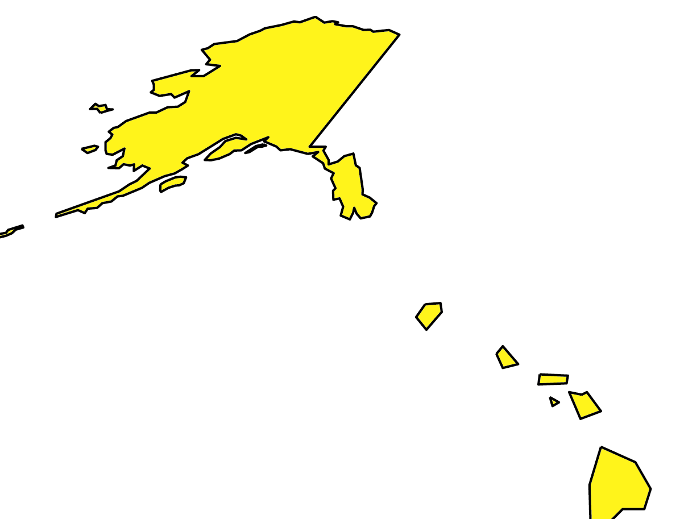
State of Deregulation in the United States
Most States are still moving ahead
Markets including 4% of population and 5% of total load have elected to delay market opening
Nevada and Oklahoma delayed indefinitely
Arkansas, West Virginia and Montana delayed to later years originally planned
*
*
DE
*
* Legislation and Regulatory Order have both been issued.
AK
Alaska
HI
Reconstructuring Legislation Enacted
Comprehensive Regulatory Order Issued
A Commission and/or Legislative Investigation is Ongoing
No Significant Activity
Status Current as of 06/01
57% of this $220B market is expected to be deregulated by 2004

Slide 22
Lessons Learned
Liberalization did not cause California’s problems
Regulatory barriers to infrastructure, hedging, competition
Unfavorable supply and demand shifts
Full liberalization is the answer for California
Real choices, opportunities to manage risk
Ease of entry to generation sector
Real market prices to end users (phase in)
Remove utilities (and state regulators) from procurement
What doesn’t work
Heated political rhetoric (actually increases costs in California)
Price caps (discourages production and conservation - forces political rationing)
Notes:
Today’s discussion will include an overview of the Florida Gas Transmission system as well as natural gas markets in the US and policy challenges ahead.

Slide 23
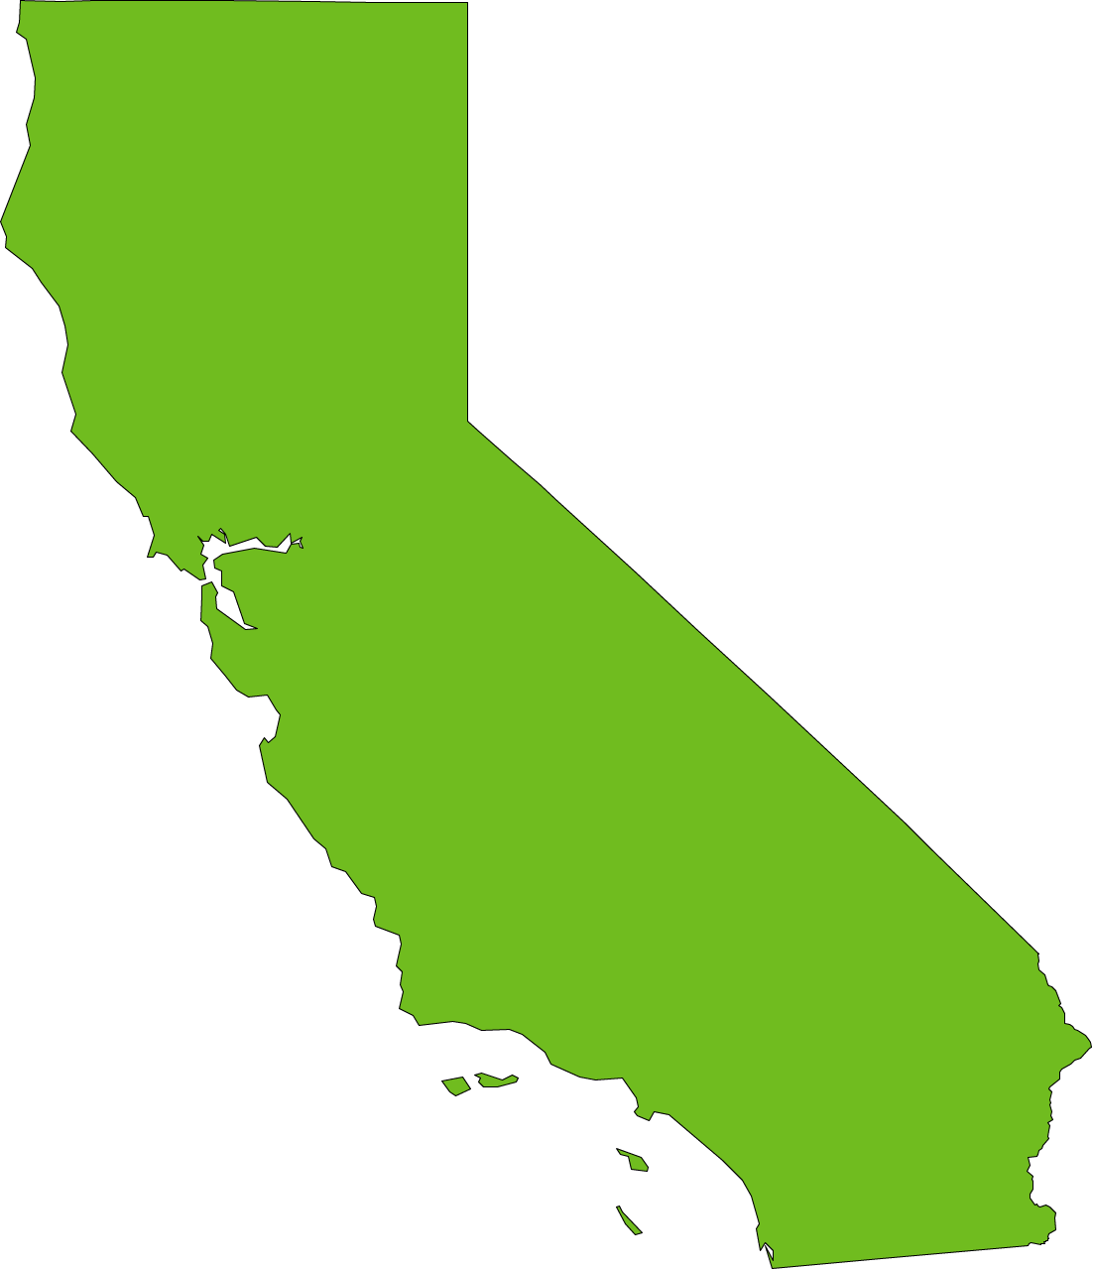
The Golden “What f?”
“If I wanted to raise rates, I could have
solved this problem in 20 minutes.”
California Governor Gray Davis
March 2001

Slide 24
®

