Slide 1
Gas and Power Wholesale Business
Enron North America
Notes:
<number>
<footer>
<header>
<date/time>

Slide 2
Financial Highlights ($ in millions)
2000
YTD 2001
21 Month Totals
ENA ENA ENA
EBIT $ 1,330 $2,747 $4,077
Funds Flow (Pre-Tax) $ 1,389 $3,706 $5,095
Cash Flow from Ops. (Pre-Tax) $ 3,465 $1,676 $5,141
**Excludes Retail Risk Management and Prudency
2
Notes:
<number>
<footer>
<header>
<date/time>

Slide 3
GROSS MARGIN BY BOOK (Yr. To Date Thru October)
2000 2001
GM YTD GM SUM
GAS
GAS - NYMEX SWAPS DESK (2,000,000) 753,979,000 751,979,000
GAS - OPTIONS DESK 43,000,000 96,675,000 139,675,000
GAS - EAST DESK 150,000,000 5,786,000 155,786,000
GAS - CENTRAL DESK 230,000,000 181,855,000 410,855,000
GAS - WEST DESK 870,000,000 (195,162,000) 674,838,000
GAS - TEXAS DESK 220,000,000 170,341,000 390,341,000
GAS - CANADA DESK 20,000,000 (2,265,000) 17,735,000
GAS - DERIVATIVE MARKETING 30,000,000 31,032,000 61,032,000
POWER - PORTLAND
POWER - WEST 460,000,000 769,562,000 1,229,562,000
POWER - MIDMARKET 40,000,000 59,679,000 99,679,000
EAST POWER - HOUSTON
POWER - NORTHEAST DESK (40,000,000) 195,041,000 155,041,000
POWER - SOUTHEAST DESK 80,000,000 11,538,000 91,538,000
POWER - MIDWEST DESK 70,000,000 94,181,000 164,181,000
POWER - TEXAS 13,000,000 54,985,000 67,985,000
POWER - EAST OPTIONS DESK -- 27,795,000 27,795,000
POWER - EAST MANAGEMENT 8,000,000 46,449,000 54,449,000
POWER - CANADA
POWER - ALBERTA -- 316,471,000 316,471,000
POWER - ONTARIO -- -- --
TOTALS 2,192,000,000 2,617,942,000 4,808,942,000
3

Slide 4
2000 Monthly Gross Margin
Gas East West Total
Power Power
Month
January 39, 957,000 (15,198,837) 23,614,000 48,372,163
February 15 ,864,000 9,287,000 28,880,000 54,031,000
March 37,433,000 (25,320,000) 37,254,000 49,367,000
April 50,297,000 13,884,000 25,398,000 89,579,000
May 220.733,000 43,119,000 75,741,000 339,593,000
June 70,671,000 15,144,000 73,681,000 159,496,000
July 15,678,000 15,760,000 15,738,000 47,176,000
August 328,792,000 24,152,000 6,411,000 359,355,000
September (62,765,000) 965,000 113.577,000 51,777,000
October 20,673,000 (26,947,000) (280,000) (6,554,000)
November 421,410,000 57,026,000 67,380,000 545,816,000
December 390,146,000 16,719,000 32,786,000 439,651,000
Totals 1,548,889,000 128,590,163 500,180,000 2,177,659,163
4

Slide 5
2001 Monthly Gross Margin (Yr. To Date Thru October)
Gas East West Alberta Total
Power Power Power
Month
January 162,794,000 (7,385,000) 253,523,000 103,457,000 512,389,000
February 44,473,000 19,129,000 (23,431,000) (7,091,000) 33,080,000
March 375,579,000 40,810,000 136,840,000 17,295,000 570,524,000
April (138,095,000) 28,396,000 114,809,000 (6,029,000) (919,000)
May (17,475,000) 180,674,000 104,753,000 (8,174,000) 259,778,000
June 479,120,000 153,503,000 27,820,000 90,696,000 751,139,000
July (43,839,000) (41,723,000) 63,733,000 7,293,000 (14,536,000)
August 29,546,000 53,540,000 63,097,000 9,508,000 155,691,000
September 87,528,000 (19,249,000) 48,933,000 101,164,000 218,376,000
October (25,311,000) (41,621,000) 450,000 4,910,000 (61,572,000)
November 87,921,000 63,915,000 38,714,000 3,442,000 193,992,000
YTD Totals 1,042,241,000 429,989,000 829,241,000 316,471,000 2,617,942,000
5

Slide 6
Enron North America Commercial Headcount
2
54
109
81
111
357
3
48
98
101
120
370
9
56
139
155
113
472
8
41
104
103
174
433
Managing Directors
Vice Presidents
Directors
Managers
Analysts & Associates
TOTAL
1998
1999
2000
2001
6

Slide 7
Enron Americas – Value at Risk [$MM]
10-Day Moving Average
2000 Average
2001 Average
7

Slide 8
Enron North America Gas Transactions Per Day
Non EOL
EOL
1997
1998
1999
2000
2001
8

Slide 9
Enron North America Power Transactions Per Day
Non EOL
EOL
1997
1998
1999
2000
2001
9

Slide 10
TRANSACTIONS PER DAY
TRADES PER DAY - 2000
TRADES PER DAY - 2001
TRADES PER DAY - OCTOBER
 | EOL |  | NON-EOL | EOL | NON-EOL | EOL | NON -EOL
GAS - NYMEX SWAPS DESK |  | 383 | 38 | 730 | 67 | 789 | 64
GAS - OPTIONS DESK |  | 0 | 25 | 25 | 23 | 52 | 23
GAS - EAST DESK |  | 338 | 152 | 890 | 115 | 1087 | 107
GAS - CENTRAL DESK |  | 406 | 84 | 897 | 71 | 994 | 59
GAS - WEST DESK |  | 298 | 87 | 486 | 72 | 586 | 61
GAS - TEXAS DESK |  | 55 | 46 | 91 | 38 | 129 | 18
GAS - CANADA DESK |  | 192 | 78 | 228 | 89 | 292 | 81
SUBTOTAL |  | 1672 | 510 | 3347 | 475 | 3929 | 413
POWER - CALIFORNIA |  | 27 | 49 | 118 | 90 | 249 | 111
POWER - NORTHWEST |  | 23 | 73 | 60 | 61 | 123 | 53
POWER - SOUTHWEST |  | 27 | 71 | 85 | 88 | 136 | 79
POWER – NORTHEAST |  | 36 | 97 | 265 | 92 | 420 | 51
POWER – SOUTHEAST |  | 19 | 63 | 116 | 98 | 173 | 86
POWER – MIDWEST |  | 40 | 90 | 155 | 66 | 214 | 30
POWER – CANADIAN |  | 0 | 0 | 12 | 5 | 20 | 7
SUBTOTAL |  | 172 | 443 | 811 | 500 | 1335 | 417
TOTALS |  | 1844 | 953 | 4158 | 975 | 5264 | 830
10

Slide 11
Enron North America Volumes Through 3rd Qtr. (Bbtue/d)
Physical Gas
Financial Gas
Physical Power
11

Slide 12
12
Notes:
<number>
<footer>
<header>
<date/time>

Slide 13
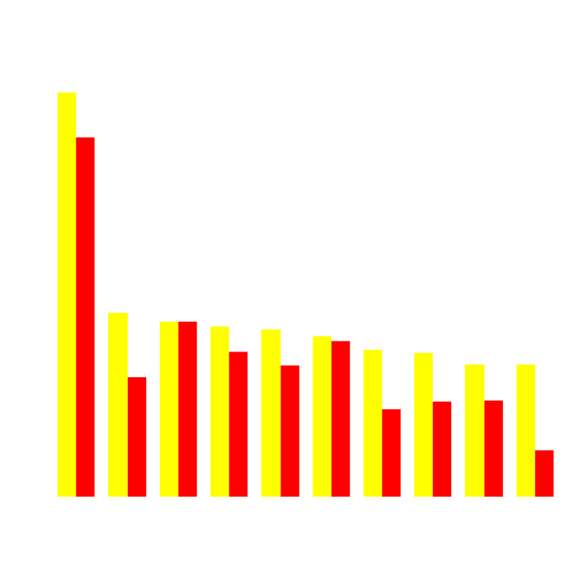
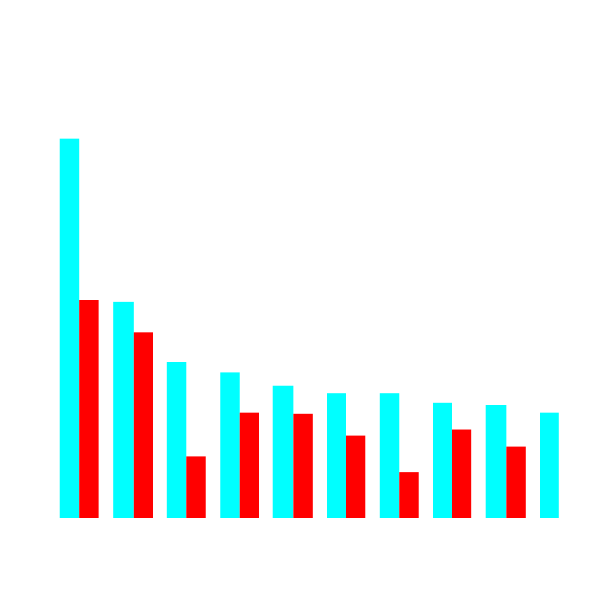
Enron’s Leading Market Position
Second Quarter 2000 vs Second Quarter 2001
(TBtue/d)
Gas Power
2Q01
2Q00
2Q01
2Q00
13
Notes:
<number>
<footer>
<header>
<date/time>

Slide 14
Enron Canada Gross Margins
14

Slide 15
Enron North America Natural Gas and Power Transactions in Last Year
Others
Top Counterparties
Notes:
<number>
<footer>
<header>
<date/time>

Slide 16
Enron North America Natural Gas Transactions in Last Year
Others
Top Counterparties
Notes:
<number>
<footer>
<header>
<date/time>

Slide 17
Enron North America Power Transactions in Last Year
Others
Top Counterparties
Notes:
<number>
<footer>
<header>
<date/time>

