Slide 1
Gas and Power Wholesale Business
Enron North America
Notes:
<number>
<footer>
<header>
<date/time>

Slide 2
Enron North America Gas Transactions Per Day
Non EOL
EOL
1997
1998
1999
2000
2001
8

Slide 3
Enron North America Power Transactions Per Day
Non EOL
EOL
1997
1998
1999
2000
2001
9

Slide 4
TRANSACTIONS PER DAY
TRADES PER DAY - 2000
TRADES PER DAY - 2001
TRADES PER DAY - OCTOBER
 | EOL |  | NON-EOL | EOL | NON-EOL | EOL | NON -EOL
GAS - NYMEX SWAPS DESK |  | 383 | 38 | 730 | 67 | 789 | 64
GAS - OPTIONS DESK |  | 0 | 25 | 25 | 23 | 52 | 23
GAS - EAST DESK |  | 338 | 152 | 890 | 115 | 1087 | 107
GAS - CENTRAL DESK |  | 406 | 84 | 897 | 71 | 994 | 59
GAS - WEST DESK |  | 298 | 87 | 486 | 72 | 586 | 61
GAS - TEXAS DESK |  | 55 | 46 | 91 | 38 | 129 | 18
GAS - CANADA DESK |  | 192 | 78 | 228 | 89 | 292 | 81
SUBTOTAL |  | 1672 | 510 | 3347 | 475 | 3929 | 413
POWER - CALIFORNIA |  | 27 | 49 | 118 | 90 | 249 | 111
POWER - NORTHWEST |  | 23 | 73 | 60 | 61 | 123 | 53
POWER - SOUTHWEST |  | 27 | 71 | 85 | 88 | 136 | 79
POWER – NORTHEAST |  | 36 | 97 | 265 | 92 | 420 | 51
POWER – SOUTHEAST |  | 19 | 63 | 116 | 98 | 173 | 86
POWER – MIDWEST |  | 40 | 90 | 155 | 66 | 214 | 30
POWER – CANADIAN |  | 0 | 0 | 12 | 5 | 20 | 7
SUBTOTAL |  | 172 | 443 | 811 | 500 | 1335 | 417
TOTALS |  | 1844 | 953 | 4158 | 975 | 5264 | 830
10

Slide 5
Enron North America Volumes Through 3rd Qtr. (Bbtue/d)
Physical Gas
Financial Gas
Physical Power
11

Slide 6
12
Notes:
<number>
<footer>
<header>
<date/time>

Slide 7
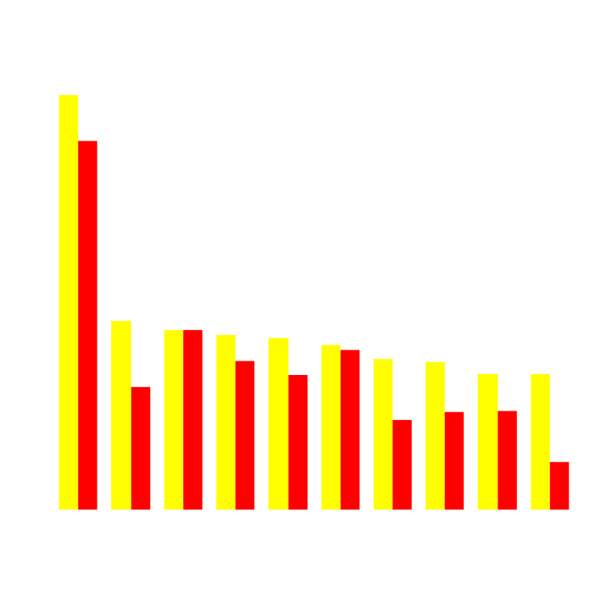
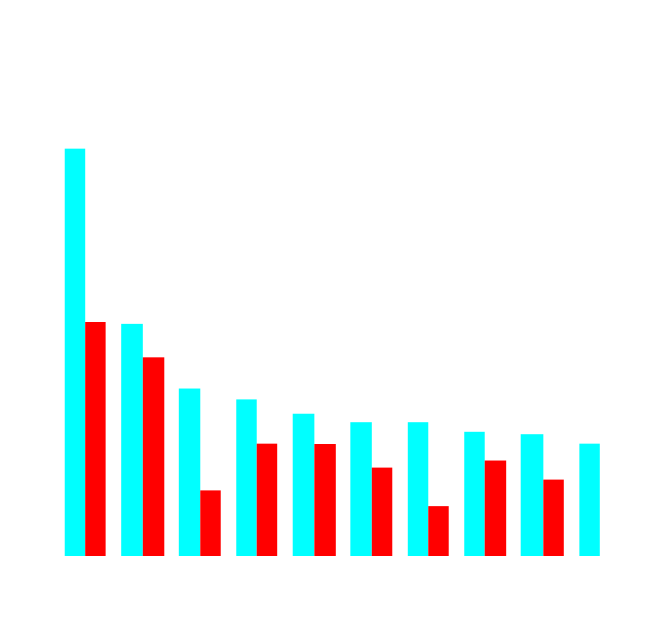
Enron’s Leading Market Position
Second Quarter 2000 vs Second Quarter 2001
(TBtue/d)
Gas Power
2Q01
2Q00
2Q01
2Q00
13
Notes:
<number>
<footer>
<header>
<date/time>

Slide 8
Enron Canada Gross Margins
14

