Slide 1

®
Energy Commodity Pricing and
Price Risk Management
John Neslage
August 4, 2000

Slide 2

Enron Corp.
Transportation
&
Distribution
Wholesale
Energy
Retail
Energy
Broadband
Services
Net Works
Natural Gas
Transportation
Electric Distribution
Marketing and
Delivery of Energy
Products Worldwide
Energy Outsourcing
to Commercial and
Industrial Customers
Bandwidth Management
and Broadband Delivery Services
Expansion Vehicle
for New Commodity
Industry Penetration
Notes:
<number>
<footer>
<header>
<date/time>
2

Slide 3
Commodity / Risk Management
Notes:
Welcome,
I'm a bit new to EES, but not to Enron - so while I have industry knowledge I am learning to applyit to the N.A. retail environment. What I am going to attempt to do is explain as simply as possible how our commodity solution will work for Square D and to explain some of your options and the fundamentals of the future energy markets.

Slide 4
Summary of Products Traded
Natural Gas
- Physically and Financially
- All Pipes and Locations in
North America
- Internationally
Electricity
- Physically and Financially
- All locations in U.S.
- Internationally
Crude Oil
- WTI
- WTS
- Brent
- Dubai
- Bow River
- Light Louisiana Sweet
- Heavy Louisiana Sweet
- Various California Crudes
Petrochemicals
- Benzene
- Tolulene
- Xylene
* Mixed Xylene
* Paraxylene
* Orthoxylene
- Styrene
- Methanol
- Mono-Ethylene Glycol (MEG)
- Cyclo Hexane
- Pure Theraphtalic Acid (PTA)
- Propylene
- MTBE
Plastics
- Ethylene
- Propylene
- Polypropylene-various grades
- Polyethylene-various grades
© 2000 SW-2060214-<number>

Slide 5
Summary of Products Traded (cont)
Fuel Oil
- NYH/GC 1%
- NYH/GC 3%
- Europe 1%
Natural Gas Liquids
- Ethane
- Propane
- Normal Butane
- Iso-Butane
- Natural Gasoline
Coal
- Domestic and International
- All Grades All Locations
Emissions Credits
- SO2
- NO2
Distillates and Others
- Jet Fuel-#54, #55, DERD
- Low Sulphur #2
- Gasoline-All Grades
- Alkylate
- Naptha
- Condensate
- Crack Spreads
Weather Derivatives
- Swaps, Caps, Collars, Floors
Pulp and Paper Products
- LWC No. 5, 34lb- 240lb
- Newsprint
- Linerboard
- OCC, ONP Recycled Materials

Slide 6
What Are The Main Drivers Of Short-term Price Volatility?
Affects Supply Affects Demand
Weather
Economic/business conditions
Stock levels
Pipeline capacity
Operational difficulties
Lack of timely,
reliable information

Slide 7
Taking No Action is Accepting the
Risk of Market Volatility
Notes:
<number>
<footer>
<header>
<date/time>

Slide 8
Increased Price Volatility has Become Common in the Gas Industry
January 1980 - January 2000
1999 Dollars
Nominal Dollars

Slide 9
Gas and Power Trading Desks
Trade hourly, daily, monthly and longer term contracts for power and gas
Hedge and trade against utility’s total deal portfolio
Make profits from bid/offer spread
Notes:
<number>
<footer>
<header>
<date/time>

Slide 10
Commodity
Deal Structures

Slide 11
Fixed Price
X% below or above historic baseline for deal term
Guaranteed price, guaranteed savings from electric baseline (includes T&D)
No price volatility
May be less than or greater than future prices
Notes:
<number>
<footer>
<header>
<date/time>

Slide 12
Floating (Index) Price
Moves with the market
Can be volatile
Risk may be managed with secondary products (derivatives- cap, floor or collar)
Can choose between a variety of Indices
Multiple possible methods of calculation (forward, spot, averaging, etc.)
Notes:
<number>
<footer>
<header>
<date/time>

Slide 13
Price Risk Continuum
Many pricing options exist between fixed and index
Fixed Price
Volatility
Index Price
Less
More
Notes:
<number>
<footer>
<header>
<date/time>
We already know that Square D prefers to be toward the index side of this continuum. We want to stress the options however along the spectrum.

Slide 14
Commodity Products
Values and Limitations

Slide 15
Example: Information
Based Decision Making
Thorough Understanding of Daily, Hourly and Weekly Consumption Allows Anticipatory Purchasing
Opportunities Identified to Use Generators During Peak Periods

Slide 16
What is Risk ?
Effects of external factors on the internal aspects of a company
Types of exposure which can effect earnings / cash flow / balance sheet
Price volatility
Supply / demand uncertainty
Politics / weather / seasonality
Notes:
<number>
<footer>
<header>
<date/time>

Slide 17
Vocabulary
Hedge - A hedge is a position that is equal and opposite to a position that exposes one to price risk in the market.
Long - When you own or have firm obligations from another party to deliver more commodity then is required to hedge your portfolio.
Short - When you are obligated to purchase or deliver more commodity then you have in your portfolio.
Contango - Market condition where prices of underlying commodity trades at progressively higher prices in distant delivery months.
Backwardation - When the price of near-term underlying commodity trades at a premium to the same commodity traded further forward.
Basis - The differential that exists at any time between the cash, or spot, price of a given commodity and the price of the nearest futures contract for the same or related commodity.
Notes:
<number>
<footer>
<header>
<date/time>

Slide 18
Vocabulary (cont...)
Price curve - a simple schedule of the current dealable price of energy based on different delivery dates into the future.
Offer - The price at which we would be willing to sell a swap or option.
Mid - The mid-point of the bid/ask spread currently available for the commodity in the OTC market.
Bid - The price at which we would be willing to buy a swap or option.
Notes:
<number>
<footer>
<header>
<date/time>

Slide 19
Why Hedge?
Eliminate uncertainty
Not hedging, i.e. buying on spot, is the same as speculating
Buying index still leaves you at the mercy of market conditions
Smooth production costs - be able to budget effectively - costs are known up front
Minimizes exposure to cyclical cash flows
A high price environment does preclude a hedging program
Allows you to focus on core business

Slide 20
Hedging Minimizes Price Risk
Speculating Means Unknown Outcomes
Hedging
Speculating
Specific objective driven
Offset by cash position
Reduces volatility exposure
Reduced likelihood of large losses
Stable production costs
Profit driven
No offsetting cash position
Volatility driven
Reduced Increased likelihood of large losses or gains
Full spectrum from home run to bankruptcy
Notes:
<number>
<footer>
<header>
<date/time>

Slide 21
Alternatives to Hedging Still Leave You Exposed to Price Risk
  Some companies simply buy spot
  - No supply commitment, no price protection
  Buying “on index” (i.e. Monthly Price)
  - Supply commitment, but no price protection
  - Benefit is always being “at the market”
  - Exposed to risk of price spikes
  - Can be used with financial price protection
Doing nothing is a decision - you are choosing to speculate on the direction of energy prices

Slide 22
Why Hedge?
Market-Based Pricing Is Speculation
Commodity Market
Exposure
Consumer Product
Company
End Product Markets -
Pricing Pressure
Price
Price
Time
Time
Problems
Fluctuating earnings and margins
Focus resources on commodity price forecasting rather than controllable costs

Slide 23
Commodity Price Stability
Risk Management Objectives
Hedge Commodity
Exposure
Consumer Product
Company
End Product Markets -
Pricing Pressure
Price
Price
Time
Time
Benefits
Reduces price risk exposure
Insures against adverse price movement
Reduces earnings variability
Facilitates planning/budgeting
Enhances credit worthiness

Slide 24
Basic Tools: Financial Instruments
Risk Management products are all based on the following basic financial instruments
  - Forwards/Futures
  - Options: Calls and (caps) and puts (floors)
  - Swaps
These instruments can be customized to address the specific needs and sensitivities of the hedging firm.

Slide 25
Calls, Puts, and Collars - Objectives
Call (Cap) buyer’s objective
  Protection against market moving up
  Full participation in down move
Put (Floor) buyer’s objective
  Protection against market moving down
Full participation in up move
Collar buyer’s objective
  Moderate extreme price swings
  Forfeit participation in down move in
  exchange for protection in up move
Option seller’s objective
  Collect premium on covered position

Slide 26
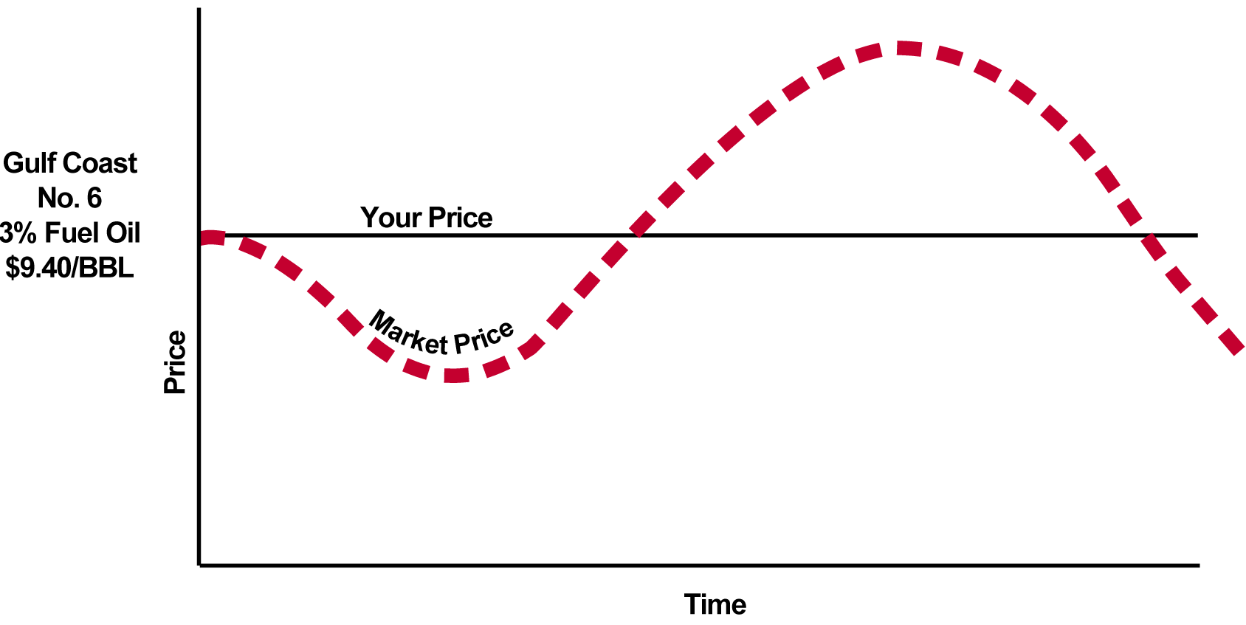
Fixed Price Swaps (cont’d)
USG Diesel
LS #2
$0.72/gal
Remember: Your current and future buying practices and relationships: UNCHANGED
Prices are for illustrative purposes only

Slide 27
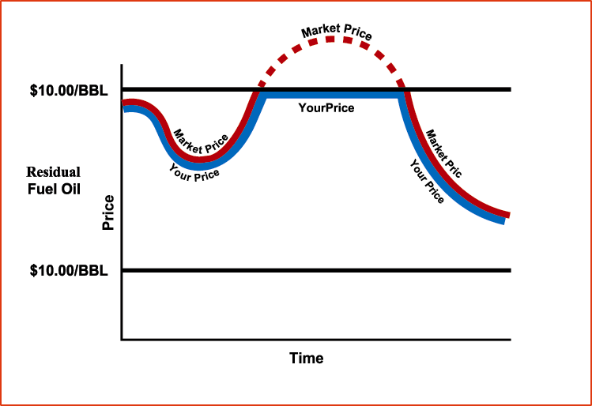
Caps/ Call
1. Objective:
  A maximum price is established
  Customer participates in all the downward movement below the established ceiling (maximum price)
2. Cap Mechanics:
  For example, $0.80/ gal for diesel - this is the maximum you will pay and you benefit from all downside price movement
  The protection has a cost, for Nov 00 - Mar 01 the cost would be $0.045/gal for this insurance
$0.80/gal
USG LS#2
Prices are illustrative only

Slide 28
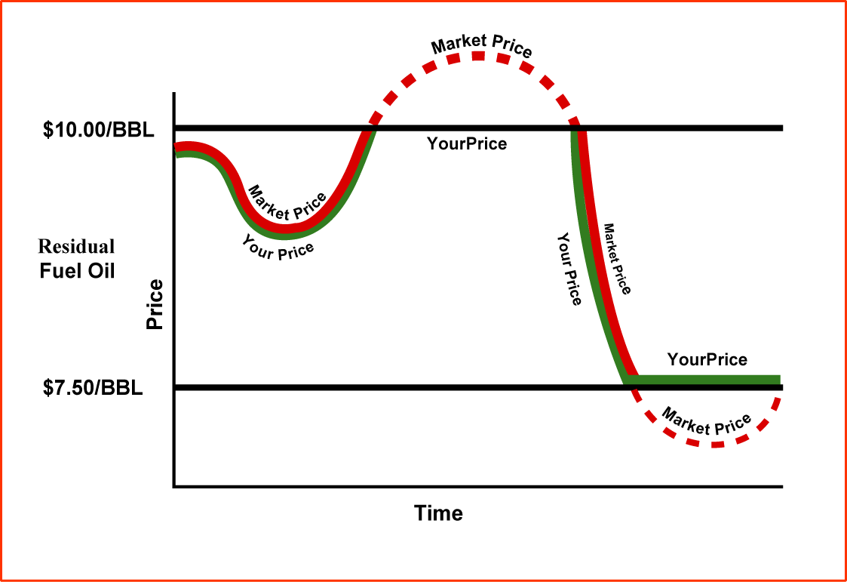
Costless Collars
1. Objective:
  For endusers looking to limit their upside price exposure, but who do not wish to pay for this insurance
2. Collar Mechanics:
  In this case, the enduser chooses a range: opportunity given up on the downside is used to fund the cost of upside price protection (e.g., $0.66 - $0.80 / gal)
$0.80 / gal
Your Price
USG Diesel
$0.66 / gal
Prices are illustrative only

Slide 29
The “Costs” of Risk Management
Swaps
  - No fee
  - Only an opportunity cost
Options
  - Premium
  - Depends on strike price, interest rate, time to expiration, and volatility

Slide 30
Fixed Price Swaps
1. Objective
  End user wishes to eliminate all price uncertainty over a given period
  Fuel cost is known and fixed for a given volume for a set period of time. Enduser is able to fix their production costs for energy
2. Swap characteristics and benefits
  No upfront cost
  Customized risk management tool
  Effectively transfers unacceptable price or basis risk exposure to Enron
  Do not necessarily involve physical delivery of energy, preserving existing supply relationships
  Establishes price certainty for substantially longer period of time compared to futures

Slide 31
Fixed Price Swaps (cont’d)
3. Swap Mechanics
  Swaps are used to convert a floating price for physical supply (i.e. monthly posted price or monthly index) to a fixed price
  Swaps are settled financially at regular agreed upon intervals
  Swaps do not change your physical supply relationship in anyway

Slide 32
Tools for Risk Management I:
Fixed Price Swaps
1. Objective
  Product cost is known and fixed for a given volume for a set period of time.
  Customer gets a fixed price for product
2. Swap Mechanics
  Swaps are used to convert a floating price for physical supply (i.e. monthly posted price or monthly index) to a fixed price
  Swaps are settled financially
  Swaps do not change your physical supply relationship in anyway

Slide 33



Swap Mechanics Example
Company pays $0.70/gal
Physical supply
Company pays based on an Index
Enron pays Company the Index price each month
Scenario 1:
Price for Apr-00 is $0.90/gal
Company pays supplier $0.90/gal X 500,000 gals =$450,000
Enron pays company $0.20/gal
Distribution company spends $350,000
- its price is fixed at $0.70/gal
Scenario 2:
Price for Apr-00 is $0.50/gal
Company pays supplier $0.50/gal X 500,000 gals =$250,000
Company pays Enron $0.20/gal
Distribution company spends $350,000
- its price is fixed at $0.70/gal
The Company’s price is fixed at $ 0.70/gal regardless of market conditions
Prices are illustrative only

Slide 34

Example: US Gulf Coast Diesel Fixed Price Swap for Nov 00 - Mar 01 at $0.72 / gal for 100,000 gal/month
Fixed Price Swaps (cont’d)
Physical supply of diesel
UPS pays Enron $0.72 /gal
UPS buys diesel based on Platt’s Index
Enron pays UPS Platt’s Index
Scenario 1:
Scenario 2:
Platt’s Index for Nov ‘00 is $0.80 /gal
UPS pays supplier $0.80 X 100,000 = $80,000
Enron pays UPS $0.08gal or $8,000
UPS spends $72,000 on fuel - its price is fixed at $0.72/gal
Platt’s Index for Nov ‘00 is $0.65 /gal
UPS pays supplier $0.65 X 100,000 = $65,000
UPS pays Enron $0.07/gal or $7,000
UPS spends $72,000 on fuel - its price is fixed at $0.72/gal
Customer’s price is fixed at $0.72/gal, regardless of market conditions
Prices are illustrative only

Slide 35
Tool / Benefit Summary
Use a Swap
Use a Cap
Use a Floor
Use a Costless Collar
To remove all uncertainty about price
To insure against price spikes
To secure the value of finished goods inventory
To remove most uncertainty about price or margin

Slide 36
Risk Management II:
Caps Fixing a Maximum Price
While Benefiting From Price Decreases
1. Objective:
  A maximum price is established
  Customer participates in all the downward movement below the established ceiling (maximum price)
2. Cap Mechanics:
  The cap price is the maximum you will pay and you benefit from all downside price movement
  The protection/ insurance has a cost
Prices are illustrative only

Slide 37
Risk Management III
Collars: Upside Price Protection with No Upfront Cost
1. Objective:
  For customers looking to limit their upside price exposure, but who do not wish to pay for this insurance
2. Collar Mechanics:
  In this case, the end user chooses a range: opportunity given up on the downside is used to fund the cost of upside price protection
Prices are illustrative only
Notes:
<number>
<footer>
<header>
<date/time>

Slide 38
Keys to a Successful Risk Management Program
Risk management is used to decrease uncertainty - not to beat the market
Belief that future outcomes can be changed
Doing nothing is the same as speculating
Risk management is a dynamic, iterative process
Have a view on the market and be prepared to change course

Slide 39
Examples
Notes:
Welcome,
I'm a bit new to EES, but not to Enron - so while I have industry knowledge I am learning to applyit to the N.A. retail environment. What I am going to attempt to do is explain as simply as possible how our commodity solution will work for Square D and to explain some of your options and the fundamentals of the future energy markets.

Slide 40
ENA Marketplace Alignment
Customer Term Structured Strategic
Group Trading Marketing Transactions Business
Gas & Electric Utilities
Municipal Utilities
Industrials
IPP’s
Retail
Hourly/Day Trading
Weekly Trading
30 Day Spot Deals
Broadcast Market Coverage
Regional Focus
Real-Time Decisions
Term Commodity Deal (Forward)
Risk Management Products
Broad Market Coverage
Regional & Customer Focus
Real-Time & Value Decisions
Transactions Covering Multiple Disciplines (Commodities/ Facilities)
Solution Based Deals Covering Complex Business Issues
Highly Targeted Markets
Customer Focus
Value Decisions
Mergers/ Acquisitions
Joint Ventures
TurnKey Projects
Corporate Objectives
Customer Focus
Value Decisions
Narrow Focus
Resources
Broad Focus
Value Proposition

Slide 41
Peoples Energy
Natural Gas
Power
Coal
Crude Products
Emissions
Weather
Pulp and Paper
Merchant
Investments
Long Term Gas
Supply
Hub
Services
Wholesale
Electric Supply
Supply Peoples’ Natural Gas
Requirements
  5 Year Term
  270 MMcf/d
  10% of Natural Gas Consumed in Chicago
Enron
Marketing
Risk Management
National Reach
Peoples
Storage Assets
Transportation
Regional Expertise
Provide Key Services
to Peoples’ Retail Power
Markets
- Wholesale Power Supply
- Risk Management
Target Market Area
Representing 5% of U.S.
Natural Gas Consumed
Increase Liquidity & Flexibility at Chicago City Gate
- Access Multiple Supply
Basins
- Interconnect With 6 Major
Pipelines
Acquire and Optimize
Transport Capacity Within Enron’s Broader Portfolio
Provide Weather Risk Management Services

Slide 42
The United Illuminating
Company (U.I.)
Natural Gas
Power
Coal
Crude Products
Emissions
Weather
Pulp and Paper
Merchant
Investments
Long-Term Power Outsourcing for Major Northeastern Utility Serving 314,000 Customers
Assumes and Optimizes U.I.’s Power Purchase Agreements
Significantly Increases Enron’s Power Portfolio
Facilitated by Unparalleled Capabilities
  Load Forecasting, Volume Management and Superior Systems
Significant Opportunities in Managing Full
Requirements Power Contracts

Slide 43
ENA/Sithe Partnership
Independence Project
Project Description
1,000 MW natural gas fired cogeneration project located 2 miles northeast of Oswego, New York
Power Sales
  Consolidated Edison (Capacity and Energy)
  Niagara Mohawk (energy only)
Project Fuel Supply
  Maximum Daily Quantity of 193,000 MMBtu/D
  Annual Minimum Quantity of 63 Bcf
  20 Year Term
  Total contract quantity of 1.5 Tcf
Project Need
ENA Solution
Fuel strategy to ensure gas supply and competitive pricing
Preserve linkage between revenues and costs to secure project financing
Diversified supply strategy providing firm gas from all North American supply basins via 25 separate transport agreements on 7 different pipelines
Designed innovative avoided-cost pricing that resulted in the first ever preconstruction phase investment grade debt ratings for an IPP (Moodys, Fitch and S&P)

Slide 44
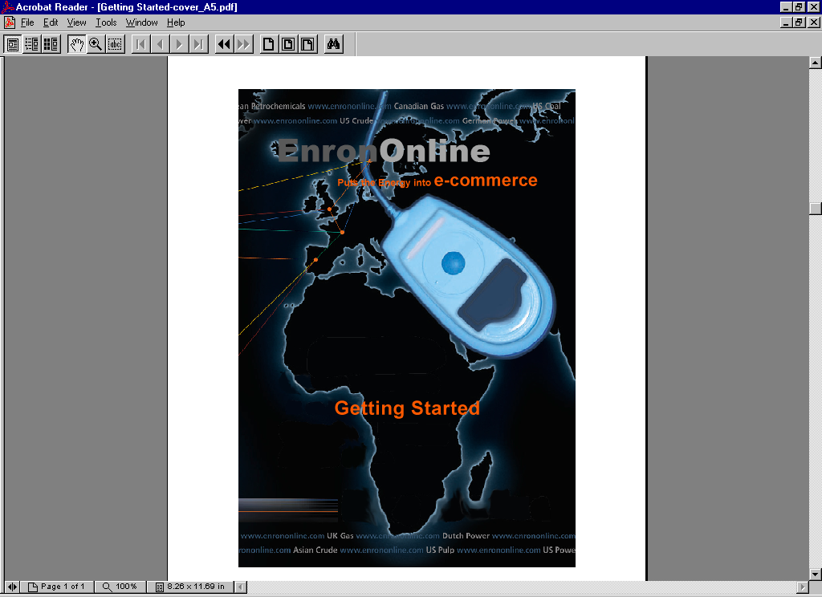
The Future: Electronic Commerce Comes of Age

Slide 45
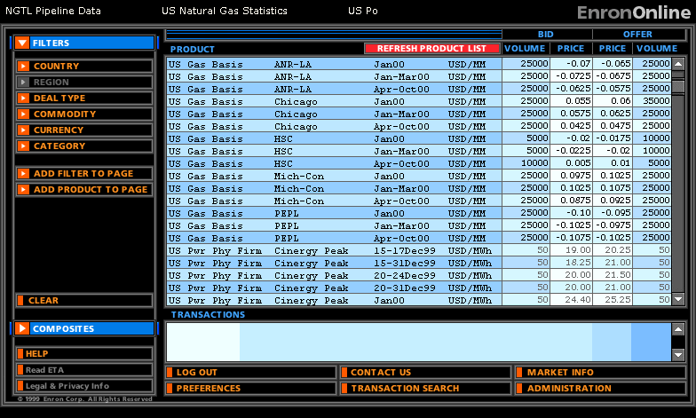
Crude and Products are also available
© 2000 SW-2060214-<number>

Slide 46
®

