Slide 1


Enron Overview & Current Electricity Issues Jeff Skilling President & Chief Operating Officer
Media Briefing
National Press Club
Washington, D.C.
September 6, 2000

Slide 2

Wholesale
Energy
Transportation
&
Distribution
Broadband
Services
Net Works
Retail
Energy
Natural Gas Transportation and Electric Distribution
Marketing and Delivery of Energy Products Worldwide
Expansion Vehicle for New Commodity Market Penetration
Energy Outsourcing to Commercial and Industrial Customers
Bandwidth Management and Broadband
Delivery Services

Slide 3
Wholesale Energy Operations and Services
Physical Volumes
(BBtue/d)
Income Before Interest and Taxes
(Millions)
32,429
$1,317
27,308
$968
17,970
$654
12,392
$466
8,966
$401
1995
1996
1997
1998
1999
1995
1996
1997
1998
1999
38% Compounded Annual Growth Rate
35% Compounded Annual Growth Rate
37%+ CAGR

Slide 4
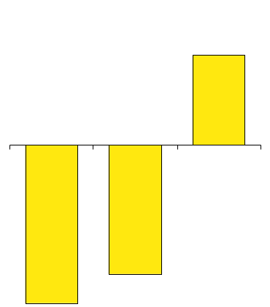
Enron Energy Services First Half Performance (Millions)
Contracting
(Total Contract Value)
Revenues
EBIT
$7,500
$1,482
$40
($70)
($57)
$3,400
$710
$349
$1,400
1998
1999
2000
1998
1999
2000
1998
1999
2000

Slide 5








First Half 2000 Contracting Activity
$610 Million, 10-Year Agreement to Service 10 Facilities in 3 States
$1 Billion, 10-Year Agreement to Service 66 Facilities in 28 States
QUEBECOR INC
$750 Million, 10-year Agreement to Service Over 650 Facilities in 11 States
$180 Million, 10-Year Agreement to Service 19 Facilities in 6 States
$583 Million, 10-Year Agreement to Service Over 50 Facilities in 8 States
$210 Million, 10-Year Agreement to Service 100 Facilities in 27 States
Sonoco Inc.
$180 Million Upsell with Advanced Glass Fiber Yarn for 10 Years
$150 Million, 10-Year Agreement to Service 19 Facilities in 11 States

Slide 6
Enron Broadband Services
Enron
Intelligent
Network
Bandwidth Intermediation
Deploy the Most Open, Efficient Network with Broad Connectivity
Content Services
Be the World’s Largest Provider of Premium Broadband Delivery Services
Be the World’s Largest Buyer and Seller of Bandwidth
Fiber
Servers
Pooling Points
Network Control
Bandwidth Marketing & Trading
Comprehensive Bandwidth Management
Broadband Content Management & Delivery
Data Management Services

Slide 7
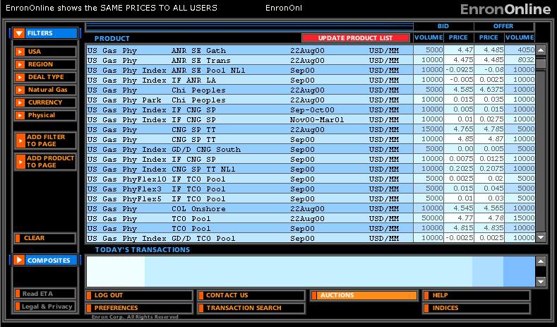
EnronOnline Extending Enron’s Products to the Internet
Free, Reliable Transaction System with Enron as Principal
Fully Integrated into Enron’s Established Risk Management and Logistic Processes
Utilizing Site to Offer Energy-Related Auction Capabilities
Expands Enron’s Information Base and Market Knowledge
“Tried and Tested” Platform for Expanding Enron’s
eCommerce Activity
Gross Transaction
Value
Through
8/30:
Transactions
271,000
$131 Billion

Slide 8
Enron–Accelerating Market Development
Metals
Commodity
Product
Financial
Bandwidth
Australian Power & Gas
Pulp & Paper
Coal
Weather
Scandinavian Power & Gas
Plastics
Emissions
Financials (interest rate, equity)
UK Power & Gas
Electricity
Currencies
Natural
Gas
1985
1986
1987
1988
1989
1990
1991
1992
1993
1994
1995
1996
1997
1998
1999
2000
* Lighter shading indicates a developing market
Darker shading indicates a mature market

Slide 9
Enron is Neutrally Positioned
to Make Commodity Markets Work
Market Making Capabilities
Operating
Capabilities
Other
Capabilities
eCommerce Platforms
Risk Management Process
Capital
Cash Markets
Forward Markets
Futures Markets
Transactions
Logistics
Settlement
Define Product Standards and Contracts
Obtain Access to Physical Product
Develop Physical Distribution
Market Making Establishes Liquidity
Innovative Structured Products
Risk Management

Slide 10
Electricity–More Important Than Ever
“The Internet consumed 8 percent of U.S. electric output in 1998, and is responsible for 40 percent of the U.S. load growth over the last 10 years.”
-Robert Nardelli,
CEO, GE Power Systems
“The [demand] battlefield…is in data centers where thousands of servers and other powerful computers are stacked floor to ceiling. A single data center will use as much electricity as six 40-story office buildings. Roughly 20 data centers are currently planned for the Chicago area.”
-Fortune (August 14, 2000)

Slide 11
U.S. Peak Electricity Demand Growth
in Gigawatts
625
593
63 GW
562
172
200
All Others
191
157
SERC
147
149
55
ERCOT
47
51
113
WSCC
104
110
92
92
100
ECAR
1995
1997
1999
Peak electricity demand has increased 11% since 1995
Source: Cambridge Energy Research Associates

Slide 12
Key U.S. Electricity Facts
Peak demand up by 11% since 1995
Reserve margins down by 14% since 1997
Transmission Loading Reliefs (TLRs) up by 300%

Slide 13
Transmission Loading Relief (TLR)
Level 2-6 Incidents
1998-Present
1998
1999
2000
Source: NERC

Slide 14
California Electricity Imbalance
1996-99
11,000 MW
12% Increase
5,500 MW
1% Increase
672 MW
Peak Demand
Increase
Powerplant Capacity
Additions
Proposed Capacity
Backlog
Source: CPUC; Electricity Oversight Board

Slide 15
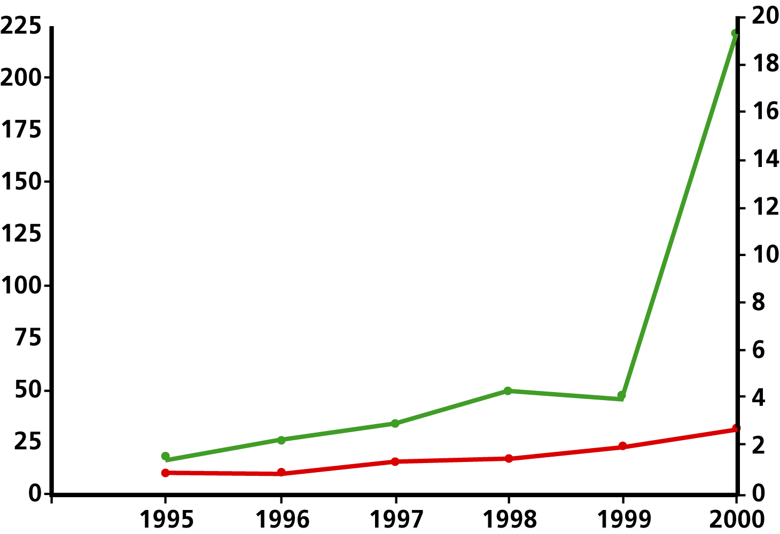
Increasing Price Volatility in the Southern California Power Market
19% peak
Capacity Margin
$ per MWH
Capacity Margin %
Top Price Quartile
7%
present
Bottom Price Quartile

Slide 16
Circle of Strife
Shortages
Regulated
Shortages
Less Supply
More Demand
Price Spikes
Brownouts
Blackouts
Blackouts
Price Caps

