Slide 1

®
Demand
Natural Gas Overview
Julie Gomez
February, 2001

Slide 2
“State of the Grid”
An Update on the Status of
the North American
Natural Gas Pipeline Grid
Enron North
America point
of view on the
value of
transportation
& storage
throughout
the North
American
Pipeline Grid
* Updated Annually
* Develops viewpoint on basis values throughout the grid
Confidential

Slide 3
Overview
The Components of Supply and Demand Have Fundamentally Changed Throughout North America
New Gas-fired Power Generation Plants Will Be the Principle Growth Area for Natural Gas Demand
Gas Demand Growth Will Occur in Regions of the U.S. Unaccustomed to and Unprepared for Such Changes
Gas Supply Growth Will Come From Remote and Frontier Regions and Will Enter the Natural Gas Grid on the “Fringes”
The Natural Gas Pipeline Infrastructure Will Need to be Enhanced and Expanded to Handle the Fundamental Shift in Supply and Demand

Slide 4
Demand

Slide 5
Current and Projected Components
of U.S. Natural Gas Demand: Electric Generation Experiences the Greatest Growth
(Year 1985 - 2020)
Bcf per day
Projected Annual Growth Rate (1999 - 2020)
Residential: 1.3% Total: 2.3%
Commercial: 1.3%
Industrial: * 1.2%
Generation: 5.4%
* Includes Cogenerators
19% Growth
35 Tcf
Source: EIA, Annual Energy Outlook 2001

Slide 6
Merchant Plant Activity - Megawatts by Region
(1998 and forward)
Why are 95% of new plants natural gas fired?
  Low construction costs relative to alternative generating technologies
  Technological advances-superior conversion efficiencies
NPCC
32,706 MW
MAPP
2,709 MW
WSCC
52,901 MW
MAIN
32,211 MW
MAAC
16,128 MW
ECAR
47,350 MW
SPP
15,697 MW
SERC
74,339 MW
ERCOT
31,644 MW
FRCC
21,871 MW
Total announced projects 327,556 MW
707 Facilities

Slide 7
Fuel Mix by Census Region
New England
104,973
GWh
West North Central
278,951
GWh
Pacific
378,829
GWh
East North Central
601,024
GWH
Middle Atlantic
374,457
GWh
Mountain
330,612
GWh
East South Central
345,395
GWh
2000 Generation*
MWh By Fuel
West South Central
560,092
GWh
South Atlantic
745,141
GWh
600,000,000
300,000,000
60,000,000
COAL
GAS
HYDRO
PETROLEUM
NUCLEAR
OTHER
* Twelve Months Ending October, 2000

Slide 8
Natural Gas Delivered to
Electric Utility Customers
17
11
23
17
13
10
12
2000 - 2004 New Plants
High Probability
12
13
15 + Plants
10 - 14 Plants
1999 Annual Consumption
30
100 Bcf or Greater
50 to 100 Bcf
28
Texas is Four Times the Largest Gas Consuming State
Demand Historically in States With Excess Summer Transportation Capacity

Slide 9
Power Generation - Gas Demand by
Census Region - New Plants 2000-2003
# of Plants - 150
High Probability Plants - 63
Peak Gas Demand (Bcf/d) - 4.34
Expected Annual Usage (Bcf/d) - 0.79
% Growth over 1999 - 630%
# of Plants - 52
High Probability Plants - 20
Peak Gas Demand (Bcf/d) - 2.28
Expected Annual Usage (Bcf/d) - 0.72
% Growth over 1999 - 414%
# of Plants - 26
High Probability Plants - 16
Peak Gas Demand (Bc/d) - 0.82
Expected Annual Usage (Bcf/d) - 0.16
%Growth over 1999 - 215%
# of Plants - 53
High Probability Plants - 22
Peak Gas Demand (Bcf/d) - 2.20
Expected Annual Usage (Bcf/d) - 0.77
% Growth over 1999 - 3479%
# of Plants - 54
High Probability Plants - 27
Peak Gas Demand (Bcf/d) - 2.25
Expected Annual Usage (Bcf/d) - 0.71
% Growth over 1999 - 399%
# of Plants - 62
High Probability Plants - 20
Peak Gas Demand (Bcf/d) - 1.69
Expected Annual Usage (Bcf/d) - 0.52
% Growth over 1999 - 230%
# of Plants - 115
High Probability Plants - 48
Peak Gas Demand (Bcf/d) - 5.61
Expected Annual Usage
(Bcf/d) - 1.82
% Growth over 1999 - 105%
# of Plants - 136
High Probability Plants - 59
Peak Gas Demand (Bcf/d) - 6.10
Expected Annual Usage (Bcf/d) - 1.35
% Growth over 1999 - 325%
# of Plants - 57
High Probability Plants - 29
Peak Gas Demand (Bcf/d) - 2.65
Expected Annual Usage (Bcf/d) - 0.73
% Growth over 1999 - 554%
High
Peak Gas
Expected
Number
Pr
obability
Demand
Annual Usage
Of Plants
Plants
(Bcf/d)
(Bcf/d)
Total US
707
304
28.00
9.76

Slide 10
2001 Natural Gas Fired Generation Additions
Megawatts by Region
High Probability Plants
NPCC
3,614
MAPP
1,349
WSCC
6,023
MAAC
(PJM)
1,440
ECAR
3,296
MAIN
3,903
SPP
1,935
SERC
7,948
ERCOT
8,261
FL
4,121

Slide 11
2002 Natural Gas Fired Generation Additions
Megawatts by Region
High Probability Plants
NPCC
5,520
MAPP
0
WSCC
5,559
MAAC
(PJM)
2,230
ECAR
1,520
SPP
2,058
MAIN
3,435
SERC
10,107
ERCOT
3,917
FL
3,208

Slide 12
Supply

Slide 13
U.S. Dry Gas Production
(Tcf)
Domestic production flat with increasing levels of gas drilling

Slide 14
Major Supply Factors
U.S. Gas Rigs
Onshore Offshore
High
Low
Current
Gas Drilling Has Rebounded -
788 (2/9/01)
134 (7/14/00)
318 (4/23/99)
38 (5/14/99)
788
115
Decline Rates Up - increasing by double in the major areas over the past decade
Capital Discipline - capital expenditures back up to pre-1999 levels even though gas prices are significantly higher
Numerous Major Plays Working - big plays becoming more remote and capital intensive

Slide 15
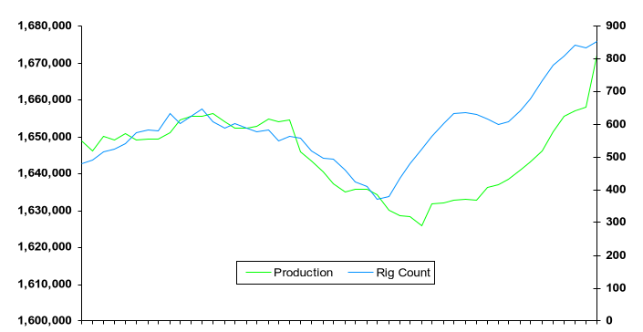
DOE/EIA Production Data
MMcf
= Henry Hub Cash Prices
Active Rigs
$6.02
$3.30
$4.09
$1.63
$4.36
$1.80
$2.36
$1.63
1/1997
1/1998
1/1999
1/2000
12/2000

Slide 16
Major North American Gas Exploration and Development Hotspots
Mackenzie
Delta Area
Northeast
BC
NWT
Monkman
Pass
Alberta
WCSB
Hibernia Area
Labarge and
Big Piney
Area
Wind River Basin
Madden Deep Unit
Cave Gulch Area
Waltman Field
Overthrust Belt
Powder River
Coalbed
Methane
Sable Island Area
Antrim Shale
Green River
Basin
Jonah Field
Central Northern
Appalachian Basins
Coalbed Methane
DJ Basin
Hugoton Infill
Raton Basin
Arkoma
Basin
CSM Project
Pocahontas Gas
Elk Hills
Andarko
Basin
Swan Creek Field
Molino Offshore
Pinnacle
Reefs
San Juan Basin
Coalbed Methane
and Coventional Infill
Austin
Chalk Deep
Tuscaloosa/Chalk Trend
Mobile Bay
Norphlet
Deep Frio
and Miocene
associated with
salt domes
Lower Cretaceous
Carbonate Trend
Canyon Sands
Val Verde Basin
Strawn
Hackberry
Sand
Galveston
Bay
Vicksburg
Burgos Basin
Gas Development
Area
Deep Wilcox,
Lobo, and
Yegua Trend.
(Bob West and
Lopeno Fields)
Flexure Trend,
Subsalt, Shelf,
and Transition
Zone

Slide 17
U.S. Lower 48 Undiscovered Gas Resources Subject to Access Restrictions*
Canadian Scotian Shelf
Rockies**
29 Tcf
Atlantic
Offshore
Shelf and Slope
27 Tcf
Major basins affected
Green River
Powder River
Baltimore Canyon Trough
Carolina Trough–
Salt Basin
Pacific offshore Shelf and Slope
19 Tcf
24
Tcf
Blake Plateau
Basin
Gas Production/discovery
OSC Sale
181
Oil production
Oil and gas production
Source: Cambridge Energy Research Associates.
* 99 Tcf are off limits for exploration and development.
** An additional 108 Tcf of the Rockies gas resources are available with restrictions.

Slide 18
U.S. Gulf of Mexico Gas Production
?
?

Slide 19
Gulf of Mexico Production By Region
GULF OF MEXICO PRODUCTION BY REGION (MMcf/d)
2000 Field Names (Areas)
Apla (GB 73)
Black Widow (EW 966)
Conger (GB 215)
Diana (EB 945)
Einset (VK 873)
Europa (MC 935)
Marlin (VK 915)
Northwestern (GB 200)
Petronius (VK 786)
1999 Field Names (Areas)
Allegheny (GC 254)
Angus (GC 113)
Chinook (VK 734)
Dulcimer (GB 367)
GB 161
Gemini (MC 292)
Genesis (GC 205)
Gyrfalcon (GC 20)
Macaroni (GB 602)
Marlin (VK 915)
Penn State (GB 216)
Pluto (MC 718)
Ursa (MC 810)
Virgo (VK 823)
May 2000 Versus May, 1999
LA
MS
AL
FL
= Production Increase
= Production Decrease
Deepwater-2000 Wells
Deepwater-1999 Wells
SABINE PASS
MOBILE
PENSOCOLA
+14
-8
VIOSCA KNOLL
WEST
CAMERON
-40
BRETON
SOUND
CHANDELEUR
+22
SOUTH
PELTO
MAIN PASS
DESTIN DOME
HIGH
ISLAND
WEST
CAMERON
(WA)
VERMILLION
WEST
DELTA
VIOSCA KNOLL
EAST
CAMERON
SOUTH
MARSH
ISLAND
EUGENE
ISLAND
SHIP
SHOAL
GRAND
ISLE
SOUTH
PASS
GALVESTON
HIGH
ISLAND
(EA)
SOUTH
TIMBALIER &
BAY MARCHAND
-93
BRAZOS
-232
-257
-127
+250
DESOTO CANYON
-226
-170
MISSISSIPPI CANYON
MATAGORDA
ISLAND
-69
EWING BANK
MUSTANG
ISLAND
EAST BREAKS
GARDEN BANKS
GREEN CANYON
ATWATER VALLEY
LLOYD RIDGE
NORTH
PADRE
ISLAND
CORPUS CHRISTI
+12
KEATHLY CANYON
WALKER RIDGE
LUND
HENDERSON
SOUTH
PADRE
ISLAND
PORT ISABEL
ALAMINOS CANYON
WESTERN LOUISIANA (INCLUDING HIGH ISLAND)
TEXAS
CENTRAL LOUISIANA
EASTERN LOUISIANA
EASTERN GULF
Supply is Shifting to the East
Source: Wood Mackensie

Slide 20
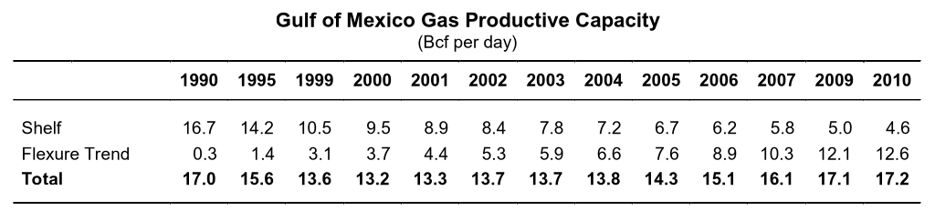
U.S. Gulf of Mexico*
Wet Gas Productive Capacity Outlook
20
18
16
Fields without a development plan
Future discoveries
14
12
Deepwater Flexure Trend
Fields producing or under development
10
Billion Cubic Feet per Day
8
Shallow water shelf
(<600 feet)
6
4
2
0
1990
1991
1992
1993
1994
1995
1996
1997
1998
1999
2000
2001
2002
2003
2004
2005
Source: Cambridge Energy Research Associates.
* Includes Louisiana and Texas only.

Slide 21
Deepwater Gas Production Profile
Source: Wood Mackensie

Slide 22
Recoverable Reserves: Commercial & Technical
Initial Commercial & Technical Reserves = 13,065 mmboe

Slide 23
Overall Trends 2001 - 2005
Deepwater production will overtake shelf production within the next five years due to federal incentives, improved technology and improved deepwater economies of scale
Developing projects such as Aconcagua, Camden Hills, Kings Peak and Crazy Horse (all Mississippi Canyon) could significantly enhance production levels by 2002
Deepwater production will continue to develop and companies will continue to explore deeper waters in GOM (over 7000 ft.) (Petrobras - Roncador field 9111 ft. - Campos Basin, Offshore Brazil)

Slide 24
Canadian Natural Gas Imports
Chicago
F
?
E

Slide 25
Western Canada’s Challenges
The market no longer encourages growth in reserves and production, demanding instead earnings.
It appears cheaper to buy undervalued stocks than drilling to replace reserves.
Major consolidation continues with few intermediates remaining and juniors having a hard time raising capital.
Rig fleet skewed to shallow operations. Only about 55 rigs are capable of drilling below 12,500 feet. Technical personnel expertise is diminishing.
Drilling more, producing less. Slowly liquidating the basin.

Slide 26
Canadian Gas Export Growth
WCSB – GAS WELL COMPLETIONS
WCSB Gas Wells Drilled
2000 - 8,100
2001 - 8,700
2002 - 8,900
count
Mackenzie Delta + Alaska
Scotian Shelf
WCSB*
Available rig fleet about 610 currently, but only 55 rigs can drill below 12,500 feet.
* 8,100 gas wells drilled per year is needed to maintain deliverability

Slide 27
WCSB – Drilling & Production
ALBERTA FOOTHILLS - GAS WELL COMPLETIONS
ALBERTA FOOTHILLS FRONT - INITIAL PRODUCTIVITIES
Count
Thousand m³/d
MMcf/d
4
3
2
WCSB Gas Areas
1
Southern
Territories
0
British
Columbia
Alberta
8
Saskatchewan
ALBERTA SOUTHEAST - GAS WELL COMPLETIONS
ALBERTA SOUTHEAST - INITIAL PRODUCTIVITIES
BC
Plains
Count
Thousand m³/d
MMcf/d
7
0.7
1b
Northwest
6
0.6
BC
Foothills
Northeast
0.5
Foothills
Front
West
Central
0.4
Central
0.3
2
5
4
9
0.2
1a
0.1
Alberta
Foothills
Southwest
0
Southeast
10
3
ALBERTA CENTRAL - GAS WELL COMPLETIONS
ALBERTA CENTRAL - INITIAL PRODUCTIVITIES
Count
Thousand m³/d
MMcf/d
1.4
1.2
1.0
0.8
0.6
0.4
0.2
0.0

Slide 28
WCSB – Drilling & Production
ALBERTA NORTHEAST - GAS WELL COMPLETIONS
ALBERTA NORTHEAST - INITIAL PRODUCTIVITIES
Count
Thousand m³/d
MMcf/d
0.8
0.6
0.4
WCSB Gas Areas
0.2
Southern
Territories
0.0
British
Columbia
Alberta
8
Saskatchewan
ALBERTA NORTHWEST - GAS WELL COMPLETIONS
ALBERTA NORTHWEST - INITIAL PRODUCTIVITIES
BC
Plains
Count
Thousand m³/d
MMcf/d
7
2.0
1b
Northwest
6
1.5
BC
Foothills
Northeast
Foothills
Front
West
Central
1.0
Central
0.5
1a
2
5
4
9
Alberta
Foothills
Southwest
0.0
Southeast
10
3
BC PLAINS - GAS WELL COMPLETIONS
BC PLAINS - GAS WELL COMPLETIONS
Count
Thousand m³/d
MMcf/d
4
3
2
1
0

Slide 29
WCSB – Drilling & Production
WCSB Gas Areas
Southern
Territories
British
Columbia
Alberta
8
Saskatchewan
SASKATCHEWAN SOUTHWEST - GAS WELL COMPLETIONS
SASKATCHEWAN SOUTHWEST - INITIAL PRODUCTIVITIES
BC
Plains
Count
Thousand m³/d
MMcf/d
7
0.16
1b
Northwest
6
0.12
BC
Foothills
Northeast
Foothills
Front
Central
West
Central
0.08
2
5
4
9
0.04
1a
Alberta
Foothills
Southwest
0.00
Southeast
10
3

Slide 30
Natural Gas Supply Over the Long Term:
A Lot of “Ifs”
Continued successful deepwater drilling and completions
Increased imports from Canada and LNG resources
Connection of frontier areas to the natural gas grid
New pipeline construction to facilitate supply shift and market growth
Continued development of technological advancements
  expand prospective resource areas
  reduce production expenses

Slide 31
Transportation

Slide 32
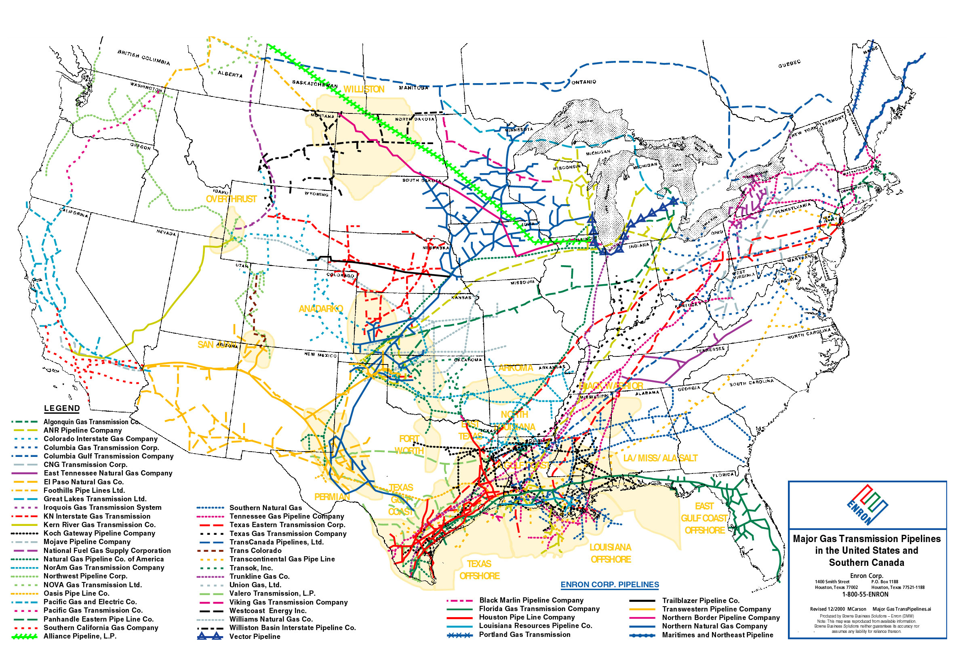
U.S. Natural Gas Pipeline Projects Completed in 1999
Canadian-Montana Pipeline Co
Montana Power Import - 10 MMcf/d (New)
Williston Basin Interstate PL
Portal Import Station - 18 MMcf/d (Expn)
Viking Gas Transmission Co
System Wide - 28 MMcf/d (Expn)
North Shore Gas Co
ANR WI Interconnection - 40 MMcf/d (Expn)
Northwest Pipeline Co
Columbia River Gorge - 51 MMcf/d (Expn)
Northern Natural Gas Co
Zone EF - 50 MMcf/d (Expn)
ANR Pipeline Co
ANR Wisconsin Loop I - 190 MMcf/d (Expn)
Portland Natural Gas Co
PNGTS Pipeline - 178 MMcf/d
Northern Natural Gas Co
Peak Day III - 31 MMcf/d (Expn)
Northwest Natural Gas Co
Mist Storage Link Phase III
190 MMcf/d (Expn)
Vermont Gas Systems Inc
Imports - 9 MMcf/d (Expn)
Maritimes & Northeast Pipeline Co
M&E Phase II - 400 MMcf/d (New)
Williston Basin Interstate PL
Billy Creek Compressor - 8 MMcf/d (Expn)
PNGTS/Maritimes & Northeast Pipeline Co
PNGTS/M&E Phase I - 632 MMcf/d (New)
Thunder Creek Gas Services L.L.C.
Thunder Creek Gathering Header
450 MMcf/d (New)
Maritimes & Northeast Pipeline Co
Veazie Lateral - 105 MMcf/d (Expn)
Fort Union Gathering, L.L.C.
Powder River Gathering Header
450 MMcf/d (New)
Algonquin Gas Transmission Co
DPA Upgrades - 32 MMcf/d (Expn)
CMS/Pennaco
Northern Header Gathering Header
256 MMcf/d (New)
National Fuel Gas Supply Co
Ellisburg to Leidy Line - 59 MMcf/d (Expn)
Wyoming Interstate Gas Co
Medicine Bow Lateral - 275 MMcf/d (Expn)
Texas Eastern Transmission Corp
CNG Lease - 49 MMcf/d (Expn)
Columbia Gas Trans Corp
CGT Market Project III - 108 MMcf/d (Expn)
TransColorado Pipeline Co
Dark Canyon Extension - 157 MMcf/d (Expn)
Transcontinental Gas P L Co
Cardinal Pipeline - 263 MMcf/d (New)
Transcontinental Gas P L Co
Transco Pine Needle LNG Link - 400 MMcf/d (New)
Tennessee Gas Pipeline Co
LSP Electric Lateral - 216 MMcf/d (Expn)
Columbia Gulf Trans Co
Mainline Expansion - 307 MMcf/d (Expn)
El Paso Natural Gas Co
Copper Plant Export - 78 MMcf/d (New)
Transcontinental Gas P L Co
SELA Crossover - 264 MMcf/d (Expn)
Destin Pipeline Co LLC
Gemini - 180 MMcf/d (Expn)
Dauphin Island Gathering Partners
Main Pass Gathering II - 169 MMcf/d (Expn)
Tennessee Gas Pipeline Co
Reynolds/Pemex Export - 215 MMcf/d (New)
Texaco Inc
Discovery Pipeline - 350 MMcf/d (Expn)

Slide 33
U.S. Natural Gas Pipeline Projects Completed in 2000
Bighorn Gas Gathering L.L.C.
Bighorn Gathering Header - 250 MMcf/d (New)
Alliance Pipeline Inc.
Alliance Project - 1,325 MMcf/d (New)
Northern Natural Gas Co
Elk River Looping - 23 MMcf/d (Expn)
Vector Pipeline Co
(US Portion) - 700 MMcf/d (New)
Burlington Resources/Enron Corp.
Lost Creek Gathering Header - 130 MMcf/d (New)
Northern Natural Gas Co
Peak Day 2000 IV - 21 MMcf/d (Expn)
ANR Pipeline Co
Wisconsin Loop IIA - 109 MMcf/d (Expn)
Maritimes & Northeast Pipeline Co
Gotham Lateral - 160 MMcf/d (Expn)
Wyoming Interstate Gas Transmission
Medicine Bow - 120 MMcf/d (Expn)
Algonquin Gas Transmission Co
Lake Road Lateral - 140 MMcf/d (Expn)
Tuscarora Pipeline Co
Hungry Valley - 10 MMcf/d (Expn)
Paiute Pipeline Co
Carson Lateral - 10 MMcf/d (Expn)
Algonquin Gas Transmission Co
Triverton Electric Lateral - 46 MMcf/d (Expn)
Questar Pipeline Co
Fidlar Station - 280 MMcf/d (New)
Texas Eastern Transmission Corp
Ironwood Lateral - 117 MMcf/d (Expn)
Colorado Interstate Gas Co
Picketwire - 33 MMcf/d (Expn)
Transwestern Gas Co
Gallup - 136 MMcf/d (Expn)
Eastern Shore Gas Co
System 2000 - 7 MMcf/d (Expn)
San Diego Gas & Elec Co
Project Vecinos - 300 MMcf/d (New)
Tengasco Pipeline Co
Intrastate PL Link II - 25 MMcf/d (New)
ANR Pipeline Co
LSP Electric Lateral - 235 MMcf/d (New)
Transcontinental Gas Pipeline
SouthCoast - 200 MMcf/d (Expn)
Southern Natural Gas Co
Northern Alabama Project - 75 MMcf/d (Expn)
Coral Energy Co
Kings Ranch to Pemex - 300 MMcf/d (New)
Blue Dolphin Pipeline Co
High Island A5-6 Link - 75 MMcf/d (New)
East Breaks Gathering Co
East Break Project - 400 MMcf/d (New)
Texas Eastern Transmission Co
Main Pass Looping - 100 MMcf/d (Expn)
ANR Pipeline Co
South Marsh Isle Lateral - 225 MMcf/d (Expn)

Slide 34
Lower-48 Gas Transmission Patterns
— 2000 —
(Trillion Btus Per Year)
385
1,019
Pacific
1
894
176
547
New
England
674
132
West North
Central
461
130
East
North
Central
Middle
Atlantic
337
Mountain 1
657
1,898
1,462
Pacific
2
349
1,314
910
3,346
736
South
Atlantic
58
656
East
South
Central
56
23
Mountain 2
West South
Central
240
2,603
6,117
78
New pipeline additions will devalue existing transportation capacity throughout the grid
Source: GRI 1999 GRI Baseline Projection

Slide 35
Regional Exposure to Capacity Expirations
1998 - 2025
Midwest
West
7.5
11.7
Central
7.5
Northeast
3.1
3.3
1.4
1.5
1.8
1.8
3.2
3.8
2.1
12.8
8.3
9.3
4.1
Southwest
Southeast
4.6
3.2
1.6
1.1
0.7
0.2
1.2
0.9
1998
1999-2003
2004-2008
2009-2025
(Trillion Btu per Day)

Slide 36
Natural Gas Grid Outlook

Slide 37
Supply and Demand Shifts 2000 - 2004
Western Canada
+1,300
Eastern Canada
+635
Everett
+100
Rockies
+1,155
Cove Point
+472
In State
+120
SJ
-586
TOK
-376
Elba
+426
LA-ON
+400
Texas-GC
+1,000
Lk. Charles
-226
High Market Growth States
Offshore
+780
Volumes Stated in MMcf/d

Slide 38
Major Pipeline Additions/Expansions
and New Gas Supplies 2000 Through 2002
Alberta
Sable Island
Canada to California
less than
the 1.3 Bcf/d
needed
+200 MMcf/d
(Net U.S.)
PGT 200 MMcf/d
Sable Island to Northeast
Dawn
Dracut, MA
Maritimes & 440 MMcf/d
Northeast
Malin
Canada to Midwest
Rocky
Mountain
New
Alliance Pipeline 1,325 MMcf/d
Chicago
York
Midwest to Northeast
Rocky Mountain to California
Independence Pipeline 296 MMcf/d
MarketLink*
Millenium 650 MMcf/d
Kern River 125 MMcf/d
Chicago to Dawn
Rockies to Mdwest
Vector 700 MMcf/d
Trailblazer 300 MMcf/d
CIG 500 MMcf/d
San Juan to California
San Juan
Questar 120 MMcf/d
Transwestern 140 MMcf/d
SoCal
Permian
Mobile Bay
Henry Hub
Out of Mobile Bay
New/Additional Gas
Deepwater
Florida Gas 700 MMcf/d
Gulfstream 1,100 MMcf/d
Transco 475 MMcf/d
Production
+1.6 Bcf/d
Proposed / Planned
* Note: Transco’s portion (Market Link) will disconnect from the Chicago to New York long-haul project, and build the section from Leidy, PA to New York

Slide 39
The Bottom Line:
Power generation holds the key to gas demand
Supply growth in Deep-Water, Canada, Rockies and LNG will be critical for market expansion
Capital expenditures need to increase
Gas flows across North America will change radically from historical patterns
Regional price disparities and basis volatility will continue
<number>

Slide 40
®

