Slide 1

The Impact of Hydro and Storable Resources on Current
Market Prices
Center for Public Utilities Conference
March 25, 2001
Tim Belden
Managing Director
Enron North America

Slide 3
The Missing Links
The relationship between Northwest hydro output and the California crisis.
The pricing of storable commodities.

Slide 4
California’s Proportion of 1999 WSCC Demand
Hydro’s Proportion of 1999 WSCC Capacity
Everything Else
Everything Else
Hydro
California

Slide 5
Have We Been Lulled by Unusually Strong Hydro in Recent Years?
Volume Runoff Percent of Normal

Slide 9
Note scale change:

Slide 10
The Dalles Runoff:
132% 150% 98% 117% 93% 54%

Slide 12
Decreased Hydro Has Tremendous Impact on Prices
Higher thermal forced outages.
Higher gas prices.
Higher NOX prices.
NOX related generation limitations.

Slide 13
NOX Limited Plants and Hydro Are Both Storable Commodities
Many peaking plants in Southern California are limited to 800 hours per year.
BC Hydro can store for more than a year.
Northwest utilities can store for one week to several months.

Slide 14
How Do You Price a Storable Commodity?
Current Price = NPV (Highest Forward Price).
Brings off-peak and peak prices together.
Drives all prices towards peak super values.
Economically efficient.

Slide 15
Conclusions
Hydro fundamentals explain current prices.
Current studies have not addressed impact
of hydro.
Current studies use marginal cost and don’t consider storage pricing.
Things will get worse before they get better.

Slide 17
Cross Examine

Slide 22
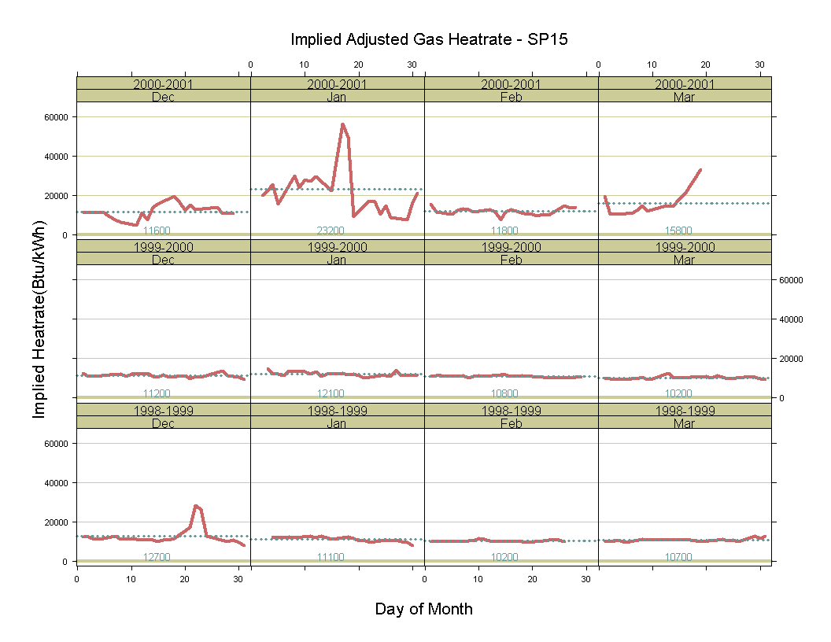

Slide 23
The Dalles Runoff:
132% 150% 98% 117% 93% 54%

